Slide 1
Data Structures: Trees

Slide 2
Announcements – Climate / Culture
The rumors of my demise are greatly exaggerated. ☺
Reminder: Climate and culture in the classroom are important.
https://eecs.link/climate EECS Climate Form
CDSS / Data Science climate form
You are free to use either or both forms.
Midterm Grading:
Regrade Requests due tonight!
Will resolve them by end up the week
Grading updates next week.
Likely dropping the lowest 2-3 questions / scaling scores
Will release grade reports soon.

Slide 3
Announcements
Ants Project out next week
~ 3 weeks long
Partners recommended, but work together!
Do not “trade off” questions!

Slide 4
Learning Objectives
Trees can be seen as a general version of linked lists
Trees have a value, and are connected to "sub-trees" called branches
We can often use recursion to process all items in a tree
We typically have recursion inside a loop over all the tree's branches
This is called "Depth First Search"
Michael Ball | UC Berkeley | https://c88c.org | © CC BY-NC-SA

Slide 5
Why Use Trees?
Trees represent lots of natural structures
A boss who has employees report to them
Courses which belong to departments, and departments which colleges in a University
Anything with a hierarchy, really.
A family tree
Biological taxonomies (Kingdom, Phylum….)
Files and Folders
A game board, which representers as series of potential moves, one after the next.
E.g. Given Move 1, link the next possible moves, which link the next set of possible moves
Michael Ball | UC Berkeley | https://c88c.org | © CC BY-NC-SA

Slide 6
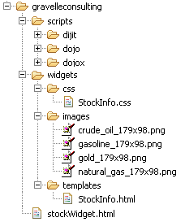
Recall: Tree Recursion
List all items on your hard disk
Files
Folders contain
Files
Folders
def process_directory(directory):
for item in directory:
if is_file(item):
process_file(item)
else:
process_directory(item)
Michael Ball | UC Berkeley | https://c88c.org | © CC BY-NC-SA

Slide 7
Review: Linked Lists
A Recursive List, sometimes called a "rlist"
Linked lists contain other linked lists
A series of items with two pieces:
A value, usually called "first"
A “pointer” to the rest of the items in the list.
We’ll use a very small Python class “Link” to model this.
Michael Ball | UC Berkeley | https://c88c.org | © CC BY-NC-SA

Slide 8
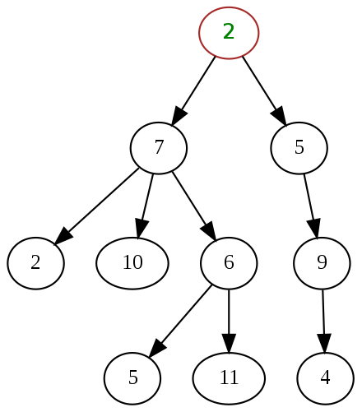
What is a tree?
What is a tree? (in CS…)
A data structure -- an organization of objects in a particular format.
In this case, Objects which have one or more children
Almost like a linked list!
What if a linked list could have multiple "rest" elements?
We call these children elements branches.
Michael Ball | UC Berkeley | https://c88c.org | © CC BY-NC-SA

Slide 9
Trees are Recursive
Another recursive data structure!
We can keep practicing recursion and working with classes
Computer science really likes recursion. ☺
Recall: tree recursion from before the midterm…
Tree recursion exists independently of tree data structures!
However, tree recursion is a common technique for processing data in trees.
Each branch is also its own Tree.

Slide 10
How many trees are there?
Mostly a rhetorical question…

Slide 11
How many trees are there?
Mostly a rhetorical question…

Slide 12
How many trees are there?
Leaf notes are the elements with no branches
They are also a Tree – this will make our recursive code simpler. ☺

Slide 13
Trees are common in Computer Science
We shown trees showing numbers for simplicity.
In practice, the value of each tree element varies a lot!
In can be a person, a course, any kind of object.
Trees give us awesome approaches for “divide and conquer”
Used in every computer to speed up searching for files (Binary search!)
Used for modeling decision systems in AI programs
Used for modelling the potential moves in a game.
Trees are a simplified form of a graph, a tool which can help us model just about anything.
Graphs are a (relatively) important topic in CS61B
Michael Ball | UC Berkeley | https://c88c.org | © CC BY-NC-SA

Slide 14
Trees: Code Overview
(Go Inspect the ipynb)

Slide 15
What’s a tree? (C88C-style)
A tree is a list of trees!
Each tree has a node, with a value.
Each node has `branches` which are itself, trees.
There can be zero or many branches
There is always 1 ”root” node

Slide 16
Our Simple Tree Class: A couple new methods!
class Tree:
def __init__(self, value, branches=()):
self.value = value
for branch in branches:
assert isinstance(branch, Tree)
self.branches = list(branches)
def __repr__(self):
branches_str = ''
if self.branches:
branches_str = ', ' + repr(self.branches)
return f'Tree({self.value}{braches_str})'
def is_leaf(self):
return not self.branches
def add_branch(self, tree):
assert isinstance(tree, Tree), "Each branch of a Tree must be an instance of a Tree"
self.branches.append(tree)

Slide 17
Trees: Practice With Recursion: traverse_recursive

Slide 18
Trees: Counting Each Node

Slide 19
How do we count nodes?
The "root" or top of the tree is one node.
(We assume we can't have a tree of 0 nodes!)
For each subtree we… Count the nodes!
Doesn't this sound like recursion?
Hard Part: How do we group the results of recursion?
Remember our recursive algorithm:
Base case
Recursive Case:
Divide
Invoke
Combine

Slide 20
def count_nodes(t):
"""The number of leaves in tree.
>>> count_nodes(fib_tree(5))
8
"""
if t.is_leaf():
return 1
else:
return 1 + sum(map(count_nodes, t.branches))

Slide 21
Trees: Practice With Recursion: print_tree

Slide 22
Trees: Advanced Topics: Searching Optional!

Slide 23
Searching Trees: Two Strategies
The searching we have been doing today is called “Depth First Search”, or DFS.
Recursion makes the algorithm very nice.
First: we deal with our current item, then we get to the branches.
We always make a recursive call on the first branch
We continue recursing until there are no more branches
Then the function executes, and we go back “up” a level and check out the next branch.
We sometimes say: “popping up the stack”.
The stack is the “stack of function calls” the computer uses to keep track of how things work, and you’ll learn about this in CS61B.

Slide 24
Searching a Tree by level: Breadth First Search
What if I want to check out all the values of my branches before making a recursive call?
What if we said, you just can’t use recursion. (Sometimes, CS instructors do weird things like that…)
This is used in practice for lots of cool things:
Shortest path between two items (more of a graph and not a tree, usually). Google Maps uses it for routing and the algorithms that power the internet use it.

Slide 25
Binary Search Trees
Notice how the tree is “ordered” such that the left is always less than the right side.

