Slide 1
Programming Paradigms

Slide 2
CITN: A "Backdoor" Almost Infected Millions of Computers
What we know about the xz Utils backdoor that almost infected the world [Link]
Malicious updates made to a ubiquitous tool were a few weeks away from going mainstream.
DAN GOODIN - 3/31/2024, 11:55 PM
"On Friday, a lone Microsoft developer rocked the world when he revealed a backdoor had been intentionally planted in xz Utils, an open source data compression utility available on almost all installations of Linux and other Unix-like operating systems. The person or people behind this project likely spent years on it. They were likely very close to seeing the backdoor update merged into Debian and Red Hat, the two biggest distributions of Linux, when an eagle-eyed software developer spotted something fishy."
Why is this interesting? Software is incredibly complex, managed by many individuals. Open-source software (like Python, Jupyter, Linux) means everyone can read + audit the source code

Slide 3
Announcements
Q&A/AMA "Lecture" on April 24
Review/Wrap Up Optional Lecture April 29
Mon of RRR week. Probably Zoom, TBD.
70% of you filled out the midterm survey!
Don't forget to do your taxes! :/
But you'll probably get a refund, and can even file for free
We don't have time for it – but good story of tech + government + society

Slide 4
Midterm Feedback Survey
Not really the "midpoint" anymore.. :/
Thank you!
You hit 70%! But still please fill it out!
That means 2 points of EC for you. ☺
General Feedback:
Some notes/improvements on course website+software. Working on it.
More time at the beginning – yes, this makes sense. Will add some followups on Final survey.
Interesting and useful comments about AI! ☺ Y'all are on the right track.

Slide 5
Programming Paradigms

Slide 6
Programming Paradigms
Paradigm (Merriam Webster): a typical example or pattern of something; a model. Example: "there is a new paradigm for public art in this country"
Programming Paradigm (Joe Turner, Clemson University): “A programming paradigm is a general approach, orientation, or philosophy of programming that can be used when implementing a program.” You might call this a "style"

Slide 7
Why?
Understanding the paradigm helps you understand the intent of the programmer
Pick the right tool for the job!
Different problems require different solutions
Most programs written today are multi-paradigm
They mix and match the style
Problem solving technique

Slide 8
Examples of Paradigms
Example, three very different approaches to squaring list:
lst = []
for i in range(5):
lst += [ i*i ]
map(lambda x: x*x, range(5))
[ x * x for x in range(5) ]
range(5).square_nums() # Only theoretically, e.g assume `def square_nums(self)` exists.

Slide 9
Word of Warning
There is no universally agreed upon taxonomy of human programming styles.
One possible list:
Imperative
Functional
Array-based
Object-Oriented
Declarative
These terms are a bit fluid, and as you’ll see if you read more on wikipedia, there is substantial disagreement about these terms.

Slide 10
Programming Paradigms
Example, three very different approaches to squaring list:
Functional: map(lambda x: x*x, [1, 2, 3])
Array-based: np.array([1,2,3]) * np.array([1,2,3]) np.array([1,2,3]) ** 2
Imperative:
def squares(nums):
result = []
for num in nums:
result += [ num * num ]
return result

Slide 11
The Imperative Programming Paradigm
An imperative program provides a sequence of steps.
Like following a recipe.
Assignment is allowed (can set variables).
Mutation is allowed (can change variables).
Example (acronym):
def acronym_i(words):
result = ''
words = words.split(' ')
for word in words:
if len(word) > 4:
result += word[0]
return result

Slide 12
The Functional Programming Paradigm
In functional programming, computation is thought of in terms of the evaluation of functions.
No state (e.g. variable assignments).
No mutation (e.g. changing variable values).
No side effects when functions execute.
def acronym_f(words):
return reduce(add,
map(lambda w: w[0],
filter(lambda w: len(w) > 3,
words.split(' '))))

Slide 13
Imperative vs. Functional
Can argue that functional is a subset of imperative.
Functional programming is still a series of steps.
“Just” need to avoid state and think of computation as functions.
Functional Programs:
More often fewer clear /correct ways to do something.
Programming feels more like solving puzzles.
Solutions can seem like magic (especially to imperative programmers).

Slide 14
Why do we push functional programming?
Tend to be shorter.
Tend to be easier to debug (no need to track variables / side effects).
Tend to parallelize better (can split work on multiple computers).
Example: Each computer can do 1/8th of a “map” operation.
Reducing mutations makes computation easier to scale
Hugely prevalent in AI fields.
Growing in popularity.
Explosion of ideas in new programming languages
“old” ideas are becoming new/popular

Slide 15
A Hybrid Approach
Paradigms are not official rules. Just attempts to taxonomize approaches taken by humans.
Code below is sorta functional, sorta imperative.
Utilizes state for clarity. Many program this way. You might not.
def acronym_h(words):
words = words.split(' ')
long = filter(lambda w: len(w) > 4, words)
letters = maps(lambda w: w[0], long)
return ''.join(letters)

Slide 16
Discussion and Debate
Which of these do you like best?
Imperative Very small steps to reason about. Seems "natural", but lots of code
Functional: Less to keep track of. Fewer variables, lines
def acronym_f(words):
return reduce(add,
map(lambda w: w[0],
filter(lambda w: len(w) > 3,
words.split(' '))))
def acronym_i(words):
result = ''
words = words.split(' ')
for word in words:
if len(word) > 4:
result += word[0]
return result
Hybrid: Some functional, but uses variables, soom OOP!
def acronym_h(words):
words = words.split(' ')
long = filter(lambda w: len(w) > 3, words)
letters = maps(lambda w: w[0], long)
return ''.join(letters)

Slide 17
Array-Based Programming!
Not something we can easily demo in native Python.
Treats arrays a "first class" objects – not just containers:
Mathematical Operations correspond to "Pairwise" computations:
np.array([1,2,3]) * np.array([1,2,3])
np.array([1,2,3]) + np.array([1,2,3]) == [2, 4, 6] → array([ True, True, True])
Note! Even == is now an array operation. Good? Bad? Just different!
Very common in data science, engineering!
R (STAT 134), MATALAB, Julia, APL

Slide 18
Object-Oriented Programming

Slide 19
The Object-Oriented Programming Paradigm
In object programming, we organize our thinking around objects, each containing its own data, and each with its own procedures that can be invoked.
We've had plenty of practice here!
OOP provides many tools!
But also leaves many import questions open:
Should functions be mutable or immutable?
How much inheritance is the right amount?
Notes:
https://www.pinclipart.com/pindetail/mwxoJT_bean-wizard-alternate-colors-clipart/

Slide 20
Object-Oriented Programming
There is a LOT more than what we see in C88C
Rich model for composing classes together
Python allows you to inherit from multiple classes at once
Can easily be overused.
Explored in depth in CS61B
In Python "everything is an object”
You benefit from OOP ideas even when you don’t realize.
Global functions like len() delegate to "magic" methods on objects, e.g. __len__
Notes:
https://www.pinclipart.com/pindetail/mwxoJT_bean-wizard-alternate-colors-clipart/

Slide 21
Declarative Programming

Slide 22
Declarative Programming
In declarative programming, we express what we want, without specifying how. A program is simply a description of the result we want.
Can be a very different thought process!
Incredibly useful, but not necessarily best for all types of problems.

Slide 23
The Web: HTML
Web pages are built with a language called HTML.
Programmers specific what content should be on the page, and where.
The browser lays out the content on each device in the right spot for each screen size, etc.
Developers don't have to specify what happens when someone changes the window size, or hits print, etc.
Tags, like "section", "p" (paragraph), "header" "time" describe the type of content

Slide 24
HTML Continued
A partial section of the CS88 Website:
<div id="content" class="container">
<div class="page-header">
<h1><span class="content-title-brand">CS 88</span>:
Computational Structures in Data Science
<div class="small">Fall 2023</div>
<div class="small">Instructor: Michael Ball</div>
</h1>
</div> <section><h2>Announcements</h2>…

Slide 25
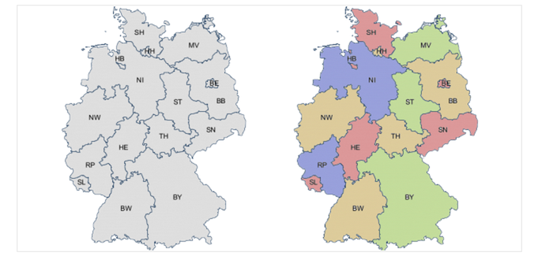
Declarative Programming
In declarative programming, we express what we want, without specifying how. A program is simply a description of the result we want.
Example: coloring a map of Germany using the Prolog language:

Slide 26


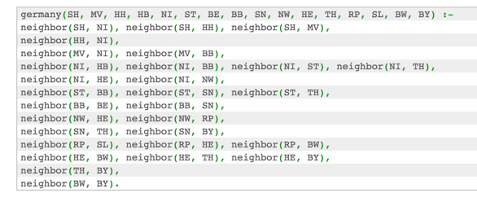
Prolog Example (From Bernardo Pires)
Tell Prolog that colors exist: Tell Prolog that same colors can’t touch:
Tell Prolog all the borders:
Ask Prolog for answer:

Slide 27

Declarative Programming → Results
Result is a list of states and color pairs

Slide 28
Declarative Programming
Each declarative language has only a limited number of tasks for which you can specify “what”, and not “how”, e.g.
Prolog: Logic.
SQL: Queries from a database.
Pandas and datascience modules: Data manipulation operations like aggregation, filtering, joining, etc.
Very common operations in Data 8 and Data 100.
While the syntax of Pandas is odd, the ideas will build upon Data 8.

Slide 29
Declarative Programming In Data 8
cones.group('Flavor')
datascience module figures out the grouping
table.where(label, conditions)
Can combine these simpler expressions together for more complex questions

Slide 30
Declarative or Object-Oriented?
Both!
Tables (in Data 8, Pandas, etc) are Python objects
There is a class Table with a def columns(self) method
However, the interface is often declarative.
You describe what the output should look like

Slide 31
Why SQL?
SQL is a declarative programming language for accessing and modifying data in a relational database.
It is an entirely new way of thinking (“new” in 1970, and new to you now!) that specifies what should happen, but not how it should happen.
Python is a multi-paradigm language, but we haven't yet tried declarative programming.

Slide 32
What is SQL?
A declarative language
Described what to compute
Query processor (interpreter) chooses which of many equivalent query plans to execute to perform the SQL statements
ANSI and ISO standard, but many variants
CS88's SQL will work on nearly all relational databases—databases that use tables.

Slide 33
What is SQL?
SELECT statement creates a new table, either from scratch or by projecting a table
INSERT adds to a table, UPDATE changes data.
CREATE TABLE statement gives a global name to a table
Lots of other statements
ANALYZE, DELETE, EXPLAIN, …

Slide 34
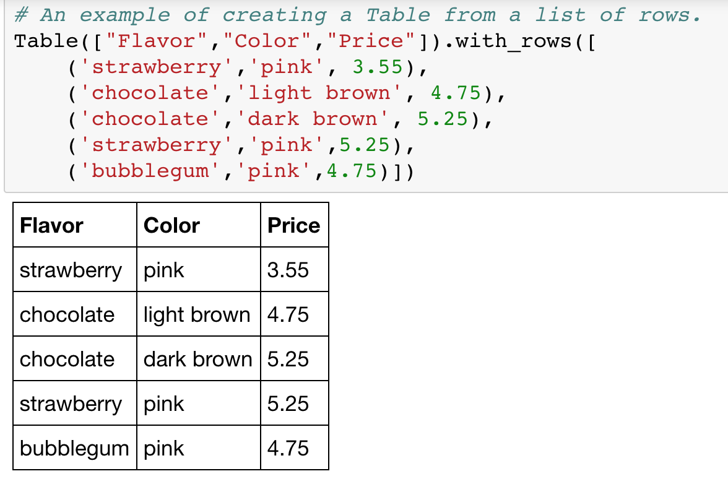
SQL: Describe The Shape of the result!

Slide 35
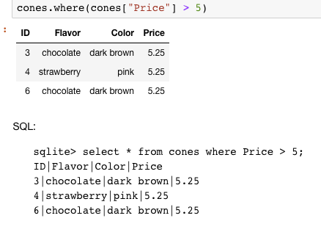
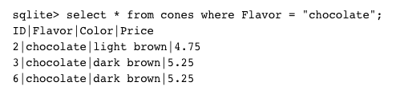
What if I want a table with just a few rows?
Here the `where()` in Python is using the datascience module.

Slide 36
Summary
Paradigms are styles, guidelines for how to approach a program
Each is equally capable, but some are suited best to particular tasks.
Declarative programming gets us to think about the what rather than the how.
Almost no programs are purely single-paradigm

