Slide 1
Data Structures: Linked Lists
Guest Lecture (Rebecca Dang)

Slide 2
Announcements
A note on the midterm…
Staff aiming to release midterm grades by end of day tomorrow (Tue 3/19) but no guarantees
Your grades don’t define you. Seriously!
From Berkeleytime historical data, ~40% of students get an A- or higher
Focus on learning the material, stay on track, don’t lose sight of the big picture
If you need support or have questions/concerns please reach out :D

Slide 3
Announcements
Lab 8 and HW 8
Released this week
Due the week we come back from spring break
Nothing due this week 🎉

Slide 4


Fun Video: CGP Grey Rock Paper Scissors
How many rounds of Rock Paper Scissors is a 1 in 1,000,000,000 chance of winning?
Each video leads to another set of videos.
This is technically a tree, but we'll come back to that later.

Slide 5
Where We’re Going
For now – we’ve learned most of the basics of Python!
There are plenty of Python we don’t see in CS88
We’ll be applying OOP principles to explore new topics.
We’re going to focus on storing / organizing data
Lists, Tuples, and Dictionaries: Data Structures you already know!
BUT: How do we build our own?
We’ll build our own lists first, then talk about trees and other ways of organizing data
Last few lectures: Switch to SQL

Slide 6
Why "Data Structures"? (Next Few lectures)
Data Structures
OOP helps us organize our programs
Data Structures help us organize our data!
Can be implemented using OOP
You already know lists and dictionaries!
We’ll see a new one today
Enjoy this stuff? Take CS 61B!
Find it challenging? Don’t worry! It’s a different way of thinking.

Slide 7
Linked Lists

Slide 8
Data Structures
A data structure is a way to organize or group a bunch of independent pieces of data.
Lists (arrays)
Dictionaries
Tuples
A class, on its own, is not necessarily a data structure, it represents a new data type.
a "car" or a "person" is an instance of that data type.
Lists, Dicts, etc are also data types; their goal is to organize other data.
These are common patterns that can be used to solve a wide variety of problems.
Sometimes we're giving structure to make it easier as a programmer, sometimes we're trying to be fast or efficient.

Slide 9
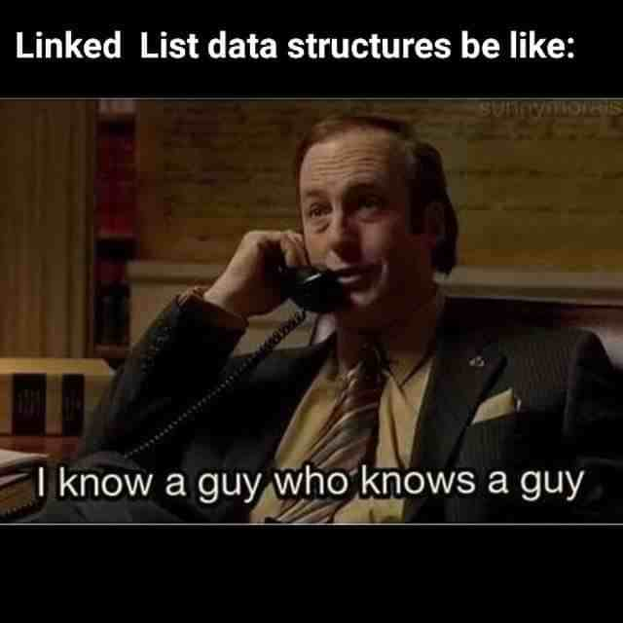
Linked Lists
A Recursive List, sometimes called a "rlist"
Linked lists contain other linked lists
A series of items with two pieces:
A value, usually called "first"
A “pointer” to the rest of the items in the list.
We’ll use a very small Python class “Link” to model this.
Link(12, Link(99, Link(37, Link.empty)))

Slide 10
What's Needed For a Linked List?
first
rest
An idea of “empty”
Nothing else is necessary
__repr__, __len__ methods are all useful shortcuts and useful recursion practice.

Slide 11
The Link Class
class Link:
empty = ()
def __init__(self, first, rest=empty):
self.first = first
self.rest = rest
That's all we need!
We can add a __repr__ method, length, etc.
Use an empty tuple for clarity / easier than None.
() has lots of useful methods defined, like len()

Slide 12
Recursion Is Implicit
self.rest

Slide 13
Different ways to think of a linked list: “Relative” vs “recursive”
self.rest

Slide 14
Iterating or Processing a Linked List
Our base case or stopping condition?
Linked List is empty!
We can use recursion or iteration.
Which is “better”?
Depends on the problem we are trying to solve!

Slide 15
Iterating Over All Items in Linked List
def print_link(link):
if not link:
return
print(link.first)
print_link(link.rest)
• Base Case: No more items
• Do Action
• Recurse on the rest of the list
def print_link(link):
if not link:
return
item = link
while item:
print(item.first)
item = item.rest
• Handle the empty list
• Keep track of current item
• Update item to be the next in sequence.

Slide 16
Iterating Over All Items in Linked List
def print_link(link):
if not link:
return
print(link.first)
print_link(link.rest)
• Base Case: No more items
• Do Action
• Recurse on the rest of the list
def print_link(link):
if not link:
return
item = link
while item:
print(item.first)
item = item.rest
• Handle the empty list
• Keep track of current item
• Update item to be the next in sequence.

Slide 17
Demo – See the Notebook

Slide 18
Uses for a Linked List
Modeling a Polynomial Equation
each item is (coefficient, exponent, next_term)
Items in a music Playlist
each item is a (song, next_song) pair
easy to add/remove items
Specifically: often want to remove the first item
Model real-world relationships
Anything that is a "chain" is a good option
Next up: We'll extend this idea to "trees"

Slide 19
Why are linked lists useful?
Honestly, a regular list is easier most of the time
Python handles all the hard details!
When data gets large, there are lots of edge cases.
In terms of efficiency: Linked lists make it fast to move items around, insert, and delete from the front and/or back (depending on implementation)
But they are slower to finding any single item (“random access”) – can’t index into a linked list
In Ants Project: You'll see a list of Place objects which are linked together via an entrance and an exit – they’re linked lists!

Slide 20
Lists vs Linked Lists
Built into Python
Create with [] or list()
Can iterate through with loops
Can use index to retrieve element (e.g. lst[0])
Not a recursive data structure
Link class (created for C88C, isn’t built into Python)
Create with Link(<first>, <rest>)
Can iterate through with loops
But not “directly” through a for loop
Can’t use indices to retrieve elements
Is a recursive data structure

Slide 21
Please send me your feedback (anonymous) :D
https://go.c88c.org/rebecca-lecture

Slide 22
Efficiency of Linked Lists vs Lists
Linked Lists generally use less memory.
Linked Lists:
Once you've found an item, inserting / removing is easy, O(1)
Finding anything other than the first/last item is O(n)
"Regular" Lists:
Inserting / Removing items, other than the last is O(n) – due to internal copying
Finding any random item is O(1).
What if you need to iterate over all items in order?
O(n) in both cases
Notes:
Save for efficiency lecture

