Slide 1
Lecture: Exceptions

Slide 2
Survey Comments

Slide 3
Learning Objectives
Exceptions give us a formal way to address error conditions
"Catch" exceptions in a Python Program
Define and Raise our own exceptions

Slide 4
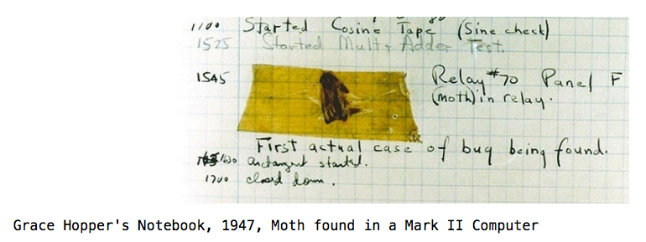
Errors Can Occur Just About Anywhere!
Function receives arguments of improper type?
Resources (e.g. files or some data) are not available
Network connection is lost or times out?

Slide 5
Example exceptions (Docs)
Unhandled, "thrown" back to the top level interpreter
Or halt the program
>>> 3/0
Traceback (most recent call last):
File "<stdin>", line 1, in <module>
ZeroDivisionError: division by zero
>>> str.lower(1)
Traceback (most recent call last):
File "<stdin>", line 1, in <module>
TypeError: descriptor 'lower' requires a 'str' object but received a 'int'
>>> ""[2]
Traceback (most recent call last):
File "<stdin>", line 1, in <module>
IndexError: string index out of range
>>>

Slide 6
Exceptions mean something bad has happened!

Slide 7
Functions
Q: What is a function supposed to do?
A: One thing well
Q: What should it do when it is passed arguments that don’t make sense?
>>> def divides(x, y):
... return y%x == 0
...
>>> divides(0, 5)
???
>>> def get(data, selector):
... return data[selector]
...
>>> get({'a': 34, 'cat':'9 lives'}, 'dog’)
????

Slide 8
Exceptional exit from functions
Function doesn’t “return” but instead execution is thrown out of the function
>>> def divides(x, y):
... return y % x == 0
...
>>> divides(0, 5)
Traceback (most recent call last):
File "<stdin>", line 1, in <module>
File "<stdin>", line 2, in divides
ZeroDivisionError: integer division or modulo by zero
>>> def get(data, selector):
... return data[selector]
...
>>> get({'a': 34, 'cat':'9 lives'}, 'dog')
Traceback (most recent call last):
File "<stdin>", line 1, in <module>
File "<stdin>", line 2, in get
KeyError: 'dog'
>>>

Slide 9
Reading A "Stack Trace" or "Traceback" (Docs)
All errors in Python should return some structured feedback.
Errors may be dense but contain some really helpful information!
👉 python3 -i 18-Exceptions.py
What is your age? 5
Catching CS88Error
Traceback (most recent call last):
File "…Exceptions.py", line 24, in <module>
get_age_in_days()
File "…", line 20, in get_age_in_days
raise e
File "…", line 14, in get_age_in_days
raise CS88Error('You seem young!')
__main__.CS88Error: You seem young!

Slide 10
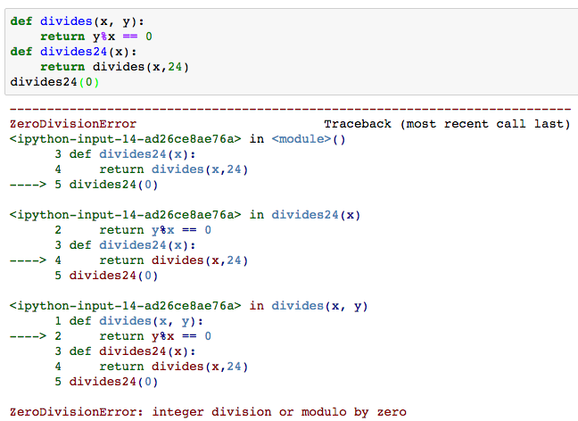
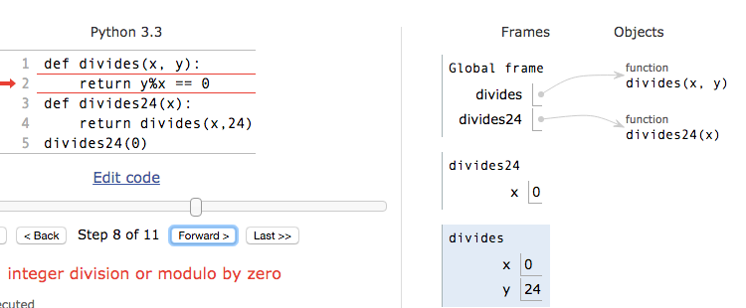
Continue out of multiple calls deep
Stack “unwinds” until exception is handled or we reach the start of the program

Slide 11
Types of exceptions
Exceptions are just classes in Python, with common types for ease of use / clarity.
All inherit from BaseException
AssertionError – The of exception raised by a failing assert statement
TypeError -- A function was passed the wrong number/type of argument
NameError -- A name wasn't found
KeyError -- A key wasn't found in a dictionary
RuntimeError -- Catch-all for troubles during interpretation
Your own exceptions!

Slide 12
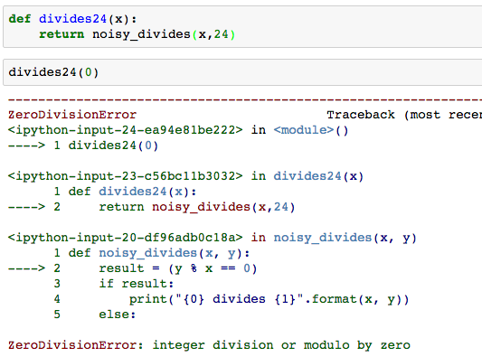
Flow of control stops at the exception
And is ‘thrown back’ to wherever it is caught, by default no where.

Slide 13
Assert Statements
Allow you to make assertions about assumptions that your code relies on
Use them liberally!
Incoming data is "dirty" and unsafe till you’ve "cleaned" it
They "do nothing" if the statement is true.
Raise an exception of type AssertionError
You can turn them off:
Ignored in optimize flag: python3 –O …
Governed by bool __debug__
assert <assertion expression>, <string for failed>
def divides(x, y):
assert x != 0, ”Denominator must be non-zero”
return y % x == 0

Slide 14
Demo
See an exception get raised
Use an assert statement to validate input
Use try/catch to recover from an exception

Slide 15
Handling Errors – try / except
Wrap your code in try – except statements
Execution rule
<try suite> is executed first
If during this an exception is raised and not handled otherwise
And if the exception inherits from <exception class>
Then <except suite> is executed with <name> bound to the exception
Control jumps to the except suite of the most recent try that handles the exception
try:
<try suite>
except <exception class> as <name>:
<except suite>
... # continue here if <try suite> succeeds w/o exception

Slide 16
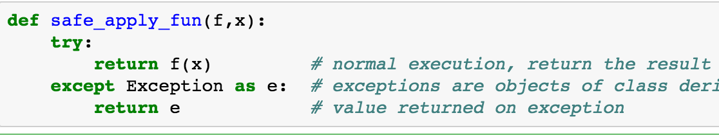
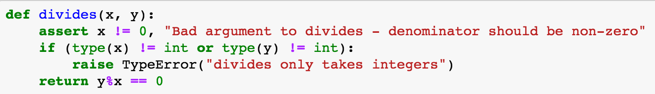
Demo

Slide 17
Raise statement
Exception are raised with a raise statement
raise <exception>, e.g.:
raise NameError(f"The property {name} does not exist")
<expression> must evaluate to a subclass of BaseException or an instance of one
Exceptions are constructed like any other object
TypeError(‘Bad argument’)
Raise Exceptions for unrecoverable errors!
Something bad has gone on and you cannot continue.

Slide 18
Exceptions are Classes
class NoiseyException(Exception):
def __init__(self, stuff):
print("Bad stuff happened", stuff)
class CS88Error(Exception):
pass # The one time you can skip init. ;)
try:
return fun(x)
except:
raise NoiseyException((fun, x))

Slide 19
Demo

Slide 20
Summary
Approach use of exceptions as a design problem
Meaningful behavior => methods [& attributes]
ADT methodology: What should a function do?
What’s private and hidden? vs What’s public?
Use it to streamline development
Anticipate exceptional cases and unforeseen problems
try … except
raise / assert

