Slide 1
Data Structures: Trees

Slide 2
Announcements
Ants Project out next week
~ 4 weeks long
Partners recommended, but work together!
Do not “trade off” questions!

Slide 3
Learning Objectives
Trees can be seen as a general version of linked lists
Trees have a value, and are connected to "sub-trees" called branches
We can often use recursion to process all items in a tree
We typically have recursion inside a loop over all the tree's branches
This is called "Depth First Search"
Michael Ball | UC Berkeley | https://c88c.org | © CC BY-NC-SA

Slide 4
Why Use Trees?
Trees represent lots of natural structures
A boss who has employees report to them
Courses which belong to departments, and departments which colleges in a University
Anything with a hierarchy, really.
A family tree
Biological taxonomies (Kingdom, Phylum….)
Files and Folders
Michael Ball | UC Berkeley | https://c88c.org | © CC BY-NC-SA

Slide 5
Review: Linked Lists
A Recursive List, sometimes called a "rlist"
Linked lists contain other linked lists
A series of items with two pieces:
A value, usually called "first"
A “pointer” to the rest of the items in the list.
We’ll use a very small Python class “Link” to model this.

Slide 6
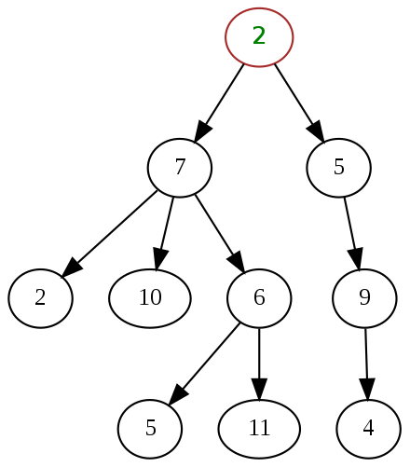
What is a tree?
A recursive data structure
Almost like a linked list!
What if a linked list could have multiple "rest" elements?
We call these "branches".
Each branch is also its own Tree.

Slide 7
Trees are common in Computer Science
Trees give us awesome approaches for “divide and conquer”
Used in every computer to speed up searching for files (Binary search!)
Used for modeling decision systems in AI programs
Used for modelling the potential moves in a game.
Another recursive data structure!
We can keep practicing recursion and working with classes
Computer science really likes recursion. ☺
Trees are a simplified form of a graph, a tool which can help us model just about anything.
Graphs are a (relatively) important topic in CS61B
Michael Ball | UC Berkeley | https://c88c.org | © CC BY-NC-SA

Slide 8
Trees: Code Overview
(Go Inspect the ipynb)

Slide 9
What’s a tree? (C88C-style)
A tree is a list of trees!
Each tree has a node, with a value.
Each node has `branches` which are itself, trees.
There can be zero or many branches
There is always 1 ”root” node

Slide 10
Our Simple Tree Class: A couple new methods!
class Tree:
def __init__(self, value, branches=()):
self.value = value
for branch in branches:
assert isinstance(branch, Tree)
self.branches = list(branches)
def __repr__(self):
branches_str = ''
if self.branches:
branches_str = ', ' + repr(self.branches)
return f'Tree({self.value}{braches_str})'
def is_leaf(self):
return not self.branches
def add_branch(self, tree):
assert isinstance(tree, Tree), "Each branch of a Tree must be an instance of a Tree"
self.branches.append(tree)

Slide 11
Trees: Practice With Recursion: traverse_recursive

Slide 12
Trees: Counting Each Node

Slide 13
How do we count nodes?
The "root" or top of the tree is one node.
(We assume we can't have a tree of 0 nodes!)
For each subtree we… Count the nodes!
Doesn't this sound like recursion?
Hard Part: How do we group the results of recursion?
Remember our recursive algorithm:
Base case
Recursive Case:
Divide
Invoke
Combine

Slide 14
def count_nodes(t):
"""The number of leaves in tree.
>>> count_nodes(fib_tree(5))
8
"""
if t.is_leaf():
return 1
else:
return 1 + sum(map(count_nodes, t.branches))

Slide 15
Trees: Practice With Recursion: print_tree

Slide 16
Trees: Advanced Topics: Searching Optional!

Slide 17
Searching Trees: Two Strategies
The searching we have been doing today is called “Depth First Search”, or DFS.
Recursion makes the algorithm very nice.
First: we deal with our current item, then we get to the branches.
We always make a recursive call on the first branch
We continue recursing until there are no more branches
Then the function executes, and we go back “up” a level and check out the next branch.
We sometimes say: “popping up the stack”.
The stack is the “stack of function calls” the computer uses to keep track of how things work, and you’ll learn about this in CS61B.

Slide 18
Searching a Tree by level: Breadth First Search
What if I want to check out all the values of my branches before making a recursive call?
What if we said, you just can’t use recursion. (Sometimes, CS instructors do weird things like that…)
This is used in practice for lots of cool things:
Shortest path between two items (more of a graph and not a tree, usually). Google Maps uses it for routing and the algorithms that power the internet use it.

Slide 19
Binary Search Trees
Notice how the tree is “ordered” such that the left is always less than the right side.

