Slide 1
Lecture 5 Higher Order Functions
Week 2, Summer 2024. 6/25 (Tues)
Notes:
1

Slide 2
Announcements
Exam dates
Midterm: Wednesday July 17th, 3PM – 5PM PST
Final: Wednesday August 7th, 3PM – 5PM PST
Exams will be administered online, and proctored via Zoom. You may need to present your ID (eg student CalID card, or any ID with your name + photo) during the Zoom call to proctors.
Important: for those that can’t make the above exam times, we will have alternate exam times. Stay tuned for details here!

Slide 3
Announcements
Do watch Ed for announcements
Please remember to pick the best category when asking questions
Use the Python code option

Slide 4
Announcements
Lab 2 released today (Due: June 29)
Homework 2 released today (Due: June 29)
Remember to do your lecture self checks!
Reminder: you must submit all assignments to Gradescope.
okpy is only a convenience tool. Its backups don’t count as submitting to Gradescope.

Slide 5
Today’s Overview
List comprehensions
Higher order functions
Environment Diagrams

Slide 6
List Comprehensions
Notes:
6

Slide 7
Learning Objectives
List comprehensions let us build lists "inline".
List comprehensions are an expression that returns a list.
We can easily “filter” the list using a conditional expression, i.e. if

Slide 8
Data-driven iteration: List Comprehensions
describe an expression to perform on each item in a sequence
let the data dictate the control
In some ways, nothing more than a concise for loop.
Always returns a list!
[ <expr with loop var> for <loop var> in <sequence expr > ]
[ <expr with loop var> for <loop var> in <sequence expr > if <conditional expression with loop var> ]

Slide 9
List Comprehensions vs for Loops
List comprehensions always return a list!
For loops do not return anything.
my_data = []
for item in range(10):
my_data.append(item)
my_data
# or
my_data = [ item for item in range(10) ]

Slide 10
Why use list comprehensions?
Transforming elements in a list
Filtering a list
Combining the two!
This is a surprising number of tasks!

Slide 11
Demo!

Slide 12
Higher Order Functions: Functions that accept functions as input
Notes:
12

Slide 13
Learning Objectives
Learn how to use and create higher order functions:
Functions can be used as data
Functions can accept a function as an argument
Functions can return a new function

Slide 14
Code is a Form of Data
Numbers, Strings: All kinds of data
Code is its own kind of data, too!
Why?
More expressive programs, a new kind of abstraction.
”Encapsulate” logic and data into neat packages.
This will be one of the trickier concepts in CS88.

Slide 15
What is a Higher Order Function?
A function that takes in another function as an argument
OR
A function that returns a function as a result.

Slide 16
Brief Aside: import
Python organizes code in modules
These functions come with Python, but you need to "import" them.
import module_name
gives us access to module_name and module_name.x
import module_name as my_module
can access my_module and my_module.x (same code, just a different name)
from module_name import x, y, z
can only access the functions we import. x is my_module.x
from math import pi, sqrt
from operator import mul

Slide 17
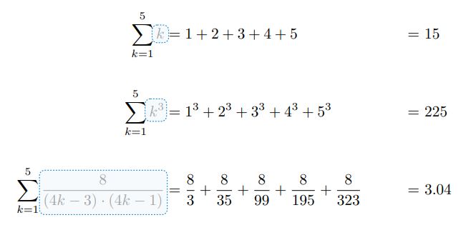
An Interesting Example

Slide 18
Why Higher Order Functions?
We can sum 1 to N easily enough.
We can sum 1 to N^2 easily enough too.
Or we can sum, 1 to N^3…
But why write so many functions?
Why not write one function(!) which allows us flexibility in solving many problems?

Slide 19
A Generic Sum Function
def summation(n, term_fn):
"""Sum the first N terms of a sequence.
>>> summation(5, cube)
225
>>> summation(5, identity)
15
>>> summation(10, identity)
55
"""
total = 0
for i in range(n + 1):
total = total + term_fn(i)
return total

Slide 20
Higher Order Functions: Functions that return another function
Notes:
20

Slide 21
Higher Order Functions
A function that returns (makes) a function
def leq_maker(c):
def leq(val):
return val <= c
return leq
>>> leq_maker(3)
<function leq_maker.<locals>.leq at 0x1019d8c80>
>>> leq_maker(3)(4)
False
>>> leq_fn = leq_maker(3)
>>> leq_fn(4)
False
>>> [x for x in range(7) if leq_maker(3)(x)]
[0, 1, 2, 3]

Slide 22
Demo

Slide 23
Environments & Higher Order Functions
Notes:
23

Slide 24
Environment Diagram motivation: variable aliasing
With HOF’s, at first glance there can be confusion between local function variables, nested function variables, and global variables
Example: here, there are two `c` variables, and two `val` variables.
How do they relate to each other?
aka “variable aliasing”
def leq_maker(c):
def leq(val):
return val <= c
return leq
c = 4
val = 2
leq_fn = leq_maker(c)
print(f"(v1) {leq_fn(2)}")
c = 1
# does leq_fn()’s behavior change?
print(f"(v2) {leq_fn(2)}")
Question: what does Python output?

Slide 25
Environment Diagram motivation: variable aliasing
With HOF’s, at first glance there can be confusion between local function variables, nested function variables, and global variables
Example: here, there are two `c` variables, and two `val` variables.
How do they relate to each other?
aka “variable aliasing”
def leq_maker(c):
def leq(val):
return val <= c
return leq
c = 4
val = 2
leq_fn = leq_maker(c)
print(f"(v1) {leq_fn(2)}")
c = 1
# does leq_fn()’s behavior change?
print(f"(v2) {leq_fn(2)}")
(v1) True
(v2) True

Slide 26
Environment Diagram motivation: variable aliasing
With HOF’s, at first glance there can be confusion between local function variables, nested function variables, and global variables
Example: here, there are two `c` variables, and two `val` variables.
How do they relate to each other?
aka “variable aliasing”
def leq_maker(c):
def leq(val):
return val <= c
return leq
c = 4
val = 2
leq_fn = leq_maker(c)
print(f"(v1) {leq_fn(2)}")
c = 1
# does leq_fn()’s behavior change?
print(f"(v2) {leq_fn(2)}")
(v1) True
(v2) True
(Python tutor link)

Slide 27
Environment Diagram motivation: variable aliasing
Keeping track of each function’s local variables can be tricky.
General tip: drawing pictures is often a helpful strategy for understanding
Thus: environment diagrams
def leq_maker(c):
def leq(val):
return val <= c
return leq
c = 4
val = 2
leq_fn = leq_maker(c)
print(f"(v1) {leq_fn(2)}")
c = 1
# does leq_fn()’s behavior change?
print(f"(v2) {leq_fn(2)}")
(v1) True
(v2) True
(Python tutor link)

Slide 28
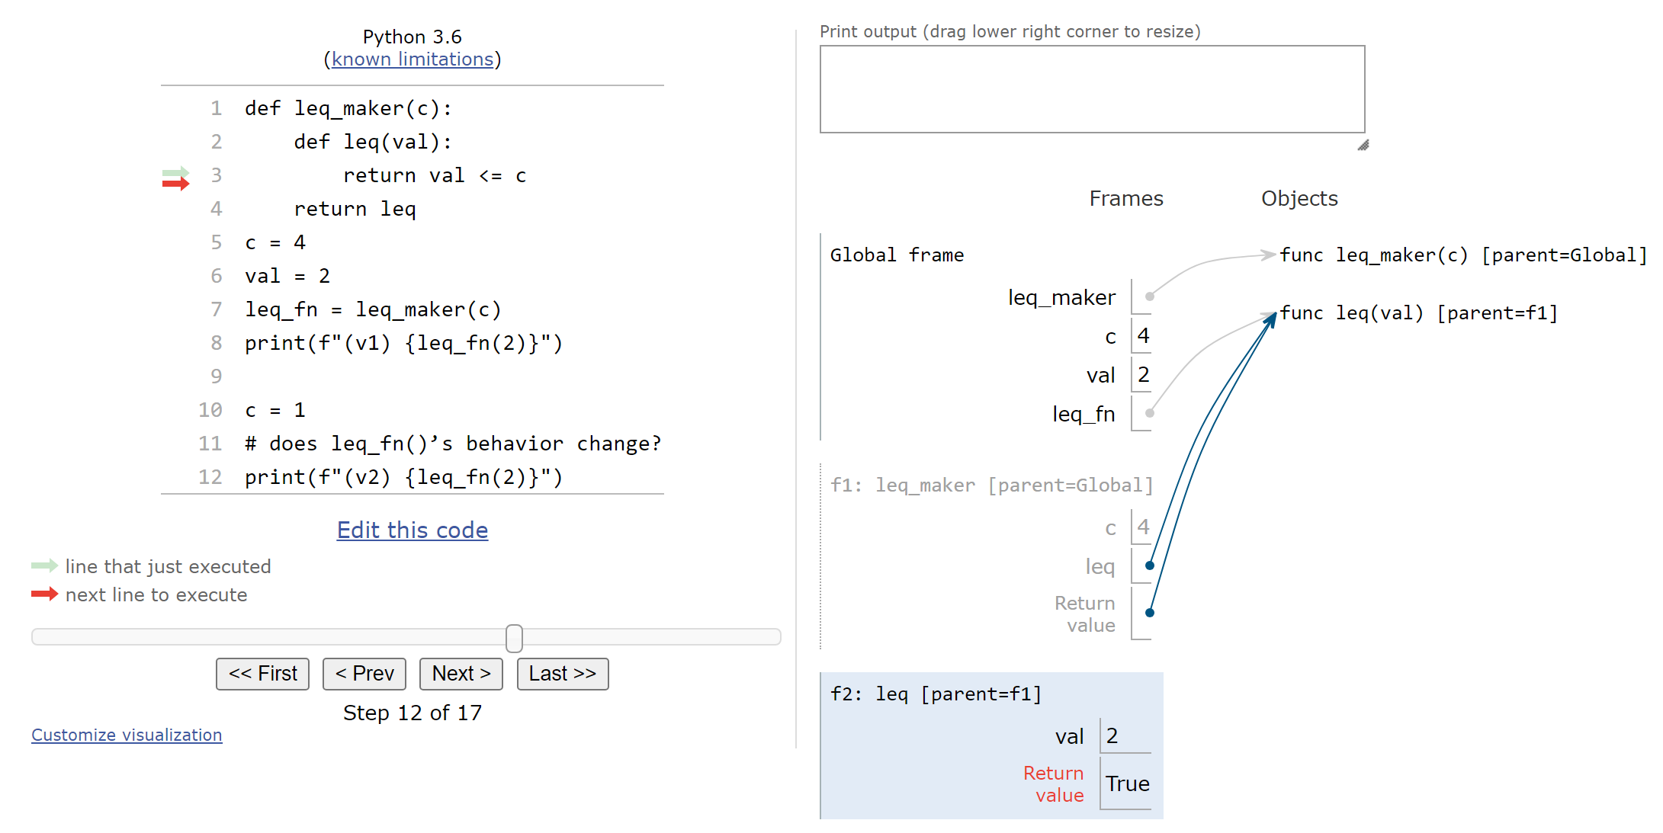
Environment Diagram: First Look
(currently evaluating this function call
(Python tutor link)

Slide 29
Environment Diagram: First Look: Frames
(currently evaluating this function call
Frames: where variables live.
Each function call has its own variable namespace.
“Global frame” is the parent-most frame.
(Python tutor link)

Slide 30
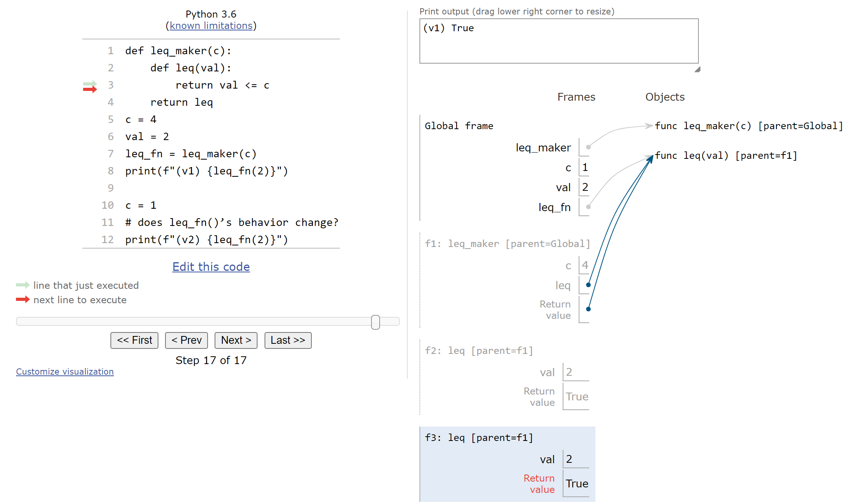
Environment Diagram: First Look: Frames
(currently evaluating this function call
Rule: each time you evaluate a function call, you draw a new frame
Each frame has a “parent frame”, dictates variable resolution order
Ex: in leq_fn, `c` evaluates to 4, NOT 1
(Python tutor link)

Slide 31
Example: compose
Python Tutor is a handy web tool that allows you to visualize the environment diagrams of your own Python code! Useful study tool.
Example: http://pythontutor.com/composingprograms.html#code=def%20square%28x%29%3A%0A%20%20%20%20return%20x%20*%20x%0A%20%20%20%20%0As%20%3D%20square%0Ax%20%3D%20s%283%29%0A%0Adef%20make_adder%28n%29%3A%0A%20%20%20%20def%20adder%28k%29%3A%0A%20%20%20%20%20%20%20%2

Slide 32
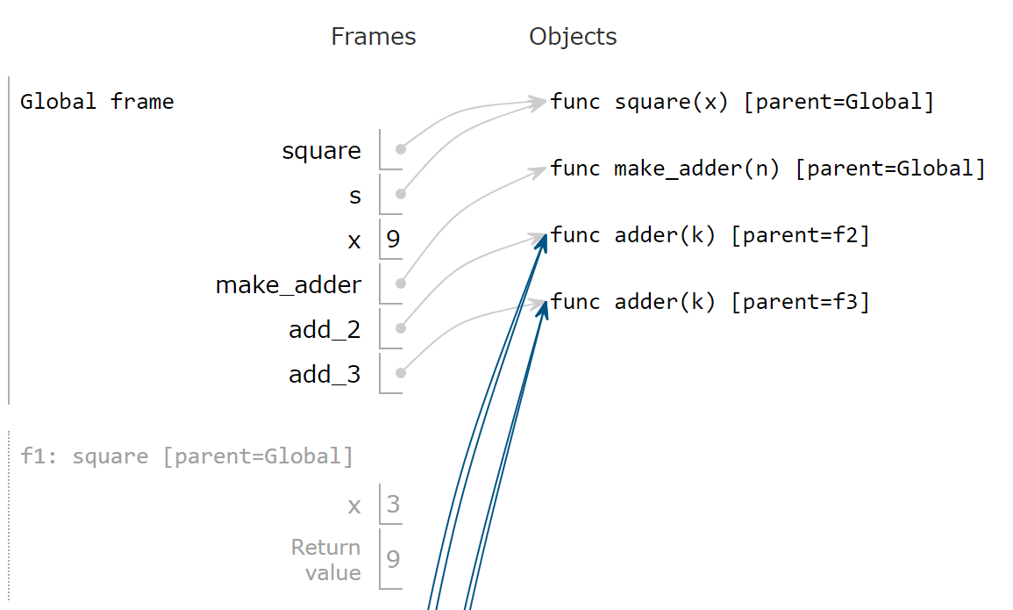
Environment Diagrams
Organizational tools that help you understand code
Allows us to more-precisely define how Python evaluates code
Up until now, we’ve been somewhat hand-wavy

Slide 33
Environment Diagrams: Terminology
Organizational tools that help you understand code
Terminology:
Frame: keeps track of variable-to-value bindings, each function call has a frame
Global Frame: global for short, the starting frame of all python programs, doesn’t correspond to a specific function
Parent Frame: The frame of where a function is defined (default parent frame is global)
Frame number: What we use to keep track of frames, f1, f2, f3, etc
Variable vs Value: x = 1. x is the variable, 1 is the value

Slide 34
Environment Diagrams Steps
Draw the global frame
When evaluating assignments (lines with single equal), always evaluate right side first
When you call a function MAKE A NEW FRAME!
When assigning a primitive expression (number, boolean, string) write the value in the box
When assigning anything else, draw an arrow to the value
When calling a function, name the frame with the intrinsic name – the name of the function that variable points to
The parent frame of a function is the frame in which it was defined in (default parent frame is global)
If the value isn’t in the current frame, search in the parent frame

Slide 35
Environment Diagram Tips / Links
NEVER EVER draw an arrow from one variable to another.
Useful Resources:
http://markmiyashita.com/cs61a/environment_diagrams/rules_of_environment_diagrams/
http://albertwu.org/cs61a/notes/environments.html
Tip: historically, students have had trouble with drawing environment diagrams (eg on exams). Let’s do a great job this semester!

Slide 36
Today’s Overview. Any questions?
List comprehensions
Higher order functions
Environment Diagrams

Slide 37
Question
Question: What's the result of the following?
def greet(name):
print('Hello, ' + name)
hello = greet
def greet(name):
print('Hi, ' + name)
hello('CS88')
A) Error
B) prints "Hello, CS88"
C) prints "Hi, CS88"
D) "I'm lost…."

Slide 38
Three super important HOFS
* For the builtin filter/map, you need to then call list on it to get a list. If we define our own, we do not need to call list
list(map(function_to_apply, list_of_inputs))
Applies function to each element of the list
list(filter(condition, list_of_inputs))
Returns a list of elements for which the condition is true
reduce(function, list_of_inputs)
Applies the function, combining items of the list into a "single" value.
02/10/2020
38

Slide 39
Today's Task: Acronym
Input: "The University of California at Berkeley"
Output: "UCB"
def acronym(sentence):
"""YOUR CODE HERE"""
P.S. Pedantry alert: This is really an initialism but that's rather annoying to say and type. ☺ (However, the code we write is the same, the difference is in how you pronounce the result.) The more you know!
02/10/2020
UCB CS88 Fa20 L6
39

Slide 40
MAP
list(map(function_to_apply, list_of_inputs))
Transform each of items by a function.
e.g. square()
Inputs (Domain): • Function
• Sequence Output (Range):
• A sequence
def map(function, sequence):
return [ function(item) for item in sequence ]
02/10/2020
UCB CS88 Fa20 L6
40

Slide 41
What does this do?
list(map(capitalize, ['michael', 'Alex', 'Srinath', 'julia']
)) Assume capitalize('michael') == 'Michael'
A) ['michael', 'Alex', 'Srinath', 'julia']
B) ['Michael', 'Alex', 'Srinath', 'Julia']
C) []
D) Error
E) I'm lost.
02/10/2020
UCB CS88 Fa20 L6
41

Slide 42
FILTER
list(filter(function, list_of_inputs))
*Keeps* each of item where the function is true.
Inputs (Domain): • Function
• Sequence Output (Range):
• A sequence
def filter(function, sequence):
return [ item for item in sequence if function(item) ]
02/10/2020
UCB CS88 Fa20 L6
42

Slide 43
What does this do?
list(filter(return_false, range(100)
)) Assume return_false(42) == False
A) range(0, 100) # A standard range object
B) [0, 1, 2, … 96, 97, 98, 99]
C) [ ]
D) Error
E) I'm lost.
02/10/2020
UCB CS88 Fa20 L6
43

Slide 44
REDUCE
reduce(function, list_of_inputs)
Successively combine items of our sequence
• function: add(), takes 2 inputs gives us 1 value.
Inputs (Domain): • Function, with 2 inputs
• Sequence Output (Range):
• An item, specifically, the output of our function.
def reduce(function, sequence):
result = function(sequence[0], sequence[1])
for index in range(2, len(sequence)):
result = function(result, sequence[index])
return result
02/10/2020
UCB CS88 Fa20 L6
44

Slide 45
Higher Order Functions
Functions that operate on functions
A function
A function that takes a function arg
def odd(x):
return x%2==1
odd(3)
True
Why is this not ‘odd’ ?
def filter(fun, s):
return [x for x in s if fun(x)]
filter(odd, [0,1,2,3,4,5,6,7])
[1, 3, 5, 7]
02/10/2020
UCB CS88 Fa20 L6
45

Slide 46

Computational Concepts today
Higher Order Functions
Functions as Values
Functions with functions as argument
Functions with functions as return values
Environment Diagrams
Big Idea: Software Design Patterns
02/10/2020
UCB CS88 Fa20 L6
46

