Slide 1
Environments, Mutable Data
Week 3, Summer 2024. 7/1 (Thurs)
Notes:
1

Slide 2

Announcements
Photo by Stephanie McCabe on Unsplash
Upcoming due dates
HW03, Lab03: Due 7/1 11:59 pm PST (tonight!)
Project01 (“Maps”) will be released later this week
You can work on this + submit with one partner.
Or, you can solo it.
(Holiday) July 4: No lecture/labs/OH!
Credit: Stephanie McCabe: https://unsplash.com/photos/time-lapse-photography-of-sparkler-and-usa-flag-let-_Ajm-ewEC24

Slide 3
Lecture overview
Environment diagrams (review, lambdas)
Mutable data
dict

Slide 4
Environment Diagrams (review, lambdas)
Notes:
4

Slide 5
Inner (“Nested”) Functions
Inner functions are scoped – they are not visible to the outside world
But they can be returned and thus called later on.
Like a "regular" function, they have access to all the data (including arguments) of their "parent" or "container" function.
def outer_fn(arg_outer):
def inner_fn(arg_inner):
return arg_outer + arg_inner
return inner_fn
>>> outer_fn(2)(3)
5

Slide 6
Learning Objectives
Lambda are anonymous functions, which are expressions
Don’t use return, lambdas always return the value of the expression.
They are typically short and concise
They don’t have an “intrinsic” name when using an environment diagram.
Their name is the character 𝜆

Slide 7
(review) lambda syntax
Function expression
“anonymous” function creation
Expression, not a statement, no return or any other statement
lambda <arg or arg_tuple> : <expression using args>
add_one = lambda v : v + 1
def add_one(v):
return v + 1

Slide 8
Examples
>>> def make_adder(i):
... return lambda x: x+i
...
>>> make_adder(3)
<function make_adder.<locals>.<lambda> at 0x10073c510>
>>> make_adder(3)(4)
7
>>> list(map(make_adder(3), [1,2,3,4]))
[4, 5, 6, 7]

Slide 9
Environment Diagrams (review)
Organizational tools that help you understand code
Terminology:
Frame: keeps track of variable-to-value bindings, each function call has a frame
Global Frame: global for short, the starting frame of all python programs, doesn’t correspond to a specific function
Parent Frame: The frame of where a function is defined (default parent frame is global)
Frame number: What we use to keep track of frames, f1, f2, f3, etc
Variable vs Value: x = 1. x is the variable, 1 is the value

Slide 10
Environment Diagrams Rules (review)
Always draw the global frame first
When evaluating assignments (lines with single equal), always evaluate right side first
When you CALL a function MAKE A NEW FRAME!
When assigning a primitive expression (number, boolean, string) write the value in the box
When assigning anything else (lists, functions, etc.), draw an arrow to the value
When calling a function, name the frame with the intrinsic name – the name of the function that variable points to
The parent frame of a function is the frame in which it was defined in (default parent frame is global)
If the value for a variable doesn’t exist in the current frame, search in the parent frame

Slide 11
(redo from lec07) Python Tutor Example #3 (LINK)
def make_adder(a):
return lambda x: x + a
add_2 = make_adder(2)
add_3 = make_adder(3)
x = add_2(2)
def compose(f, g):
def h(x):
return f(g(x))
return h
add_5 = compose(add_2, add_3)
z = add_5(x)
Main takeaway from this:
A function’s parent frame is the frame in which it was created, NOT where it is called from!
Aka “lexical/static” scoping.
Lambdas behave just like functions, but with “no name” (anonymous fn)
Variable “shadowing”: the `x` in `h()` frame “shadows” the `x` in the global frame

Slide 12
Sorting + HOF’s
Notes:
12

Slide 13
More Python HOFs
sorted – sorts a list of data
min
max
All three take in an optional argument called key which allows us to control how the function performs its action. They are more similar to filter than map.
max([1,2,3,4,5], key = lambda x: -x)
key is the name of the argument and a lambda is its value.
>>> fruits = ["pear", "grape", "KIWI", "APPLE", "melon", "ORANGE", "BANANA"]
>>> sorted(fruits key=lambda x: x.islower())
['KIWI', 'APPLE', 'ORANGE', 'BANANA', 'pear', 'grape', 'melon']

Slide 14
Sorting Data
It is often useful to sort data.
What property should we sort on?
Numbers: We can clearly sort.
What about the length of a word?
Alphabetically?
What about sorting a complex data set, but 1 attribute?
Image I have a list of courses: I could sort be course name, number of units, start time, etc.
Python provides 1 function which allows us to provide a lambda to control its behavior

Slide 15
Sorting with Lambdas
>>> sorted([1,2,3,4,5], key = lambda x: x)
[1, 2, 3, 4, 5]
>>> sorted([1,2,3,4,5], key = lambda x: -x)
[5, 4, 3, 2, 1]
# Sorting a list of tuples by various criterion
>>> my_tuples = [(2, "hi"), (1, "how"), (5, "goes"), (7, "it")]
# Sort by first entry (int)
>>> sorted(my_tuples, key = lambda x: x[0])
[(1, 'how'), (2, 'hi'), (5, 'goes'), (7, 'it')]
# Sort by second entry (str)
>>> sorted(my_tuples, key = lambda x: x[1])
[(5, 'goes'), (2, 'hi'), (1, 'how'), (7, 'it’)]
# Sort by length of second entry
>>> sorted(my_tuples, key = lambda x: len(x[1]))
[(2, 'hi'), (7, 'it'), (1, 'how'), (5, 'goes')]

Slide 16
Dictionaries
Notes:
16

Slide 17
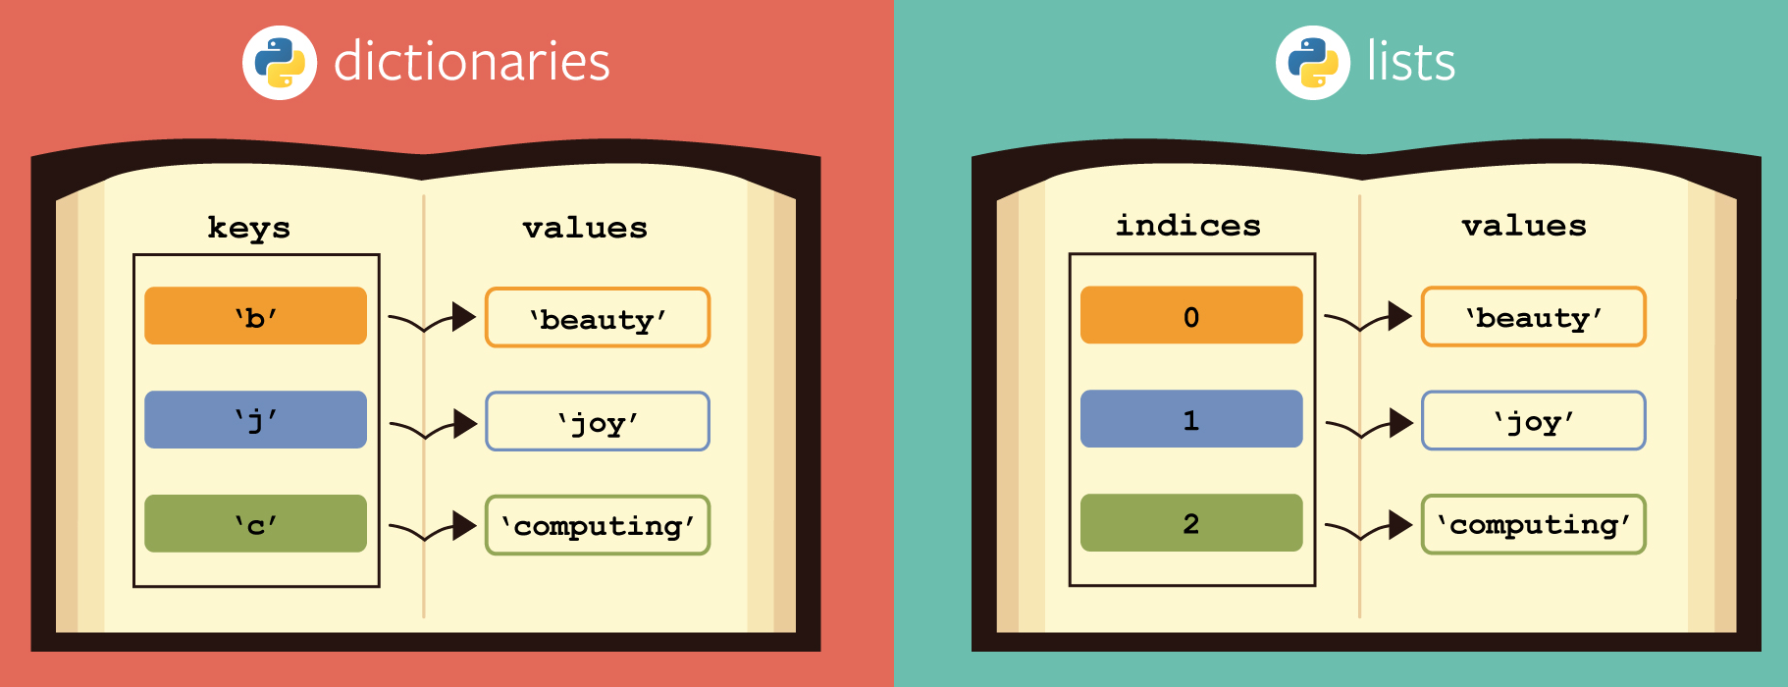
Learning Objectives
Dictionaries are a new type in Python
Lists let us index a value by a number, or position.
Dictionaries let us index data by other kinds of data.
KEY -> VALUE mapping. Aka “lookup table”
Extremely useful data type used in many languages/systems
Credit: https://berkeley-cs61as.github.io/textbook/dictionaries-and-memoization.html

Slide 18
Dictionaries: syntax
# Constructors
# dict( <list of 2-tuples> )
my_dict = dict(('key1', 'value1'), ('key2', 'value2'))
# dict( <key>=<val>, ...) # like kwargs
dict(key1='value1', key2='value2')
# { <key exp>:<val exp>, ... }
{"key1": "value1", "key2": "value2"}
# { <key>:<val> for <iteration expression> }
{key: value for (key, value) in [("key1", "value"), ("key2", "value2")]}
# Example:
>>> {x: y for x, y in zip(["a", "b"], [1, 2])}
{'a': 1, 'b': 2}

Slide 19
Dictionaries: common operations
my_dict = {"key1": "value1", "key2": "value2"}
# selector (key present / missing)
>>> my_dict['key1']
'value1’
>>> my_dict['meow']
Traceback (most recent call last):
File "<stdin>", line 1, in <module>
KeyError: 'meow’
>>> my_dict.get('meow') # returns None
>> my_dict.get('meow', 'fallback')
'fallback'
# operators: in, not in, min/max
>>> 'key1' in my_dict
True
>>> 'not_present' in my_dict
False
# writing to a dict
my_dict['key3'] = 42
my_dict['key3']
42

Slide 20
Demo
person = { 'name': 'Michael' }
person.get('name')
person['email'] = 'ball@berkeley.edu'
person.keys()
'phone' in person
text = 'One upon a time'
{ word : len(word) for word in text.split() }

Slide 21
Mutability

Slide 22
Learning Objectives
Distinguish between when a function mutates data, or returns a new object
Many Python "default" functions return new objects
Understand modifying objects in place
Python provides “is” and “==” for checking if items are the same, in different ways

Slide 23
Why does Mutability Matter?
Recall: “mutable/mutation” means “to modify / modifiable”
“immutable” means “unmodifiable”
Mutable data is a reality — lists, dictionaries, objects (coming soon)
It's a challenging aspect of programming
There are common patterns, which you will slowly become familiar with and internalize.
Use your environment diagrams!

Slide 24
Objects in Python (preview of Object-Oriented Programming)
An object is a bundle of data and behavior.
A type of object is called a class.
Every value in Python is an object.
string, list, int, tuple, et
All objects have attributes
Objects often have associated methods
lst.append(), lst.extend(), etc
Objects have a value (or values)
Mutable: We can change the object after it has been created
Immutable: We cannot change the object.
Objects have an identity, a reference to that object.

Slide 25
Immutable Object: string
course = 'CS88'
What kind of object is it?
type(course)
What data is inside it?
course[0]
course[2:]
What methods can we call?
course.upper()
course.lower()
None of these methods modify our original string.

Slide 26
Dictionaries are Mutable, too
Mutable Objects: lists and dictionaries
Immutable – the value of the object cannot be changed
integers, floats, booleans
strings, tuples
Mutable – the value of the object can change over time
Lists
Dictionaries
>>> adict = {'a':1, 'b':2}
>>> adict
{'b': 2, 'a': 1}
>>> adict['b']
2
>>> adict['b'] = 42
>>> adict['c'] = 'elephant'
>>> adict
{'b': 42, 'c': 'elephant', 'a': 1}
>>> alist = [1,2,3,4]
>>> alist
[1, 2, 3, 4]
>>> alist[2]
3
>>> alist[2] = 'elephant'
>>> alist
[1, 2, 'elephant', 4]

Slide 27
Dictionaries – by example
Dictionaries (syntax/operations review)
Constructors:
dict( hi=32, lo=17)
dict([('hi',212),('lo',32),(17,3)])
{'x':1, 'y':2, 3:4}
{wd : len(wd) for wd in "The quick brown fox".split()}
Selectors:
water['lo']
<dict>.keys(), .items(), .values()
<dict>.get(key [, default] )
Operations:
in, not in, len, min, max
'name' in course
Mutators
course['number' ] = 'C88C'
course.pop('room')
del course['room']
These mutator operations modify the dict object!

Slide 28
Immutability vs Mutability
An immutable value is unchanging once created.
Immutable types (that we've covered): int, float, string, tuple
a_string = "Hi y'all"
a_string[1] = "I" # ERROR
a_string += ", how you doing?"
an_int = 20
an_int += 2
A mutable value can change in value throughout the course of computation. All names that refer to the same object are affected by a mutation.
Mutable types (that we've covered): list, dict
grades = [90, 70, 85]
grades_copy = grades # Not actually a copy!
grades[1] = 100 # grades_copy changes too!
words = {"agua": "water"}
words["pavo"] = "turkey"

Slide 29
From value to storage …
Mutation in Environments
A variable assigned a compound value (object) is a reference to that object.
Mutable objects can be changed but the variable(s) still refer to it
x is still the same object, but its values have changed.
x = [1, 2, 3]
y = 6
x[1] = y
x[1]
frame
1
•
2
6
•
3
•
x:
•
y:
6
…

Slide 30
Mutating Lists: Example functions of the list class
append() adds a single element to a list:
s = [2, 3]
t = [5, 6]
s.append(4)
s.append(t)
t = 0
Try in PythonTutor.
extend() adds all the elements in one list to another list:
s = [2, 3]
t = [5, 6]
s.extend(4) # 🚫 Error: 4 is not an iterable!
s.extend(t)
t = 0
Try in PythonTutor. (After deleting the bad line)

Slide 31
Mutating Lists -- More Functions!
list += [x, y, z] # just like extend.
You need to be careful with this one! It modifies the list.
pop() removes and returns the last element:
s = [2, 3]
t = [5, 6]
t = s.pop()
Try in PythonTutor.
remove() removes the first element equal to the argument:
s = [6, 2, 4, 8, 4]
s.remove(4)
Try in PythonTutor.

Slide 32
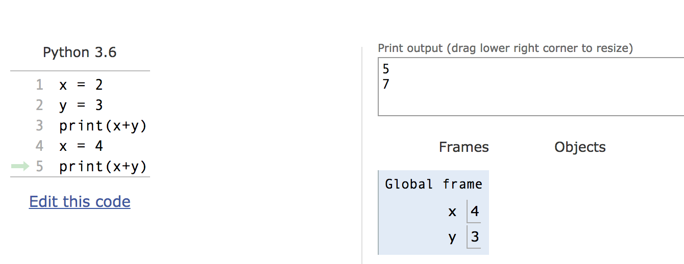
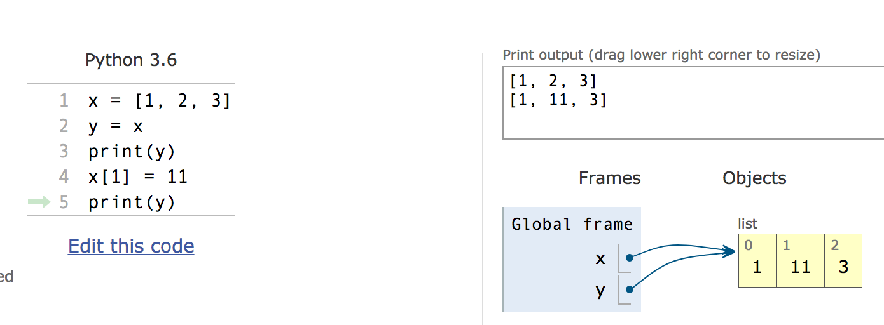
Mutation makes sharing visible
Python Tutor: Assignments Are References

Slide 33
Mutable Data Inside Immutable Objects
Mutable objects can "live" inside immutable objects!
An immutable sequence may still change if it contains a mutable value as an element.
Be very careful, and probably do notdo this!
t = (1, [2, 3])
t[1][0] = 99
t[1][1] = "Problems"
Try in PythonTutor

Slide 34
Equality vs Identity
list1 = [1,2,3]
list2 = [1,2,3]
Equality: exp0 == exp1 evaluates to True if both exp0 and exp1 evaluate to objects containing equal values (Each object can define what == means)
list1 == list2 # True
Identity: exp0 is exp1 evaluates to True if both exp0 and exp1 evaluate to the same object
Identical objects always have equal values.
list1 is list2 # False
Try in PythonTutor.

Slide 35
Copies, 'is' and '=='
Identity and == vs is
How do we know if two names (variables) are the same exact object? i.e. Will modifying one modify the other?
>>> alist = [1, 2, 3, 4]
>>> alist == [1, 2, 3, 4] # Equal values?
True
>>> alist is [1, 2, 3, 4] # same object?
False
>>> blist = alist # assignment refers
>>> alist is blist # to same object
True
>>> blist = list(alist) # type constructors copy
>>> blist is alist
False
>>> blist = alist[ : ] # so does slicing
>>> blist is alist
False
>>> blist
[1, 2, 3, 4]
>>>

Slide 36
What is the meaning of is?
is in Python means two items have the exact same identity
Thus, a is b implies a == b
Why? Each object has a function id() which returns its "address"
We won't get into what this means, but it's essentially an internal "locator" for that data in memory.
Think of two houses which have the exact same floor plan, look the same, etc. The are "the same house" but each have a unique address. (And thus are different houses)
Think this is tricky? cool? amazing?
Take CS61C (Architecture) and CS164 (Programming Languages)

Slide 37
Passing Data Into Functions

Slide 38
Learning Objectives
Passing in a mutable object in a function in Python lets you modify that object
Immutable objects don't change when passed in as an argument
Making a new name doesn't affect the value outside the function
Modifying mutable data does modify the values in the parent frame.

Slide 39
Mutating Arguments
Functions can mutate objects passed in as an argument
Declaring a new variable with the same name as an argument only exists within the scope of our function
You can think of this as creating a new name, in the same way as redefining a variable.
This will not modify the data outside the function, even for mutable objects.
BUT
We can still directly modify the object passed in…even though it was created in some other frame or environment.
We directly call methods on that object.
View Python Tutor

Slide 40
Understanding Python: What should we return?
Why do some functions return None?
Why do some functions return a value?
Functions that mutate an argument usually return None!
C88C / 61A / Data Science View: Avoid mutating data unless it's necessary!
Mutations are useful, but can get confusing quickly. This is why we focus on functional programming - map, filter, reduce, list comprehensions, etc.

Slide 41
Functions that Mutate vs Return New Objects
Lists:
sorted(list) – retiurns a new list
list.sort() – modifies the list, returns None
list.append() – modifies the list, returns None
list.extend() – modifies the list, returns None

Slide 42
Python Gotcha's: a += b and a = a + b
Sometimes similar looking operations have very different results!
Why?
= always binds (or re-binds) a value to a name.
Python Tutor
def add_data_to_thing(thing, data):
print(f"+=, Before: {thing}")
thing += data
print(f"+=, After: {thing}")
return thing
def new_thing_with_data(thing, data):
print(f"=, Before: {thing}")
thing = thing + data
print(f"=, After: {thing}")
return thing

Slide 43
Lecture overview. Any questions?
Environment diagrams (review, lambdas)
Mutable data
dict

