Slide 1
Environments, Mutable Data
Week 3, Summer 2024. 7/1 (Mon)
Rev v2 (2024-07-03 2:17 pm PST)
Notes:
1

Slide 2

Announcements
Upcoming due dates
HW03, Lab03: Due 7/1 11:59 pm PST (tonight!)
Project01 (“Maps”) will be released later this week
You can work on this + submit with one partner.
Or, you can solo it.
(Holiday) July 4: No lecture/labs/OH!
Credit: Stephanie McCabe: https://unsplash.com/photos/time-lapse-photography-of-sparkler-and-usa-flag-let-_Ajm-ewEC24

Slide 3
Lecture overview
Environment diagrams (review, lambdas)
Mutable data
dict

Slide 4
Environment Diagrams (review, lambdas)
Notes:
4

Slide 5
Inner (“Nested”) Functions
Inner functions are scoped – they are not visible to the outside world
But they can be returned and thus called later on.
Like a "regular" function, they have access to all the data (including arguments) of their "parent" or "container" function.
def outer_fn(arg_outer):
def inner_fn(arg_inner):
return arg_outer + arg_inner
return inner_fn
>>> outer_fn(2)(3)
5

Slide 6
Learning Objectives
Lambda are anonymous functions, which are expressions
Don’t use return, lambdas always return the value of the expression.
They are typically short and concise
They don’t have an “intrinsic” name when using an environment diagram.
Their name is the character 𝜆

Slide 7
(review) lambda syntax
Function expression
“anonymous” function creation
Expression, not a statement, no return or any other statement
lambda <arg or arg_tuple> : <expression using args>
add_one = lambda v : v + 1
def add_one(v):
return v + 1

Slide 8
Examples
>>> def make_adder(i):
... return lambda x: x+i
...
>>> make_adder(3)
<function make_adder.<locals>.<lambda> at 0x10073c510>
>>> make_adder(3)(4)
7
>>> list(map(make_adder(3), [1,2,3,4]))
[4, 5, 6, 7]

Slide 9
Environment Diagrams (review)
Organizational tools that help you understand code
Terminology:
Frame: keeps track of variable-to-value bindings, each function call has a frame
Global Frame: global for short, the starting frame of all python programs, doesn’t correspond to a specific function
Parent Frame: The frame of where a function is defined (default parent frame is global)
Frame number: What we use to keep track of frames, f1, f2, f3, etc
Variable vs Value: x = 1. x is the variable, 1 is the value

Slide 10
Environment Diagrams Rules (review)
Always draw the global frame first
When evaluating assignments (lines with single equal), always evaluate right side first
When you CALL a function MAKE A NEW FRAME!
When assigning a primitive expression (number, boolean, string) write the value in the box
When assigning anything else (lists, functions, etc.), draw an arrow to the value
When calling a function, name the frame with the intrinsic name – the name of the function that variable points to
The parent frame of a function is the frame in which it was defined in (default parent frame is global)
If the value for a variable doesn’t exist in the current frame, search in the parent frame

Slide 11
(redo from lec07) Python Tutor Example #3 (LINK)
def make_adder(a):
return lambda x: x + a
add_2 = make_adder(2)
add_3 = make_adder(3)
x = add_2(2)
def compose(f, g):
def h(x):
return f(g(x))
return h
add_5 = compose(add_2, add_3)
z = add_5(x)
Main takeaway from this:
A function’s parent frame is the frame in which it was created, NOT where it is called from!
Aka “lexical/static” scoping.
Lambdas behave just like functions, but with “no name” (anonymous fn)
Variable “shadowing”: the `x` in `h()` frame “shadows” the `x` in the global frame

Slide 12
Sorting + HOF’s
Notes:
12

Slide 13
More Python HOFs
sorted – sorts a list of data
min
max
All three take in an optional argument called key which allows us to control how the function performs its action. They are more similar to filter than map.
max([1,2,3,4,5], key = lambda x: -x)
key is the name of the argument and a lambda is its value.
>>> fruits = ["pear", "grape", "KIWI", "APPLE", "melon", "ORANGE", "BANANA"]
>>> sorted(fruits key=lambda x: x.islower())
['KIWI', 'APPLE', 'ORANGE', 'BANANA', 'pear', 'grape', 'melon']

Slide 14
Sorting Data
It is often useful to sort data.
What property should we sort on?
Numbers: We can clearly sort.
What about the length of a word?
Alphabetically?
What about sorting a complex data set, but 1 attribute?
Image I have a list of courses: I could sort be course name, number of units, start time, etc.
Python provides 1 function which allows us to provide a lambda to control its behavior

Slide 15
Sorting with Lambdas
>>> sorted([1,2,3,4,5], key = lambda x: x)
[1, 2, 3, 4, 5]
>>> sorted([1,2,3,4,5], key = lambda x: -x)
[5, 4, 3, 2, 1]
# Sorting a list of tuples by various criterion
>>> my_tuples = [(2, "hi"), (1, "how"), (5, "goes"), (7, "it")]
# Sort by first entry (int)
>>> sorted(my_tuples, key = lambda x: x[0])
[(1, 'how'), (2, 'hi'), (5, 'goes'), (7, 'it')]
# Sort by second entry (str)
>>> sorted(my_tuples, key = lambda x: x[1])
[(5, 'goes'), (2, 'hi'), (1, 'how'), (7, 'it’)]
# Sort by length of second entry
>>> sorted(my_tuples, key = lambda x: len(x[1]))
[(2, 'hi'), (7, 'it'), (1, 'how'), (5, 'goes')]

Slide 16
Dictionaries
Notes:
16

Slide 17
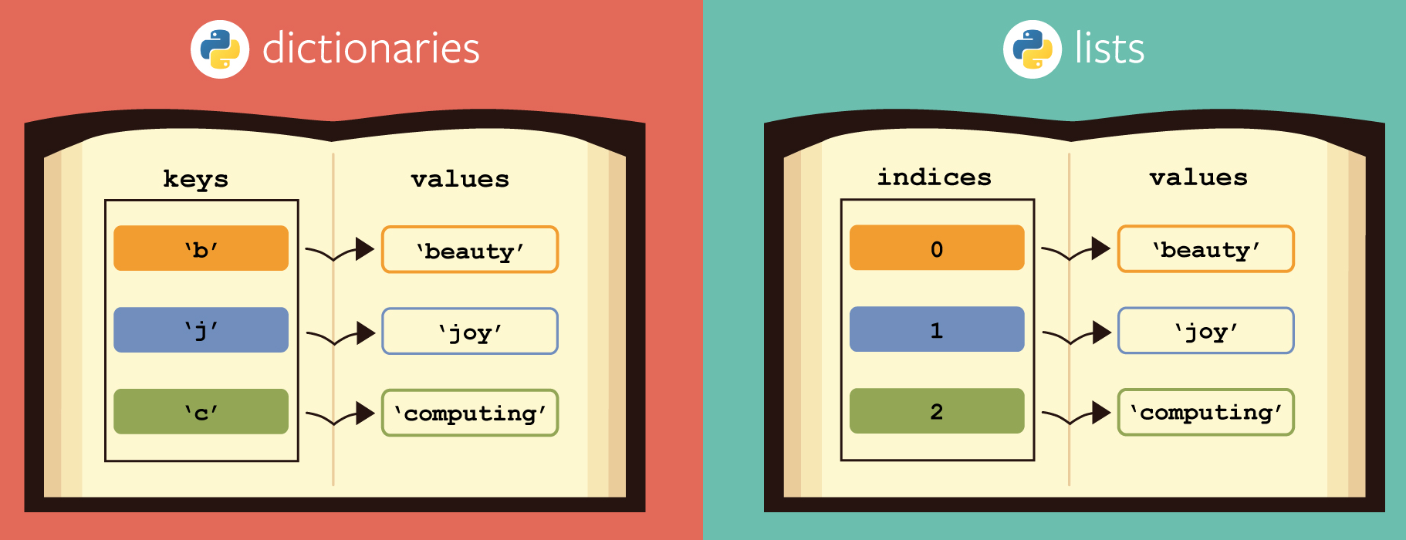
Learning Objectives
Dictionaries are a new type in Python
Lists let us index a value by a number, or position.
Dictionaries let us index data by other kinds of data.
KEY -> VALUE mapping. Aka “lookup table”
Extremely useful data type used in many languages/systems
Credit: https://berkeley-cs61as.github.io/textbook/dictionaries-and-memoization.html

Slide 18
Dictionaries: syntax
# Constructors
# dict( <list of 2-tuples> )
my_dict = dict((('key1', 'value1'), ('key2', 'value2’)))
# dict( <key>=<val>, ...) # like kwargs
dict(key1='value1', key2='value2')
# { <key exp>:<val exp>, ... }
{"key1": "value1", "key2": "value2"}
# { <key>:<val> for <iteration expression> }
{key: value for (key, value) in [("key1", "value"), ("key2", "value2")]}
# Example:
>>> {x: y for x, y in zip(["a", "b"], [1, 2])}
{'a': 1, 'b': 2}

Slide 19
Dictionaries: common operations
my_dict = {"key1": "value1", "key2": "value2"}
# selector (key present / missing)
>>> my_dict['key1']
'value1’
>>> my_dict['meow']
Traceback (most recent call last):
File "<stdin>", line 1, in <module>
KeyError: 'meow’
>>> my_dict.get('meow') # returns None
>> my_dict.get('meow', 'fallback')
'fallback'
# operators: in, not in, min/max
>>> 'key1' in my_dict
True
>>> 'not_present' in my_dict
False
# writing to a dict
my_dict['key3'] = 42
my_dict['key3']
42

Slide 20
Demo
person = { 'name': 'Michael' }
person.get('name')
person['email'] = 'ball@berkeley.edu'
person.keys()
'phone' in person
text = 'One upon a time'
{ word : len(word) for word in text.split() }

Slide 21
Mutability

Slide 22
Learning Objectives
Distinguish between when a function mutates data, or returns a new object
Many Python "default" functions return new objects
Understand modifying objects in place
Python provides “is” and “==” for checking if items are the same, in different ways

Slide 23
Why does Mutability Matter?
Recall: “mutable/mutation” means “to modify / modifiable”
“immutable” means “unmodifiable”
Mutable data is a reality — lists, dictionaries, objects (coming soon)
It's a challenging aspect of programming
There are common patterns, which you will slowly become familiar with and internalize.
Use your environment diagrams!

Slide 24
Objects in Python (preview of Object-Oriented Programming)
An object is a bundle of data and behavior.
A type of object is called a class.
Every value in Python is an object.
string, list, int, tuple, et
All objects have attributes
Objects often have associated methods
lst.append(), lst.extend(), etc
Objects have a value (or values)
Mutable: We can change the object after it has been created
Immutable: We cannot change the object.
Objects have an identity, a reference to that object.

Slide 25
Immutable Object: string
course = 'CS88'
What kind of object is it?
type(course)
What data is inside it?
course[0]
course[2:]
What methods can we call?
course.upper()
course.lower()
None of these methods modify our original string.

Slide 26
Dictionaries are Mutable, too
Mutable Objects: lists and dictionaries
Immutable – the value of the object cannot be changed
integers, floats, booleans
strings, tuples
Mutable – the value of the object can change over time
Lists
Dictionaries
>>> adict = {'a':1, 'b':2}
>>> adict
{'b': 2, 'a': 1}
>>> adict['b']
2
>>> adict['b'] = 42
>>> adict['c'] = 'elephant'
>>> adict
{'b': 42, 'c': 'elephant', 'a': 1}
>>> alist = [1,2,3,4]
>>> alist
[1, 2, 3, 4]
>>> alist[2]
3
>>> alist[2] = 'elephant'
>>> alist
[1, 2, 'elephant', 4]

Slide 27
Dictionaries – by example
Dictionaries (syntax/operations review)
Constructors:
dict( hi=32, lo=17)
dict([('hi',212),('lo',32),(17,3)])
{'x':1, 'y':2, 3:4}
{wd : len(wd) for wd in "The quick brown fox".split()}
Selectors:
water['lo']
<dict>.keys(), .items(), .values()
<dict>.get(key [, default] )
Operations:
in, not in, len, min, max
'name' in course
Mutators
course['number' ] = 'C88C'
course.pop('room')
del course['room']
These mutator operations modify the dict object!

Slide 28
Immutability vs Mutability
An immutable value is unchanging once created.
Immutable types (that we've covered): int, float, string, tuple
a_string = "Hi y'all"
a_string[1] = "I" # ERROR
a_string += ", how you doing?"
an_int = 20
an_int += 2
A mutable value can change in value throughout the course of computation. All names that refer to the same object are affected by a mutation.
Mutable types (that we've covered): list, dict
grades = [90, 70, 85]
grades_copy = grades # Not actually a copy!
grades[1] = 100 # grades_copy changes too!
words = {"agua": "water"}
words["pavo"] = "turkey"

Slide 29
From value to storage …
Mutation in Environments
A variable assigned a compound value (object) is a reference to that object.
Mutable objects can be changed but the variable(s) still refer to it
x is still the same object, but its values have changed.
x = [1, 2, 3]
y = 6
x[1] = y
x[1]
frame
1
•
2
6
•
3
•
x:
•
y:
6
…

Slide 30
Lecture overview. Any questions?
Environment diagrams (review, lambdas)
Mutable data
dict

