Slide 1
Object-Oriented Programming (OOP)
Week 4, Summer 2024. 7/11 (Thurs)
Lecture 14
Rev1: 2024-07-11 3:55 pm pst

Slide 2
Announcements
Midterm next week!
HW07, Lab07 out today (due: 7/15)
Project01 (“Maps”) is ongoing.
isn’t k-means neat?

Slide 3
Midterm content
Midterm will cover content from start of course up to (and including) OOP+Inheritance, aka:
Start (inclusive): Lecture 01: “Welcome & Intro” (6/17)
End (inclusive): Lecture 15: “OOP – Inheritance” (7/15)
Midterm will be done through Zoom + Gradescope
Study tip: past C88C exams can be found here: https://c88c.org/sp24/articles/resources.html#past-midterms
Take a look to get a sense of what C88C exams tend to look like. (I highly, highly encourage this)
“Be prepared” – Boy Scouts
“Luck is when preparation meets opportunity” – Roman philosopher Seneca

Slide 4
Midterm logistics
The midterm will be held over Zoom + Gradescope
You must have your camera + screen sharing on during the entire exam, and we will be doing screen+camera recording.
You must take the exam in a quiet room with no other students present
Things to bring to the exam (and nothing else!):
Photo ID. Ideally your UCB student ID, but anything with your name + photo is fine, eg: Passport, driver’s license, etc.
(Optional) Five (5) pages of handwritten (not typed!) notes
(Optional, recommended) Additional blank scratch paper, pencil/pen/eraser.
We will provide everyone with a 1-2 page digital PDF of additional reference
Other than the above notes, the exam will be closed book, closed notes.
(For more info, stay tuned for an Ed post)

Slide 5
Object-Oriented Programming (OOP)

Slide 6
Learning Objectives
Learn how to make a class in Python
class keyword
__init__ method
self

Slide 7
Object-Oriented Programming (OOP)
Objects as data structures
With methods you ask of them
These are the behaviors
With local state, to remember
These are the attributes
Classes & Instances
Instance an example of class
E.g., Fluffy is instance of Dog
Inheritance saves code
Hierarchical classes
e.g., a Tesla is a special case of an Electric Vehicle, which is a special cade of a car
Other Examples (though not pure)
Java (CS61B), C++
www3.ntu.edu.sg/home/ehchua/programming/java/images/OOP-Objects.gif

Slide 8

Object-Oriented Programming is About Design
"In my version of computational thinking, I imagine an abstract machine with just the data types and operations that I want. If this machine existed, then I could write the program I want.
But it doesn’t. Instead I have introduced a bunch of subproblems — the data types and operations — and I need to figure out how to implement them. I do this over and over until I’m working with a real machine or a real programming language. That’s the art of design."
— Barbara Liskov,
Turing Award Winner, UC Berkeley '61.
Full interview

Slide 9
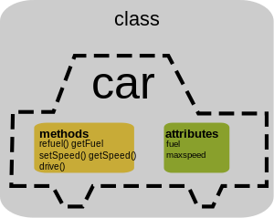
Classes
Consist of data and behavior, bundled together to create abstractions
Abstract Data Types use functions to create abstractions
Classes define a new type in a programming language
They make the "abstract" data type concrete.
A class has
attributes (variables)
methods (functions)
that define its behavior.

Slide 10
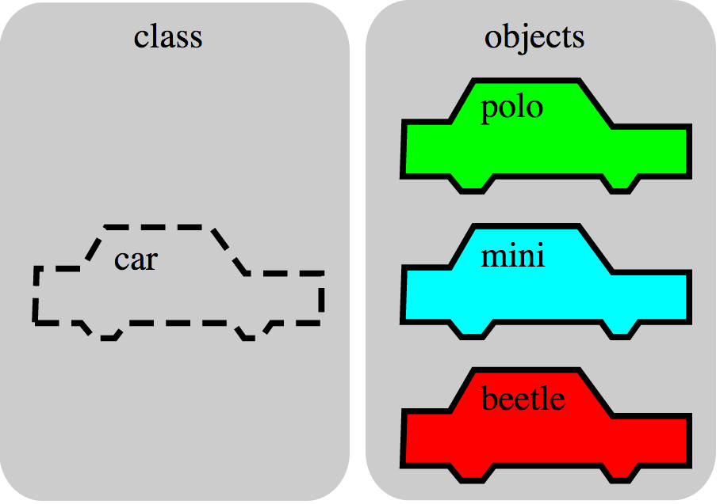
Objects
An object is the instance of a class.
Analogy:
A “class” is a “blueprint”
An “object” is an actual “built/instantiated” entity based off the blueprint (class)

Slide 11
Objects
Objects are concrete instances of classes in memory.
They have state
mutable vs immutable (lists vs tuples)
Methods are functions that belong to an object
Objects do a collection of related things
In Python, everything is an object
All objects have attributes
Manipulation happens through methods

Slide 12
Python class statement
class ClassName:
def __init__(self):
<initialization steps>
.
.
.
<statement-N>
# Coming Next Week:
class ClassName ( inherits ):
<statement-1>
.
.
.
<statement-N>

Slide 13
From ADTs to Classes
Recall our Point ADT from earlier
# constructor
def create_point(x, y):
return [x, y]
# selectors
def get_x(point):
return point[0]
def get_y(point):
return point[1]
# Operators
def distance_l2(p1, p2):
# L2 distance btwn points p1, p2
return ((get_x(p1) - get_x(p2))**2
+ (get_y(p1) - get_y(p2))**2)**0.5
class Point:
# Constructor
def __init__(self, x, y):
# instance vars
self.x = x
self.y = y
# Selectors
def get_x(self):
return self.x
def get_y(self):
return self.y
# Instance Methods
def dist_l2(self, pt_other):
# L2 dist btwn myself (self) and pt_other
return ((self.x - pt_other.x)**2
+ (self.y - pt_other.y)**2)**0.5

Slide 14
From ADTs to Classes (usage)
# constructor
def create_point(x, y):
return [x, y]
# selectors
def get_x(point):
return point[0]
def get_y(point):
return point[1]
# Operators
def distance_l2(p1, p2):
# L2 distance btwn points p1, p2
return ((get_x(p1) - get_x(p2))**2
+ (get_y(p1) - get_y(p2))**2)**0.5
class Point:
# Constructor
def __init__(self, x, y):
self.x = x # instance vars
self.y = y
# Selectors
def get_x(self):
return self.x
def get_y(self):
return self.y
# Instance Methods
def dist_l2(self, pt_other):
# L2 dist btwn myself (self) and pt_other
return ((self.x - pt_other.x)**2
+ (self.y - pt_other.y)**2)**0.5
>>> pt1 = create_point(1, 1)
>>> pt2 = create_point(2, 3)
>>> distance_l2(pt1, pt2)
2.23606797749979
>>> pt1 = Point(1, 1)
>>> pt2 = Point(2, 3)
>>> pt1.dist_l2(pt2)
2.23606797749979
Very similar in spirit! Interesting.

Slide 15
From ADTs to Classes (usage)
# constructor
def create_point(x, y):
return [x, y]
# selectors
def get_x(point):
return point[0]
def get_y(point):
return point[1]
# Operators
def distance_l2(p1, p2):
# L2 distance btwn points p1, p2
return ((get_x(p1) - get_x(p2))**2
+ (get_y(p1) - get_y(p2))**2)**0.5
class Point:
# Constructor
def __init__(self, x, y):
self.x = x # instance vars
self.y = y
# Selectors
def get_x(self):
return self.x
def get_y(self):
return self.y
# Instance Methods
def dist_l2(self, pt_other):
# L2 dist btwn myself (self) and pt_other
return ((self.x - pt_other.x)**2
+ (self.y - pt_other.y)**2)**0.5
>>> pt1 = create_point(1, 1)
>>> pt1
[1, 1]
>>> type(pt1)
<class 'list'>
>>> pt1 = Point(1, 1)
>>> pt1
<__main__.Point object at 0x000001A2A589FFD0>
>>> type(pt1)
<class '__main__.Point'>
Our pt1 instance has type Point! More explicit than ADT’s

Slide 16
Example: Account
class BaseAccount:
def __init__(self, name, initial_deposit):
self.name = name
self.balance = initial_deposit
def account_name(self):
return self.name
def get_balance(self):
return self.balance
def withdraw(self, amount):
self.balance -= amount
return self.balance
new namespace
Instance attributes
The object
Dot notation (“dot operator”)
Instance methods

Slide 17
Constructor: Special Initialization Method
class BaseAccount:
def __init__(self, name, initial_deposit):
self.name = name
self.balance = initial_deposit
def account_name(self):
return self.name
def get_balance(self):
return self.balance
def withdraw(self, amount):
self.balance -= amount
return self.balance
# calling the constructor ("__init__()")
my_account = BaseAccount("bob", 100)
# access an instance attribute via "dot operator"
>>> my_account.name
bob
# call an instance method (also via dot operator)
>>> my_account.account_name()
bob
>>> my_account.withdraw(5)
95
>>> my_account.get_balance()
95
>>> my_account.balance
95
return None

Slide 18
(Aside) Public vs private attributes
Sometimes, it’s useful to distinguish between ”public” and “private” data.
Used to clarify to programmers how you class should be used.
In Python an _ prefix of an attribute name means “this thing is private”
Example: “thing.secret” vs “thing._secret”
_foo and __foo do different things inside a class.
More for the curious.

Slide 19
(Aside) Public vs private attributes
class Lockbox:
def __init__(self, secret_password):
# Convention: "_" prefix means other programmers
# shouldn't access this!
self._secret_password = secret_password
def unlock(self, password):
if password == self._secret_password:
return "Unlocked"
else:
return "Invalid password"
>>> my_lockbox = Lockbox("pull the lever")
# mwahaha, conventions won't stop me
>>> my_lockbox.unlock(my_lockbox._secret_password)
Unlocked
In other programming languages, like Java/C++, there is strict private/public accessibility syntax that the language will enforce. (CS 61B)
But Python doesn’t support this, instead relies on convention and “disciplined developers” to not rely on “_VAR” that aren’t part of the public API
Important: for this class we won’t ask about public/private in exams.

Slide 20
Class variables vs instance variables
Class variables vs Instance variables:
Class variable set for all instances at once
aka a “global var” for the class
Instance variables per instance value
aka a “local var” for each instance

Slide 21
Example: class attribute
class BaseAccount:
account_number_seed = 1000
def __init__(self, name, initial_deposit):
self._name = name
self._balance = initial_deposit
self._acct_no = BaseAccount.account_number_seed
BaseAccount.account_number_seed += 1
def name(self):
return self._name
def balance(self):
return self._balance
def withdraw(self, amount):
self._balance -= amount
return self._balance
>>> BaseAccount.account_number_seed
1000
>>> acc1 = BaseAccount("accountA", 100)
>>> BaseAccount.account_number_seed
1001
>>> acc2 = BaseAccount("accountB", 50)
>>> BaseAccount.account_number_seed
1002
# You can also access Class variables from
# instances, but for reasons*, in this
# class (and, IMO, beyond), please always
# access Class variables from the Class name
>>> acc1.account_number_seed
1002
>>> acc2.account_number_seed
1002
* (Optional) for reasons, read this SO post

Slide 22
More class attributes
class BaseAccount:
account_number_seed = 1000
accounts = []
def __init__(self, name, initial_deposit):
self._name = name
self._balance = initial_deposit
self._acct_no = BaseAccount.account_number_seed
BaseAccount.account_number_seed += 1
BaseAccount.accounts.append(self)
def name(self):
...
def show_accounts():
for account in BaseAccount.accounts:
print(account.name(),
account.account_no(),account.balance())
You can have class methods as well!
Note the missing `self`. This is because class methods aren’t called on an instance, it’s called on the Class itself!

Slide 23
More class attributes
class BaseAccount:
account_number_seed = 1000
accounts = []
def __init__(self, name, initial_deposit):
self._name = name
self._balance = initial_deposit
self._acct_no = BaseAccount.account_number_seed
BaseAccount.account_number_seed += 1
BaseAccount.accounts.append(self)
def name(self):
return self._name
def account_no(self):
return self._acct_no
def balance(self):
return self._balance
def show_accounts():
for account in BaseAccount.accounts:
print(account.name(),
account.account_no(),
account.balance())
>>> acc1 = BaseAccount("A", 100)
>>> acc2 = BaseAccount("B", 50)
>>> BaseAccount.show_accounts()
A 1000 100
B 1001 50
Note: since `show_accounts()` is a Class method (not an instance method), I call it on `BaseAccount.show_accounts()`, NOT `acc1.show_accounts()`

Slide 24
OOP Terminology (jargon). Any questions?
There’s a lot of synonyms in OOP. I’ll enumerate the most common ones:
Instance attributes, aka: instance variables
Instance methods
Class attributes, aka: class variables
Class methods, aka: static methods
Calling a class constructor, aka: “instantiate an object”, “create an instance of the class”
In this class, I’ll try to be consistent, but do get familiar with all of this jargon.

