Slide 1
Object-Oriented Programming: Part 2, Inheritance
Week 5, Summer 2024. 7/15 (Mon)
Lecture 15

Slide 2
Announcements
Midterm this week!
Project01 (“Maps”) due 7/18 (Thurs!)
HW07, Lab07 due tonight!

Slide 3
Midterm content
Midterm will cover content from start of course up to (and including) OOP+Inheritance, aka:
Start (inclusive): Lecture 01: “Welcome & Intro” (6/17)
End (inclusive): Lecture 15: “OOP – Inheritance” (7/15)
Midterm will be done through Zoom + Gradescope
Study tip: past C88C exams can be found here: https://c88c.org/sp24/articles/resources.html#past-midterms
Take a look to get a sense of what C88C exams tend to look like. (I highly, highly encourage this)
“Be prepared” – Boy Scouts
“Luck is when preparation meets opportunity” – Roman philosopher Seneca

Slide 4
Midterm logistics
The midterm will be held over Zoom + Gradescope
You must have your camera + screen sharing on during the entire exam, and we will be doing screen+camera recording.
You must take the exam in a quiet room with no other students present
Things to bring to the exam (and nothing else!):
Photo ID. Ideally your UCB student ID, but anything with your name + photo is fine, eg: Passport, driver’s license, etc.
(Optional) Five (5) pages of handwritten (not typed!) notes
(Optional, recommended) Additional blank scratch paper, pencil/pen/eraser.
We will provide everyone with a 1-2 page digital PDF of additional reference
Other than the above notes, the exam will be closed book, closed notes.
(For more info, stay tuned for an Ed post)

Slide 5
Today’s lecture content
OOP: inheritance
Python “magic methods”
ex: __init__, __add__, __repr__, __str__, etc

Slide 6
Reviewing Our Account

Slide 7
Example: Suggested “private” attributes
class BaseAccount:
def __init__(self, name, initial_deposit):
self._name = name
self._balance = initial_deposit
def name(self):
return self._name
def balance(self):
return self._balance
def withdraw(self, amount):
self._balance -= amount
return self._balance

Slide 8
Python's Instance Attributes
self.attribute_name = x
Sets up an attribute which can be modified by anyone

Slide 9
(Optional) internal/private Instance Attributes
self._attribute_name = x
Sets up an attribute which is suggested that is "internal only"
e.g. my_instance._attribute_name = y will work, but should look wrong.
Internally, self._attribute_name = y is OK.
self.__attribute_name = x
Sets up an attribute which is private
e.g. my_instance.__attribue_name = y will error!
Internally, self.__attribute_name = y is OK.
Important: in this class, we will not test you on internal/private instance vars, eg “_VAR” vs “__VAR”

Slide 10
Class Attributes: Keeping Track of Our Instances?
Problem:
We can make many accounts… they all live in memory.
But how do we know what all of our accounts are?
How could we create an account number which is always increasing?
Solution:
A class in Python can manage data shared across all instances
We call these class attributes which are distinguished from instance attributes

Slide 11
Classes Can Have Attributes Too!
Class attributes (as opposed to instance attributes) belong to the class itself, instead of each object
This means there is one value which is shared for all of the class's objects
Be Careful!
It's easy to overdo class attributes
Methods that rely only on class attributes are called class methods
Python has some special features we won't use, but are useful
Declaring a method as belonging to a class, not an instance.
Important: in this class, we will not require you to use @classmethod, @staticmethod in exams, nor do you need to understand the difference between the two. But if you’re curious, here’s a good explanation of the difference.

Slide 12
Example: class attribute
class BaseAccount:
account_number_seed = 1000
def __init__(self, name, initial_deposit):
self._name = name
self._balance = initial_deposit
self._acct_no = BaseAccount.account_number_seed
BaseAccount.account_number_seed += 1
def name(self):
return self._name
def balance(self):
return self._balance
def withdraw(self, amount):
self._balance -= amount
return self._balance

Slide 13
More class attributes
class BaseAccount:
account_number_seed = 1000
accounts = []
def __init__(self, name, initial_deposit):
self._name = name
self._balance = initial_deposit
self._acct_no = BaseAccount.account_number_seed
BaseAccount.account_number_seed += 1
BaseAccount.accounts.append(self)
def name(self):
...
def show_accounts():
for account in BaseAccount.accounts:
print(account.name(),
account.account_no(),account.balance())

Slide 14
Are There Better Approaches?
BEWARE! Class attributes are useful but can get confusing.
Perhaps what want is a Bank() class
The bank would have a create_account() method
Each Bank() would have its own accounts list, as a set of instance variables.
class Bank():
def __init___(self): self.account_no_seed = 1000
self.accounts = []
def create_account(self, name, balance):
acct = BaseAccount(name, balance, self.account_no_seed)
self.accounts.append(acct)
self.account_no_seed += 1

Slide 15
Object-Oriented Programming: Inheritance

Slide 16
Learning Objectives
Inheritance allows classes to reuse methods and attributes from a parent class.
super() is a new method in Python
Subclasses or child classes are distinct from another, but share properties of the parent.

Slide 17
Class Inheritance: Motivation
Say we are working in the vehicle domain, and define a class for each vehicle type
Observation: many of these classes are very similar
Car, SportsCar, SUV have lots of shared functionality, eg methods like: `drive(), fill_up_gas(), open_door()`, etc
However, they are all different classes, so we will likely have lots of repeated code
Is there a better way?
class Car:
pass
class SportsCar:
pass
class SUV:
pass
class Tank:
pass
class Boat:
pass
...

Slide 18
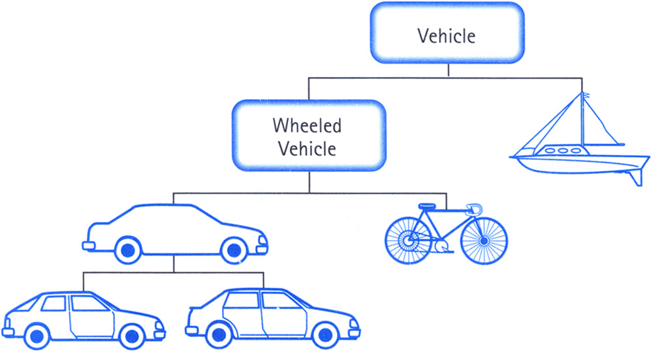
Class Inheritance
Idea: model our vehicle classes via a type hierarchy!
Classes can inherit methods and attributes from parent classes but extend into their own class.

Slide 19
Inheritance
Define a class as a specialization of an existing class
Inherent its attributes, methods (behaviors)
Add additional ones
Redefine (specialize) existing ones
Ones in superclass still accessible in its namespace

Slide 20
Python class statement
class ClassName:
<statement-1>
.
.
.
<statement-N>
class ClassName ( inherits / parent-class ):
<statement-1>
.
.
.
<statement-N>

Slide 21
Example
class BaseAccount:
def __init__(self, name, initial_deposit):
# Initialize the instance attributes
self._name = name
self._acct_no = Account._account_number_seed
Account._account_number_seed += 1
self._balance = initial_deposit
class CheckingAccount(BaseAccount): def __init__(self, name, initial_deposit):
# Use superclass initializer
BaseAccount.__init__(self, name, initial_deposit)
# Alternatively (recommended):
# super().__init__(name, initial_deposit)
# Additional initialization
self._type = "Checking"
CheckingAccount inherits from the BaseAccount class
BaseAccount is the “parent class” of the CheckingAccount class.
(jargon) CheckingAccount “extends” BaseAccount

Slide 22
Accessing the Parent Class: super()
super() binds methods in the parent or "superclass" to the current instance
Can be called anywhere in our class
Handles passing self to the method
Handles looking up an attribute on a parent class, too.
We can directly call ParentClass.method(self, …)
This is not quite as flexible if our class structure changes.
In general, prefer using super()!
Outside of C88C, things can get complex…
https://docs.python.org/3/library/functions.html#super

Slide 23
Accessing the Parent Class: super()
class Person:
def __init__(self, age):
self.age = age
def have_birthday(self):
self.age += 1
return f"Now I'm one year older: {self.age}!"
def have_fun(self):
return "Whee!"
class Employee(Person):
def __init__(self, age, company_name):
super().__init__(age)
self.company_name = company_name
def have_birthday(self):
out_super = super().have_birthday()
return out_super + f" Well, time for work at {self.company_name}!"
def have_fun(self):
return f"I can't have fun, I have to work at {self.company_name}!"
>>> youngster = Person(10)
>>> youngster.have_birthday()
Now I'm one year older: 11!
>>> youngster.have_fun()
Whee!
>>> employee = Employee(35, "BigCorp")
>>> employee.have_birthday()
Now I'm one year older: 36! Well, time for work at BigCorp!
>>> employee.have_fun()
I can't have fun, I have to work at BigCorp!

Slide 24
Object-Oriented Programming: Evolving The Bank Model

Slide 25
Composing Classes Together
Currently, our BaseAccount stores a lot of data in class attributes…
This suggests we are trying to accomplish an entirely new kind of class, or object
A Bank!
We should extract that these functions into their own class
A bank can now manage:
making accounts
keeping track of account numbers
showing and listing accounts
Demo: lecture15.py, BaseAccount + Bank class

Slide 26
Object-Oriented Programming: "Magic" Methods

Slide 27
Learning Objectives
Python's Special Methods define built-in properties
__init__ # Called when making a new instance
__sub__ # Maps to the - operator
__str__ # Called when we call print()
__repr__ # Called in the interpreter

Slide 28
Special Initialization Method
__init__ is called automatically when we write: my_account = BaseAccount('me', 0)
class BaseAccount:
def __init__(self, name, initial_deposit):
self.name = name
self.balance = initial_deposit
def account_name(self):
return self.name
def account_balance(self):
return self.balance
def withdraw(self, amount):
self.balance -= amount
return self.balance

Slide 29
More special methods: __repr__ vs __str__
class BaseAccount:
… (init, etc removed)
def deposit(self, amount):
self._balance += amount
return self._balance
def __repr__(self):
return '< ' + str(self._acct_no) +
'[' + str(self._name) + '] >'
def __str__(self):
return 'Account: ' + str(self._acct_no) +
'[' + str(self._name) + ']'
def show_accounts():
for account in BaseAccount.accounts:
print(account)
Goal: unambiguous
Goal: human readable

Slide 30
More special methods: __repr__ vs __str__
class BaseAccount:
... # Display representation
def __repr__(self):
return f'<{self.account_type()}: {self.account_name()}-{self.account_number()}>'
# Print representation
def __str__(self):
return f'{self.account_type()}: {self.account_name()}-{self.account_number()} Balance: {self._balance}'
# Tip: __repr__ vs __str__
# Python interpreter outputs repr()
>>> account_c
<BaseAccount: account_c-1000>
# print() calls str()
>>> print(account_c)
BaseAccount: account_c-1000 Balance: 9999
>>> str(account_c)
'BaseAccount: account_c-1000 Balance: 9999'
>>> repr(account_c)
'<BaseAccount: account_c-1000>'
__repr__ goal: unambiguous
__str__ goal: human readable

Slide 31
More Magic Methods
We will not go through an exhaustive list!
Magic Methods start and end with "double underscores" __
They map to built-in functionality in Python. Many are logical names:
__init__ → Class Constructor
__add__ → + operator
__sub__ → - operator
__getitem__ → [] operator
__repr__ and __str__ → control output
A longer list for the curious:
https://docs.python.org/3/reference/datamodel.html

Slide 32
Live Demo
Demo: lecture15.py, magic methods

Slide 33
Aside: opinions on OOP
Object oriented programming (OOP) got really popular in the 1980’s/1990’s.
Java (“what if EVERYTHING was a Class?”), C++ (“C with Classes”)
With hindsight, one learning is that OOP is not always the software paradigm
OOP is a great tool…for the right situation
some people have very strong opinions for and against OOP
Alternatives: functional (aka map/reduce/filter), imperative, declarative (SQL)
My advice: try to use the best tool for the problem at hand.
Avoid the “with a hammer, every problem looks like a nail” syndrome

Slide 34

Aside: opinions on coding. Any questions?
At the end of the day: it’s very hard to design programs the “right way”
A “good design” lets you be productive and solve problems. Feels great!
A “bad design” feels like you are suffocated by an unwieldy API, etc
This is an art! Like any craft, to get better at it you must practice
Experience + wisdom. (usually gained by learning through mistakes, heh)
“Your first 100 songs will suck. So, start writing and get them out of the way!” – advice on songwriting
100% the same for writing code!
Source: https://www.scotthyoung.com/blog/2019/08/26/better-writing-brainstorm/

