Slide 1
Lecture: Exceptions
Week 6, Summer 2024. 7/23 (Tues)

Slide 2
Announcements
Project02 (“Ants”) out!
Mid-point course survey out (optional, +2 extra credit points)
On Gradescope, named “Extra Credit Mid-semester Feedback”
Due: 7/29 11:59 PM PST

Slide 3
Learning Objectives
Exceptions give us a formal way to address error conditions
"Catch" exceptions in a Python Program
Define and Raise our own exceptions

Slide 4
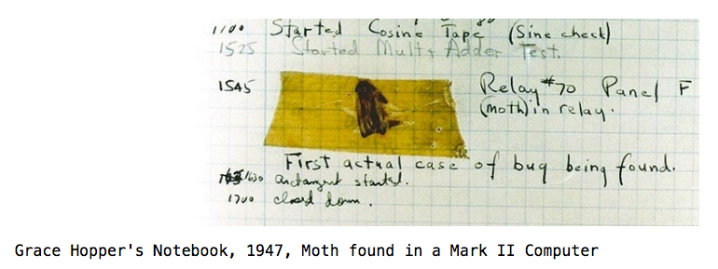
Errors Can Occur Just About Anywhere!
Function receives arguments of improper type?
Resources (e.g. files or some data) are not available
Network connection is lost or times out?

Slide 5
Error Handling Approach: int status code
Historically, there are simple (yet primitive) error handling approaches
int error codes: Each function returns (or sets) a status code to indicate whether a call failed/succeeded.
# Define int status codes
STATUS_CODE_SUCCESS = 0
STATUS_CODE_VIDEO_URL_INVALID = 1
STATUS_CODE_DOWNLOAD_FAILURE = 2
STATUS_CODE_DOWNLOAD_THROTTLED = 3
STATUS_CODE_VIDEO_IS_PRIVATE = 4
# ...many more...
def fetch_video(video_url):
if not is_valid_url(video_url):
return STATUS_CODE_VIDEO_URL_INVALID, None
download_status, video = download_video(video_url)
if download_status == STATUS_CODE_DOWNLOAD_FAILURE:
return STATUS_CODE_DOWNLOAD_FAILURE, None
elif download_status == STATUS_CODE_DOWNLOAD_THROTTLED:
return STATUS_CODE_DOWNLOAD_THROTTLED, None
if is_private(video):
return STATUS_CODE_VIDEO_IS_PRIVATE, None
return STATUS_CODE_SUCCESS, video

Slide 6
Error Handling Approach: Exceptions
Idea: add a new language feature for error handling
Called “Exceptions”
Pros
Exceptions keep track of where in the code the error came from (eg function name, line number). Very useful for debugging
Cons
Requires language support. Implementation is nontrivial
def fetch_video(video_url):
if not is_valid_url(video_url):
raise InvalidUrl(video_url)
video = download_video(video_url)
if is_private(video):
raise VideoIsPrivate(video_url)
return video
`download_video()` may throw its own exceptions like “VideoNotFound” or “DownloadThrottled”
New Python syntax: `raise`! Syntax for raising (aka throwing) an Exception

Slide 7
Raise statement
Exception are raised with a raise statement
raise <exception>, e.g.:
raise NameError(f"The property {name} does not exist")
<expression> must evaluate to a subclass of BaseException or an instance of one
Exceptions are constructed like any other object
TypeError(‘Bad argument’)
Raise Exceptions for unrecoverable errors!
Something bad has gone on and you cannot continue.

Slide 8
What does an Exception look like? Example exceptions (Docs)
Unhandled, "thrown" back to the top level interpreter
Or halt the program
>>> 3/0
Traceback (most recent call last):
File "<stdin>", line 1, in <module>
ZeroDivisionError: division by zero
>>> str.lower(1)
Traceback (most recent call last):
File "<stdin>", line 1, in <module>
TypeError: descriptor 'lower' requires a 'str' object but received a 'int'
>>> ""[2]
Traceback (most recent call last):
File "<stdin>", line 1, in <module>
IndexError: string index out of range
>>>
Exceptions contain useful info:
Exception name/message. Tells you what went wrong.
Error location. Tells you exactly where in the code the Exception was thrown (`raise`).

Slide 9
What does an Exception look like? Example exceptions (Docs)
def square_sum_nums(lst_nums):
if not isinstance(lst_nums, list):
raise TypeError(f"Expected list, got: {type(lst_nums)}")
return sum(map(lambda num: num ** 2, lst_nums))
def fn_a():
my_var = 42
x = square_sum_nums(my_var)
return x + 2
Exceptions contain useful info:
Exception name/message. Tells you what went wrong.
Error location. Tells you exactly where in the code the Exception was thrown (`raise`).
>>> fn_a()
Traceback (most recent call last):
File "<stdin>", line 1, in <module>
File ".\lecture19.py", line 36, in fn_a
x = square_sum_nums(my_var)
File ".\lecture19.py", line 31, in square_sum_nums
raise TypeError(f"Expected list, but got: {type(lst_nums)}")
TypeError: Expected list, but got: <class 'int'>

Slide 10
Reading A "Stack Trace" or "Traceback" (Docs)
All errors in Python should return some structured feedback.
Errors may be dense but contain some really helpful information!
👉 python3 -i 18-Exceptions.py
What is your age? 5
Catching CS88Error
Traceback (most recent call last):
File "…Exceptions.py", line 24, in <module>
get_age_in_days()
File "…", line 20, in get_age_in_days
raise e
File "…", line 14, in get_age_in_days
raise CS88Error('You seem young!')
__main__.CS88Error: You seem young!
Pro Tip: learning how to read an error stack trace is an extremely useful skill that will help you in this class, your other classes, and your future career.
(aka don’t just “eye-glaze” when faced with a stack trace)

Slide 11
What do Exceptions do? Exceptional exit from functions
Function doesn’t “return” but instead execution is thrown out of the function
>>> def divides(x, y):
... return y % x == 0
...
>>> divides(0, 5)
Traceback (most recent call last):
File "<stdin>", line 1, in <module>
File "<stdin>", line 2, in divides
ZeroDivisionError: integer division or modulo by zero
>>> def get(data, selector):
... return data[selector]
...
>>> get({'a': 34, 'cat':'9 lives'}, 'dog')
Traceback (most recent call last):
File "<stdin>", line 1, in <module>
File "<stdin>", line 2, in get
KeyError: 'dog'
>>>

Slide 12
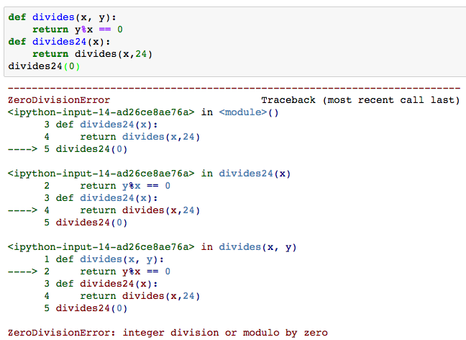
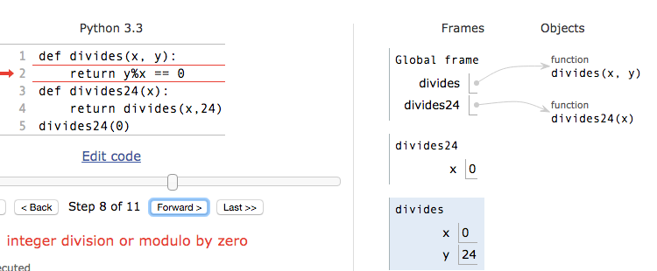
Continue out of multiple calls deep
Stack “unwinds” until exception is handled or we reach the top level frame (program crash!)

Slide 13
Flow of control stops at the exception
And is ‘thrown back’ to wherever it is caught, by default no where.
def throws_exception():
raise Exception("lol")
print("Never gets here")
return 42
>>> x = throws_exception()
Traceback (most recent call last):
File ".\lecture19.py", line 44, in <module>
x = throws_exception()
File ".\lecture19.py", line 41, in throws_exception
raise Exception("lol")
Exception: lol
>>> x
Traceback (most recent call last):
File "<stdin>", line 1, in <module>
NameError: name 'x' is not defined
This print statement never happens, as the Exception interrupts the execution and “jumps” out of the function back to the caller
Important: `x` is never assigned to! The Exception interrupted the assignment statement.
A sign that Exceptions in Python are indeed a Special Thing

Slide 14
Types of exceptions
Exceptions are just classes in Python, with common types for ease of use / clarity.
All inherit from BaseException
AssertionError – The of exception raised by a failing assert statement
TypeError -- A function was passed the wrong number/type of argument
NameError -- A name wasn't found
KeyError -- A key wasn't found in a dictionary
RuntimeError -- Catch-all for troubles during interpretation
Your own exceptions!

Slide 15
Assert Statements
Allow you to make assertions about assumptions that your code relies on
Use them liberally!
Incoming data is "dirty" and unsafe till you’ve "cleaned" it
They "do nothing" if the statement is true.
Raise an exception of type AssertionError
You can turn them off:
Ignored in optimize flag: python3 –O …
Governed by bool __debug__
assert <assertion expression>, <string for failed>
def divides(x, y):
assert x != 0, ”Denominator must be non-zero”
return y % x == 0

Slide 16
Handling Exceptions
What if I wanted to try to recover from an Exception?
Try/except to the rescue!
def fetch_video_recover(video_url):
if not is_valid_url(video_url):
raise InvalidUrl(video_url)
try:
video = download_video(video_url)
except DownloadFailed:
# wait for 2 seconds, and try again
# if this 2nd try fails, then fail
# the entire function call
import time
time.sleep(2) # wait for 2 seconds
video = download_video(video_url)
if is_private(video):
raise VideoIsPrivate(video_url)
return video
def fetch_video_recover(video_url):
if not is_valid_url(video_url):
raise InvalidUrl(video_url)
# Idea: if video download fails,
# wait 2 seconds and retry...
video = download_video(video_url)
if is_private(video):
raise VideoIsPrivate(video_url)
return video
New Python syntax: `try`, `except`

Slide 17
Handling Errors – try / except
Wrap your code in try – except statements
Execution rule
<try suite> is executed first
If during this an exception is raised and not handled otherwise
And if the exception inherits from <exception class>
Then <except suite> is executed with <name> bound to the exception
Control jumps to the except suite of the most recent try that handles the exception
try:
<try suite>
except <exception class> as <name>:
<except suite>
... # continue here if <try suite> succeeds w/o exception

Slide 18
Demo: safe_apply_fn
def safe_apply_fn(f, x, y):
try:
return f(x, y)
except Exception as e:
return e
def divides(x, y):
assert x != 0, "Bad arg to divides, denom must be non-zero"
if (type(x) != int or type(y) != int):
raise TypeError("divides only takes integers")
return y % x == 0
>>> divides(0, 3)
Traceback (most recent call last):
File "<stdin>", line 1, in <module>
File ".\lecture19.py", line 82, in divides
assert x != 0, "Bad arg to divides, denom must be non-zero"
AssertionError: Bad arg to divides, denom must be non-zero
>>> safe_apply_fn(divides, 3, 9)
True
>>> safe_apply_fn(divides, 0, 9)
Bad arg to divides, denom must be non-zero
>>> safe_apply_fn(divides, 'hi', 42)
divides only takes integers

Slide 19
Exceptions are Classes
class NoiseyException(Exception):
def __init__(self, stuff):
print("Bad stuff happened", stuff)
class CS88Error(Exception):
pass # The one time you can skip init. ;)
try:
return fun(x)
except:
raise NoiseyException((fun, x))

Slide 20
Summary
Approach use of exceptions as a design problem
Meaningful behavior => methods [& attributes]
ADT methodology: What should a function do?
What’s private and hidden? vs What’s public?
Use it to streamline development
Anticipate exceptional cases and unforeseen problems
try … except
raise / assert

