Slide 1

Wrap Up
(Starting Berkeley Time!)

Slide 2
Announcements
Final Exam Next Week
Seating assignments out this week (we'll be in 2-3 rooms)
Remember to wrap up assignments

Slide 3
Final Exam Information
Time: Tues 11:30 AM -2:30 PM
We'll be split in 3 rooms; emails to be sent later week
Confirmations on accommodations, alt times sent soon.
Similar to Midterm!
Fall 2022 was done on Gradescope, but is very different. Topically good practice.
Clobber Policy:
If you improve upon your midterm score, your midterm score goes up
Everything in class is in scope, but focus on post-midterm topics.

Slide 4
Is Your Brain Full Yet?
Data: values, literals, operations,
Functions
Variables
List, Tuples, Dictionaries
Function Definition Statement
Conditional Statement
Iteration: list comp, for, while
Lambda function expr.
Higher Order Functions
Higher order function patterns
Map, Filter, Reduce
Recursion
Abstract Data Types
Mutation
Class & Inheritance
Exceptions
Iterators & Generators
SQL / Declarative Programming

Slide 5
Grading Updates
http://howamidoing.c88c.org/
We will periodically update over the next weeks.
Sum everything up!
Lecture Self-Checks
Basically everyone should 20/20 on the lecture self-checks. That's the point. ☺
Correctness does count! Resubmit open ones, if you haven't gotten them right. (No late penalty!) Lateness does not matter
There are 27 self-checks which means you could have skipped 6 lectures
There's a few "bonus" ones on Gradescope, just from different semesters that are optional practice, but can get you to 20 pts if you need.

Slide 6
Wrap Up

Slide 7
CONGRATULATIONS!!

Slide 8
Final Review

Slide 9
Approaching The Exam
Skim the topics (~1 min)
Handle the "easy"(est) questions first
Read the whole question first!
Read the text
Read the doctests!
What techniques might be applicable?
Pattern matching is OK
Draft a solution on scratch paper!
Write yourself notes

Slide 10
Spring 2022 – Question 5 - cascade
5. (6.0 points) Cascading Numbers
Complete the function cascade, which takes in an integer base, a function fn, and a non-negative integer count. cascade returns a sequence of numbers starting with base, fn(base), fn(fn(base)), . . . and so on, count number of times and then continues the sequence in reverse back to base.
if count == 0:
return _______________________________
elif count == 1:
return _______________________________
else:
middle = cascade(____________________________)
return ______________________________

Slide 11
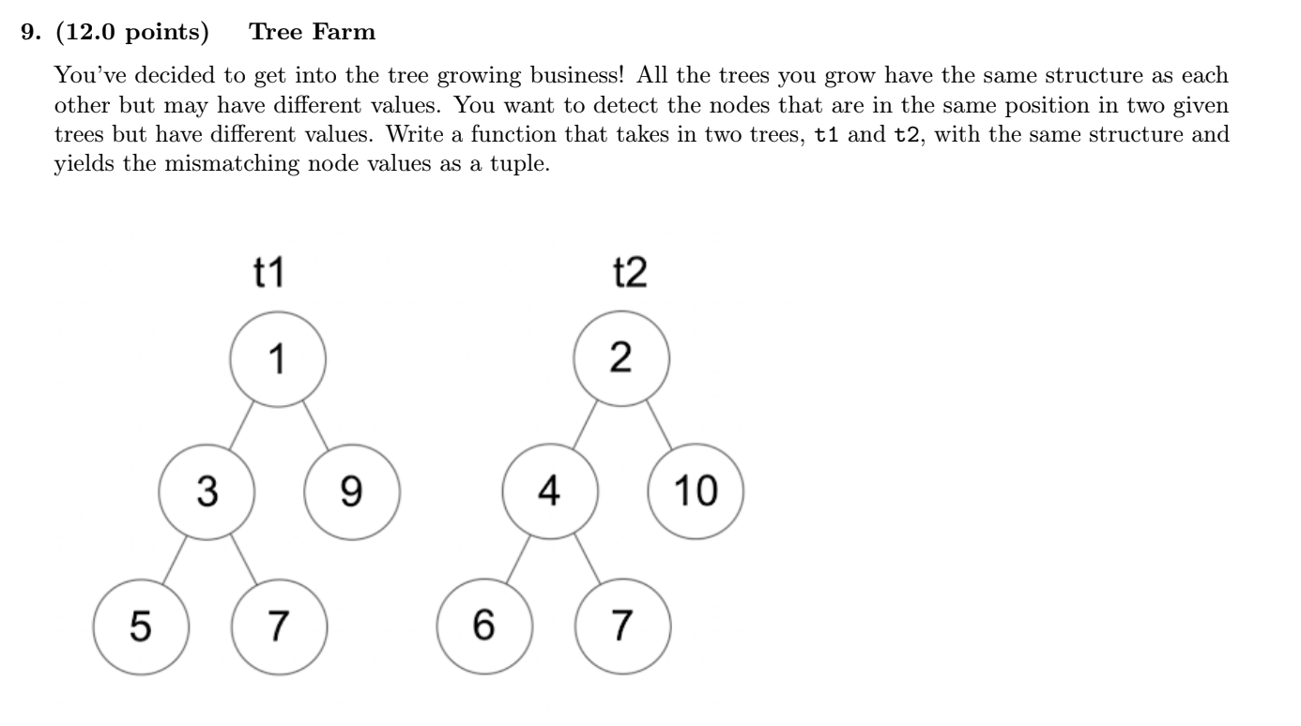
Fall 2021 Q9 – Tree Farm

Slide 12
THANK YOU!

Slide 13
COME JOIN COURSE STAFF!

Slide 14
The One Big Thing…

Slide 15

Abstraction
Detail removal
“The act of leaving out of consideration one or more properties of a complex object so as to attend to others.”
Generalization
“The process of formulating general concepts by abstracting common properties of instances”
Technical terms: Compression, Quantization, Clustering, Unsupervised Learning
Henri Matisse “Naked Blue IV”

Slide 16
Keep on Programming

Slide 17
LOTS of Courses to Follow Up! [Courses]
Explore all the DS connectors
Data 88E (Econ)
Stat 88 / DATA C88S
Data 100: Principles of DS
Data 101: Data Engineering
Data 102: Data, Inference, and Decisions
Data 104: Human Context and Ethics
Data 140: Probability
INFO – Course Schedule Varies!
INFO C103 in Spring: "History of Information"
Some Database courses, web development, etc.

Slide 18
CS Courses
CS61B: (conventional) data structures, statically typed production languages.
CS61C: computing architecture and hardware as programmers see it.
CS70: Discrete Math and Probability Theory.
CS170, CS171, CS172, CS174: “Theory”—analysis and construction of algorithms, cryptography, computability, complexity, combinatorics, use of probabilistic algorithms and analysis.
CS161: Security
CS162: Operating systems.
CS164: Implementation of programming languages
CS168: Introduction to the Internet
CS160, CS169: User interfaces, software engineering
CS176: Computational Biology

Slide 19
CS Courses Part 2
* CS182, CS188, CS189: Neural networks, Artificial intelligence, Machine Learning
CS184: Graphics
CS186: Databases
CS191: Quantum Computing
CS195: Social Implications of Computing
EECS 16A, 16B: Designing Information Systems and Devices
EECS 126: Probability and Random Processes
EECS149: Embedded Systems
EECS 151: Digital Design
CS194: Special topics. (e.g.) computational photography and image manipulation, cryptography, cyberwar.
Plus graduate courses on these subjects and more.

Slide 20
EE Courses Are There Too
EE105: Microelectronic Devices and Circuits.
EE106: Robotics
EE118, EE134: Optical Engineering, Photovotalaic Devices.
EE120: Signals and Systems.
EE123: Digital Signal Processing.
EE126: Probability and Random Processes.
EE130: Integrated Circuit Devices.
EE137A: Power Circuits.
EE140: Linear Integrated Circuits (analog circuits, amplifiers).
EE142: Integrated Circuits for Communication.
EE143: Microfabrication Technology.
EE147: Micromechanical Systems (MEMS).
EE192: Mechatronic Design.

Slide 21
Personal Course Recommendations
INFO C103
Computational Photography – especially if you like photoshop
HCE Courses
History, Poli Sci, Psychology
LS110 Brilliance of Berkeley (Spring)
https://curricularconnections.berkeley.edu/ls110/
An 'experiment' of sorts, but seems cool

Slide 22
What's next? (Otherwise)
Programming contests
Hackathons
More paradigms and languages: the web
The open-source world: Go out and build something!
Above all: Have fun!

Slide 23
And there's lots more to Python!

Slide 24
What can you do with Python?
Almost anything!
Webapp backends
Web scraping
Natural Language Processing
Data analysis
Machine Learning
Scientific computing
Games

Slide 25
What can you do with Python?
Almost anything! Thanks to libraries!
Don't try to memorize libraries, learn how to learn how to use them!
Webapp backends (Flask, Django)
Web scraping (BeautifulSoup)
Natural Language Processing (NLTK)
Data analysis (Numpy, Pandas, Matplotlib)
Machine Learning (FastAi, PyTorch, Keras)
Scientific computing (SciPy)
Games (Pygame)

Slide 26
(Reminder) Peer Resources: Join Ed!
https://eecs.link/data001 - Data 001 Ed Group
https://eecs.link/eecs101 - EECS 101 Ed Group

Slide 27
Ask Us Anything!

Slide 28
THANK YOU!
(Again!)

