Slide 1

Suzanna Kangas
Daniel Leblanc
Lucas Berge
Fredrik Fostvedt
Joseph Schutz
Eric Smith

Slide 2



















Slide 3
Comic Rocket
Over 12,000 titles indexed
4.1% more titles per month
More than 1.5 million pages
5.3% more pages per month
Unique visitors climbing by 30% per month

Slide 4
Comic Rocket
Web Comics
Comic Rocket
End Users

Slide 5
Rocket Booster
Web Comics
Comic Rocket
End Users
Rocket Booster

Slide 6
Rocket Booster
Manage Comic Rocket’s interaction with the web
Cache all pages
Check for new comics
Check for updates to old comics
Limit number of checks

Slide 7
Rocket Booster Architecture
Scheduler
HTTP Listener
Predictor
Compare
Notification
Cache
Page Tree
HTTP Fetch
Fetch Web
Web
Comic Check
Test Server

Slide 8
Planned Timeline
Planning
Initial setup
Git repository
Coding and Unit Testing
Individual coding
Initial design
Project analysis
Task breakdown
Risk assessment
Coding standards
Function names
Handling issues
Project Assembly
Project Testing
Combining units into a whole
Test Server
Testing code
Scripted Tests
Dealing with issues that arise
Cache compression
Additional functionality
Feb 11, 2013 – Mar 11, 2013
Jan 28, 2013 – Feb 11, 2013
Nov 26, 2012 – Jan 28, 2012
Nov 19, 2012 – Nov 26, 2012
Oct 15, 2012 – Nov 19, 2012
Initial Design

Slide 9
Actual Timeline
Planning
Initial setup
Git repository
Coding and Unit Testing
Individual coding
Initial design
Project analysis
Task breakdown
Risk assessment
Coding standards
Function names
Handling issues
Project Assembly
Project Testing
Combining units into a whole
Testing code
Scripted Tests
Dealing with issues that arise
Feb 25, 2013 – Mar 13, 2013
Feb 11, 2013 – Feb 25, 2013
Nov 26, 2012 – Feb 11, 2013
Nov 19, 2012 – Nov 26, 2012
Oct 15, 2012 – Nov 19, 2012
Time compression
Initial Design

Slide 10
Daniel Leblanc
Scheduler
HTTP Listener
Predictor
Compare
Notification
Cache
Page Tree
HTTP Fetch
Fetch Web
Web
Comic Check
Test Server

Slide 11
Scheduler
Keeps track of history checking
Continuous loop of all comics
Checks at most 20 per hour per domain
Checks the list of comics provided by the Predictor every hour
Getting it to terminate was a challenge

Slide 12
HTTP Requester
Pretends to be Jamey
Receives notifications and responds with HTTP requests
Keeps track of bad notifications and missed updates

Slide 13
What I Learned
Mitigating risks
Explaining a technical idea can be challenging

Slide 14
Fredrik Fostvedt
Scheduler
HTTP Listener
Predictor
Compare
Notification
Cache
Page Tree
HTTP Fetch
Fetch Web
Web
Comic Check
Test Server

Slide 15
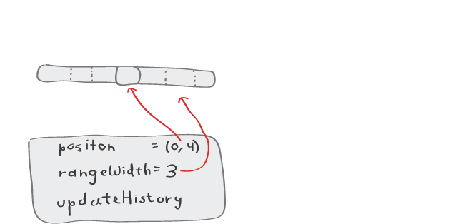
Predictor Structure

Slide 16
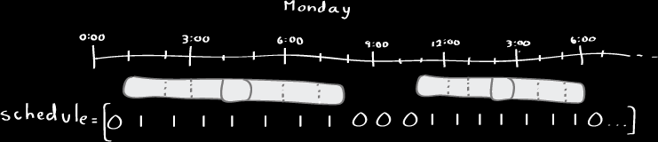
Predictor Structure

Slide 17
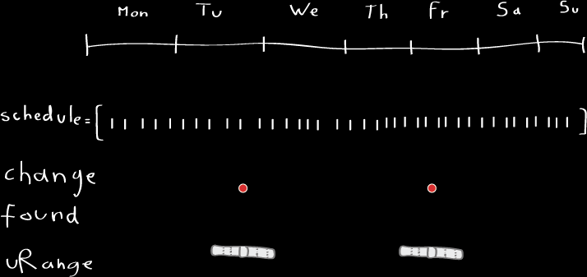
Predictor Building

Slide 18
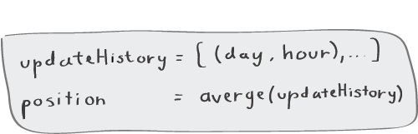
Predictor Learning

Slide 19
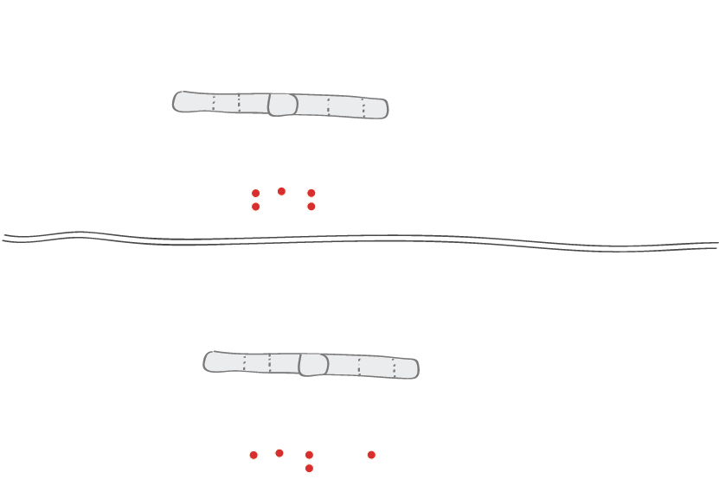
Predictor Learning

Slide 20

Predictor Scheduling

Slide 21
Suzanna Kangas
Scheduler
HTTP Listener
Predictor
Compare
Notification
Cache
Page Tree
HTTP Fetch
Fetch Web
Web
Comic Check
Test Server

Slide 22
Cache
Stores page versions for comparison
Retrieve any past version
Revision pushing
File structure of storage
No compression currently

Slide 23
Page Tree
Internal representation of a web page
Readily extensible

Slide 24
What I Learned
Python
Working with a team
Got a glimpse of how important testing can be

Slide 25
Lucas Berge
Scheduler
HTTP Listener
Predictor
Compare
Notification
Cache
Page Tree
HTTP Fetch
Fetch Web
Web
Comic Check
Test Server

Slide 26
HTTP Listener
What it is
Modified SimpleHTTPRequestHandler
What it does
Runs on a separate thread waiting for requests
Searches Cache for comicID, gets from Web if not found
Allows a user to send commands to predictor
Internal notifications

Slide 27
Fetch HTTP
What it is
Checks cache for a page, requests from Web if not found
What it does
Asks for a pointer to the object, if none call FetchWeb

Slide 28
Fetch Web
What it is
HTTP Client that constructs pageTree objects and stores them in the cache
What it does
Requests objects with urllib2
Parses out all links with BS4
Constructs a pageTree object and caches it with ComicID key
Internal notifications

Slide 29
What I Learned
GitHub basics
Not the most user friendly
Python
Great language
Libraries
More useful when you know how they work

Slide 30
GitHub
Commit Often!
Even if you don’t like what you have
Conflicts
Stash and pull
Use the shell
Don’t be afraid to break everything

Slide 31
Python
No prior experience
Easy to understand syntax
Lots of support and documentation
Human readable libraries!
2.7 vs 3.0
Urllibs
Whitespace
My new language of choice

Slide 32
Libraries
Urllib2
BaseHTTPServer
BeautifulSoup
Threading
Read Manuals, Look at examples, debug objects, delve into library code

Slide 33
Eric Smith
Scheduler
HTTP Listener
Predictor
Compare
Notification
Cache
Page Tree
HTTP Fetch
Fetch Web
Web
Comic Check
Test Server

Slide 34
Compare
Compares two pages and reports if they are different
Three iterations:
Page Data
Hash value
Links

Slide 35
Notification
Sends a message to Jamey via Rabbitmq
Two iterations:
New comic notifications only, list of notifications sent
General notifications (new comic, error, etc…), no list

Slide 36
Comic Check
newComic & histComic
Wrapper functions that call the other functions
Three iterations:
Latest three
One by one
List based

Slide 37
Joseph Schutz
Scheduler
HTTP Listener
Predictor
Compare
Notification
Cache
Page Tree
HTTP Fetch
Fetch Web
Web
Comic Check
Test Server

Slide 38
Challenges
Web Comics updated slowly.
Web Comics update in uncontrollable ways
Most Web Comics don’t appreciate extra bandwidth from “testing”

Slide 39
Solution
Fake HTTP Server
Comic Rocket Fetch Web
Fake Jamey
Database
Add Page
Add Comment
Template Engine
Page Engine
Comment Engine

Slide 40
Solution
Template Engine
Builds a page, with {key = value} pairs
Builds comments in a similar manner
Crontab
Scheduler to run scripts at specific times, ie updates for comics or comment insertion
Hosts File
Redirects specific domains to 127.0.0.1 (or localhost)
Http Server
Parses specific domains, and calls the template engine to build the page

Slide 41
Testing the Rocket Booster
Time Scale
First Scale: 1 hour = 75 sec
Second Scale: 1 hour = 5 sec
Update Schedules
Uniform Schedule
Variable Schedule
Comments
HTML Diff
Link Diff

Slide 42
Future Enhancements
Should be easily extensible to store more page information
Compression of the cache
Filter out unimportant changes

