Slide 1

Suzanna Kangas
Daniel Leblanc
Lucas Berge
Fredrik Fostvedt
Joseph Schutz
Eric Smith

Slide 2





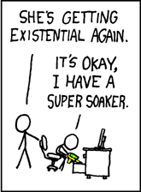













Slide 3
Project Overview
Improve update response time
Notice when a comic has released a new page
Predict when new pages will be released
Store comic histories
Archive pages
Keep track of changes to old pages

Slide 4
Key Assumptions
All changes are important changes
Even minor alterations need to get reported
No following links
Comic Rocket’s code handles what links to follow
Just find changes

Slide 5
Initial Design
Scheduler
New Comic Check
Compare
Store Cache
History Check
Fetch Cache
HTTP Listener
HTTP Fetch
Fetch Web
Web
Cache
HTML Parser
Predictor

Slide 6
Development Process
Iterative waterfall
Inception and planning
Elaboration and initial setup
Coding and unit testing
Product assembly
Testing
Delivery

Slide 7
Suzanna Kangas
Scheduler
New Comic Check
Compare
Store Cache
History Check
Fetch Cache
HTTP Listener
HTTP Fetch
Fetch Web
Web
Cache
HTML Parser
Predictor

Slide 8
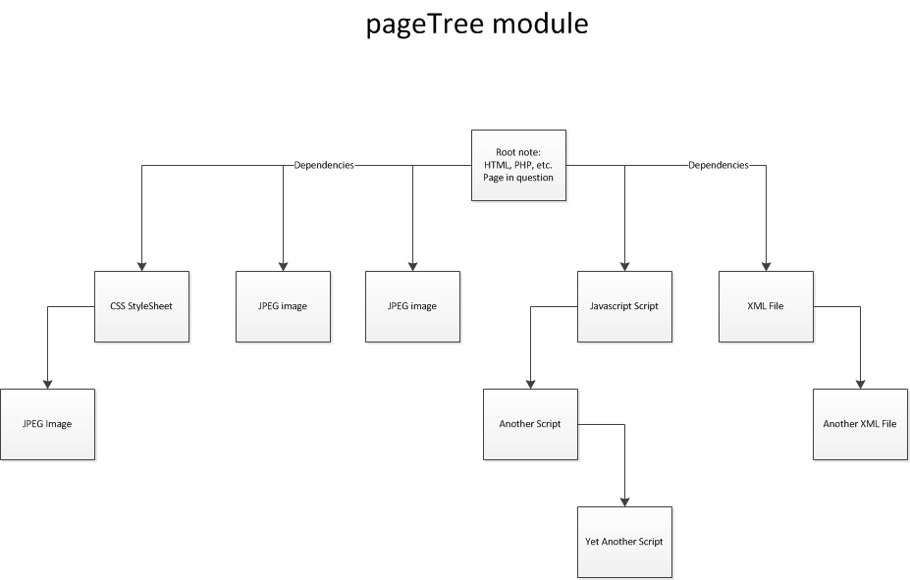
PageTree Design

Slide 9
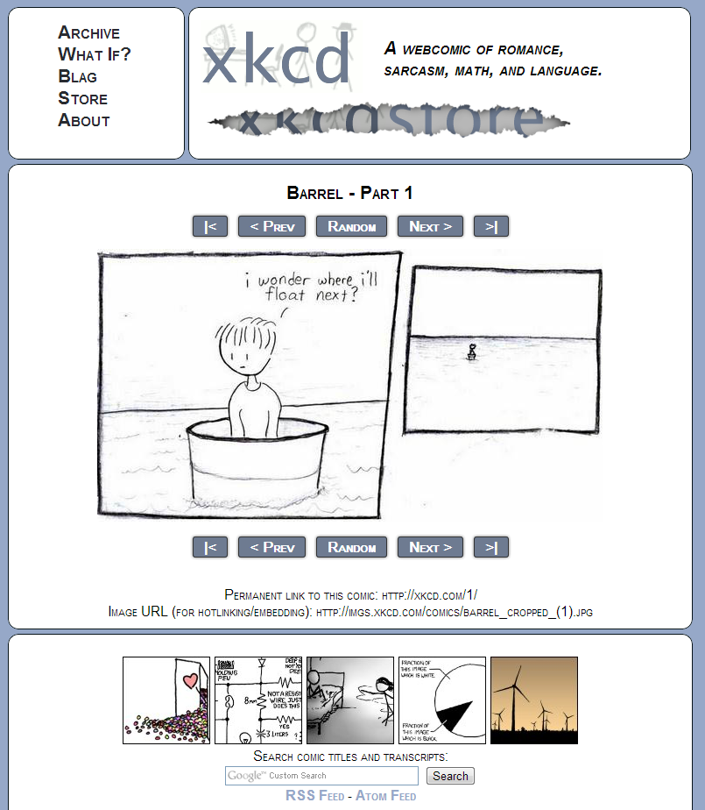
PageTree Design

Slide 10
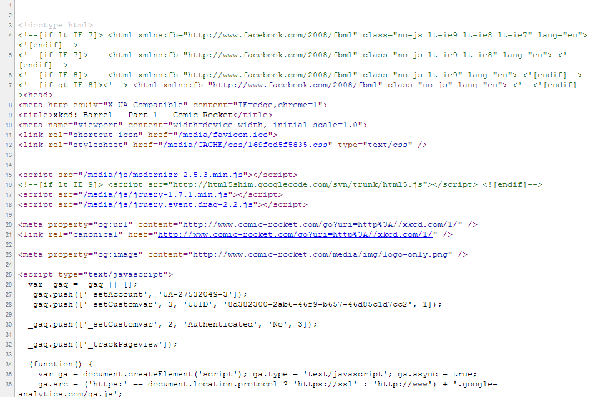
PageTree Design

Slide 11
PageTree Design

Slide 12
Eric Smith
Scheduler
New Comic Check
Compare
Store Cache
History Check
Fetch Cache
HTTP Listener
HTTP Fetch
Fetch Web
Web
Cache
HTML Parser
Predictor

Slide 13
Update Checking
Compare:
Compares Cache and Web versions of the site
NewComicCheck
HistoryCheck
Notify
Sends a notification to the existing code to update the comic

Slide 14
Fredrik Fostvedt
Scheduler
New Comic Check
Compare
Store Cache
History Check
Fetch Cache
HTTP Listener
HTTP Fetch
Fetch Web
Web
Cache
HTML Parser
Predictor

Slide 15
Scheduler and Predictor

Slide 16
Lucas Berge
Scheduler
New Comic Check
Compare
Store Cache
History Check
Fetch Cache
HTTP Listener
HTTP Fetch
Fetch Web
Web
Cache
HTML Parser
Predictor

Slide 17
HTTP Responder
HTTP Listener
Waits for requests in a separate thread
Takes no input, passes requested URL and image flags
Page Fetch
Takes a URL and image flag
Searches for page in cache, calls Web Fetch
Returns a PageTree object
Web Fetch
Takes a URL and image flag
Fetches a page from the web and creates a PageTree object
HTML Parser
BeautifulSoup

Slide 18
Test Server
Distribute fake Pages
Hosts file
Specialized content
Correct link patterns
Crontab adds content

Slide 19
Planned Schedule
Planning
Initial setup
Git repository
Coding and Unit Testing
Individual coding
Initial design
Project analysis
Task breakdown
Risk assessment
Coding standards
Function names
Handling issues
Project Assembly
Project Testing
Combining units into a whole
Test Server
Testing code
Scripted Tests
Dealing with issues that arise
Cache compression
Additional functionality
Feb 11, 2013 – Mar 11, 2013
Jan 28, 2013 – Feb 11, 2013
Nov 26, 2012 – Jan 28, 2012
Nov 19, 2012 – Nov 26, 2012
Oct 15, 2012 – Nov 19, 2012

Slide 20
Risk Management
Predictor
Testing in a realistic environment is challenging
Unsupervised machine learning
How to handle incorrect predictions
Scalability
Total number of comics is increasing quickly
Our project needs to scale with the increasing number of comics

Slide 21
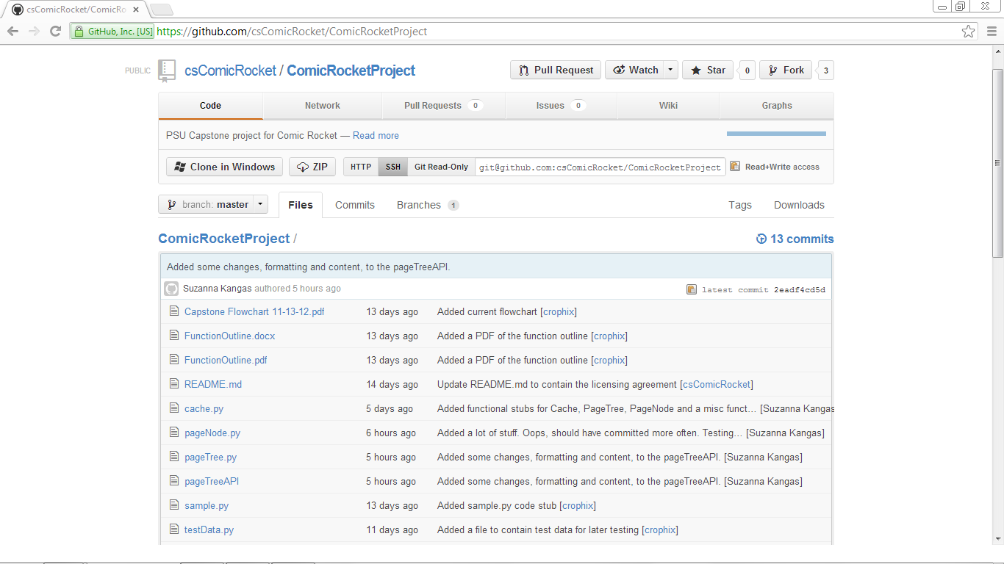
Deliverables

