Slide 1

Enhancing Financial Inclusion through Mobile Money in Kenya
Analyzing Progress, Challenges, and Opportunities

Slide 2

Introduction & Problem Statement
Mobile Money Success
Kenya is a global leader in mobile money adoption, with usage reaching 82.3% of adults by 2024.
Mobile money has significantly closed the gender gap and expanded access in rural areas.
Problem Statement
Despite high adoption, 9.9% of adults remain financially excluded, especially rural youth (45.5%).
Key barriers: lack of mobile phones, national ID cards, and digital literacy.
Growing debt distress and fraud concerns threaten sustainable inclusion.

Slide 3
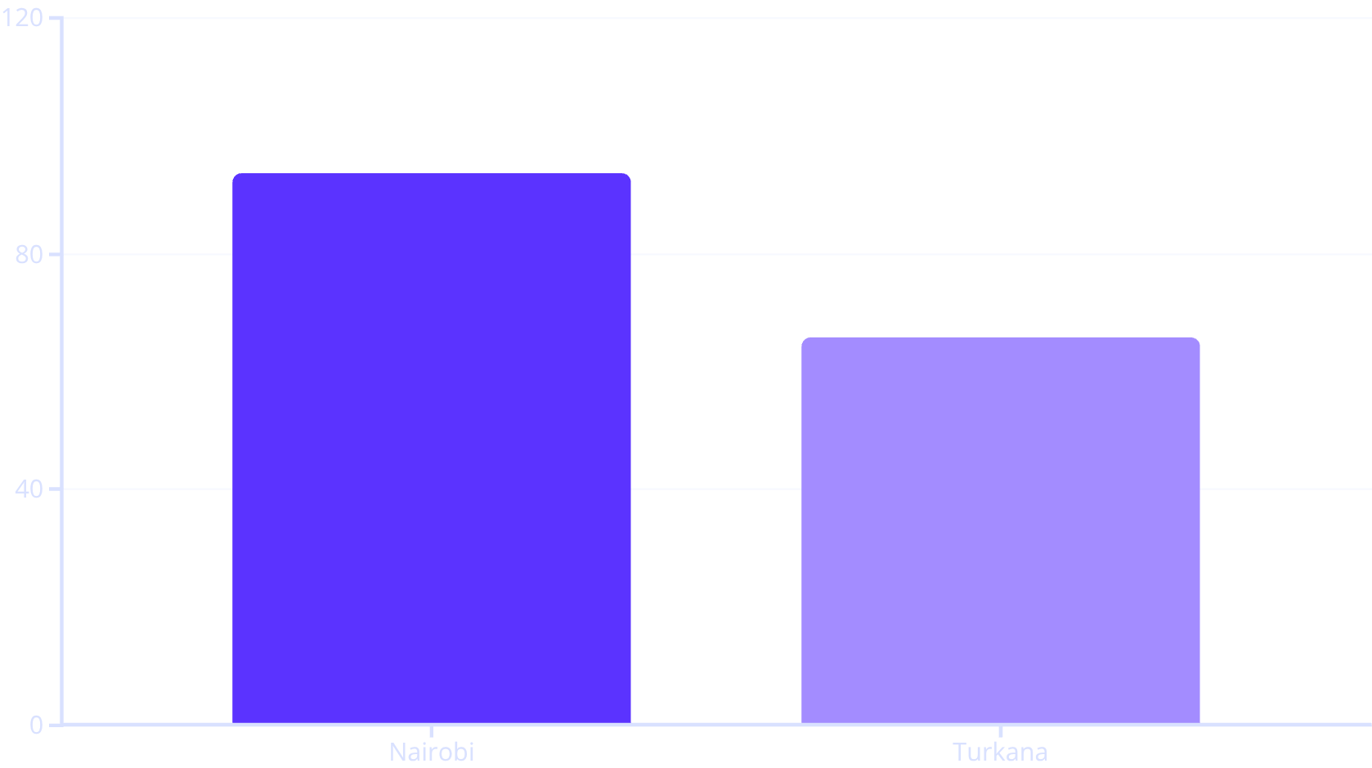
Research & Analysis Key Findings from FinAccess 2024
Demographic Insights
Youth (18–25) and PWDs (Persons with Disabilities) have significantly lower financial health and access rates.
Usage Trends
Daily usage of mobile money doubled to 52.6% from 23.6% in 2021
Mobile money empowers underserved demographics through digital accessibility
Main Barriers to Deeper Usage
Affordability (service fees, overdraft charges like Fuliza)
Trust concerns (9.8% of users lost money)
Eligibility restrictions (phone ownership, documentation)
Regional disparities: Turkana (65.9%) vs. Nairobi (93.7%) in formal inclusion.

Slide 4
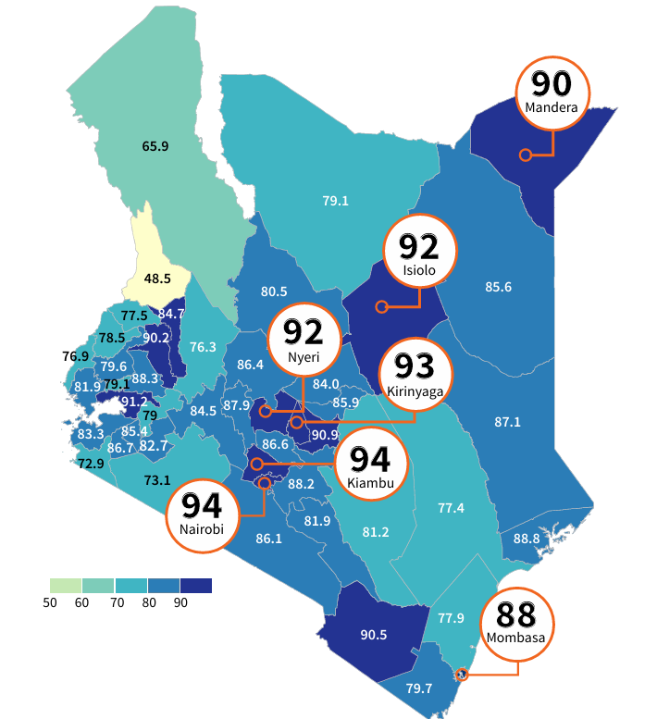



Summary Report
Strengths of Mobile Money
Expands financial access where brick-and-mortar fails
Offers daily liquidity, payments, and access to government services
Weaknesses & Loopholes
Debt risks: Fuliza default rate rose to 16.6%
Limited financial literacy: Only 42.1% scored high on financial literacy questions
Exclusion Persists In
Digital-only approaches that assume tech readiness
Non-interoperability between platforms
Impact: Mobile money was pivotal in climate finance investments and emergency resilience, but access doesn't equal empowerment.

Slide 5
Actionable Recommendations
1
2
3
Improve Device & ID Access
Strengthen Consumer Protection & Transparency
Invest in Digital Financial Literacy
Government/private sector to expand subsidized mobile phone programs & facilitate youth ID registration.
Enforce clearer terms on overdraft charges & data usage; penalize fraud.
Scale up community workshops and integrate curriculum in rural schools.
4
5
Design Inclusive Products for Youth & PWDs
Promote County-Level Innovation
Incentivize counties with lowest inclusion to collaborate with mobile money providers for localised solutions.
Build interoperable, low-cost savings, credit & insurance bundles tailored for vulnerable groups.

Slide 6



Thank You.
PS: Safaricom, Airtel and Telkom Please Hire Us.

