Slide 1

Copernicus Hackathon
@ Danube Hack 2018
Copernicus by newbies:
SK LAU1 WASTE SCRAPPER
Csaba SIDOR

Slide 2
Copernicus Hackathon @ Danube Hack 2018
Motivation of a noob
1. Use available Copernicus data within the European Tourism Indicator System dataset template
Copernicus | European Tourism Indicator System
https://land.copernicus.eu/global/themes/vegetation | Dominant habitats & Level of biodiversity Urban:____________ Sand/shingle beach:____ Moor/heathland: ____ Farmland:_______ Forest/Woodland:______ Alpine:_________ Scrubland:______ Desert: ________ Wetland:_______ Other (please describe): _____________________
https://cds.climate.copernicus.eu/#!/home | Average sunshine hours Summer: ________ Winter: _________
https://cds.climate.copernicus.eu/#!/home | Percipation Summer: ________ Winter: _________
https://cds.climate.copernicus.eu/#!/home https://land.copernicus.eu/global/products/lst | Seasonal temperatures Summer: Day: ___°C Night: ___°C Winter: Day: ___°C Night: ___°C
Additional datasets that could expand the use of ETIS for monitoring destinations at local level: Change of air quality: https://cds.climate.copernicus.eu/cdsapp#!/dataset/satellite-ozone?tab=overview https://cds.climate.copernicus.eu/cdsapp#!/dataset/satellite-carbon-dioxide?tab=overview https://cds.climate.copernicus.eu/cdsapp#!/dataset/satellite-methane?tab=overview Water bodies’ change and quality used by tourists/visitors: https://cds.climate.copernicus.eu/cdsapp#!/dataset/sis-water-quality-swicca?tab=overview https://cds.climate.copernicus.eu/cdsapp#!/dataset/sis-water-quantity-swicca?tab=overview https://land.copernicus.eu/global/products/wl

Slide 3
Copernicus Hackathon @ Danube Hack 2018
SPOILER ALERT or what the noob did / did not manage
Did manage to connect to some of the APIs or download the data.
Since it was first time experience with NetCDF¹, the noob had to move to Plan B:
SK LAU1 WASTE SCRAPPER
¹ At the end of the hackahton did get a good tutorial on NetCDF, so tangible outcomes of the original motivation are coming soon.

Slide 4
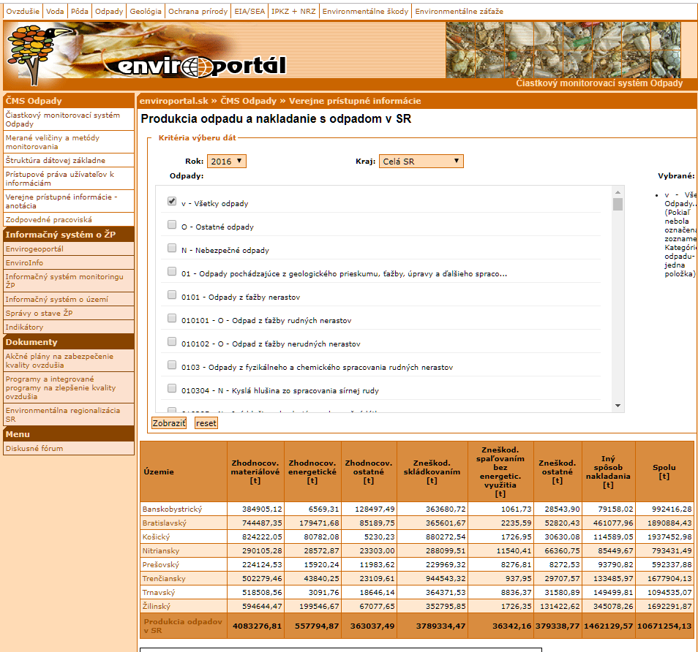
Copernicus Hackathon @ Danube Hack 2018
SK LAU1 WASTE SCRAPPER
Motivation:
1. Create an example of open data’s (Waste management) subsidiarity to Copernicus and Inspire.
2. Find and easier way to scrap open data from the Slovak partial waste monitoring system (Ministry of environment of SR, 2018)
for further use by non-programmers.
Reasoning:
In order to get a dataset covering:
one category of waste,
for 2005-2016 and 72 districts,
has to manually copy 20 tables.
In order to get data on all waste categories (987) he has to download 19 740 tables.
12 years
8 regions covering 72 districts
987 waste categories

Slide 5
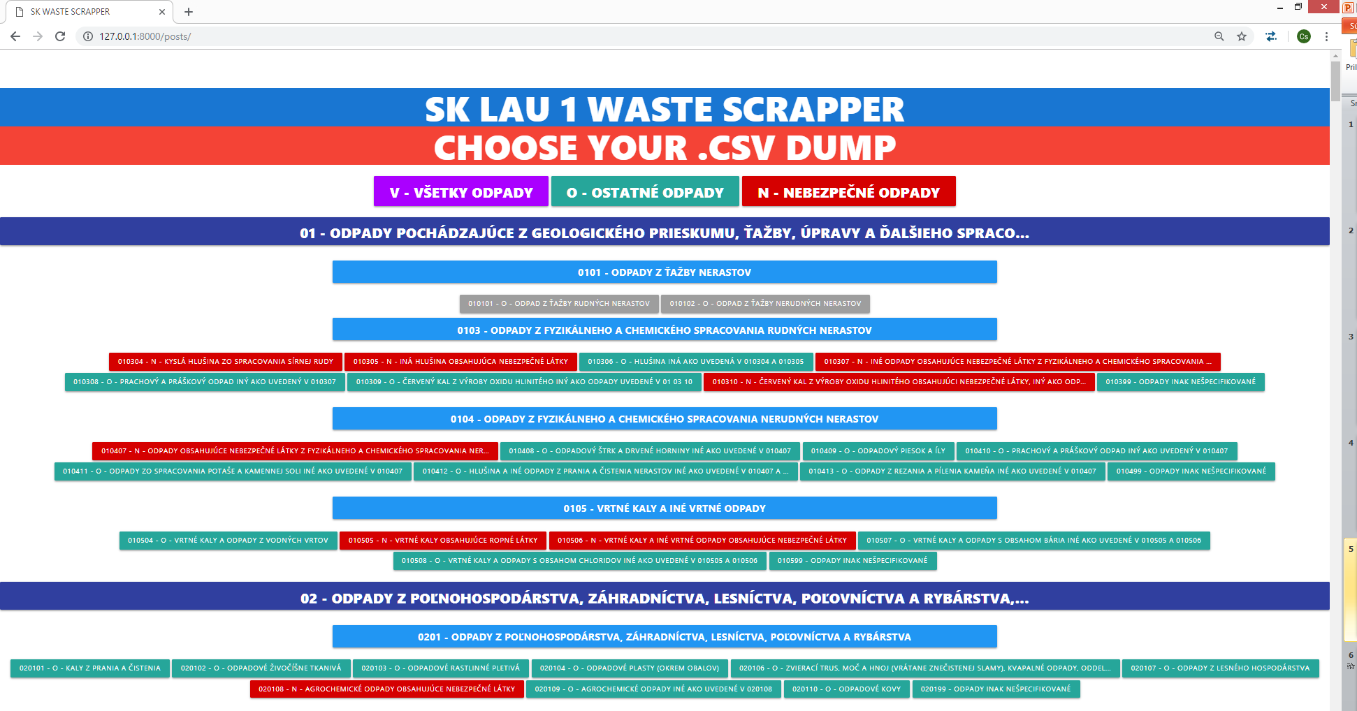
Copernicus Hackathon @ Danube Hack 2018
Inputs
Slovak partial waste monitoring system.
Inspire protected sites (hereinafter IPS)
SK LAU1
Outcomes:
SK LAU1 WASTE SCRAPPER:
A Simple Django app in a simpler template with each
waste category represented by a button, that allows the
user to download correspondent waste category for all
available years and regions at once into .CSV ² in 60 seconds
Target groups:
Academia, public administrations, citizens
² It maybe easily altered into database connection.
.

Slide 6
Copernicus Hackathon @ Danube Hack 2018
Outcomes:
2. ips_m_0512.shp
Merged shapefile of all Slovak protected sites in accordance to the date of their legal foundation from 2005 to 2012
3. ips_nn_union
Merged shapefile of all a Slovak protected sites without a date of legal foundation
4. sk_lau1_ips_pct.shp:
Shapefile of SK LAU1 with the size (ha) and coverage (pct) by protected sites from 05 - 12 ³
ips_xx_ha = size of protected areas with a date of legal foundation in hectares
Ips_xx_pct = pct coverage of the district by protected sites with a date of legal foundation
Ips_nlf_ha = size of protected areas without a date of legal foundation in hectares
t_ips_xx_ha = ips_xx_ha + _ips_nlf_ha

Slide 7
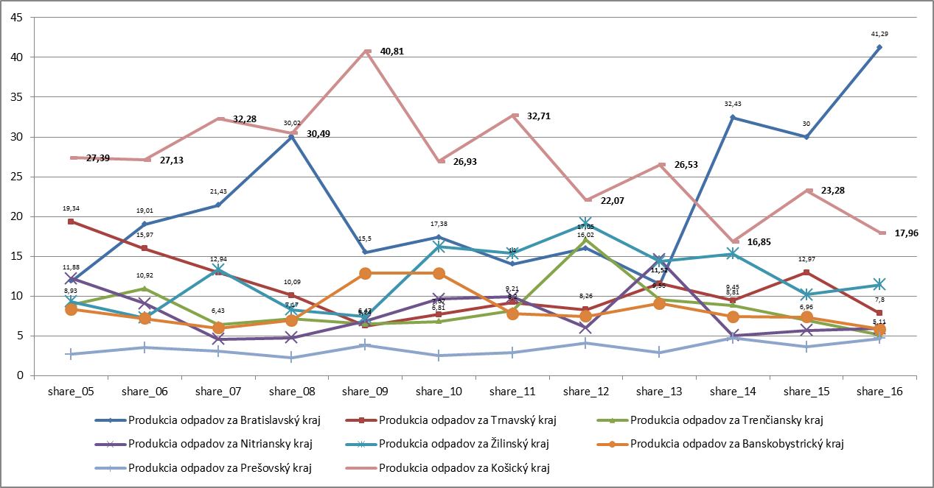
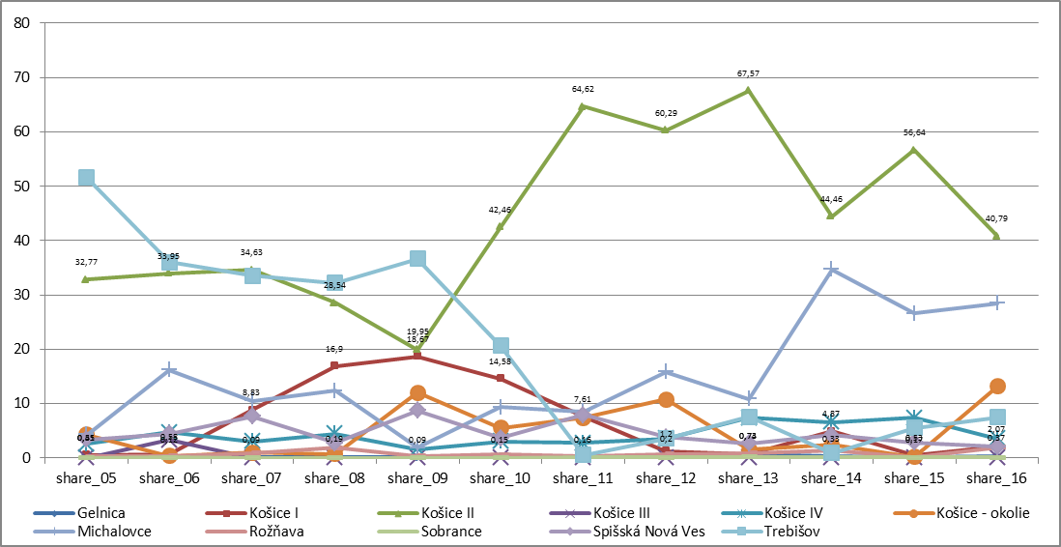
Copernicus Hackathon @ Danube Hack 2018
Example use case of the outcomes:
Let’s say:
A user want’s to take a closer look on the historical status of all Dangerous waste per districts (lau1) in a particular region(nuts3), e.g. region_id = ‘8’.
Downloads the relative table by one click and reorders the table by the relevant variable and he can easily:
Calculate and plot the e. g. annual share of the region on production of total dangerous waste in Slovakia or the share of
Districts within the region, or whatever he desires.

Slide 8
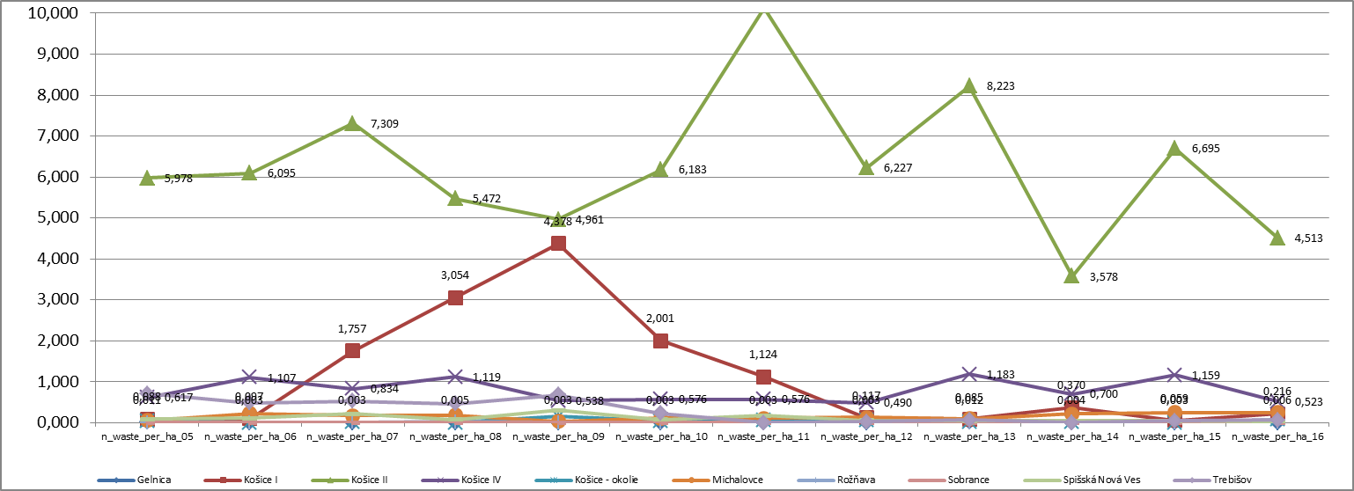
Copernicus Hackathon @ Danube Hack 2018
Example use case of the outcomes:
2. Or he wants to see, the production of dangerous waste in districts and their share of protected sites (e. g. tons of waste per hectare).
region_name | t_ips05_pct | t_ips06_pct | t_ips07_pct | t_ips08_pct | t_ips09_pct | t_ips10_pct | t_ips11_pct | t_ips12_pct | t_ips13_pct | t_ips14_pct | t_ips15_pct | t_ips16_pct | t_ips16_pct-2
Gelnica | 77,34 | 77,34 | 77,34 | 77,34 | 77,34 | 77,34 | 77,34 | 77,34 | 77,34 | 77,34 | 77,34 | 77,34 | 77,34
Košice I | 42,69 | 42,69 | 42,69 | 42,69 | 42,69 | 42,69 | 42,69 | 42,69 | 42,69 | 42,69 | 42,69 | 42,69 | 42,69
Košice II | 0,03 | 0,03 | 0,03 | 0,03 | 0,03 | 0,03 | 0,03 | 0,03 | 0,03 | 0,03 | 0,03 | 0,03 | 0,03
Košice IV | 0 | 0 | 0 | 0 | 0 | 0 | 0 | 0 | 0 | 0 | 0 | 0 | 0
Košice - okolie | 57,8 | 57,8 | 57,8 | 57,8 | 57,8 | 57,8 | 57,8 | 57,8 | 57,8 | 57,8 | 57,8 | 57,8 | 57,8
Michalovce | 23,04 | 23,04 | 23,04 | 23,04 | 23,04 | 23,05 | 23,05 | 23,05 | 23,05 | 23,05 | 23,05 | 23,05 | 23,05
Rožňava | 58,92 | 58,92 | 58,92 | 58,92 | 58,92 | 58,92 | 59,26 | 59,26 | 59,26 | 59,26 | 59,26 | 59,26 | 59,26
Sobrance | 48,53 | 48,53 | 48,53 | 48,53 | 48,53 | 48,53 | 48,53 | 48,53 | 48,53 | 48,53 | 48,53 | 48,53 | 48,53
Spišská Nová Ves | 63,56 | 63,56 | 63,56 | 63,56 | 63,56 | 63,56 | 63,62 | 63,62 | 63,62 | 63,62 | 63,62 | 63,62 | 63,62
Trebišov | 52,46 | 52,46 | 52,46 | 52,46 | 52,46 | 52,46 | 52,46 | 52,46 | 52,46 | 52,46 | 52,46 | 52,46 | 52,46

Slide 9
Copernicus Hackathon @ Danube Hack 2018
Limitations
Since waste production is bound to other variables (local economy, population), the app itself is good only for getting some partial data and the user still has to majority of the work.
The gui itself is too simple and prehistoric.
Not all protected sites have date a of legal foundation, for this, the share of protected sites per LAU1 is not exact.
LAU1’s to large areas for seeking exact answers about the efforts of local business and public administrations in sustainable waste management.
Plans
Tune up open on NetCDF
Get access to waste management data at LAU2 (municipalities)
Bound them with data from the Registry of financial statements and Registry of legal entities
Try fill in the missing legal foundations of protected sites and try to fill in the degree of protection that regulates human activity
Create a sk_lau2_ips_pct for each SK municipality
Create the web app based on leaflet and dc.js.
Get back to original motivations

Slide 10
Thank you
hopefuly it wasn’t a WASTE of Your time
http://copernicus.danubehack.eu
copernicus@danubehack.eu
Organised by
Notes:
Contact Folie

