Slide 1


Storyboard Design
Welcome to Storyboarding for self-paced online learning
Notes:
Welcome to Storyboarding for self-pace online learning

Slide 2
Overview
What is a Storyboard?
Why is it Important?
Roles and Responsibilities
When Should You Start?
Overview of the topics we will be discussing today
Key Elements Required
HTML Programming
Incorporating Images
Using LTS’s Template
Questions?
Notes:
Overview of the topics we will be discussing today

Slide 3
What is a Storyboard?
What is a Storyboard?
Why is it Important?
Roles and Responsibilities
When Should You Start?
An e-learning storyboard is a simple visual layout document that indicates all the necessary elements of a course, such as on-screen text, multimedia elements (graphics, audio, video), and any interactive features for every screen of the course. It also helps programmers understand the structure and the sequencing of your course.
Key Elements Required
HTML Programming
Incorporating Images
Using LTS’s Template
Questions?
Notes:
An e-learning storyboard is a simple visual layout document that indicates all the necessary elements of a course, such as on-screen text, multimedia elements (graphics, audio, video), and any interactive features for every screen of the course. It also helps programmers understand the structure and the sequencing of your course.

Slide 4
Why is it important?
What is a Storyboard?
Why is it Important?
A storyboard allows designers, programmers, SME’s, clients and any other stakeholders the opportunity to see the content, media elements and interactive features prior to programming. Basically it illustrates what you’re thinking with your design, flow and structure of the course, and ensures everyone is on the same page.
Roles and Responsibilities
When Should You Start?
Key Elements Required
Storyboarding is important because the development of a product can be extremely time consuming, and any mistakes made during the development phase can be extremely costly. By getting approvals before anything gets developed, you can reduce the amount of rework needed later on in the process.
HTML Programming
Incorporating Images
Finally a storyboard is used during the FQA and IQA process to ensure the course was programmed and functioning the way the client requested.
Using LTS’s Template
Questions?
Notes:
A storyboard allows designers, programmers, SME’s, clients and any other stakeholders the opportunity to see the content, media elements and interactive features prior to the HTML programming. Basically it illustrates what you’re thinking with your design, flow and structure of the course, and ensures everyone is on the same page.
Storyboarding is important because the development of a product can be extremely time consuming, and any mistakes made during the development phase can be extremely costly.
For example, re-shooting a video, re-producing voice-over or motion graphics, re-editing images or reprogramming interactivity could easily cost a great deal of time and money.
By getting approvals before anything gets developed, you can reduce the amount of rework needed later on in the process.
Finally a storyboard is used during the FQA and IQA process to ensure the course was programmed and functioning the way the client requested.

Slide 5
Who is responsible in developing storyboards?
What is a Storyboard?
Why is it Important?
Roles and Responsibilities
Program Areas:
Instructional Designers are responsible for creating their own storyboards.
You will also be responsible for obtaining final signoff on all storyboards before programming begins;
Learning Technologies and Services (LTS) offers several services to help you with this process:
Consultation on concepts of storyboarding;
Consultation on WCAG compliance in storyboards;
Review of design and scripting of storyboards;
Procuring external resources for instructional design and storyboarding (under review).
When Should You Start?
Key Elements Required
HTML Programming
Incorporating Images
Using LTS’s Template
Questions?
Notes:
Program Areas:
It is the responsibility of all Instructional Designers to create their own storyboards.
You will also be responsible for obtaining final signoff on all storyboards before programming begins;
Learning Technologies and Services (LTS) offers several services to help you with this process:
Consultation on concepts of storyboarding;
Consultation on WCAG compliance in storyboards;
Review of design and scripting of storyboards;
Procuring external resources for instructional design and storyboarding (under review).

Slide 6
When should you start storyboarding?
What is a Storyboard?
Once you have an approved Learning Design Plan as well as a detailed course outline/map plus some quality content, you can begin Storyboarding.
If you storyboard too early, you may create a course that doesn't respond to the needs.
If you storyboard too late or not at all, you might not have enough time for proper reviews and validation before programming needs to start.
Why is it Important?
Roles and Responsibilities
When Should You Start?
Key Elements Required
You may ask - How long does it take to storyboard?
This all depends on the complexity of the project, the amount of SME’s or stakeholders reviewing the content, any conflicting priorities as well as your experience level in creating storyboards.
One thing that should be considered during the storyboard review process is keeping it to approximately 2 review cycles.
HTML Programming
Incorporating Images
Using LTS’s Template
Questions?
Notes:
Once you have an approved Learning Design Plan as well as a detailed course outline/map plus some quality content, you can begin Storyboarding.
If you storyboard too early, you may create a course that doesn't respond to the needs.
If you storyboard too late or not at all, you might not have enough time for proper reviews and validation before programming needs to start.
You may ask - How long does it take to storyboard?
This all depends on the complexity of the project, the amount of SME’s or stakeholders reviewing the content, any conflicting priorities as well as your experience level in creating storyboards.
One thing that should be considered during the storyboard review process is keeping it to approximately 2 review cycles.

Slide 7
What key elements are required in a storyboard
What is a Storyboard?
Why is it Important?
Elements to include:
Course title and Module number and lesson title;
On-screen title;
Page numbering – screen numbering;
Screen type;
Activity type (only when there is an activity);
Proposed on-screen images;
Alt text for images;
On screen text;
Audio information, such as the voice-over narration, video scripts or sound effects;
Include navigation/branching and interactivity instructions to programmers;
Feedback for all exercises, quizzes and interactions;
Etc…
Roles and Responsibilities
When Should You Start?
Key Elements Required
HTML Programming
Incorporating Images
Using LTS’s Template
Questions?
Notes:
Items to include:
Course title and Module number and lesson title;
On-screen title;
Page numbering – screen numbering;
Screen type;
Activity type (only when there is an activity);
Proposed on-screen images;
Alt text for image;
On screen text;
Audio information, such as the voice-over narration, video scripts or sound effects;
Include navigation/branching and interactivity instructions to programmers;
Feedback for all exercises, quizzes and interactions;
LTS has a storyboard readiness checklist available for you.
The on-screen graphics and text. Basically, what the learner is going to see on-screen. Audio information, such as the voice-over narration, or sound effects.
Navigation indications that show how the slide advances, and where the learner is going after this slide.
M2 - Scr 1 of 12 etc..
Title Area: This area usually contains the name of a unit, topic or module.
Screen Number Area: Every screen has a unique identifier. For example m1l2s1 stands for module1 lesson2 screen1.
Visual Area: Visuals, graphics, video clips etc. are shown in this area. Text can also be included here.
Audio Area: Scripts, name of a music file, sound effects, etc. are included in this area.
Interaction Area: This area describes the interactions on each screen. A wide variety of activities can be provided.

Slide 8
HTML Programming
What is a Storyboard?
Why is it Important?
It is very beneficial for the HTML programmers to attend project kickoff meetings, and other important meetings between the designer and the client so they can understand the overall scope of the project.
Roles and Responsibilities
Programmers need to review storyboards prior to development for the following reasons:
Accessibility concerns on exercises and interactions;
Understand designer’s overall vision;
Gather assessment criteria;
Understand global elements such as landing page, splash page, home, help, glossary, and resource pages.
When Should You Start?
Key Elements Required
HTML Programming
Incorporating Images
In order for them to start working on the prototype they will need the following documents:
Detailed Course Outline/Map;
Project Scope;
Learning Design Plan;
Using LTS’s Template
Questions?
Notes:
It is very beneficial for the HTML programmers to attend project kickoff meetings, and other important meetings between the designer and the client so they can understand the overall scope of the project.
Programmers need to review storyboards prior to development for the following reasons:
Accessibility concerns on exercises and interactions;
Understand designer’s overall vision;
Gather assessment criteria;
Understand global elements such as landing page, splash page, home, help, glossary, and resource pages.
In order for them to start working on the prototype they will need the following documents:
Detailed Course Outline/Map;
Project Scope;
Learning Design Plan;

Slide 9
Using iStock or other stock photos sites
What is a Storyboard?
Why is it Important?
Instructional Designers can browse and download ‘composites’ and insert them into the storyboards as proposed graphics.
If you do not have time to browse the iStock site, write detailed information, about what you are envisioning in the storyboard proposed graphics/visuals section (include an URL link or the iStock#).
LTS can assist you in purchasing and downloading of all multimedia elements (graphics, video, audio).
Reasons for this:
One-stop tracking of all e-learning resources;
Verifying the bank of already acquired graphics;
Complying with Copyright issues;
Verification of WCAG compliancy;
Roles and Responsibilities
When Should You Start?
Key Elements Required
HTML Programming
Incorporating Images
Using LTS’s Template
Questions?
Notes:
Instructional Designers can browse and download ‘composites’ and insert them into the storyboards as proposed graphics.
If you do not have time to browse the iStock site, write detailed information, about what you are envisioning in the storyboard proposed graphics/visuals section (include an URL link or the iStock#).
LTS can assist you in purchasing and downloading of all multimedia elements (graphics, video, audio).
Reasons for this:
One-stop tracking of all e-learning resources;
Verifying the bank of already acquired graphics;
Complying with Copyright issues;
Verification of WCAG compliancy;

Slide 10
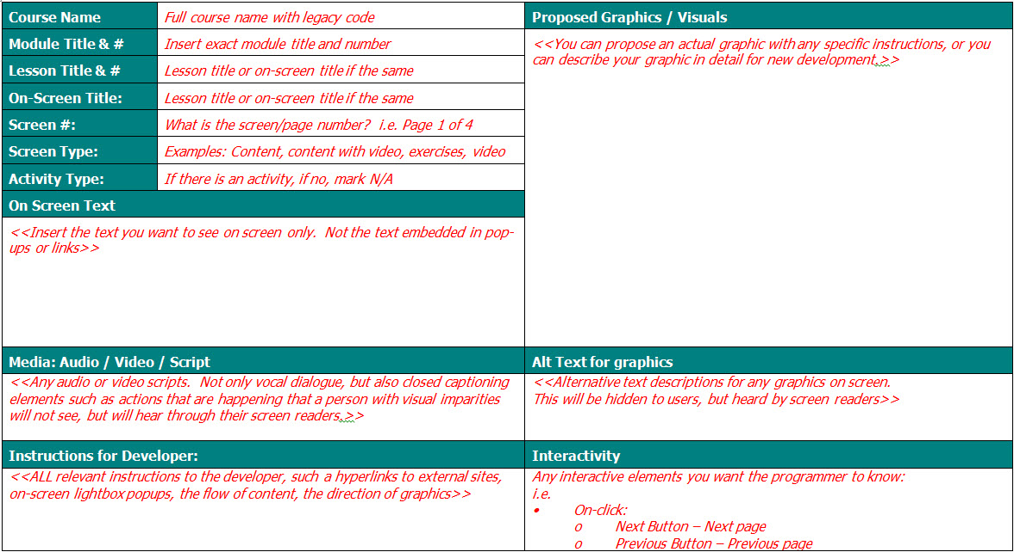
DEMO - How to use LTS’s storyboard template
What is a Storyboard?
Why is it Important?
Roles and Responsibilities
When Should You Start?
Key Elements Required
HTML Programming
Incorporating Images
Using LTS’s Template
Questions?
Notes:
Open the word document – “Storyboard ID Demo_v2.docx” for demo of using LTS storyboard template

Slide 11

Questions?
What is a Storyboard?
Why is it Important?
Roles and Responsibilities
When Should You Start?
Key Elements Required
HTML Programming
Incorporating Images
Using LTS’s Template
Questions?
Notes:
Any Questions???

