Slide 1


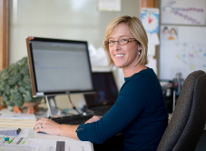

Welcome! We will be starting soon!
Please introduce yourself
using the chat tool:
Name, position, duties, etc.
(Send to all participants)

Slide 2

Welcome to this virtual event brought to you by the
Canada School of Public Service!
Please take a moment to familiarize yourself with the virtual classroom tools while you wait.

Slide 3
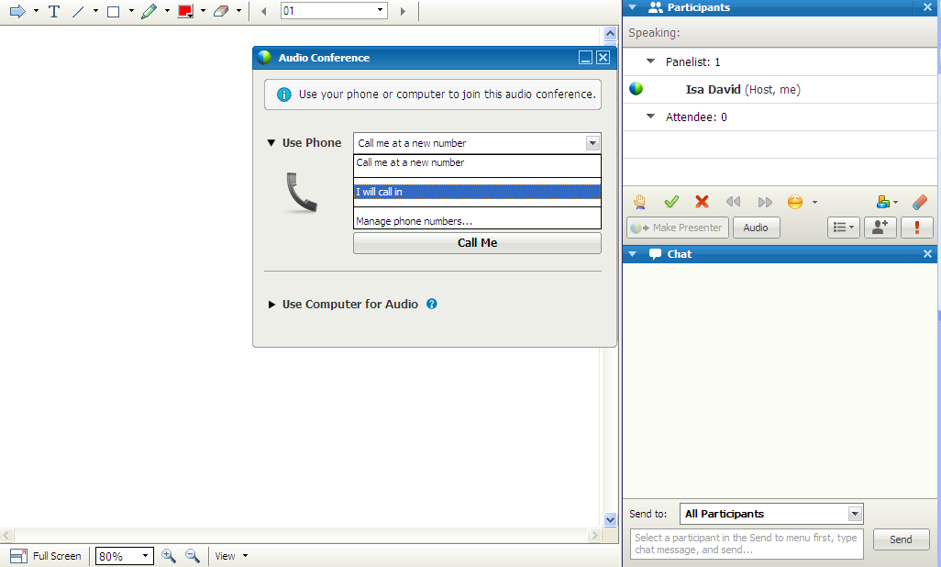

Select I will call in to access the audio conference information.

Slide 4
Select Use computer audio
if you prefer to join
with a computer headset.

Slide 5
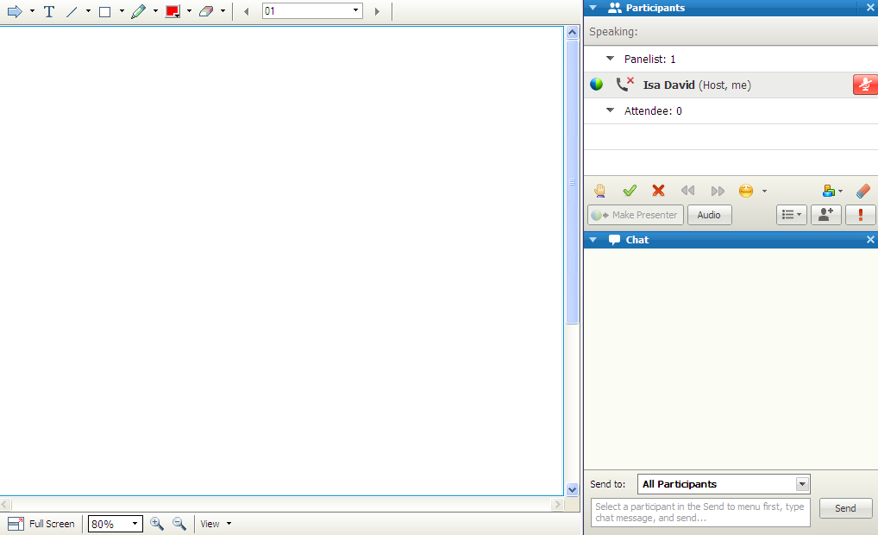
Mute and unmute your audio using the microphone icon to the right of your name.
No need to use *6 feature on your phone.

Slide 6
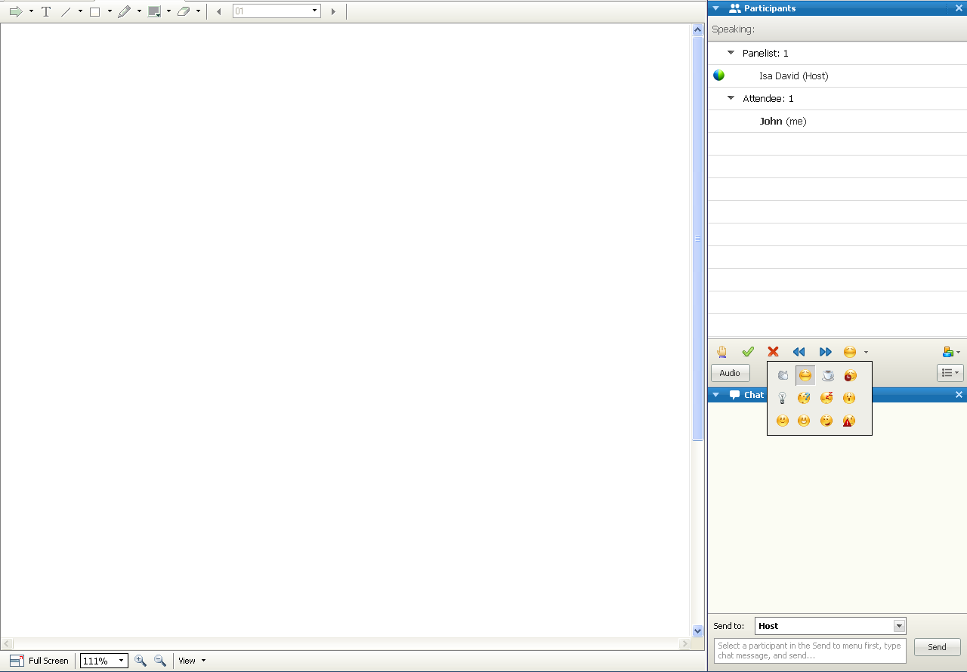

Use the interaction tools to ask a question, respond yes or no or share how you’re feeling.
Simply click on the icon you wish to use and reclick on it to remove it.

Slide 7

Use the chat panel to interact
with the other participants
and course instructor.

Slide 8

Use the annotation tools at the top left of the window to point, write, draw and highlight on the slides or whiteboard.

Slide 9
To write an answer on a slide:
1.Click the T icon
2.Type your answer
3.Click outside your textbox to make the text appear on the slide.

Slide 10
Having technical difficulty
during the session?
Write to the session host
via private chat at any time.
Enjoy your session!

