Slide 1
Correlations between gun ownership per capita, poverty per capita, and crime per capita rates
Group 4 Matt Dooley, Glenda Decapia, Chris Sadlo, Carrie O’Connor-Walker

Slide 2
Is there a relationship between murder and non-negligent manslaughter and gun ownership?
* Null Hypothesis - If rates of gun ownership are not related to murder and non-negligent manslaughter, then changes in rates of gun ownership will not correspond with changes in rates of murder and manslaughter across different states.

Slide 3
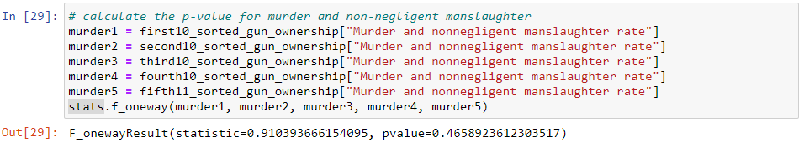
Hypothesis test
With a p value of .46 we can conclude that there is not a statistically significant relationship between murder and non-negligent manslaughter and gun ownership.

Slide 4
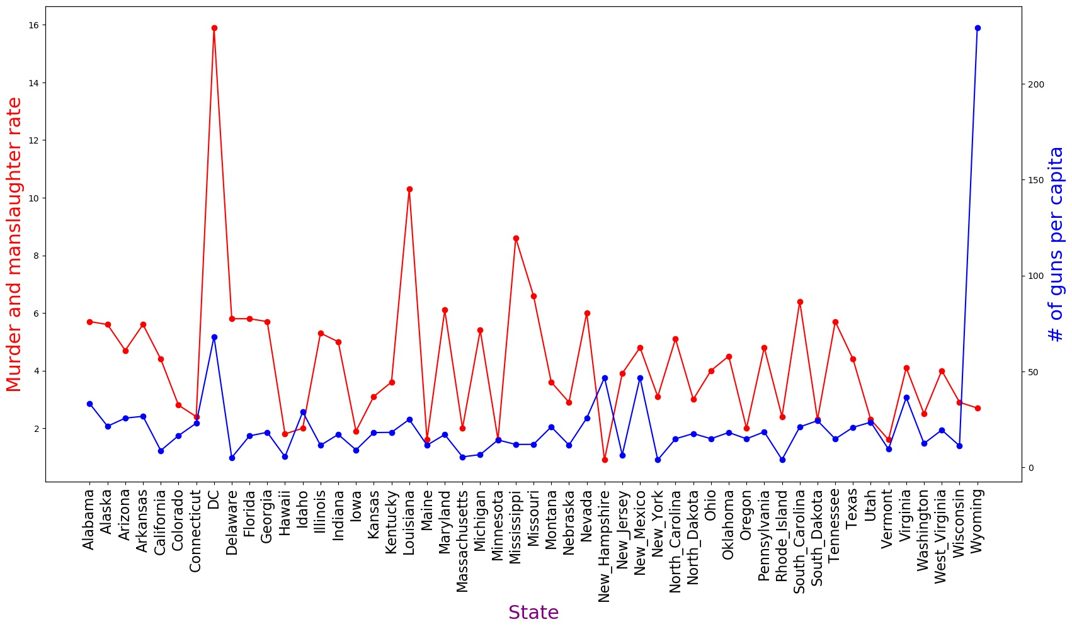

Slide 5
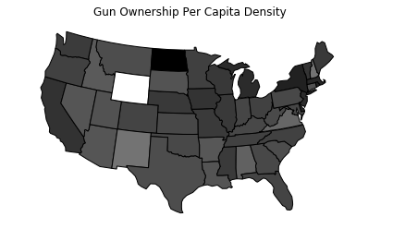
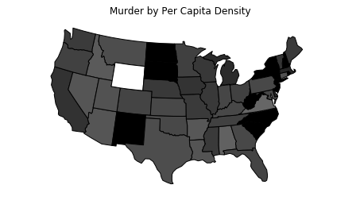
Is there a relationship between murder and non-negligent manslaughter and gun ownership?

Slide 6
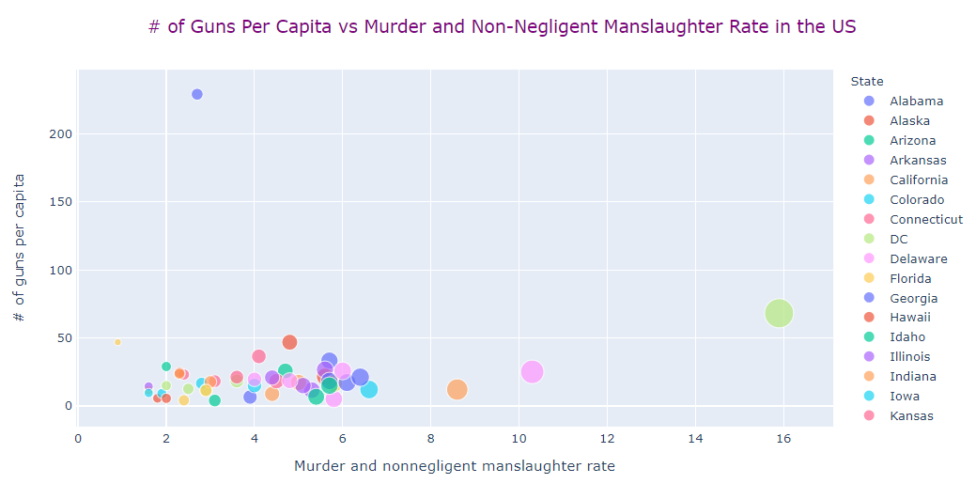
Is there a relationship between murder and non-negligent manslaughter and gun ownership?

Slide 7
Is there a relationship between gun ownership and aggravated assault?
* Null Hypothesis - If rates of gun ownership are not related to aggravated assault, then changes in rates of gun ownership will not correspond with changes in rates of aggravated assault across different states.

Slide 8
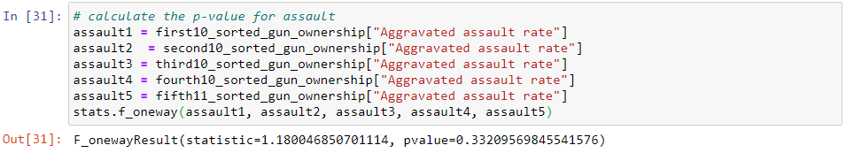
Hypothesis test
With a p value of .33 we can conclude there is not a statistically significant relationship between assault and gun ownership.

Slide 9
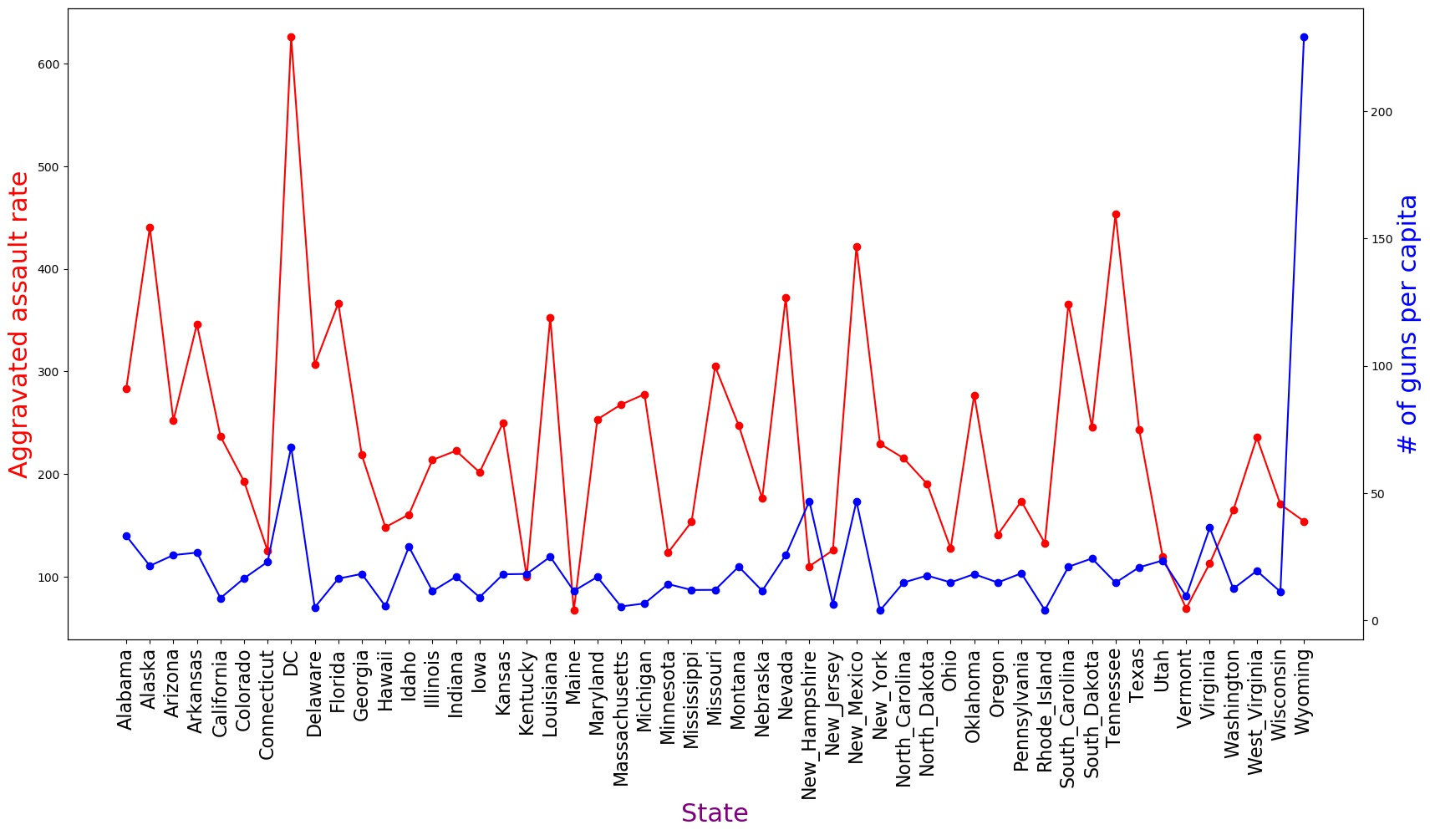

Slide 10
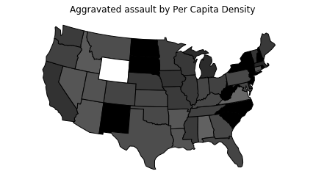
Is there a relationship between gun ownership and aggravated assault?

Slide 11
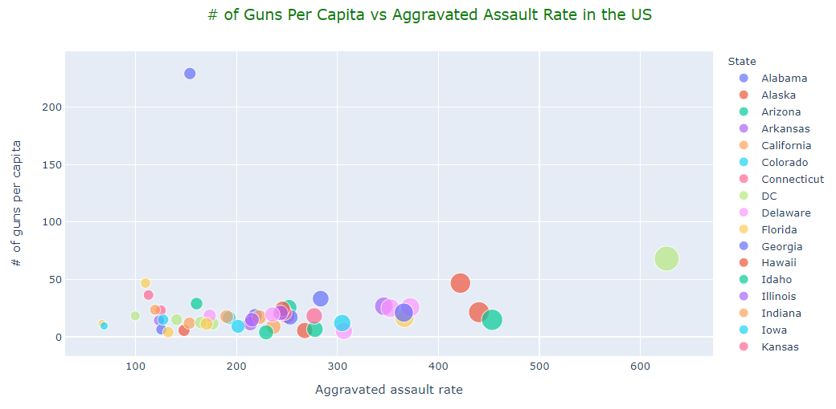
Is there a relationship between gun ownership and aggravated assault?

Slide 12
Is there a relationship between gun ownership and robbery?
* Null Hypothesis - If rates of gun ownership are not related to robbery, then changes in rates of gun ownership will not correspond with changes in rates of robbery across different states.

Slide 13
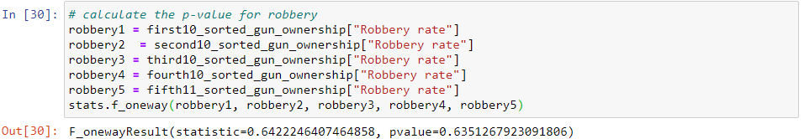
Hypothesis test
With a p value of .63 we can conclude there is not a statistically significant relationships between robbery and gun ownership.

Slide 14
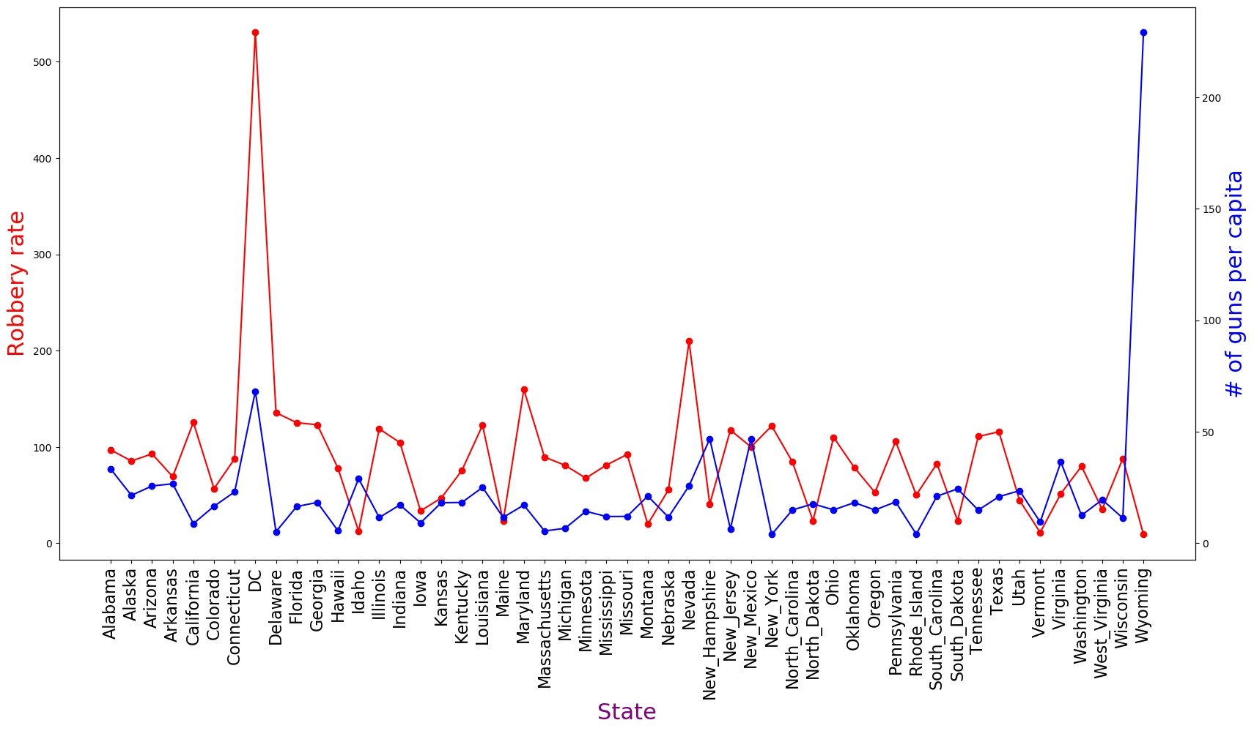

Slide 15
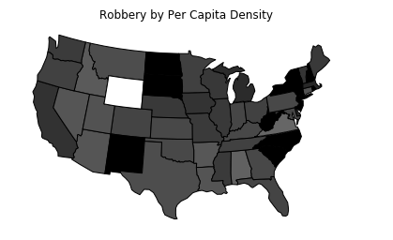
Is there a relationship between gun ownership and robbery?

Slide 16
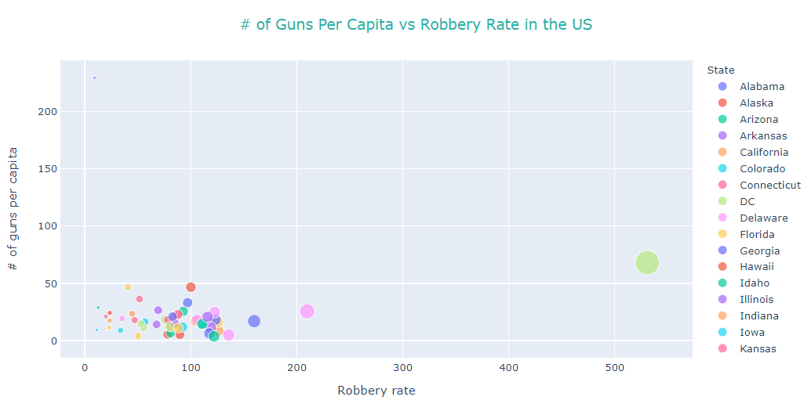
Is there a relationship between gun ownership and robbery?

Slide 17
Is there a relationship between gun ownership and motor vehicle theft?
* Null Hypothesis - If rates of gun ownership are not related to motor vehicle theft, then changes in rates of gun ownership will not correspond with changes in rates of motor vehicle theft across different states.

Slide 18
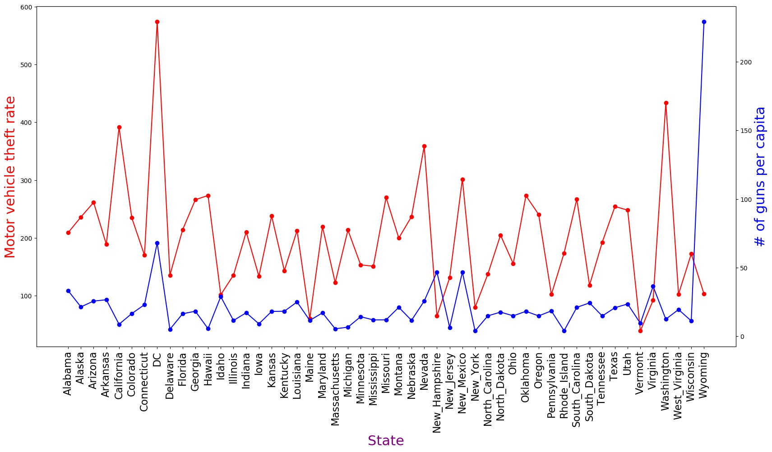

Slide 19
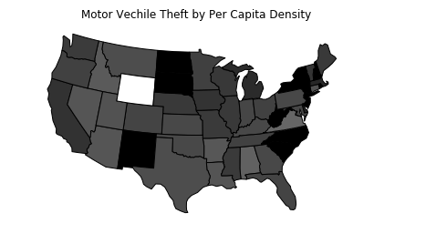
Is there a relationship between gun ownership and motor vehicle theft?

Slide 20
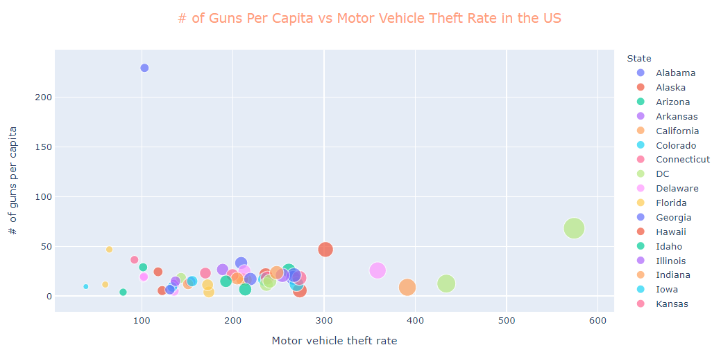
Is there a relationship between gun ownership and motor vehicle theft?

Slide 21
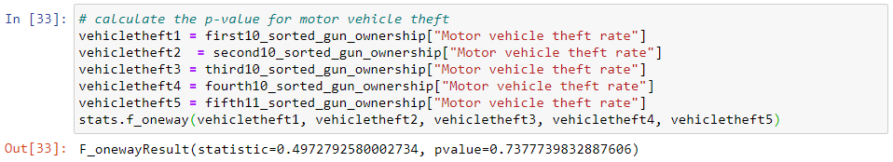
Hypothesis test
With a p value of .73 we can conclude there is not a statistically significant relationship between motor vehicle theft and gun ownership.

Slide 22
Is there a relationship between gun ownership and burglary?
* Null Hypothesis - If rates of gun ownership are not related to burglary, then changes in rates of gun ownership will not correspond with changes in rates of burglary across different states.

Slide 23
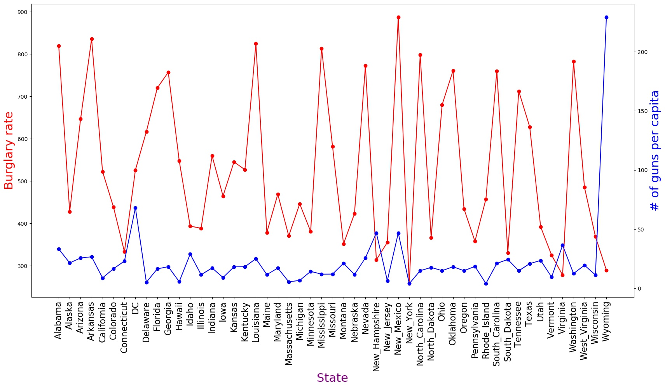

Slide 24
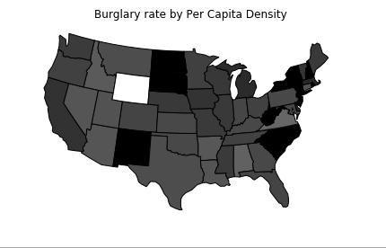
Is there a relationship between gun ownership and burglary?

Slide 25
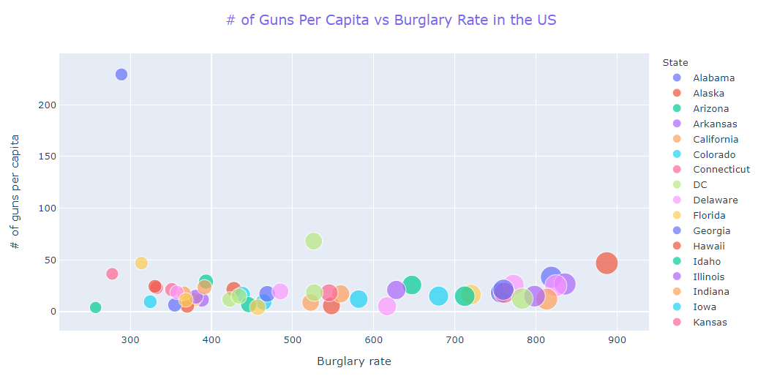
Is there a relationship between gun ownership and burglary?

Slide 26
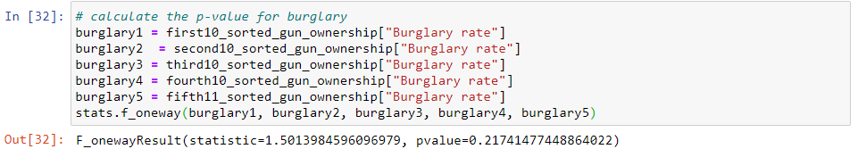
Hypothesis test
With a p value of .21 we can conclude there is not a statistically significant relationship between burglary and gun ownership.

Slide 27
Introduction of Poverty Rate
The correlation between State poverty rate and murder/manslaughter rate is 0.48
The correlation between State poverty rate and aggravated assault rate is 0.39
The correlation between State poverty rate and motor vehicle theft rate is 0.23
The correlation between State poverty rate and robbery rate is 0.26
The correlation between State poverty rate and burglary rate is 0.5

Slide 28
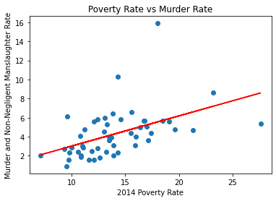
The p-value is 0.0003338114614302579

Slide 29
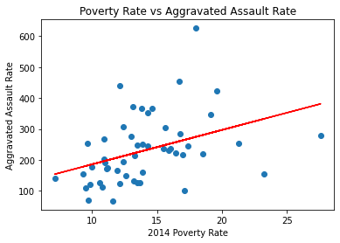
The p-value is 0.005060499740574195

Slide 30
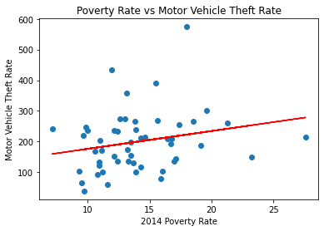
The p-value is 0.10989442496330928

Slide 31
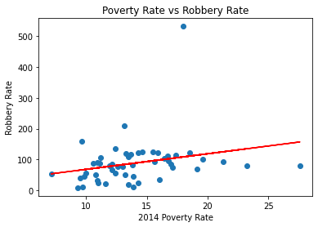
The p-value is 0.06932315092001919

Slide 32
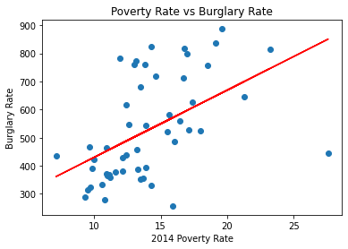
The p-value is 0.00016056217443156416

Slide 33
Questions?

Slide 34
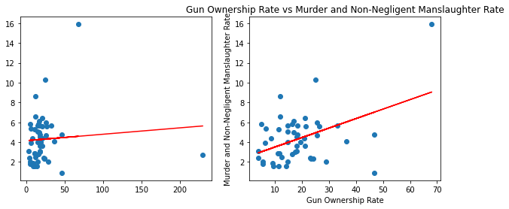
The p-value is 0.5696228758793114
The p-value with Wyoming (outlier) removed is 0.001071486430297918

Slide 35
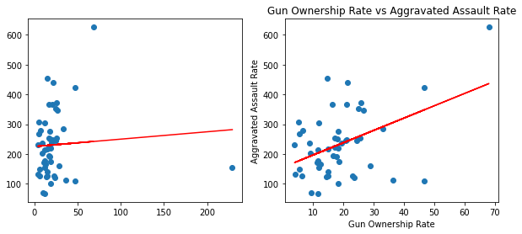
The p-value is 0.6201494895279527
The p-value with Wyoming (outlier) removed is 0.001270106023107579

Slide 36
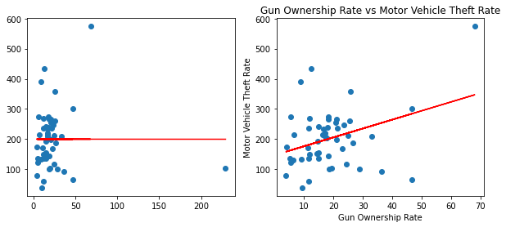
The p-value is 0.9981371910960279
The p-value with Wyoming (outlier) removed is 0.011362556698786365

Slide 37
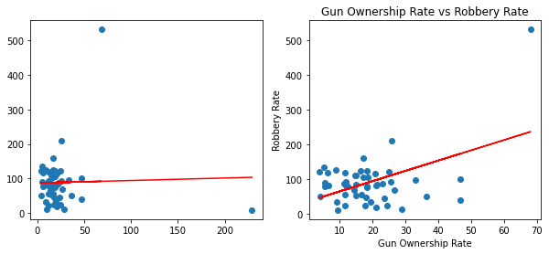
The p-value is 0.8330119466335262
The p-value with Wyoming (outlier) removed is 0.0006244292824015332

Slide 38
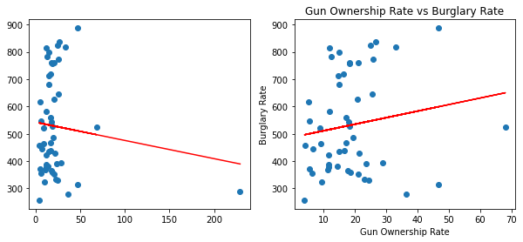
The p-value is 0.4158180659723484
The p-value with Wyoming (outlier) removed is 0.2734221475741668

