Slide 1
Environment Complaint Portal
Complaint Management & Analytics Portal for Environmental Services
Presentation for the Industry Panel | Web platform: EcoServe

Slide 2
Agenda
Background and problem statement
Objectives and proposed solution
Features for citizens, authorities and admins
Workflow, analytics and architecture
Benefits, challenges and future scope
2

Slide 3
Background
Environmental issues: waste collection, water pollution, drainage, air pollution
Citizens depend on authorities to resolve them promptly
Complaint handling quality directly affects community health and satisfaction
Digital, centralized systems can make service delivery accountable
4+
core complaint areas: waste, water, drainage, air
3

Slide 4
Problem Statement
Complaints handled manually or through disconnected platforms
Delays in assigning and resolving complaints
Poor tracking: citizens cannot see progress
Limited transparency and accountability
No consolidated data to reveal recurring issues
4

Slide 5
Objectives
Create a faster, more transparent complaint resolution process
Centralize all complaint records in one platform
Provide visual analytics for data-driven decisions
Prioritize critical complaints
Improve resource allocation and citizen participation
5

Slide 6
Proposed Solution
Register
Manage
Analyze
Citizens file complaints with details and supporting images
Authorities view, categorize, assign and update complaints
Dashboard shows issues, locations, trends and performance
6

Slide 7
Key Stakeholders
Citizens
Authorities
Administrator
Report issues and track their complaints
Resolve complaints and update status
Oversees the system, analytics and settings
7

Slide 8
Citizen Features
Register and submit environmental complaints
Choose a category and specify the location
Upload supporting images or details
Track complaint status at any time
View own complaint history
8

Slide 9
Authority Features
View all incoming complaints in one place
Categorize complaints by issue type
Assign complaints for action
Update status: Pending, In Progress, Resolved
Prioritize critical complaints
9

Slide 10
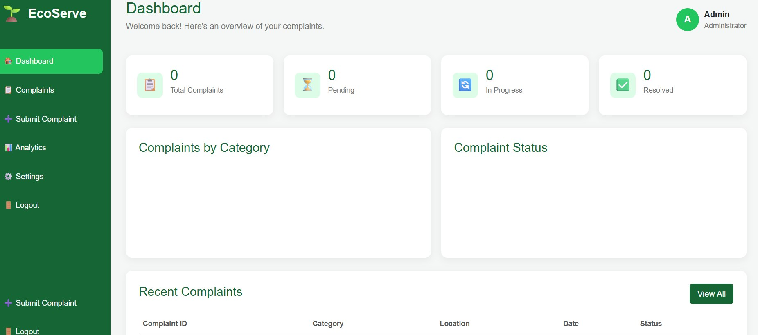
Admin Dashboard
Overview cards, category and status charts, and a recent complaints table
10

Slide 11
System Workflow
1
2
3
4
5
Register
Categorize
Assign
Update
Analyze
Complaints flow from citizen submission through authority action to analytics, with every step recorded centrally.
11

Slide 12
Complaint Categories
Waste Collection
Water Pollution
Drainage
Air Pollution
Missed pickups, overflowing bins, illegal dumping
Contaminated water bodies and supply issues
Blocked or overflowing drains
Smoke, dust and emissions
12

Slide 13
Analytics & Insights
Frequent Issues
Affected Locations
Trends
Resolution Performance
Identify the most reported complaint types
Spot problem areas and hotspots
Track complaint volume over time
Measure how quickly complaints close
13

Slide 14
Complaint Status Tracking
1
2
3
4
Submitted
Pending
In Progress
Resolved
The dashboard counts Total, Pending, In Progress and Resolved complaints so progress is visible at a glance.
14

Slide 15
System Layers
Presentation
Application
Data & Analytics
Web interface for citizens, authorities and admins
Complaint registration, assignment and status logic
Central complaint records feeding dashboard charts
15

Slide 16
Benefits
Faster Resolution
Transparency
Better Decisions
Centralized records reduce delays
Citizens see status in real time
Analytics guide resource allocation
16

Slide 17
Challenges & Future Scope
Challenge: encouraging citizen adoption and accurate reporting
Challenge: timely action by assigned authorities
Future: email/SMS notifications on status changes
Future: map-based hotspot view and mobile app
Future: automatic priority scoring of complaints
17

Slide 18
Conclusion
The Environment Complaint Portal replaces manual, fragmented handling with one transparent, analytics-driven platform, improving environmental service delivery, citizen participation and community satisfaction.

Slide 19
Thank You
Questions and feedback are welcome.

