Slide 1

Intro to Making a Website
Mark Zhang

Slide 2
HTML
CSS
Javascript
PHP
MySQL
…That’s a lot of stuff!
Notes:
My goal in this talk to help put all of these different technologies into perspective so that you can understand how all the different pieces of web programming fit together.

Slide 3
Overview of the Overview
Accessing a website
Client-side technologies
Server-side technologies

Slide 4
Accessing a Website

Slide 5


Accessing a Website
You (client)

Slide 6



Accessing a Website
You (client)
Web server

Slide 7
HTTP Request
HTTP Request: GET www.xkcd.com
You (client)
Web server
IP: 72.26.203.99

Slide 8
HTTP Response
HTTP Request: GET www.xkcd.com
You (client)
Web server
HTTP Response: web content (HTML file)
IP: 72.26.203.99

Slide 9
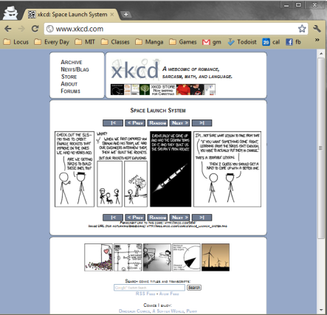
Browser Renders Files
You (client)
Web server
IP: 72.26.203.99

Slide 10
Review
Client - your computer (usually by your browser)
Server – computer that stores and provides the website

Slide 11
Demo

Slide 12
Questions?

Slide 13
Client-side Technologies

Slide 14
Client Side
HTML
CSS
Javascript
These are kinds of files that a web-server can send to your computer. Your browser uses these files to render the web-page.

Slide 15
HTML
Describes the content of a web-page
<html>
<head>
<title>My Title</title>
</head>
<body>
<p>Hello world!</p>
</body
</html>

Slide 16
CSS
Styles HTML elements
p {
font-size: 20px;
color: red;
}

Slide 17
Javascript
Adds interactivity to web-pages
Submit forms
React to mouse movement
Change HTML content (like text in a paragraph)

Slide 18
jQuery and AJAX
jQuery – Javascript with more convenient syntax
AJAX – a group of functions in Javascript that allows you to talk to a server without loading another page
Notes:
Facebook uses a lot of AJAX.

Slide 19
Questions

Slide 20
Server Side Technologies

Slide 21
Server Software
Responds to HTTP requests from clients.
Apache – most common server software; taught in 6.470
Commonly run on Linux computers.
LAMP stack = Linux, Apache, MySQL, PHP

Slide 22
PHP
Allows programmer to make web pages dynamic.
Collect form data
Handle user sessions and authentication
It often does this in conjunction with a database (MySQL)
Common alternatives: Python, Ruby

Slide 23
Databases (MySQL)
Database – an organized collection of data that is maintained on the server
Account information and passwords
User-generated content (comments, posts, etc.)
MySQL is a particular database system that is commonly used with PHP.

Slide 24
PHP and MySQL
Often work together
PHP makes queries to MySQL
MySQL provides reliable storage and fast access to large amounts of data
PHP uses the content to generate a dynamic webpage

Slide 25
Additional Technologies
Web frameworks – simplify common tasks like user accounts, database access, etc.
Django
Ruby on Rails

Slide 26
Additional Technologies
Git – version control
Lets you save and rollback your work
Lets you make branches.
With Github, lets you easily collaborate with others.

Slide 27
Getting a Web Server
MIT
You can get web space on scripts with just your Athena account
http://scripts.mit.edu/
Commercial Web Hosting
WebFaction
Bluehost
Amazon EC2 (advanced)

Slide 28
Questions?

Slide 29

Intro to Making a Website
Mark Zhang

