Slide 1

Ruby on Rails
Mark Zhang

Slide 2
In this talk
Overview of Ruby on Rails
Core ideas
Show a tiny bit of example code
Touch on several general web development/ software development concepts

Slide 3
What is Ruby on Rails?
Ruby on Rails is an open source full-stack web framework.
It is an alternative to PHP/MySQL.
It can render templates, handle user authentication, has built-in database functionality, etc.

Slide 4
Ruby on Rails
A lot of people love Ruby on Rails because it allows you to make websites really fast.

Slide 5
Advantages
Convention over Configuration
One example: every model is automatically included in the controllers (no imports necessary)
Less code, but can be confusing to beginners.
A lot of “automagic” behavior
Notes:
In other frameworks, you might have to CONFIGURE the system to hook up these associations between objects and data. Rails does this for you automatically.
However, can be confusing to beginners. Hard to remember which variables are automatically defined and what they’re called. Can be hard to look under the hood.

Slide 6
Advantages
Ruby generally focuses on having simple, powerful code.
Rails focuses on programmer productivity and happiness.
Rails is generally regarded as well designed and thought out.

Slide 7
Advantages
Active community, lots of resources
The pains of Rails are quickly getting better
Gems
Bootstrap-sass, jquery-rails – automatically imports those
Faker – tool to automatically generate fake data
Rspec, capybara – testing integrated with rails (TDD)
Guard – automatically watch files and run tests
Notes:
Gems are little packages you can install
TDD = Test Driven Development, something we won’t have time for today

Slide 8
Disadvantages
Things are changing quickly, compatibility issues (rvm and gemsets help to solve this)
High initial learning curve
Lots of black magic
Forced to do things “the Rails Way”
Notes:
Rails makes assumptions about the best way to do things. It can be hard to get Rails to do what you want *the way that you want it*.

Slide 9
Ruby
It’s not called Ruby on Rails for nothing.
But you only need a subset of Ruby to start using Rails.
I think it’s fine to dive into Rails first and learn about Ruby a little later.
Notes:
I’m barely going to mention any Ruby syntax in this talk, except when we look at code.

Slide 10
Summary of the Talk
The Rails Way
REST
Models
Views
Controllers
Rails Tools
Structure of Rails App Directory
How to do Static Pages

Slide 11
The Rails Way
DRY – “Don’t Repeat Yourself
Convention Over Configuration
REST is the best pattern for web applications
Notes:
DRY – “Don’t Repeat Yourself” – suggests that writing the same code over and over again is a bad thing.
Convention Over Configuration – means that Rails makes assumptions about what you want to do and how you’re going to do it, rather than requiring you to specify every little thing through endless configuration files.
REST is the best pattern for web applications – organizing your application around resources and standard HTTP verbs is the fastest way to go.

Slide 12
REST
“Representational State Transfer”
Using resource identifiers such as URLs to represent “resources”.

Slide 13
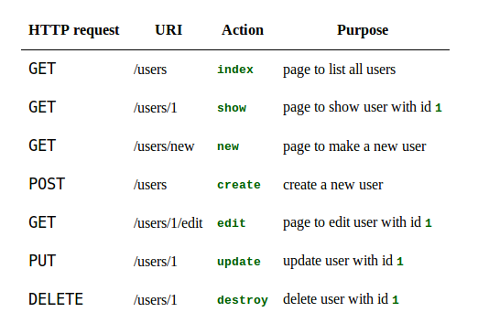
Resources
Example with a “user” resource
Get back to this when talking about controllers.
Notes:
Rails expects your URLs to be like this for every single of your resources (users, posts, tweets, etc.)

Slide 14
Model-View-Controller Paradigm
A way of organizing a software system
Benefits:
Isolation of business logic from the user interface
Ease of keeping code DRY
Making it clear where different types of code belong for easier maintenance

Slide 15
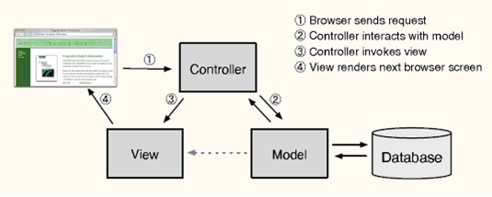
MVC
Notes:
Model - the information (data) of the application and the rules to manipulate that data. Business logic should be concentrated here.
View – takes data and displays it
Controller – the glue between the model and controller. In Rails, they’re responsible for processing the incoming requests from the web browser, interrogating the models for data, and passing that data on to the views for presentation.
It’s possible to put your business logic anywhere. But best practice says put it in the model. This usually increases readability.
Business logic for example might involve getting data and then manipulating it.

Slide 16
Models (with demo)
the information (data) of the application and the rules to manipulate that data. Business logic should be concentrated here.
Models are usually related to tables in a database.
Model’s attributes are “columns”.
But not always.
Models that are not related to database tables are transient.
Notes:
If a model is related to a table, the table’s name will be “line_items” for model LineItem, for example.
Demo: app/model/user.rb

Slide 17
Models
You can use the interactive “rails console” to play with your models (and even modify your database)
You can also access the methods in your controllers (next slide)
Examples of methods on models:
david = User.find_by_name('David')
users = User.where(name: 'David', occupation: 'Code Artist').order('created_at DESC')
user.update(name: 'Dave')
Notes:
Examples: User.new, User.save, User.create, User.first, User.all, User.destroy

Slide 18
Controllers (with demo)
Glue between model and view
Notes:
responsible for processing the incoming requests from the web browser, interrogating the models for data, and passing that data on to the views for presentation.
Demo: app/controllers/user_controllers.rb

Slide 19
Controllers
By default, conform to REST
The expectation is that each controller corresponds to a resource and each controller action corresponds to a RESTful action.
To tweak, go to config/routes.rb
Notes:
The expectation is that you have

Slide 20
RESTful controller actions
Notes:
Here it is again

Slide 21
Views (Demo)
the user interface of your application
all code in views should deal with presentation of data.
usually HTML with embedded Ruby
Rails will automatically render a view at the end of a controller action.
If action was “index”, Rails will render index.html.erb
Notes:
Demo: app/views/user/index.html.erb

Slide 22
Views (Demo)
Additional organization to view files
Layouts (application.html.erb)
Partials (_header.html.erb)

Slide 23
Rails tools
Rails comes with a ton of tools
Manage your databases
Generate boilerplate code
Generators
rails generate controller Users new
rails generate model User name:string email:string

Slide 24
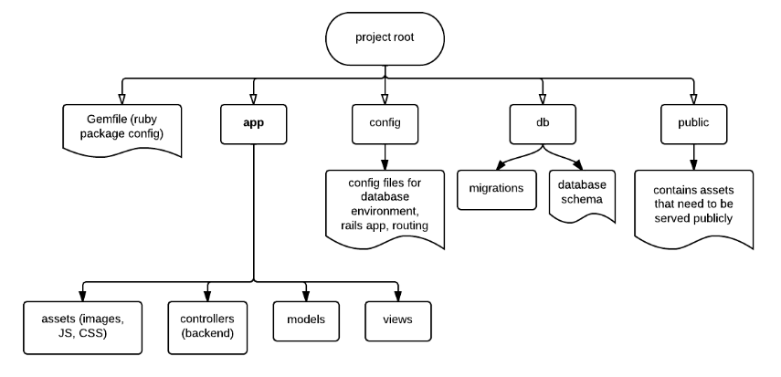
Structure of the Rails App Directory
Notes:
This is only a subset of the most common directories. There’s also directories for tests, rails (rake) tasks, etc.

Slide 25
How to do Static Pages (demo)
Notes:
Demo: config/routes.rb
Demo: app/controllers/static_page_controller
Demo: app/views/static_pages/home.html.erb

Slide 26
Summary of the Talk
The Rails Way
REST
Models
Views
Controllers
Rails Tools
Structure of Rails App Directory
How to do Static Pages

Slide 27
Installing Rails
Rails installer on Windows
On Mac/Linux
Install ruby
Install RVM (ruby version manager)
Install rails
Process can be finicky
Auto-installer on scripts.mit.edu

Slide 28
Deploying Rails
You can run it on Heroku ("cloud application platform") or with Phusion Passenger (module for Apache).

Slide 29
The Rails Way
DRY – “Don’t Repeat Yourself
The choice of MVC helps this
Convention Over Configuration
REST is the best pattern for web applications
Notes:
DRY – “Don’t Repeat Yourself” – suggests that writing the same code over and over again is a bad thing.
Convention Over Configuration – means that Rails makes assumptions about what you want to do and how you’re going to do it, rather than requiring you to specify every little thing through endless configuration files.
REST is the best pattern for web applications – organizing your application around resources and standard HTTP verbs is the fastest way to go.

Slide 30
What is Ruby on Rails?
Ruby on Rails is an open source full-stack web framework.
It is an alternative to PHP/MySQL.
It can render templates, handle user authentication, has built-in database functionality, etc.
Notes:
It can be challenging to learn, but if you’re willing to put in the extra time, I believe it’s a good investment.

Slide 31
Sample Code
https://github.com/MarkAZhang/sample_app

Slide 32

Ruby on Rails
Mark Zhang

