Slide 1

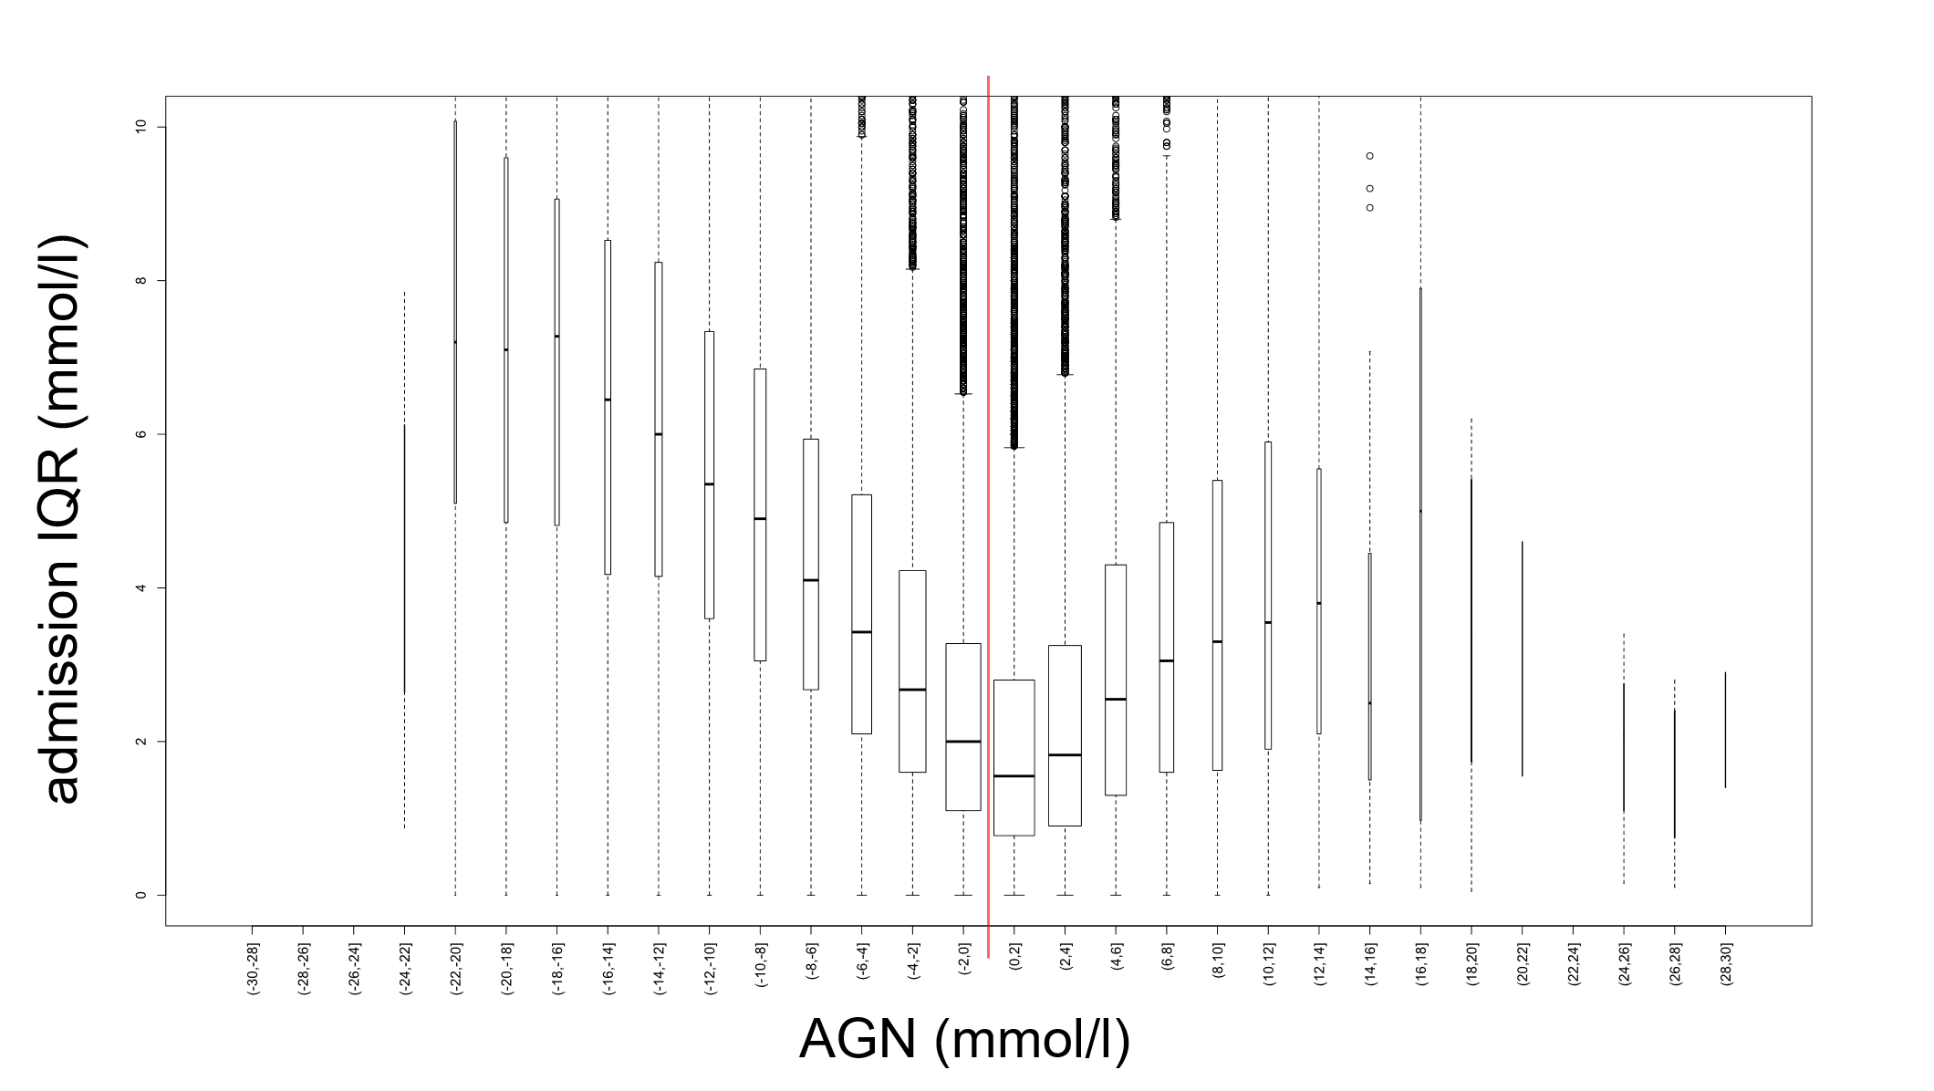
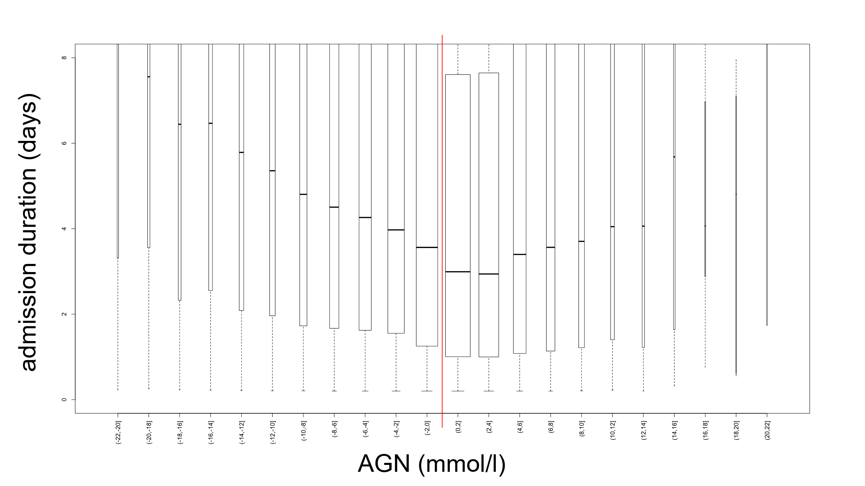
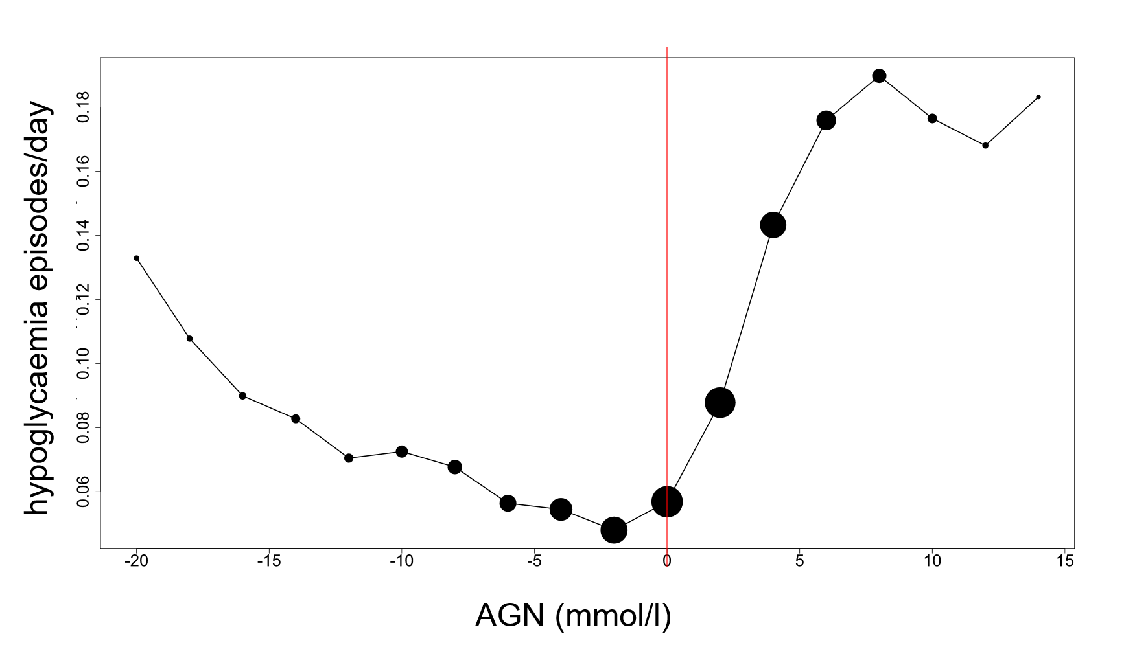
Admission Glucose Number (AGN): a novel score associated with adverse outcomes in patients admitted with Type 2 Diabetes
CAR Sainsbury¹, SG Cunningham², R Srivastava³, GC Jones¹
Department of Diabetes, Gartnavel General Hospital, Glasgow, Scotland
Clinical Technology Centre, Ninewells Hospital, Dundee, Scotland
Department of Biochemistry, Queen Elizabeth University Hospital, Glasgow, Scotland
Introduction
Type 2 Diabetes is a common co-morbidity in hospital inpatients. Dysglycaemia is common in this cohort (1). Increased glycaemic variability is associated with poor long term outcome including increased mortality (2). Stratification of individuals for risk of dysglycaemia including glycaemic variability and hypoglycaemia at the point of admission would enable an appropriate clinical response to risk, potentially improving outcomes for patients. We tested the association of a simple metric derived from a measure of average glucose for the individual, and from admission glucose, against inpatient glucose metrics.
Methods
We identified capillary blood glucose (CBG) readings of patients with type 2 diabetes (T2DM) (from national dataset) and CBG measured within our health board 01/2009-01/2016. Analysis was performed on admissions with >1 CBGs performed during admission, and where an HbA1c was available within a 15 month widow prior to the date of admission.
Estimated average glucose (eAG) was calculated from the last measured HbA1c. The first CBG measured during admission (CBG¹) was identified, and the AGN was calculated using the formula ( AGN = eAG – CBG¹).
Minimum CBG, interquartile range (IQR), admission duration, total number of clinical hypoglycaemic (<4 mmol/l) episodes per admission, and hypoglycaemia rate (episodes/day) were calculated for each admission.
The distribution of AGN was investigated, and the association between AGN and subsequent glucose variability, admission duration, minimum glucose and hypoglycaemia rate was plotted.
The first admission for each individual within the dataset was identified, and a survival analysis over a maximum of 6 years of follow up was performed. AGN was expressed as distance from 0 for this analysis. A cox proportional hazards model was used, testing admissions with an AGN (distance from 0) above the median value vs those with an AGN (distance from 0) below the median value. Age, admission duration and diabetes duration were covariables in the analysis.
Results
The dataset contained 159360 secondary care contacts of 44971 individuals with Type 2 Diabetes over the period 01/09 to 01/16, with 1898226 recorded CBG values.
71950 admission episodes from 27820 unique individuals were associated with >1 measured CBG during admission, with an HbA1 within 15 months of admission.
Admission Characteristics
age at admission 70.9 (61.4 – 78.6) years
diabetes duration 9.3 (4.8 – 14.3) years
admission duration 2.7 (0.8 – 7.6) days
median glucose 8.2 (6.6 – 10.8) mmol/l
glucose IQR 2.2 (1.2 – 4.0) mmol/l
initial glucose 8.4 (6.3 – 12.0) mmol/l
hypoglycaemia rate 0.07 episodes / day
last HbA1c 55 (46 – 70) mmol/mol
eAG 8.9 (7.5 – 11.0) mmol/l
AGN 0.4 (-2.2 – 2.4) mmol/l
proportion of admissions with >=1 CBG <4mmol/l: 0.20
Figures 1-3 show the association of AGN with glycaemic variability, duration of admission and hypoglycaemia frequency.
An AGN (distance from 0) above the median value was associated with an increased mortality with a HR of 1.15 (p<0.001) n=27702
Fig 1. Association of AGN with IQR of CBG during admission
Fig 2. Association of AGN with duration of admission
Fig 3. Association of AGN with frequency of hypoglycaemia during admission
Conclusions
Results demonstrate a U-shape association between the AGN value, and increased glucose variability, admission duration and hypoglycaemia frequency. A similar association is seen with minimum and maximum glucose values recorded during an admission. The AGN is means by which the recorded admission glucose is contextualised for the individual patient. The greater the deviation of the admission CBG value from that patient’s average glucose, the greater the probability of dysglycaemia during the subsequent admission. When accounting for the important covariables of age, admission duration and diabetes duration, the a greater distance of AGN from 0 is associated with a highly significant increase in mortality over a 6 year follow up period.
References
Trends in recorded capillary blood glucose and hypoglycaemia in hospitalised patients with diabetes. 2014. GC Jones, H Casey, CG Perry, B Kennon, CAR Sainsbury. Diabetes research and clinical practice 104 (1), 79-83
Inpatient glycemic variability and long-term mortality in hospitalized patients with type 2 diabetes. 2017. JG Timmons, SG Cunningham, CAR Sainsbury, GC Jones. Journal of Diabetes and its Complications. 31 (2), 479–482

