Slide 1
Admission Glucose Number (AGN):
A novel point-of-admission score associated with prolonged admission duration, and with glycaemic characteristics in patients with Type 1 Diabetes
¹R Maitland, ²R Srivastava, ³S Cunningham, ¹G Jones, ¹C Sainsbury
¹Gartnavel General Hospital, Glasgow, UK
²Queen Elizabeth University Hospital, Glasgow, UK
³Ninewells Hospital, Dundee
c.sainsbury@nhs.net http://glucose.ai

Slide 2

Faculty Disclosure
 | No, nothing to disclose
 | Yes, please specify:
Company Name | Honoraria/ Expenses | Consulting/ Advisory Board | Funded Research | Royalties/ Patent | Stock Options | Ownership/ Equity Position | Employee | Other (please specify)
Novo Nordisk |  | x
Lilly |  |  | x
GlycoSys |  |  |  |  |  | x

Slide 3
AGN - rationale
individuals with T1DM have high rate of adverse events whilst in hospital
within our dataset, inpatient hypoglycaemia common (43.6% T1DM admissions)
    dysglycaemia is associated with prolonged duration of admission¹
    higher glucose variability associated with higher rate of adverse outcome
stratification of individuals for risk at the point of admission enables appropriate clinical response to risk - with a potential for improved outcomes for patients
1. Hypoglycemia and Clinical Outcomes In Hospitalized Patients With Diabetes: Does Association With Adverse Outcomes Remain When Number of Glucose Tests Performed Is Accounted For? GC Jones et al. Journal of Diabetes Science and Technology, 2017

Slide 4
AGN - rationale
for an individual, the distance of initial glucose (at the point of admission) from average glucose values are a means of indicating metabolic stress, and may therefore assist risk stratification
    average glucose value taken from last measured HbA1c value within a 15-month window pre-admission
    initial glucose taken as the first measured CBG during the admission (CBG¹)

Slide 5
admission glucose number (AGN) calculation
last HbA1c prior to admission
CBG measured at admission
convert to estimated Average Glucose (eAG) (mmol/l)
CBG¹ (mmol/l)
point of admission
AGN = eAG – CBG¹

Slide 6
design
retrospectively identify admissions of individuals with Type 1 Diabetes
calculate Admission Glucose Number (AGN)
associate AGN with metrics directly or indirectly associated with poor outcome:
    minimum glucose during admission
    glucose variability during admission (IQR)
    admission duration
    hypoglycaemia rate / day

Slide 7
data setting – all inpatient episodes 2009-16
159360 secondary care contacts
44971 unique IDs
1898226 CBG values
n CBG per contact >1
HbA1c within 15 months prior to admission
27820 unique IDs
71950 admission episodes
1252796 cbgs

Slide 8
admission characteristics
age at admission | 70.9 (61.4 – 78.6) | years
diabetes duration | 9.3 (4.8 – 14.3) | years
admission duration | 2.7 (0.8 – 7.6) | days
median glucose | 8.2 (6.6 – 10.8) | mmol/l
glucose IQR | 2.2 (1.2 – 4.0) | mmol/l
initial glucose | 8.4 (6.3 – 12.0) | mmol/l
proportion of admissions with >=1 CBG <4mmol/l | 0.20
hypoglycaemia rate | 0.07 | episodes / day
last HbA1c prior to admisison | 55 (46 – 70) | mmol/mol
eAG | 8.9 (7.5 – 11.0) | mmol/l
AGN | 0.4 (-2.2 – 2.4) | mmol/l

Slide 9
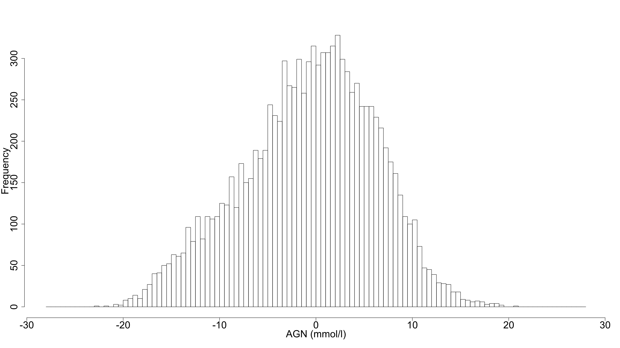
AGN distribution

Slide 10
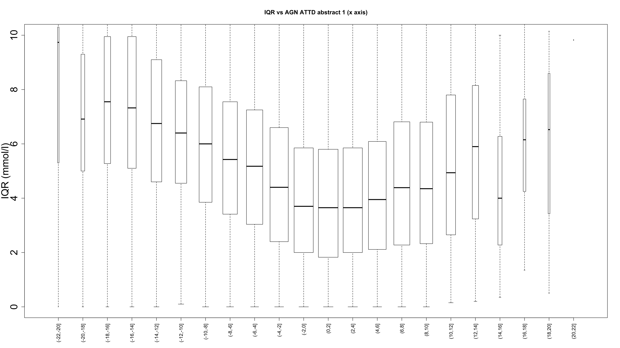
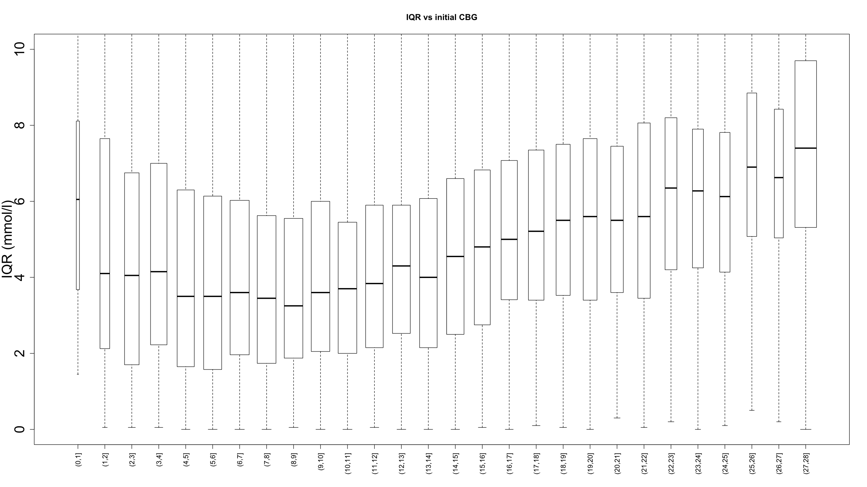
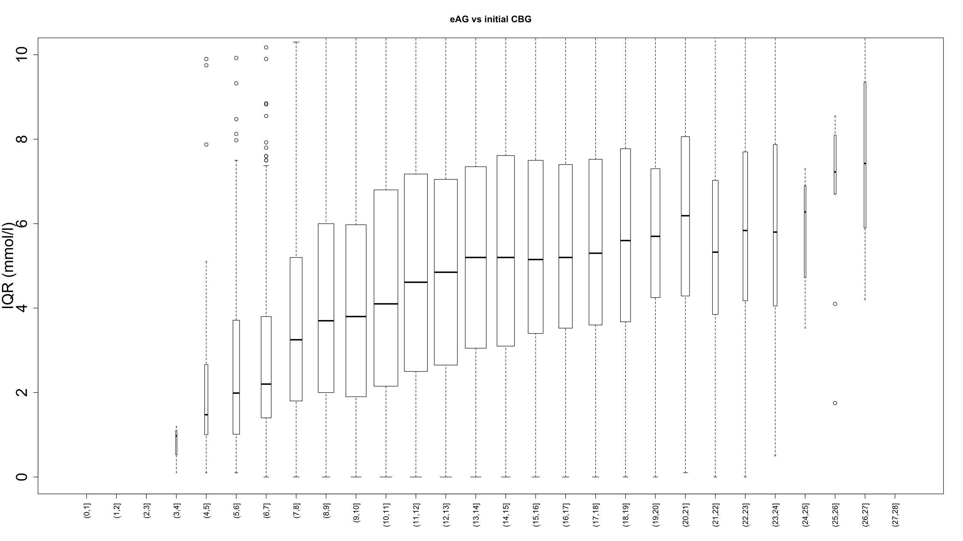
glucose variability (IQR) during admission
initial CBG
eAG
AGN

Slide 11
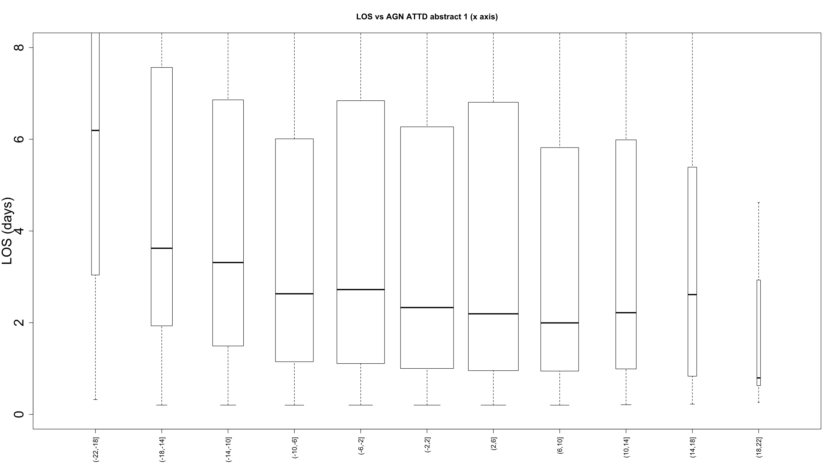
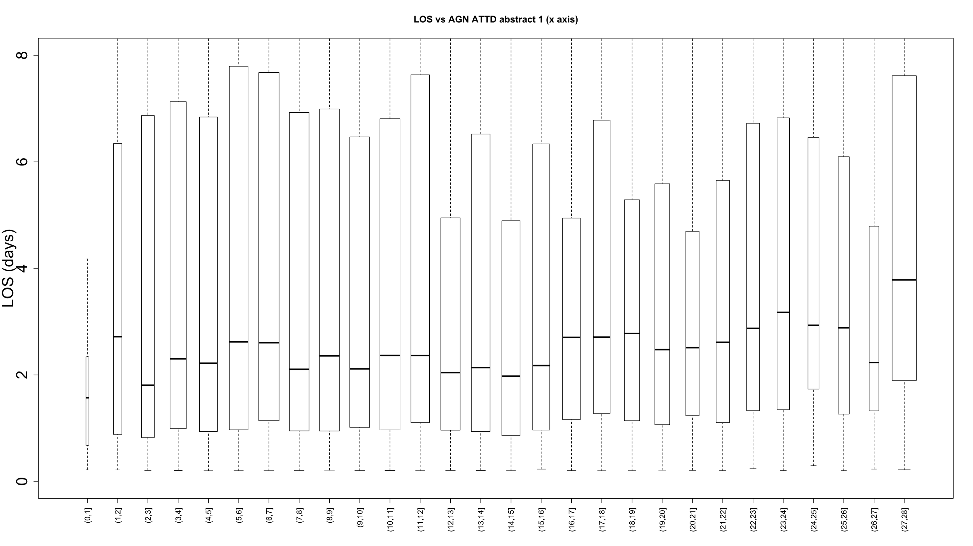
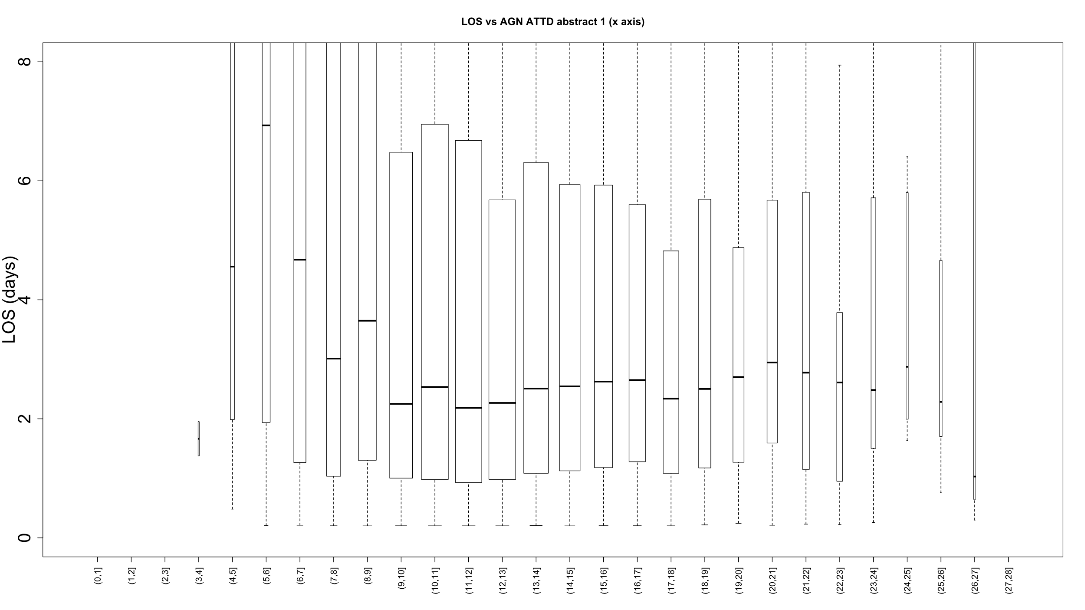
admission duration (days)
initial CBG
eAG
AGN

Slide 12
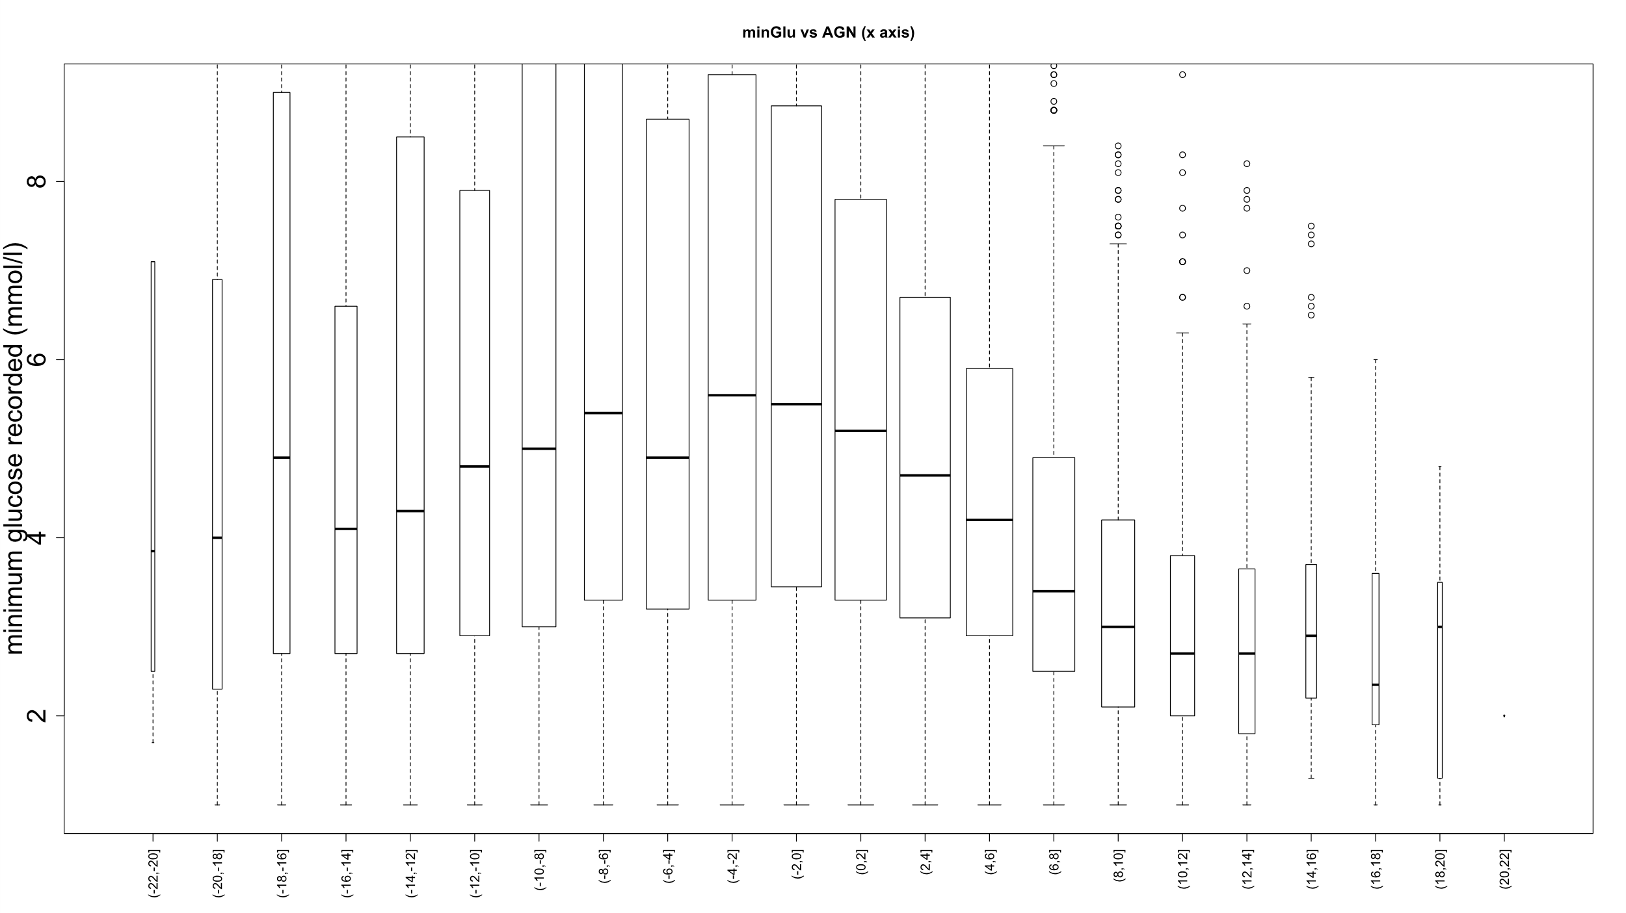
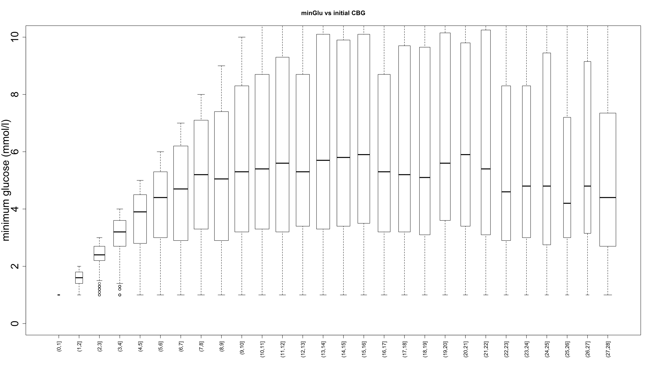
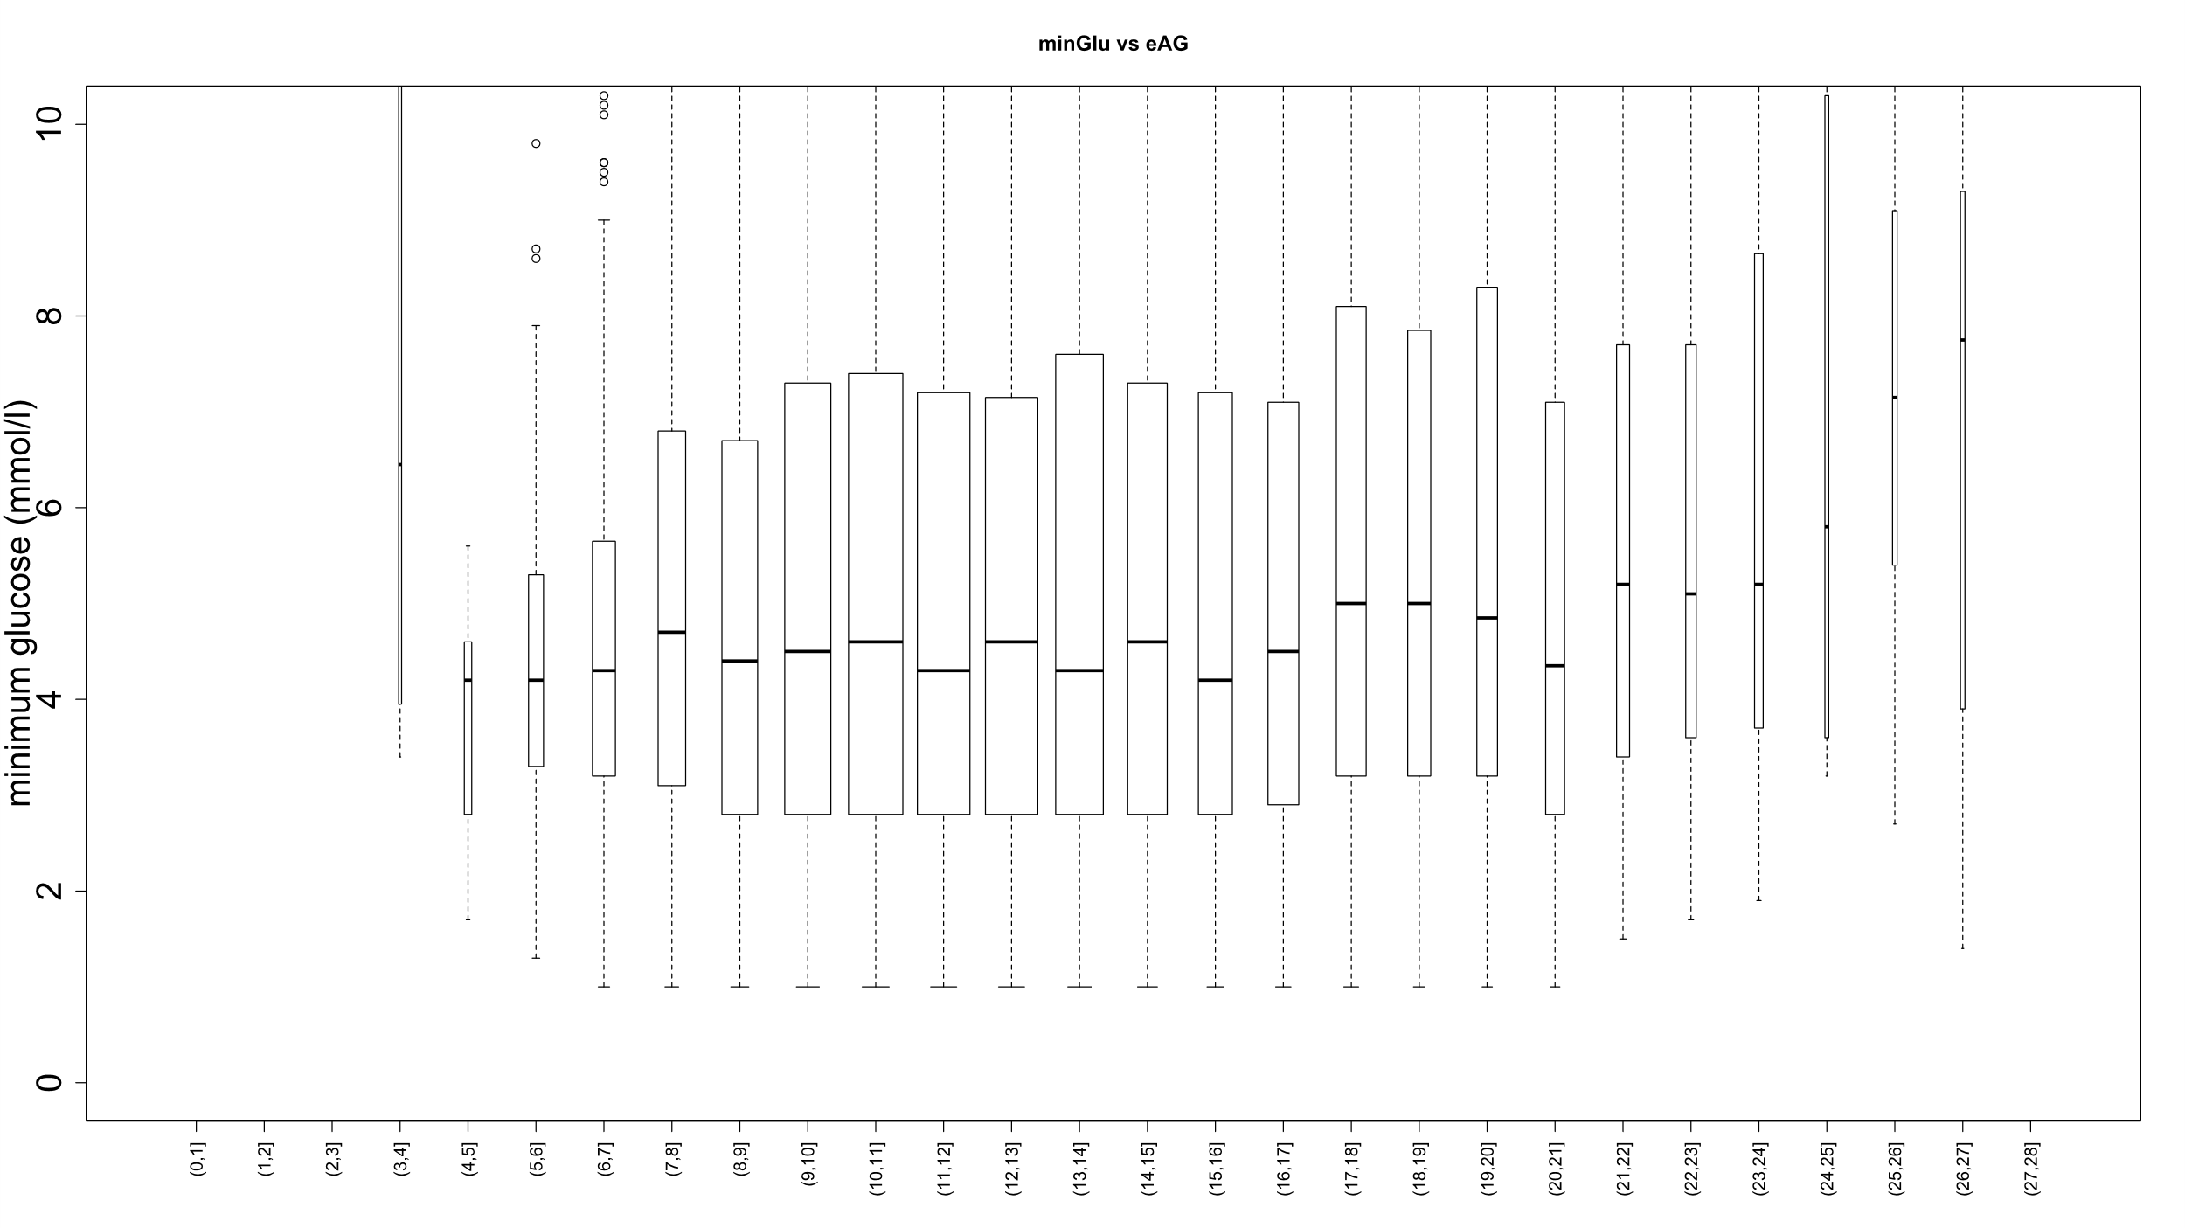
minimum glucose during admission
initial CBG
eAG
AGN

Slide 13
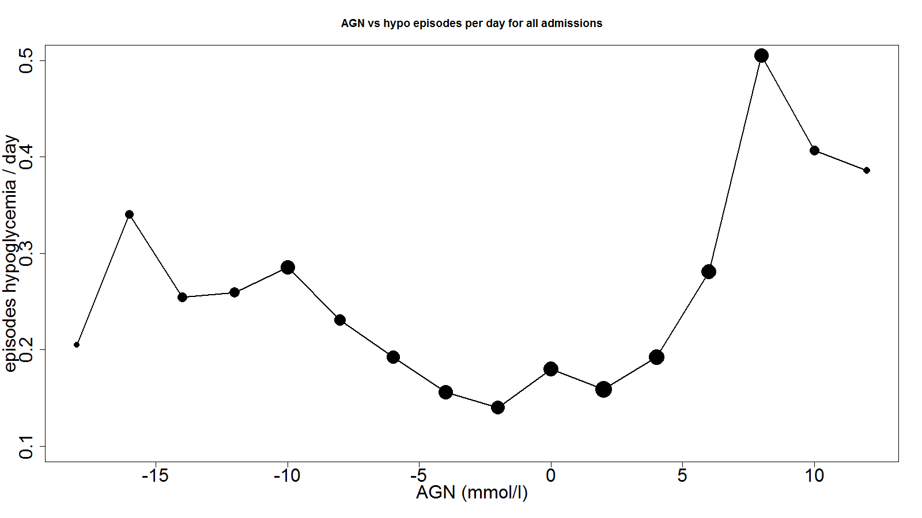
hypoglycaemia rate – episodes / day
hypoglycaemia rate – episodes / day

Slide 14
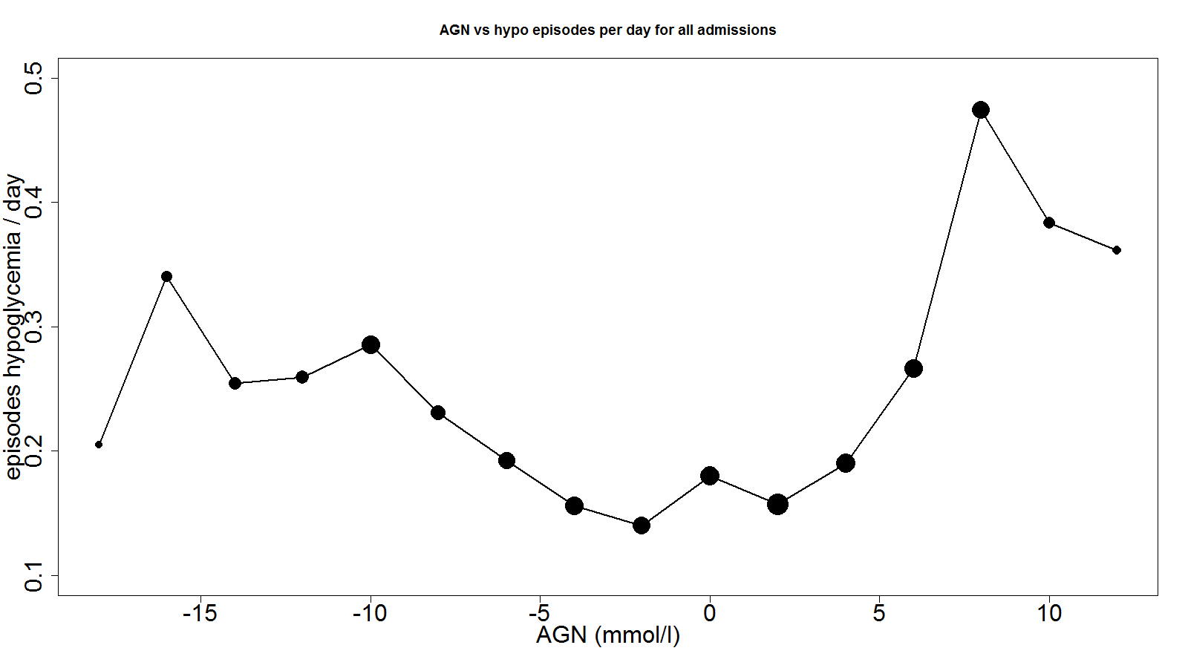
hypoglycaemia rate – episodes / day
hypoglycaemia rate – episodes / day
(excluding CBG¹ in hypo range)

Slide 15
in summary
AGN has a clear association with glycaemic variability and hypoglycaemia frequency during admission.
simple to calculate and uses measures that will be available for the majority of patients with T1DM at the point of admission
out-performs its component elements (admission CBG and immediate past HbA1c) when stratifying for risk

Slide 16
thankyou
c.sainsbury@nhs.net
http://glucose.ai

