Slide 1

Serum chloride is a mortality risk predictor in type 2 diabetes mellitus – analysis of 91,159 patients in the West of Scotland
Linsay McCallum, Christopher A Sainsbury Gregory C Jones, Sandosh Padmanabhan
Institute of Cardiovascular and Medical Sciences, University of Glasgow, UK
NHS Greater Glasgow and Clyde, UK

Slide 2

Background
Chloride is the principal extracellular anion in the body
Chloride functions
Maintenance of osmotic pressure
Acid-base balance
Muscular activity
Movement of water between fluid compartments
>85% of chloride is consumed as sodium chloride (salt)
Sodium chloride (salt) is known to increase blood pressure and CV risk
Evidence that the chloride component of NaCl may have a specific role in salt sensitivity

Slide 3
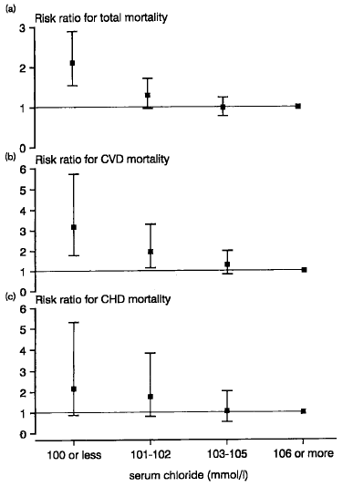
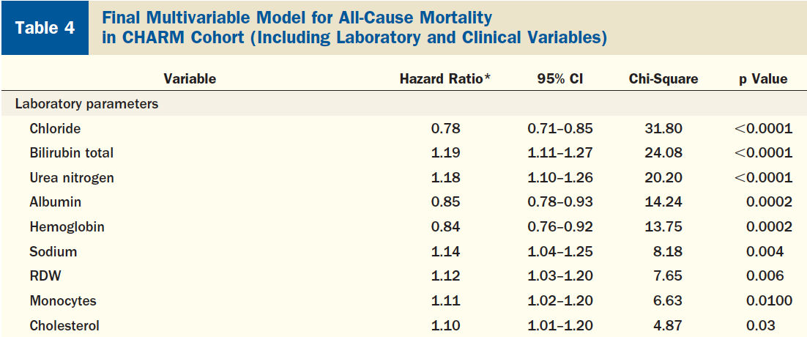
Outcome studies
Belgian Inter-university Research on Nutrition and Health (BIRNH)
General population, 10 year follow up
9106 participants,
De Bacquer et al. J Cardiovasc Risk. 1998;5(3):177-184
Candesartan in Heart failure Assessment of Reduction in Mortality and Morbidity (CHARM)
Heart failure population
2679 participants with bloods, post-hoc analysis
Each SD increase in chloride associated with reduction in all-cause mortality
Felker et al. J Am Coll Cardiol. 2007;50(1):40-47

Slide 4
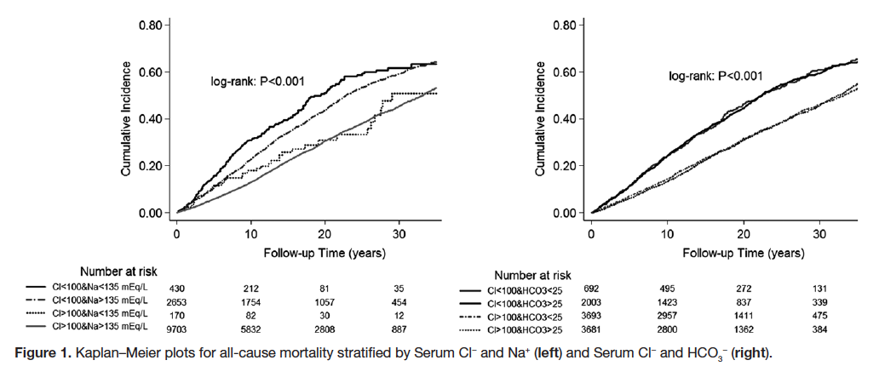
Outcome studies
Glasgow Blood Pressure Clinic (GBPC)
12,968 treated hypertensive patients, 35 year follow up
Serum chloride <100 was associated with 20% higher all cause mortality, CV and non-CV mortality
McCallum et al. Hypertension. 2013;62(5):836-845

Slide 5
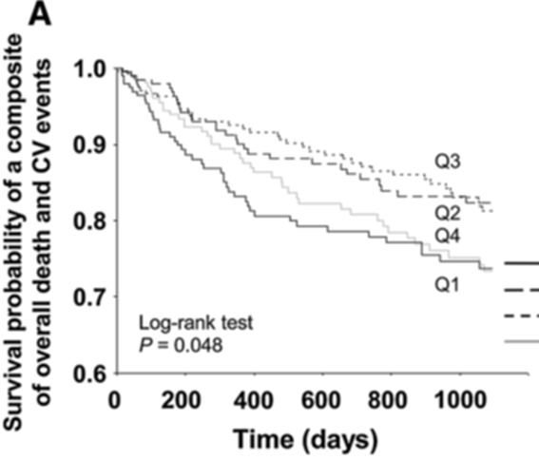

Outcome studies
Renal Failure
923 pre-dialysis CKD patients, median follow up 33 months
Increased risk of primary outcome (death or CV event) in Q1 (Cl⁻ <103.9mEq/L) and Q4 (Cl⁻ >108.1 mEq/L)
Mandai et al. Clin Exp Nephrol. 2017:21(1):104-111

Slide 6
Aim
To determine if serum chloride is associated with mortality risk in adults with type 2 diabetes mellitus

Slide 7
Methods
Study population
Data from NHSGGC SafeHaven
91,159 adults with T2DM
Patients stratified into 2 groups: serum
Serum chloride <100 mmol/L and ≥ 100 mmol/L
10 years follow up
Survival analysis
Cox-PH model used to study the association between serum chloride and mortality
Adjusted for age, sex, serum sodium

Slide 8
Outcomes
Primary
All-cause mortality
Secondary cardiovascular outcomes
Cardiovascular death
Death from MI
Death from heart failure
Death from stroke
Death from cancer

Slide 9
Demographics
 | All | Cl- <100 mmol/L | Cl- ≥100 mmol/L
 | N= 91,159 | N=13,459 | N=77,757 | P
Age, years (SD)
Female, N (%)
Serum chloride, mmol/L (SD)
Serum sodium, mmol/L (SD)
60.0 (15.7) | 60.6 (16.9) | 59.9 (15.5) | <0.001
42774 (47%) | 6270 (47%) | 36504 (47%) | 0.4
102.9 (3.6) | 96.7 (3.0) | 103.9 (2.5) | <0.001
138.6 (3.1) | 135.3 (3.8) | 139.2 (2.5) | <0.001

Slide 10
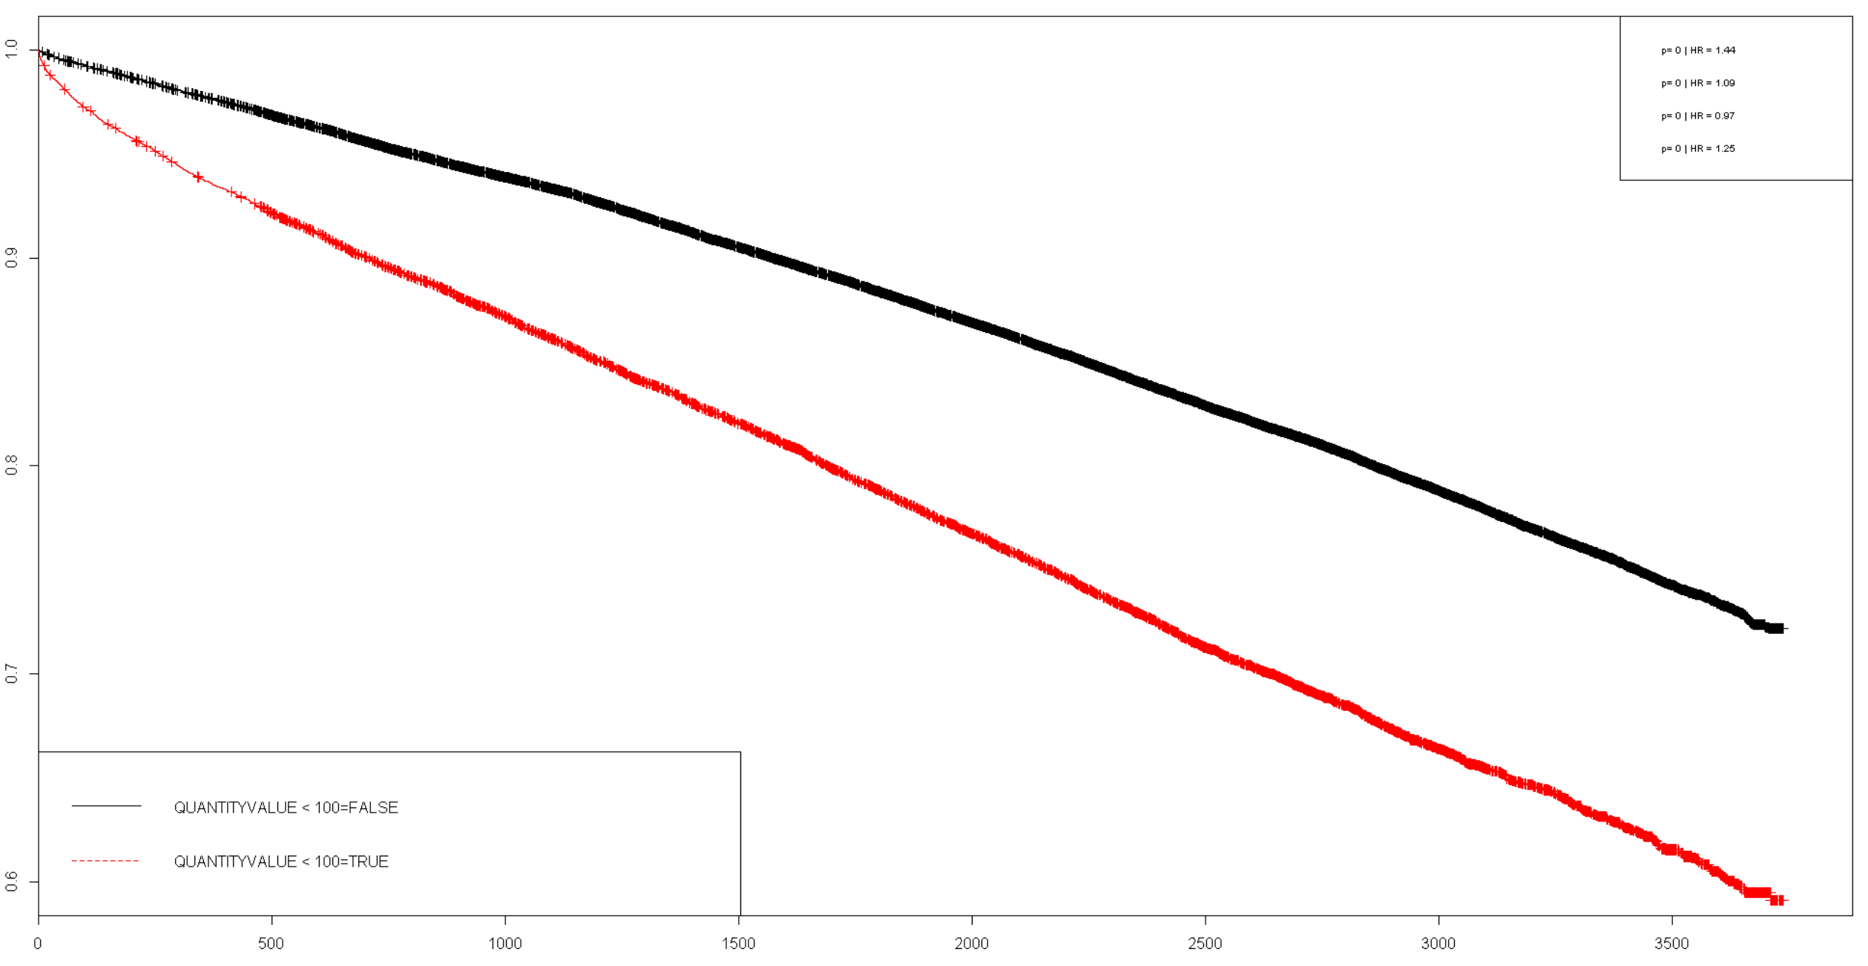
All-cause mortality
p < 0.001
HR 1.44
n at risk 91159. n events 20304
Cl >= 100 mmol/l
Cl < 100mmol/l

Slide 11
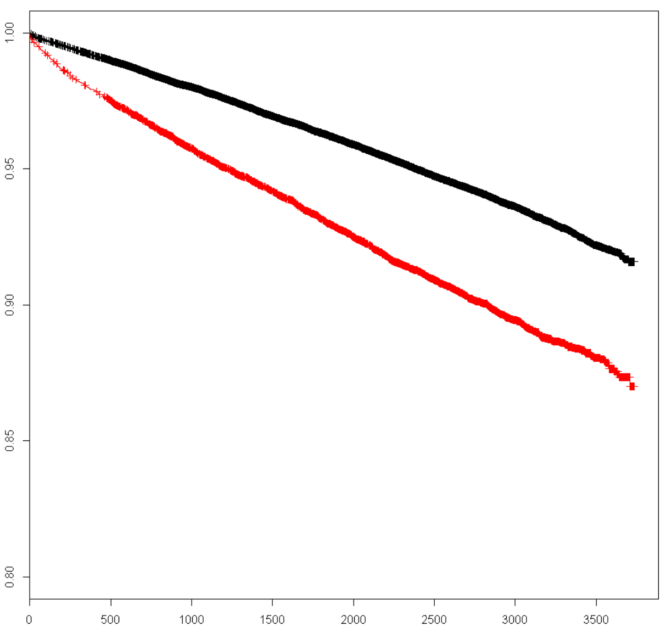
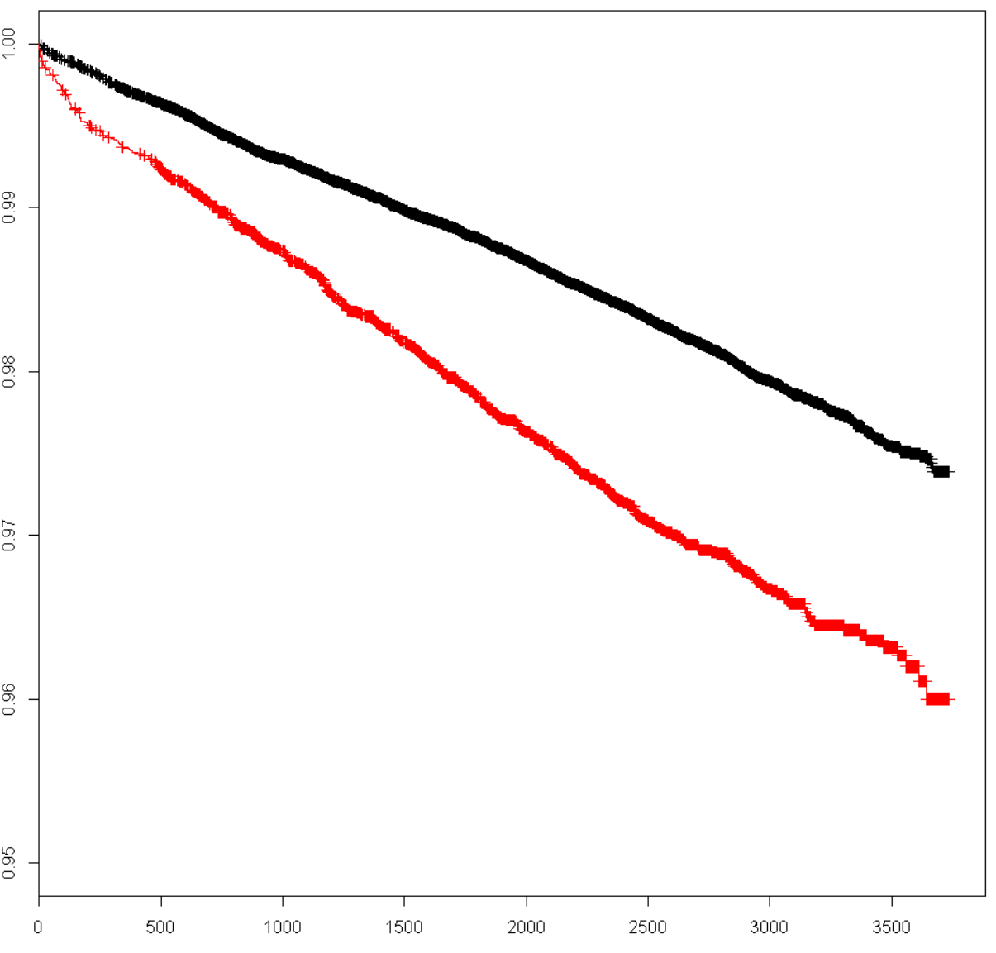
CV and MI death
vascular death. n.events = 6232
p < 0.001
HR = 1.41
MI. n.events = 1986
p < 0.001
HR = 1.41

Slide 12
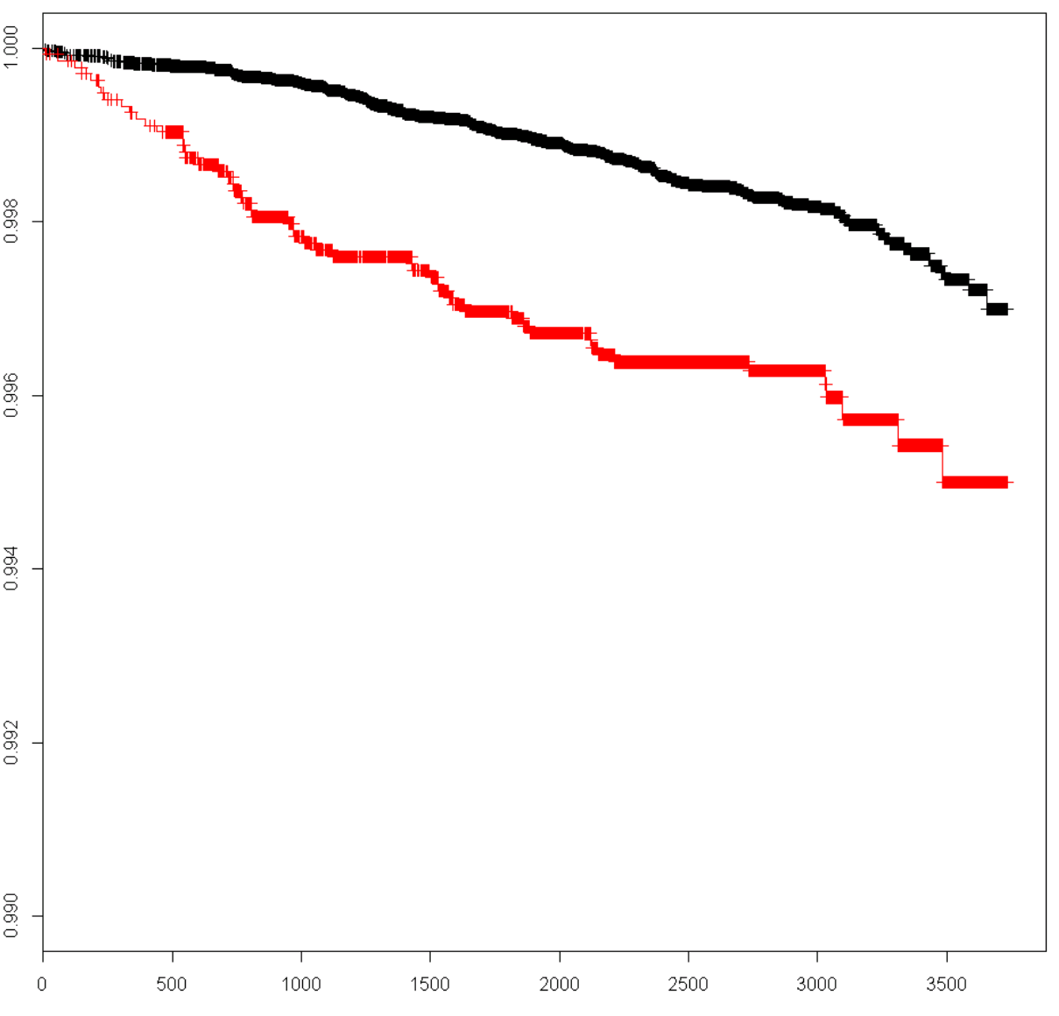
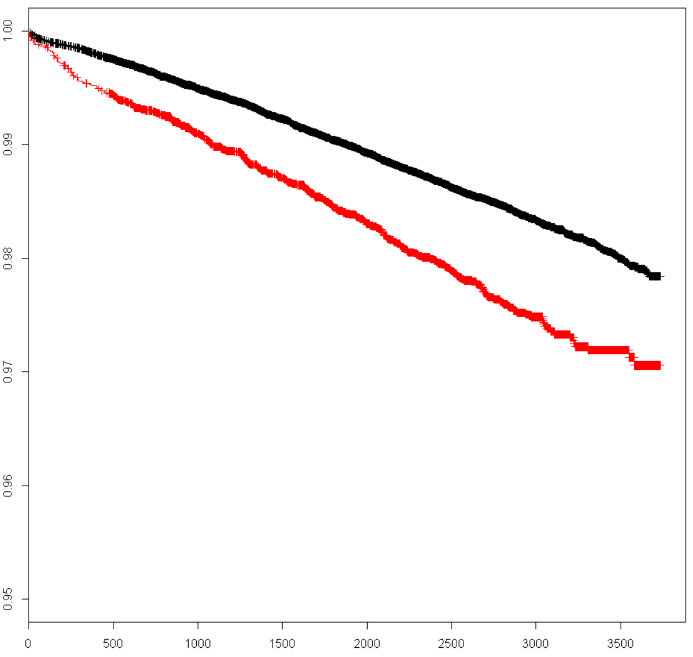
Heart failure and stroke death
heart failure. n.events = 200
p = 0.09
HR = 1.38
heart failure. n.events = 1590
p = 0.003
HR = 1.24

Slide 13
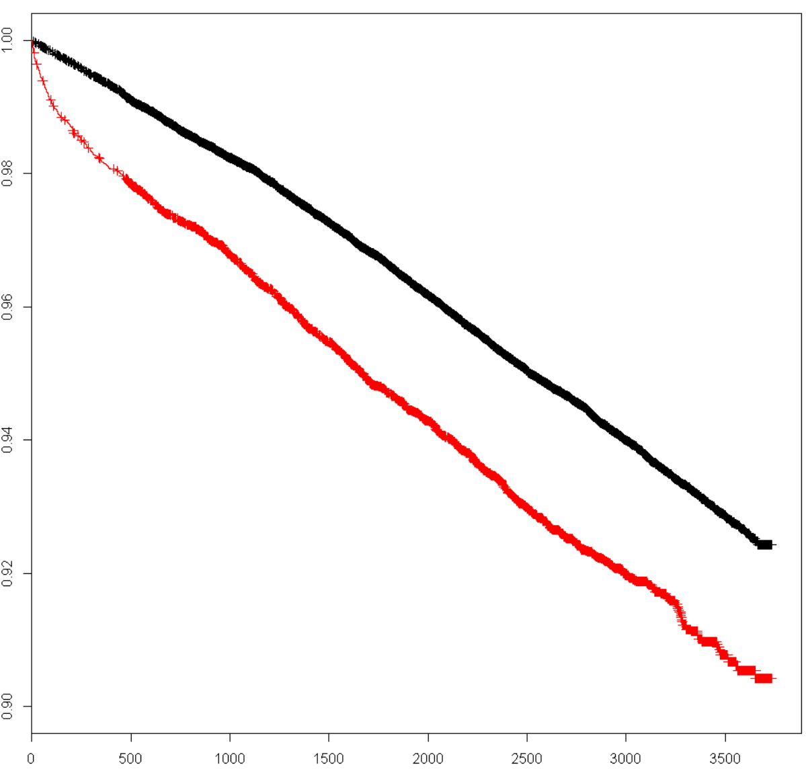
Cancer death
heart failure. n.events = 5577
p = 0.003
HR = 1.12

Slide 14
Conclusions
Serum chloride <100 mmol/L was associated with increased risk of death in adults with type 2 diabetes mellitus
Findings in keeping with studies in other populations
Mechanism by which low serum chloride is associated with mortality is unknown
Further study is warranted

Slide 15




#UofGWorldChangers
@UofGlasgow

