Slide 1
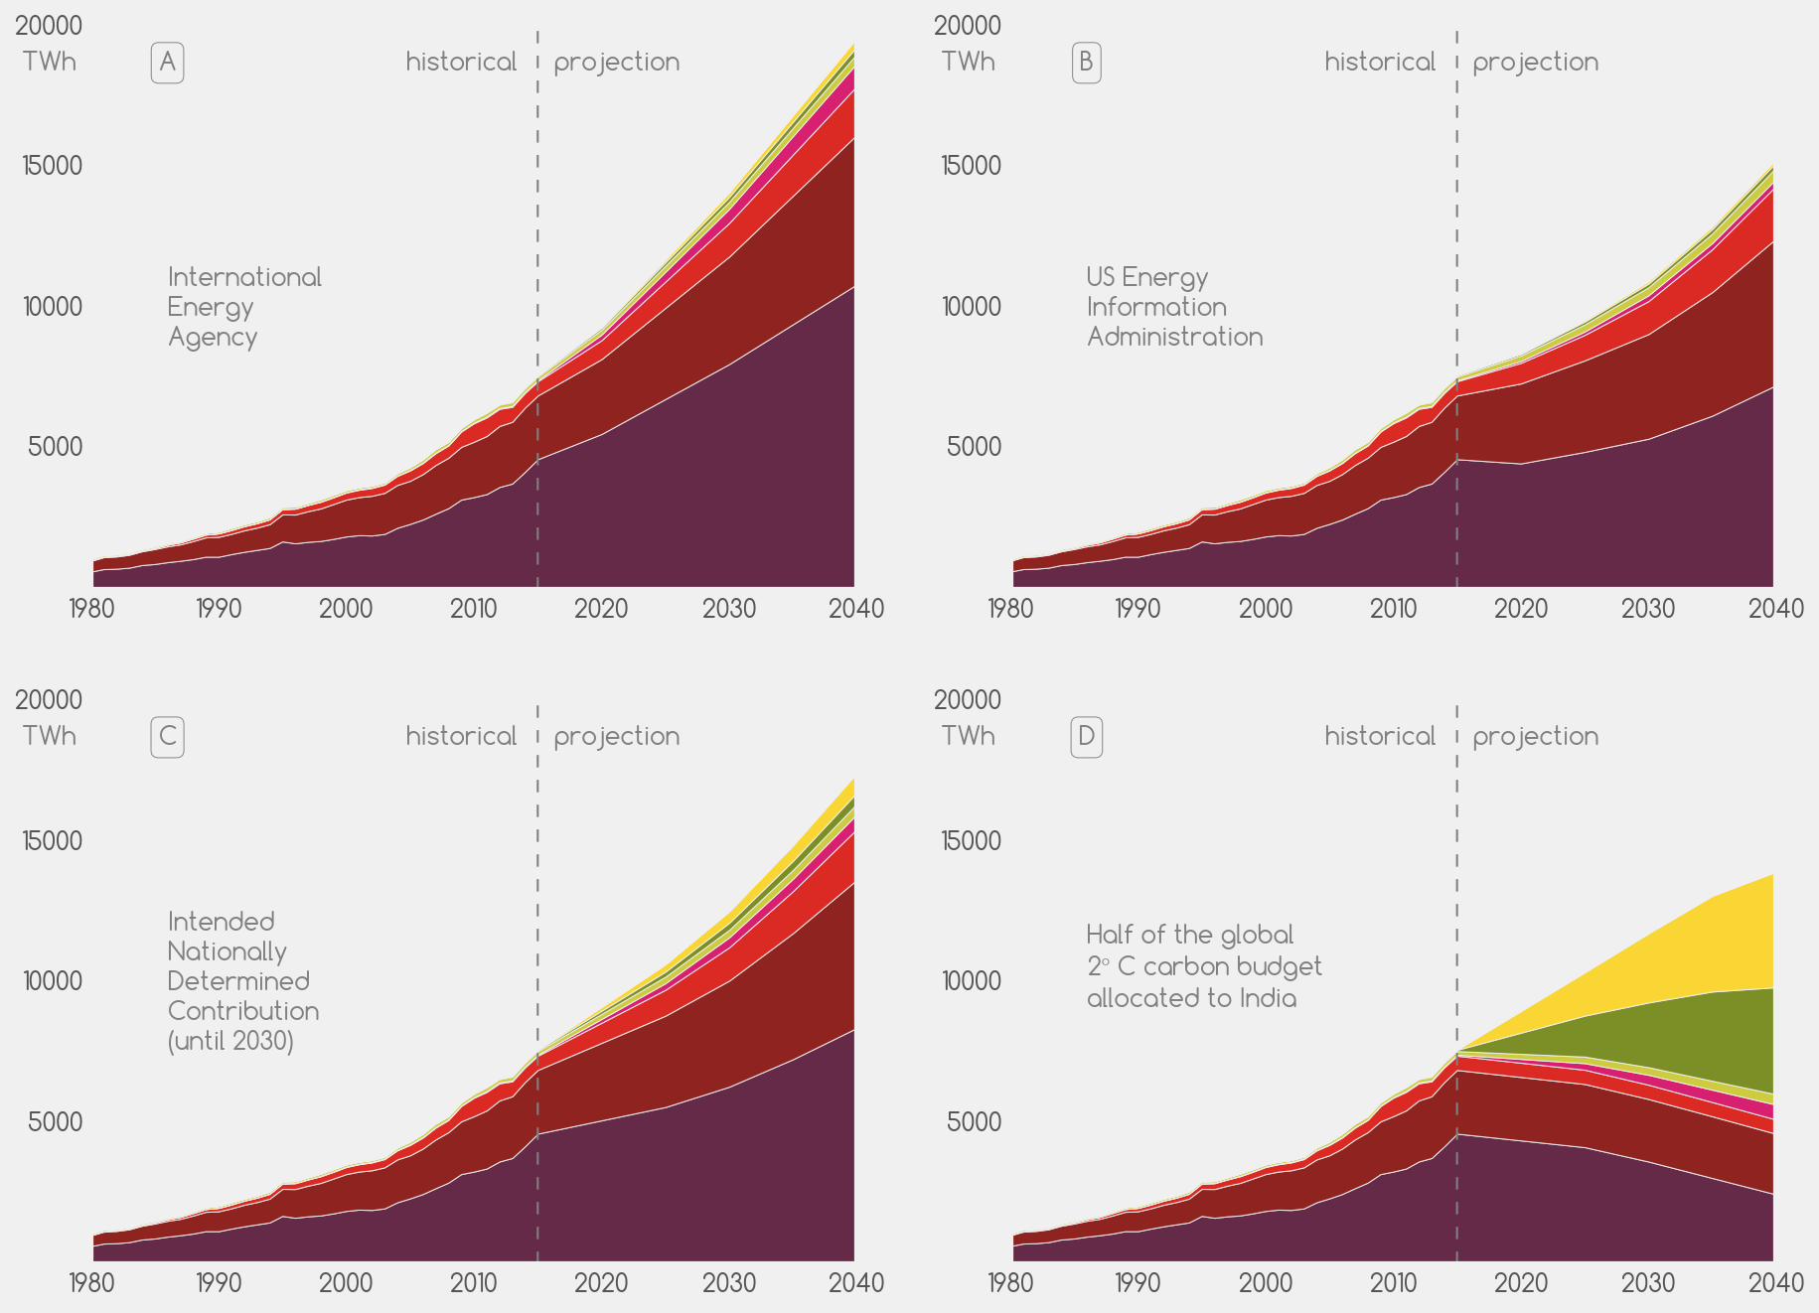







nuclear
hydro
gas
oil
photovoltaic
wind
coal

Slide 2
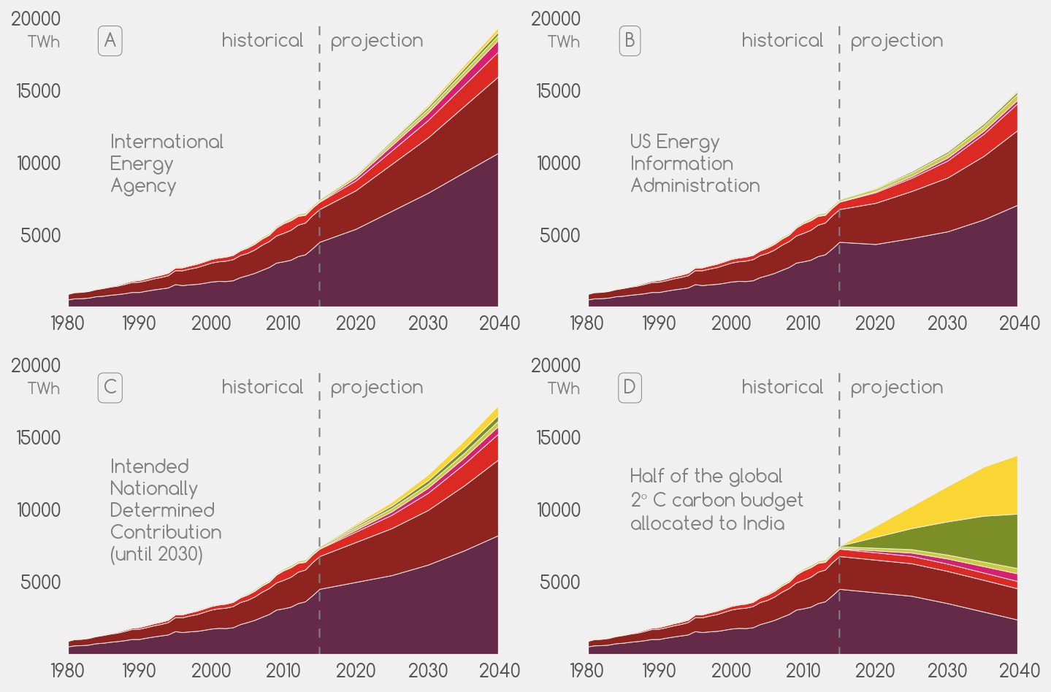
nuclear
hydro
gas
oil
photovoltaic
wind
coal

Slide 3
gas
oil
photovoltaic
wind
coal

