Slide 1
More on Sequential and Simultaneous Move Games
So far we have studied two types of games: 1) sequential move (extensive form) games where players take turns choosing actions and 2) strategic form (normal form) games where players simultaneously choose their actions.
Of course it is possible to combine both game forms as, for example, happens in the game of football.
The transformation between game forms may change the set of equilibria, as we shall see.
We will also learn the concept of subgame perfection

Slide 2
Combining Sequential and Simultaneous Moves.
Consider the following 2 player game, where Player 1 moves first:
If player 1 chooses to stay out, both he and player 2 earn a payoff of 3 each, but if player 1 chooses to enter, he plays a simultaneous move game with player 2.
Player 1
Player 2
Player 1 A B | A | B
 | 2,2 | 3,0
 | 0,3 | 4,4
Stay Out
Enter
3,3

Slide 3
Forward Induction
The simultaneous move game has 3 equilibria: (A,A), (B,B) and a mixed strategy equilibrium where both players play A with probability 1/3 and earn expected payoff 8/3.
If player 2 sees that player 1 has chosen to Enter, player 2 can use forward induction reasoning: since player 1 chose to forego a payoff of 3, it is likely that he will choose B, so I should also choose B.
The likely equilibrium of the game is therefore: Enter, (B,B).
Player 1
Player 2
Player 1 A B | A | B
 | 2,2 | 3,0
 | 0,3 | 4,4
Stay Out
Enter
3,3

Slide 4
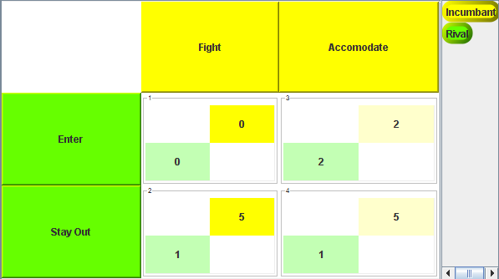
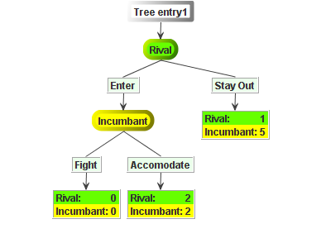
The Incumbent-Rival Game in Extensive and Strategic Form
How many equilibria are
there in the extensive form of this game?
How many equilibria are
there in the strategic form of this
game?

Slide 5
The Number of Equilibria Appears to be Different!
There appears to be just 1 equilibrium using rollback on the
extensive form game.
There appears to be 2 equilibria using cell-by-cell inspection of the strategic form game

Slide 6
Subgame Perfection
In the strategic form game, there is the additional equilibrium, Stay Out, Fight that is not an equilibrium using rollback in the extensive form game.
Equilibria found by applying rollback to the extensive form game are referred to as subgame perfect equilibria: every player makes a perfect best response at every subgame of the tree.
  Enter, Accommodate is a subgame perfect equilibrium.
  Stay Out, Fight is not a subgame perfect equilibrium.
A subgame is the game that begins at any node of the decision tree.
3 subgames (circled)
are all the games
beginning at all tree
nodes including the
root node (game itself)

Slide 7
Imperfect Strategies are Incredible
Strategies and equilibria that fail the test of subgame perfection are called imperfect.
The imperfection of a strategy that is part of an imperfect equilibrium is that at some point in the game it has an unavoidable credibility problem.
Consider for example, the equilibrium where the incumbent promises to fight, so the rival chooses stay out.
The incumbent’s promise is incredible; the rival knows that if he enters, the incumbent is sure to accommodate, since if the incumbent adheres to his promise to fight, both earn zero, while if the incumbent accommodates, both earn a payoff of 2.
Thus, Stay Out, Fight is a Nash equilibrium, but it is not a subgame perfect Nash equilibrium.
Lesson: Every subgame perfect equilibrium is a Nash equilibrium but not every Nash equlibrium is a subgame perfect equilibrium!

Slide 8
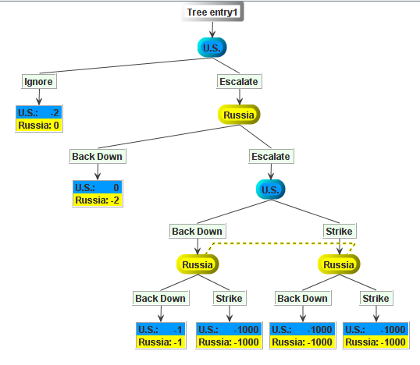
Another Example:
Mutually Assured Destruction (MAD)
What is
the rollback
(subgame perfect)
equilibrium
to this game?
A subgame
Another
subgame
Subgames must
contain all nodes in an
information set

Slide 9
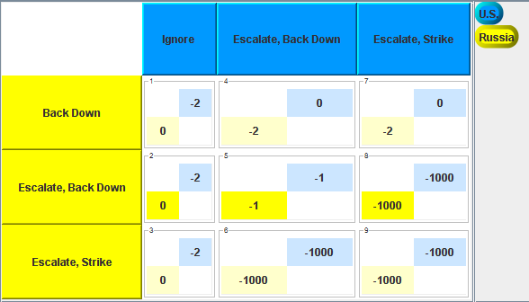
The Strategic Form Version of the Game Admits 3 Nash Equilibria
Which Equilibrium is Subgame Perfect?
Only the equilibrium where the strategies Escalate, Back Down are played by both the U.S. and Russia is subgame perfect. – Why?

Slide 10
From Simultaneous to Sequential Moves
Conversion from simultaneous to sequential moves involves determining who moves first, which is not an issue in the simultaneous move game.
In some games, where both players have dominant strategies, it does not matter who moves first.
  For example the prisoner’s dilemma game.
When neither player has a dominant strategy, the subgame perfect equilibrium will depend on the order in which players move.
  For example, the Senate Race Game, the Pittsburgh Left-Turn Game.

Slide 11
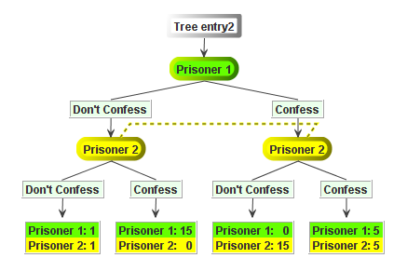
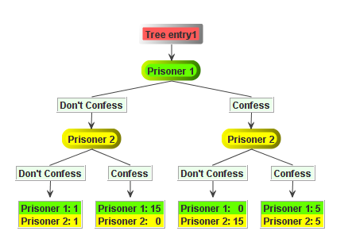
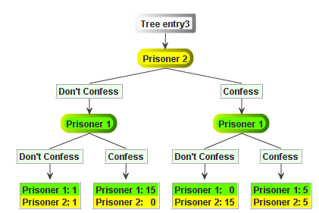
The Equilibrium in Prisoner’s Dilemma is the Same Regardless of Who Moves First
This simultaneous
move game is
equivalent to
either of the 2
sequential move
games below it.

Slide 12
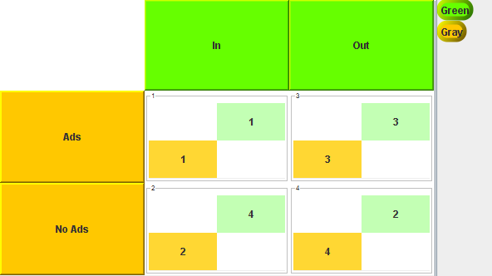
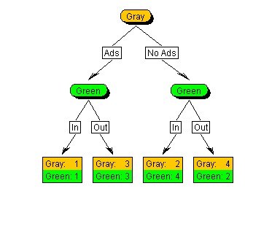
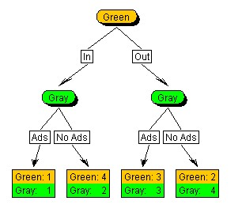
The Senate Race Game has a Different Subgame Perfect Equilibrium Depending on Who moves first.
In the simultaneous move game, there is only one Nash equilibrium.
subgame perfect eq,
subgame perfect eq,

Slide 13
Similarly, in the Pittsburgh Left-Turn Game
Driver 1
Driver 2
These subgame perfect equilibria look the same, but if Driver
1 moves first he gets a payoff of 5, while if Driver 2 moves
first Driver 1 gets a payoff of –5, and vice versa for Driver 2.

Slide 14
Going from a Simultaneous Move to a Sequential Move Game may eliminate the play of a mixed strategy equilibrium
This is true in games with a unique mixed strategy Nash equilibrium.
  Example: The Tennis Game
 |  | Venus Williams
 |  | DL | CC
Serena Williams | DL | 50, 50 | 80, 20
 | CC | 90, 10 | 20, 80

Slide 15
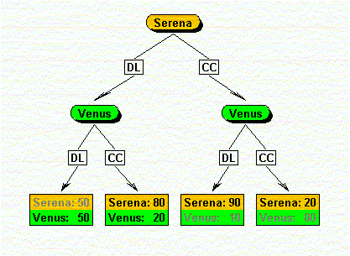
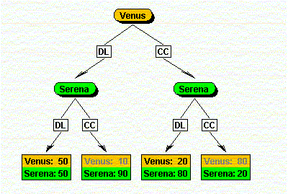
The Pure Strategy Equilibrium is Different, Depending on Who Moves First.
There is no possibility of mixing in a sequential move game without any information sets.

Slide 16
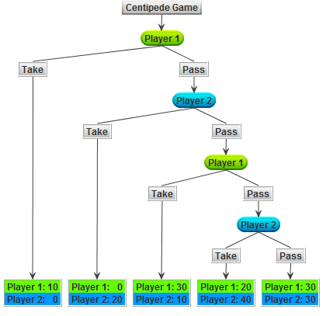
Empirical Plausibility of Subgame Perfection?
Consider the “Centipede Game”:
The original
game has 100
decision nodes
hence, the name.
For our purposes,
four nodes will
suffice.

Slide 17
Unique Subgame Perfect Equilibrium
Player 1 chooses Take at the First Opportunity.
Empirically it takes time for players to figure this equilibrium prediction out.
Players are boundedly rational

Slide 18
Strategic Moves
So far we have supposed that the rules of the game were fixed, e.g., who moves first, the timing of decisions, payoffs, etc.
In real strategic situations, players will have incentives to attempt to manipulate the rules of the game/action choices/payoffs available for their own benefit.
  E.g. who moves first, what choices remain, etc.
A strategic move is an action taken outside the rules of the game effectively transforming the original game, into a two-stage game—such moves are sometimes called “game-changers.”
Some kind of strategic move is made in stage one and some version of the original game, possibly with altered payoffs, is then played in stage 2.
For strategic moves to work, they must (1) be observable to the other players and (2) irreversible (to the extent this is credible) so that they alter other player’s expectations and make the outcome more favorable to the player making the strategic move.

Slide 19
Kinds of Strategic Moves
Commitments:
  Irreversibly limit your choice of action thereby forcing the other player to choose his/her best response to your preferred action.
  E.g., in the Pittsburgh left-turn game, I hit the gas pedal hard and jump the light early to make my left turn, so your best response is to yield.
Threats: If you do not choose an action I prefer, I will respond in a manner that will be bad for you (in the second stage).
  E.g., if you do not support my bill in Congress, I will raise money for your opponent this November.
Promises: If you choose an action I prefer, I will respond in a manner that will be good for you.
  E.g., if you vote for my bill in Congress, I will send a check for your re-election campaign.
Note that both threats and promises are costly if they have to be carried out. However, if a threat works to alter the target player’s behavior, there is no cost to the player of issuing the threat, while if a promise works, there is a cost.

Slide 20
Why Strategic Moves?
Freedom of choice / a larger action space can be a bad thing.
  For example, allowing students to make up a midterm exam or perform extra credit is costly – a new exam, extra assignments have to be written/graded.
  By announcing and adhering to a no make-up, no extra credit, no exceptions policy and announcing it on day 1 of class, writing it into the syllabus, repeating it over and over, etc. your professor is made strictly better off.

Slide 21
Credibility of Strategic Moves
The problem with strategic moves, especially threats and promises is that they may not be credible.
  Ex-post, you may not want to carry out a costly threat or follow through with a promised reward.
Strategic moves that are not credible will be ignored.
The way to make strategic moves credible is to either take options off the table completely by making a truly irreversible move, or make it costly for the strategic mover to deviate from his strategic move, i.e., change the payoffs of the game so that following through with the strategic move is a best response in the second stage.

Slide 22
Illustration of Credibility Issue: Nuisance Lawsuits
Consider a game between a Plaintiff and a Defendant.
Plaintiff moves first, deciding whether to file a lawsuit against Defendant at cost to the Plaintiff of k>0. If a lawsuit is filed, the Plaintiff makes a take-it-or-leave it settlement offer of s>0.
Defendant accepts or rejects. If Defendant rejects, Plaintiff has to decide whether or not to go to trial at cost c>0 to the Plaintiff and at cost d>0 to the Defendant.
If the case goes to trial, Plaintiff wins the amount w with probability p and loses (payoff=0) with probability 1-p.
Assume that pw < c, and this fact is common knowledge-a critical assumption.

Slide 23
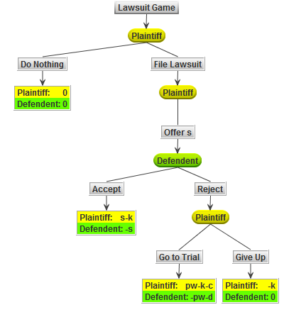
The Game in Extensive Form

Slide 24
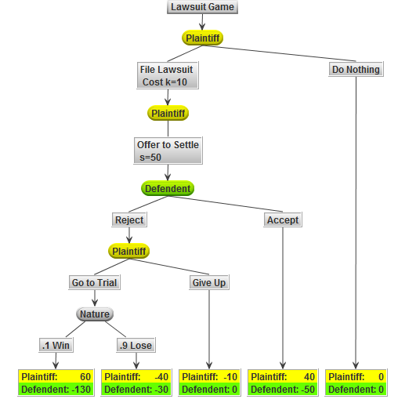
A Specific Parameterization of the Game to Play
k, cost of filing a lawsuit = 10
c=d=cost of a trial =30
Settlement offer =50
Winnings, w=100
Probability the Plaintiff wins,p=.10

Slide 25
The Lawsuit is Not Credible
The subgame perfect equilibrium is that the Plaintiff does nothing, as pw<c, so that pw-k-c <-k

Slide 26
How to Make the Nuisance Lawsuit Credible?
Consider the strategic move by which Plaintiff pre-pays his lawyer the costs of a trial, c, up-front (Plaintiff puts money in a non-refundable retainer account guaranteeing the attorney’s future availability for trial).
In this case the payoff to Give Up changes from –k to –k-c.
Plaintiff now goes to trial so long as pw>0, i.e. if there is any positive probability p of winning the amount w.
This further implies that the Defendant prefers to go to trial only if s>pw+d.
Defendant is now willing to settle for any amount s<pw+d.
So the settlement range is [pw, pw+d]. If the Plaintiff can make a take-it-or-leave-it offer, what is the settlement amount s?
Outcome is Plaintiff sues, offers to settle, and a settlement is reached.

Slide 27
Further Considerations
If Plaintiff settles, her payoff is s-k-c, where k is the cost of filing the lawsuit (threat), c is the retainer cost.
If Plaintiff can make a take-it-or-leave-it offer of s=pw+d, then the question remains as to whether the nuisance lawsuit should have been brought in the first place.
Since doing nothing yields a payoff of 0 (this is a nuisance lawsuit, no real harm was done), then we must have that: s-k-c>0 and if s=pw+d, then we require that pw+d-k-c>0.
One can further incorporate malice, whereby d enters positively in the plaintiff’s payoff from choosing to go to trial.

Slide 28
Another Example: Criminal Law
Accused criminal can plead guilty or not guilty.
If he pleads not guilty, the prosecutor can offer a full sentence, valued at s or a reduced sentence valued at r. For the prosecutor, s>r, but for the accused, the payoffs are losses: -s, -r, so -r>-s; the accused strictly prefers a reduced sentence.
Accused can accept prosecutor’s offer or reject it and go to trial.
Probability of being convicted, p, is assumed known.
Cost to the prosecutor of taking the case to trial=c.
Cost to the accused of defending himself at trial=d.
Suppose d/s > 1-p, probability of an acquittal. In this case, in equilibrium the prosecutor offers no reduction, and the accused pleads guilty and gets sentence s.
Strategic move: Accused requests a public defender (free lawyer), so that d=0. In response, the prosecutor offers a reduced sentence, r=ps-c<s; Accused accepts.
Logic: By eliminating the cost to the accused of going to trial, the accused will always go to trial rather than plead guilty since ps<s if p<1. Knowing this, prosecutor will cut a deal offering a reduced sentence of rps-c, greater than or equal to the prosecutor’s expected payoff from going to trial. The accused will only accept the lowest possible reduced sentence, r=ps-c. Prosecutor agrees to this deal as he is made indifferent between accepting it and going to trial.

Slide 29
Other Means of Acquiring Credibility
Delegation of your decision to a disinterested /non-emotional third party.
  If you do not pay by this date, a repo man is scheduled to take your car.
Legally binding contracts.
  If you violate parole, you will go back to prison.
Reputation may be a substitute for commitment in a repeated game setting –more on this next week.
  You have a reputation of getting angry if you don’t get your way. So you get your way.
Rational irrationality.
  You know I’m so crazy that I will follow through with the incredible threat.

Slide 30
Ways to Counter Strategic Moves
Counter sunk costs with sunk costs.
  In the nuisance lawsuit game the defendant can pay his lawyer in advance for the cost of a trial. Better yet, hire “in house” lawyers to deter nuisance suits in the first place.
Eliminate communication/observation – if a strategic move is not communicated/observed, it is useless.
  For example, I’m not going to look at your sign that reads “homeless, please help.”
Undermine an opponent’s need to carry out threats.
  I won’t tell if you make an exception for me; it can be “our little secret.”
Salami tactics: Reduce an opponent’s threat by complying to a very small degree, especially repeatedly over time, like cutting off and offering thin slices of salami. In this way, the threat is never triggered, though you may fail to completely comply.
  “Sorry for the delay. Times are tough for me right now. I can repay you this amount now and will send the rest of what I owe you shortly.”

