Slide 1
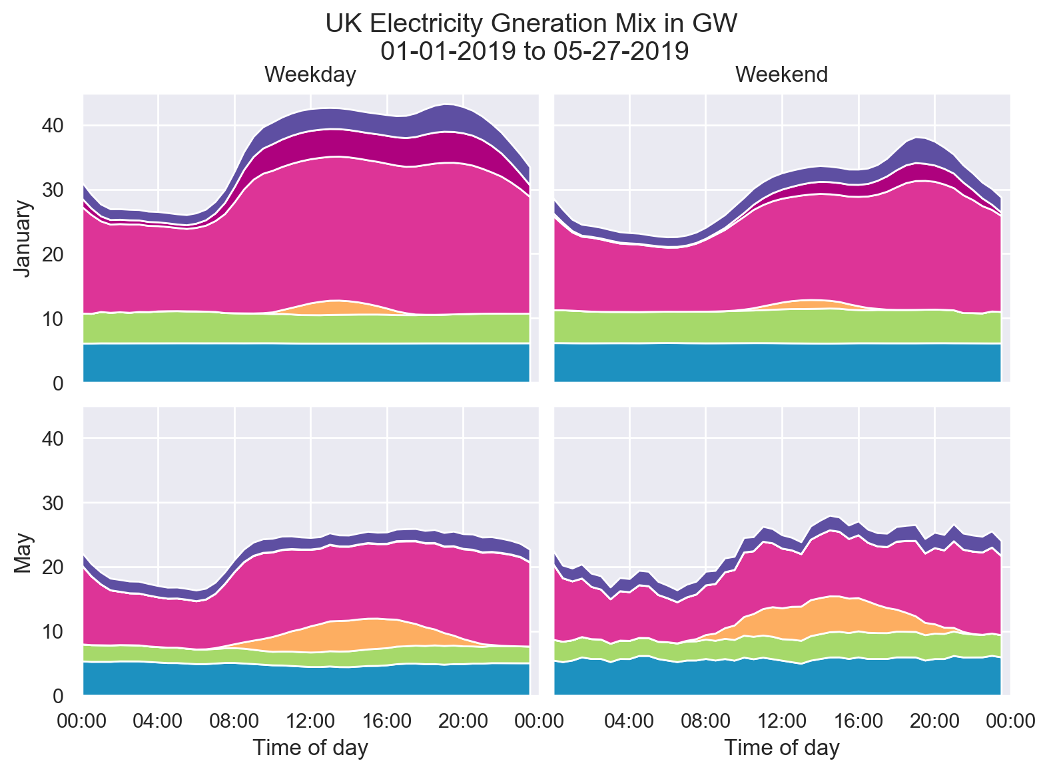






other
coal
natural gas
wind
solar
nuclear

Slide 2
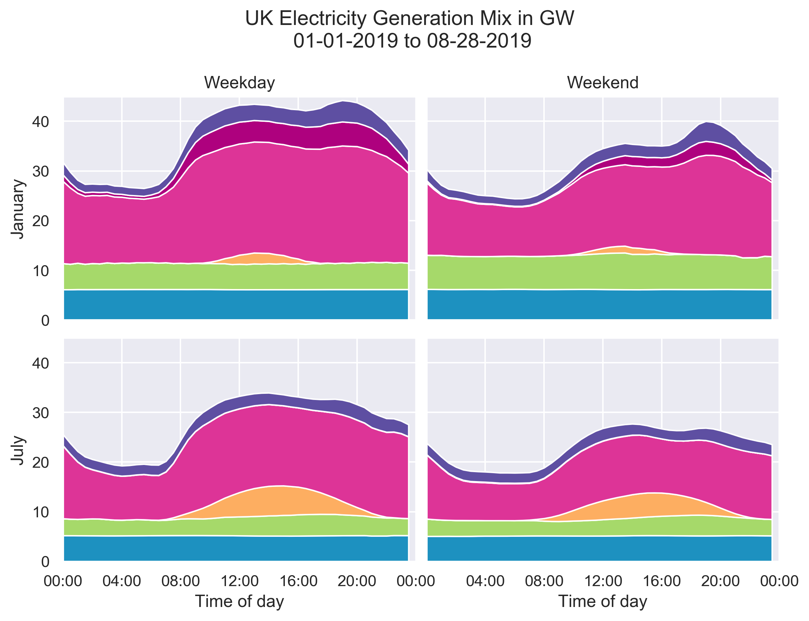
other
coal
natural gas
wind
solar
nuclear

