Slide 1

Artificial Intelligence
Minimax Algorithm
Tic-Tac-Toe

Slide 2
History of Minimax Algorithm
Two-player games
Proven in 1928

Slide 3
What is the Minimax Algorithm?
Decision rule used in AI
One player is the minimizer
Other is the maximizer

Slide 4
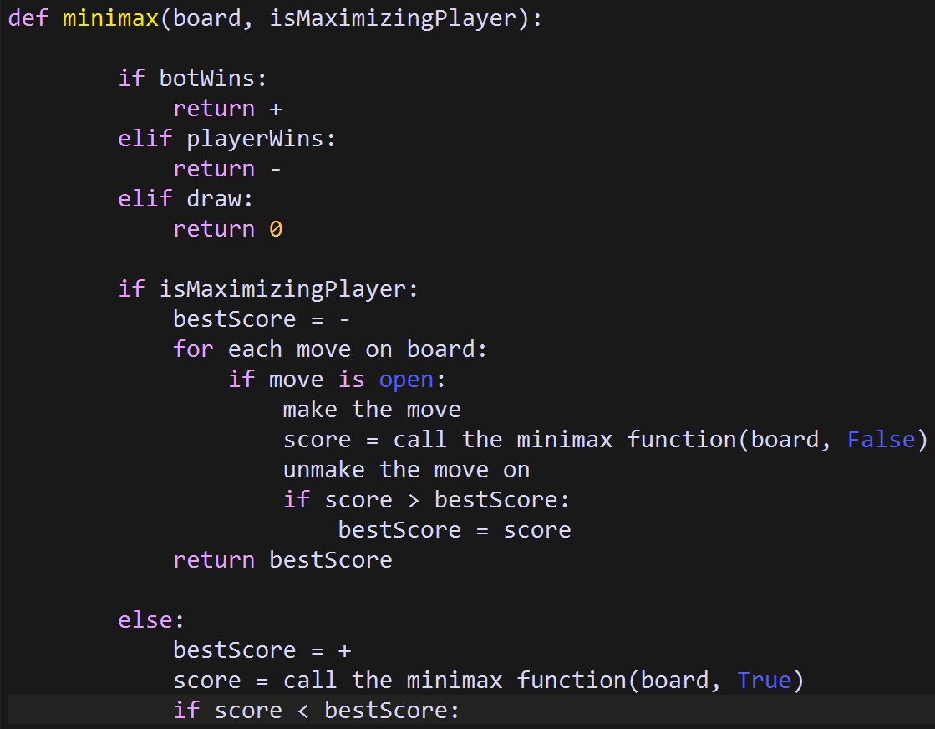
Minimax Function Pseudocode

Slide 5
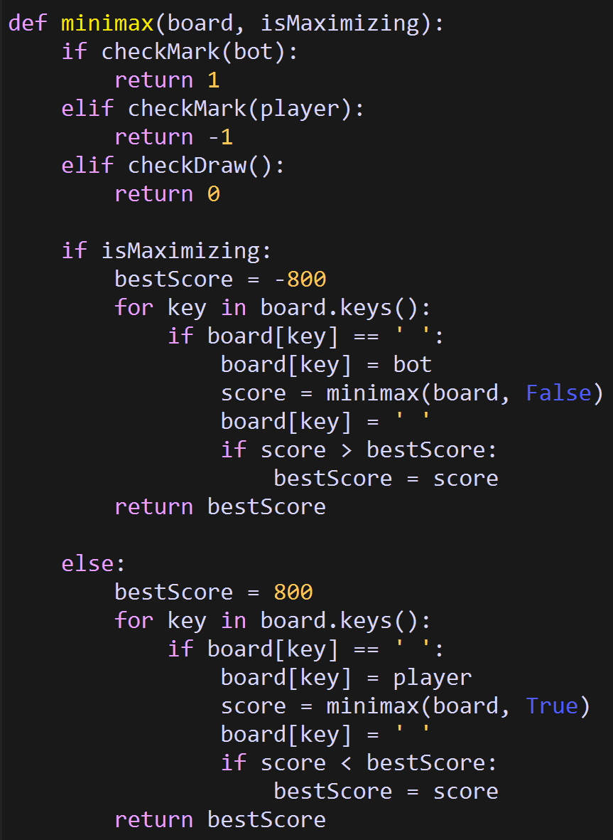
Minimax Function in my code

Slide 6
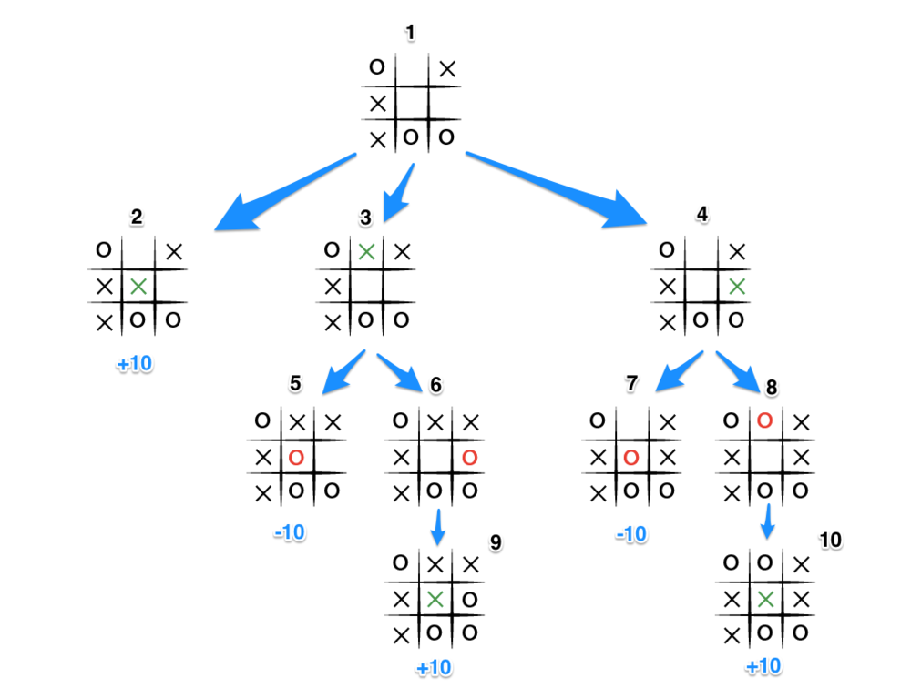
Game Tree

Slide 7

My Code

