Slide 1
Machine Learning Engineer with Microsoft Azure Udacity Nanodegree Program
Project 2
Operationalizing Machine Learning

Slide 2
Topics
Business case
Architecture
Demo
Manual deployment
Pipeline deployment

Slide 3
Assumptions
Machine Learning concepts
Azure Cloud Platform
Azure ML Studio
Azure AutoML
Azure CLI
Python
Python SDK for Azure
Jupyter notebooks

Slide 4
Business Case

Slide 5
Business Case - Dataset
Bank Marketing Data Set
https://archive.ics.uci.edu/ml/datasets/Bank+Marketing
Project Data Set
https://automlsamplenotebookdata.blob.core.windows.net/automl-sample-notebook-data/bankmarketing_train.csv
Additional Data Sets
https://automlsamplenotebookdata.blob.core.windows.net/automl-sample-notebook-data/bankmarketing_test.csv
https://automlsamplenotebookdata.blob.core.windows.net/automl-sample-notebook-data/bankmarketing_val.csv

Slide 6
Architecture

Slide 7
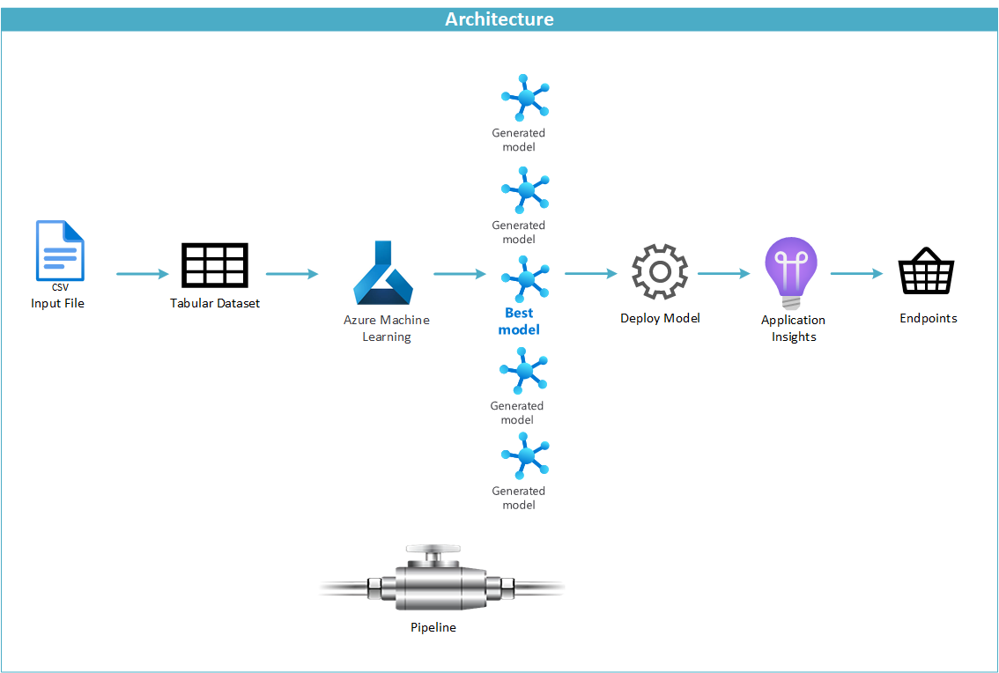

Slide 8
Demo
Manual Deployment
Generate the Model

Slide 10
Demo
Manual Deployment
Deploy the Model

Slide 12
Authentication
Login to Azure Cloud Platform
Add the Azure ML extension
Create the Service Principal
Assign access to the workspace and resource group

Slide 13
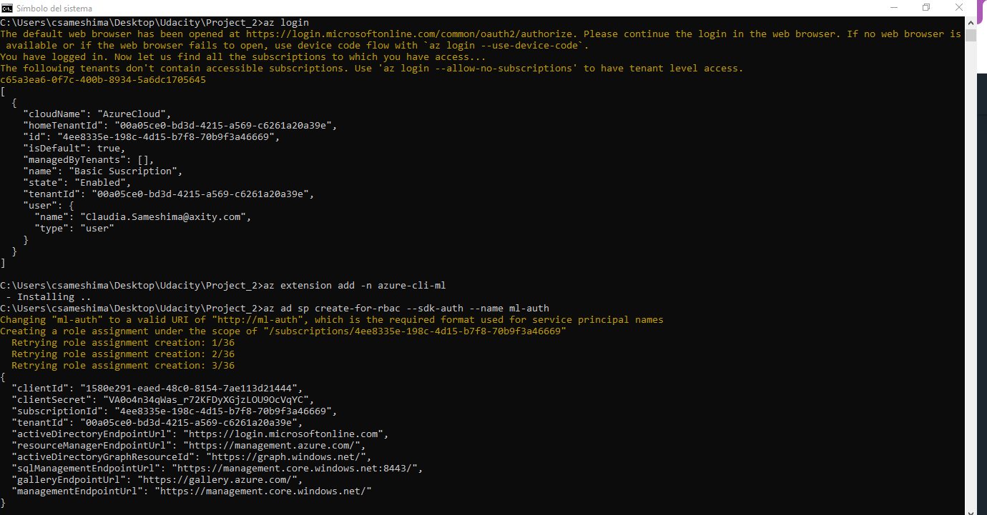

Slide 14
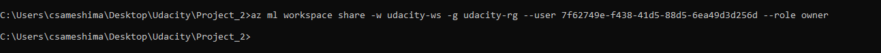

Slide 15
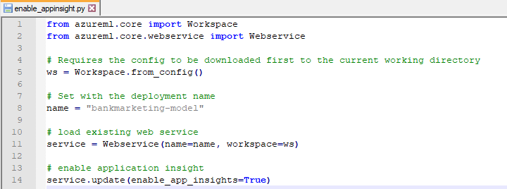
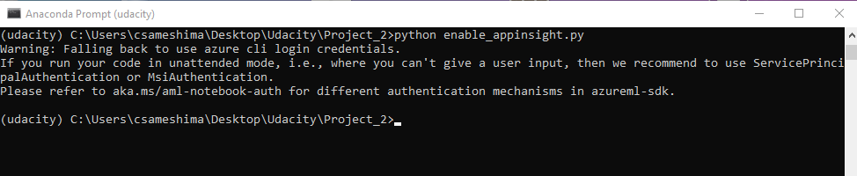

Slide 16
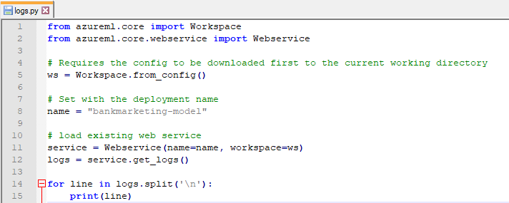
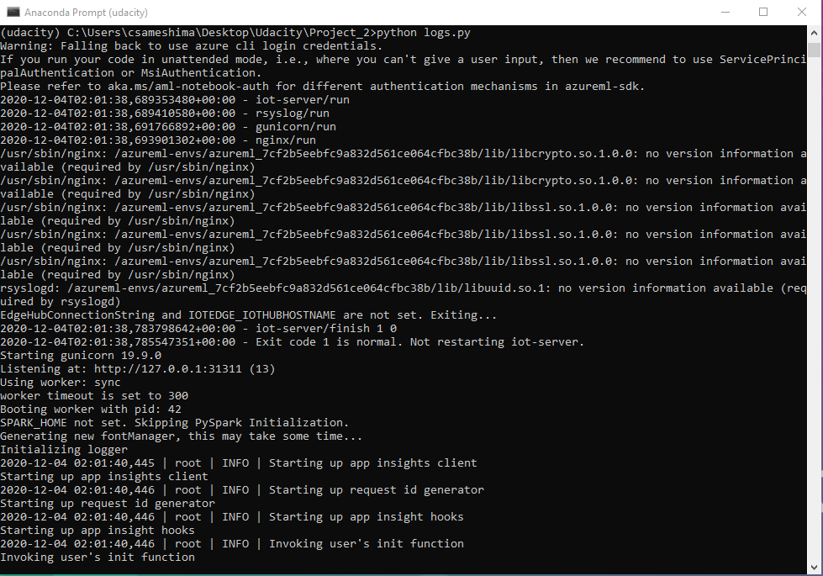

Slide 17
Demo
Manual Deployment
Consume Endpoints

Slide 19
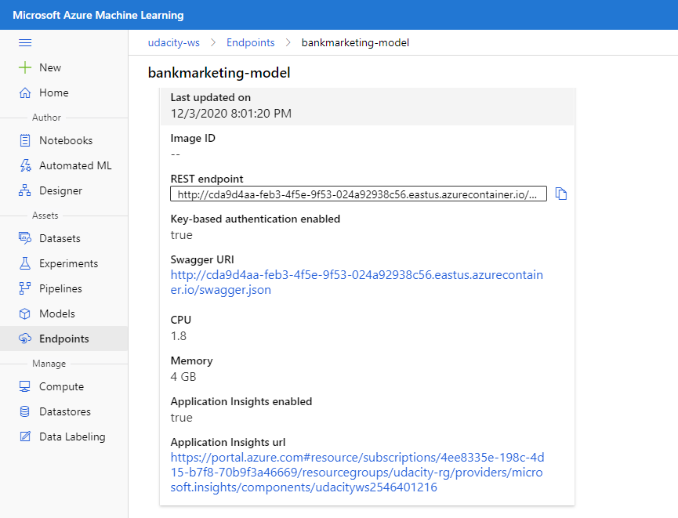

Slide 20
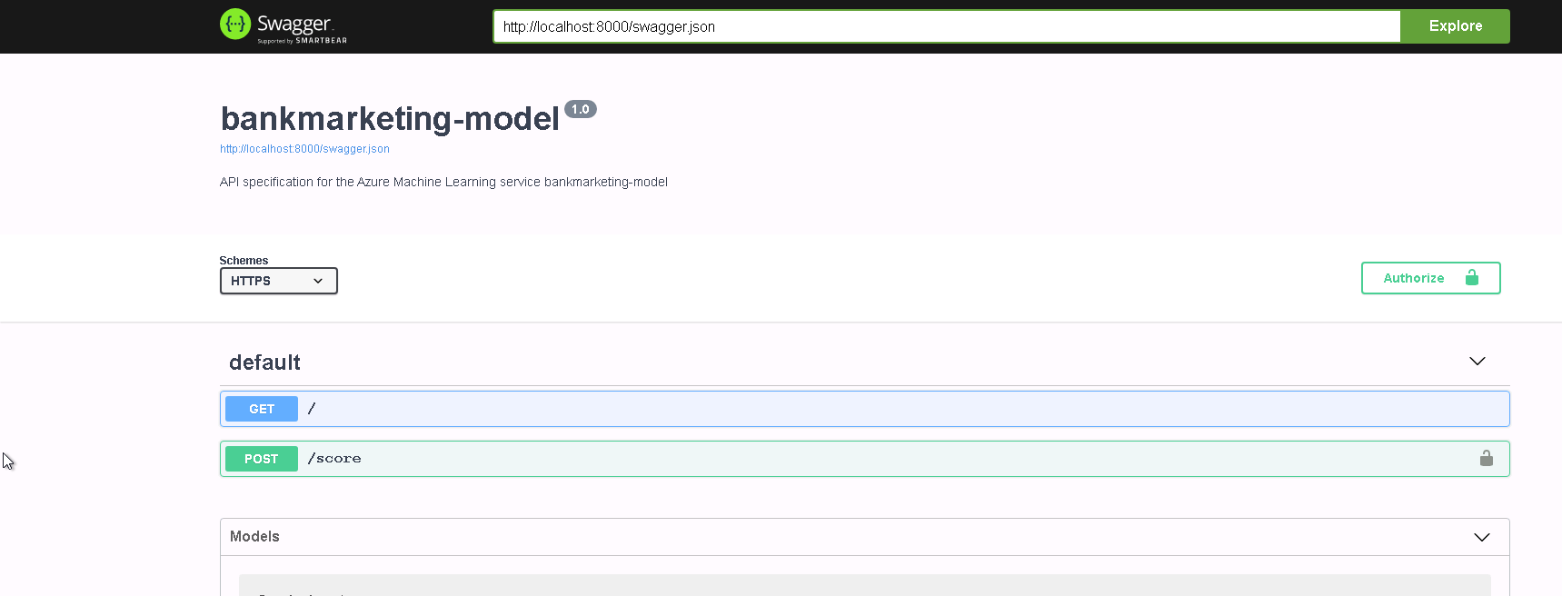

Slide 21
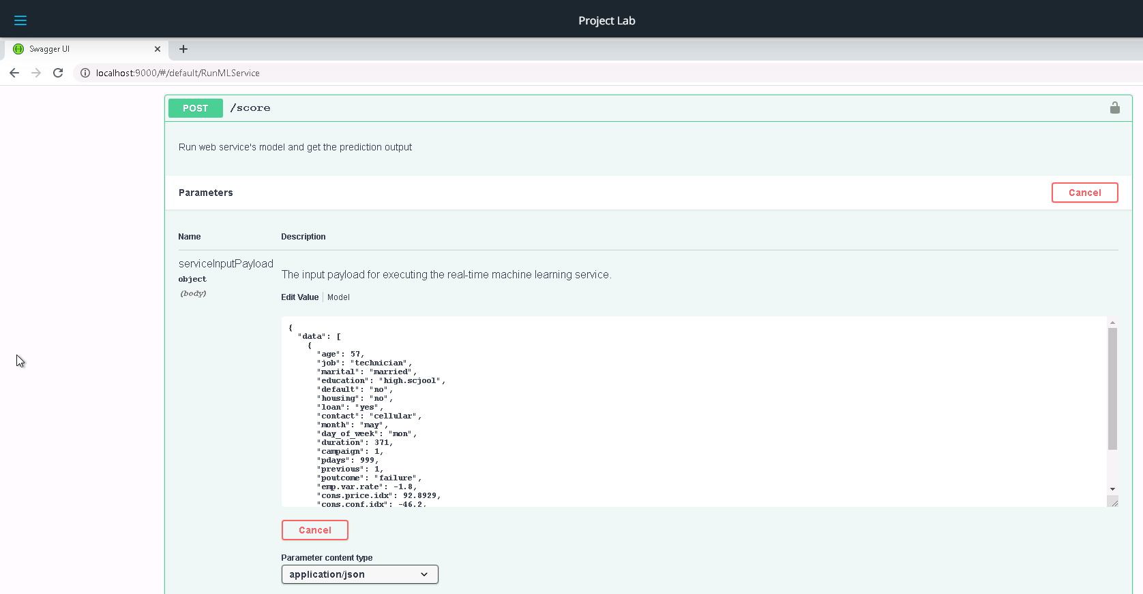

Slide 22
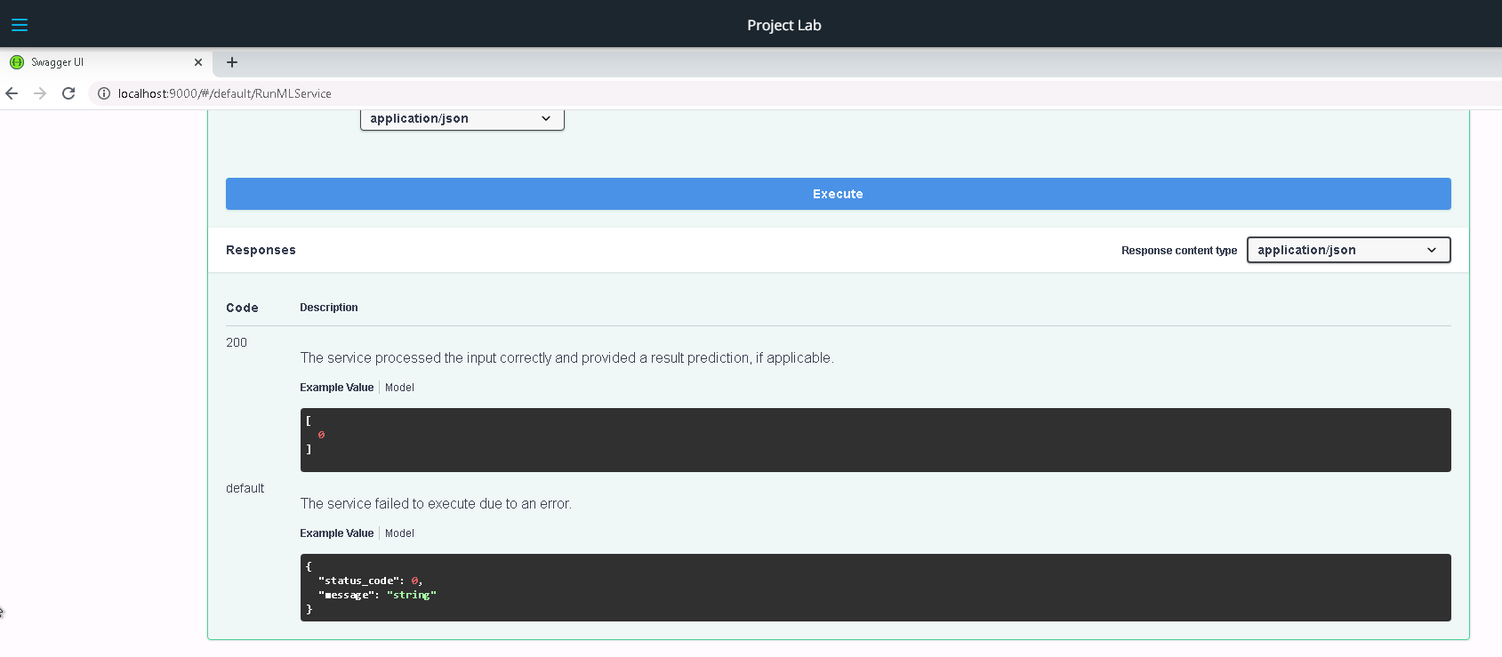

Slide 23
Demo
Pipeline Deployment

Slide 25


