Slide 1

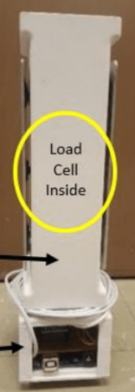
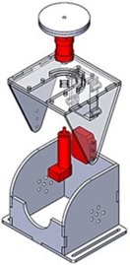
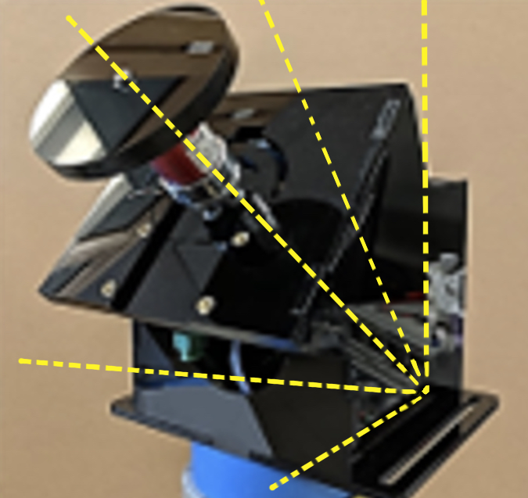
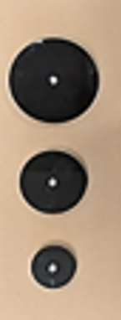
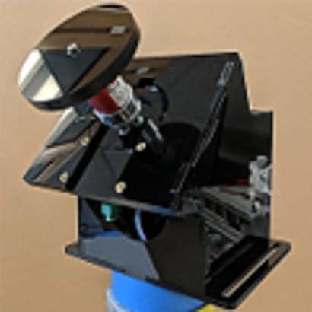
A user interface for evaluating hand force coordination in static and dynamic manipulation tasks
Samid Ceballos¹, Panadda Marayong, Ph.D.¹, and I-Hung Khoo, Ph.D.^{2,} and Vennila Krishnan, Ph.D., PT ³
^{[1]} Department of Mechanical and Aerospace Engineering, ^{[2]} Department of Electrical Engineering, ^{[3]} Department of Physical Therapy
INTRODUCTION:
Hand impairment is common in elderly over the age of 65 due to neuromuscular disorders and loss of skeletal muscle mass^{[1]}. Hand impairment makes activities of daily living, such as opening a jar difficult to accomplish.
Existing research focuses on turning torque^{[2,4]} and grasping independently^{[5]}.
Previous robot-assistive devices can provide intensive hand rehabilitation which promotes neuroplasticity; however, these systems are costly^{[4,5]}.
FORCE SENSING RESISTOR INTEGRATION:
ABSTRACT
In everyday interactions with objects, a synchronous coordination of grip force (G; normal to the object contact area) and load force (L; tangential component) is needed to prevent object slippage or breakage. Visual and haptic feedback play a key role within the central nervous system to produce efficient manipulation. Hand impairment makes activities of daily living, such as holding a cup of water challenging. This work redesigns a user interface to measure grip force and load force for evaluation and rehabilitative training of individuals with hand impairment, such as stroke survivors. The redesigned interface includes an adjustable wrist brace, and a visual feedback display. The device allows for testing static and dynamic manipulation tasks similar to grabbing an object or lifting and holding a glass of water. The design enables changing the object’s weight for different testing conditions. Additionally, the manipulation tasks can be unidirectional (motion or force in one direction) or bidirectional (sinusoidal motion or force). Previous work highlighted the decrease of G-L coordination in bidirectional tasks. We aim to investigate the effect of wrist angle on G-L coordination and visual feedback, such as force trajectory tracking, on grip force modulation. A preliminary study will be conducted with healthy subjects to obtain baseline data. Additional studies will follow with individuals with hand impairment.
Electrical resistance is inversely proportional to the applied force
Thin and flexible characteristics allows integration of the FSR on the knob to measure applied grasping force
Enables analyzing the relationship between grasping force and turning torque
Load Cell Inside
A device was developed to measure hand turning torque and grasping force for evaluation and rehabilitative training of individuals with hand impairment, such as individuals with Multiple Sclerosis.
Previously, a device was developed to assess grip force vs load force and
arm movement coordination in static and dynamic manipulation tasks^{[3]}.
Graphical User Interface (GUI):
Developed in LabVIEW to display experiment parameters
Redesigning to provide visual feedback to the user and a grasping force parameter for the operator
.
Hand Cup Body
Figure 4:
SolidWorks model of FSR and Knob.
Electronics Chassis
Figure 1: Grip-Load Device
OBJECTIVE:
Further develop the hand grasp device by integrating a force sensor to measure grasping force and analyze the relationship between grasping force and turning torque to fill in the existing literature gap.
EXISTING DEVICE:
Hardware/Software
DC motor with encoder for variable turn resistance and turn angle measurement
Torque sensor to acquire turning torque
Arduino Mega 2560 microcontroller for sensor integration and actuation control and LabVIEW
Acrylic structure with three available
knob sizes and five planes from
the horizontal
Torque
Sensor
Turnable
Knob
Figure 5: System design layout
Figure 6: GUI designed in LabVIEW
TEST MEASUREMENTS:
45°
90°
67.5°
4in
45°
67.5°
90.0°
4in
For Both Dominant and Non-Dominant Hands:
Grasping force against turning torque at various turn resistance
Maximum turning torque at varying knob sizes, wrist extension, and in pronation and supination
DC Motor with encoder
3-in
Target over- and undershoot of turn angle at different resistance
Turning torque during target angle test
3-in
2-in
Amplifier
22.5°
2-in
Figure 2:​
SolidWorks assembly without Arduino Mega ​and motor shield
22.5°
(b)
(a)
(b)
(a)
0°
0°
Figure 3:
(a) Device at a 45° plane from the horizontal (b) Available knob sizes
FUTURE WORK:
Test the functionality of the device with healthy subjects
Pilot study with individuals with hand impairment
REFERENCES:
Carmeli, E., et al. “The Aging Hand.” The Journals of Gerontology: Series A, vol. 58, no. 2, 1 Feb. 2003, doi:10.1093/gerona/58.2.m146.
Gurari, N., and A. M. Okamura. “Human Performance in a Knob-Turning Task.” Second Joint EuroHaptics Conference and Symposium on Haptic Interfaces for Virtual Environment and Teleoperator Systems (WHC'07), 2007, doi:10.1109/whc.2007.71
Herrera, D. "Hand Force and Arm Movement Coordination in Static and Dynamic Manipulation Tasks." California State University, Long Beach, 2018. [MS Thesis]
Kazemi, H., et al. “A Robotic Interface to Train Grip Strength, Grip Coordination and Finger Extension Following Stroke.” 2012 Annual International Conference of the IEEE Engineering in Medicine and Biology Society, 28 Aug. 2012, doi:10.1109/embc.2012.6346820.
Metzger, J., et al. “Design and Characterization of the ReHapticKnob, a Robot for Assessment and Therapy of Hand Function.” 2011 IEEE/RSJ International Conference on Intelligent Robots and Systems, 25 Sept. 2011, doi:10.1109/iros.2011.6094882.
Romeo, R.A, et al. "Development and preliminary testing of an instrumented object for force analysis during grasping," 2015 37th Annual Conference of the IEEE Engineering in Medicine and Biology Society (EMBC), Milan, 2015, doi: 10.1109/EMBC.2015.7319935.
Integration of Grip-Load Device for a complete hand function assessment
ACKNOWLEDGEMENTS:
This research was supported by the National Institute of General Medical Sciences of the National Institutes of Health under Award Numbers; UL1GM118979; TL4GM118980; RL5GM118978. The content is solely the responsibility of the authors and does not necessarily represent the official views of the National Institutes of Health. The authors would like to thank Don G. Napasindayao for initial development of the device and his support.

