Slide 1
DOCKER SWARM

Slide 2
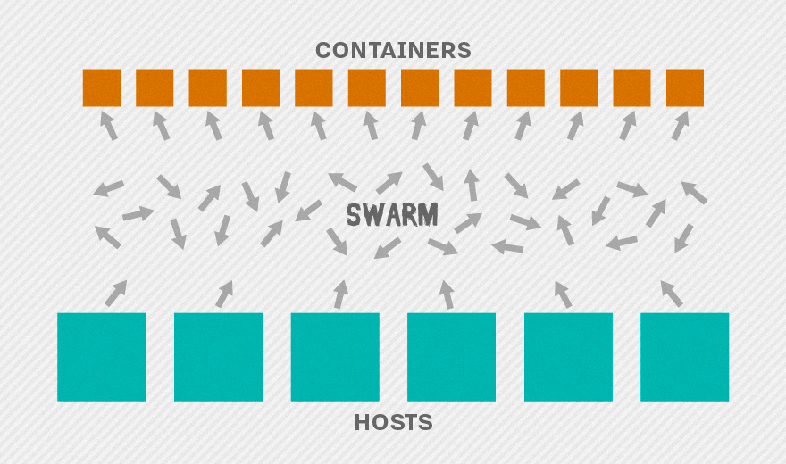
Docker Swarm
Docker Swarm is a clustering and scheduling tool for Docker containers.
Feature highlights
Cluster management integrated with Docker Engine
Declarative service model
Scaling
Desired state reconciliation
Load balancing
Rolling updates

Slide 3
Architecture ( in our case)
One Master
Master machine will monitor where to place the containers(running instance of an image) in the node/worker machine.
Two Worker Machines
Worker machine also known as nodes will run the containers.

Slide 4
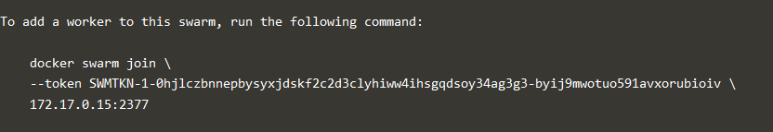
Creating Master
Launch a bare metal Ubuntu Machine in AWS
Install Docker in the newly launched machine.
Initialise the master as docker swarm.
e.g.: docker swarm init --advertise-addr <MANAGER-IP>
Master Machine will expose a token for the worker/node machine to connect with the Master machine.
Use this token in the node machine to connect to master.

Slide 5
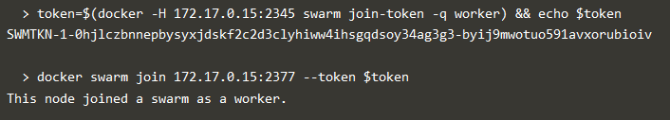
Creating Worker/Node Machine
Launch two bare metal instances of Ubuntu Machine in AWS.
Install Docker in the newly launched Ubuntu machines.
After installing docker join this machine as a worker with the master machine.
Now we are ready to deploy our images, scale the applications and Load balance the application using external Load Balancer.
Note: While joining nodes with master, make sure the nodes are able to communicate with the master.

Slide 6

Deploy Application
First, create an Overlay Network.
The overlay network is used to enable containers on different hosts to communicate.
Deploy service.
Use this overlay network to deploy a new application. Here we are deploying application eureka with 5 replicas.
.

Slide 7
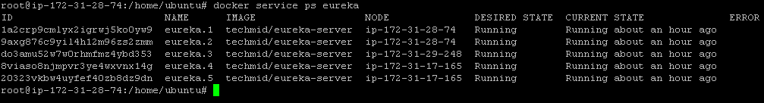
Deploy Application – cont.
Check the status of the deployed service.
We can see that the service scaled as 5 is running in three different Ips (one master and two nodes).
Since we have publish port 8761, we can use the same port to access our application.

Slide 8
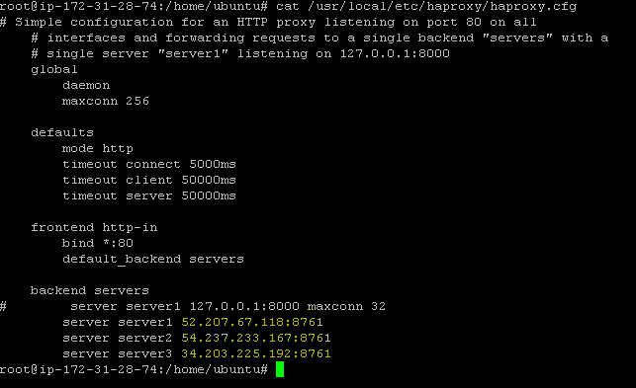
Use External Load Balancer.
Since our application when scaled will be running in various IPs, we need an external load balancers to connect to all the Ips as a common point.
Use load balancers like haproxy or nginx to connect to our applications.
Here we are using haproxy to configure the Ips.
Create a configuration file for haproxy named haproxy.cfg with contents below
.

Slide 9
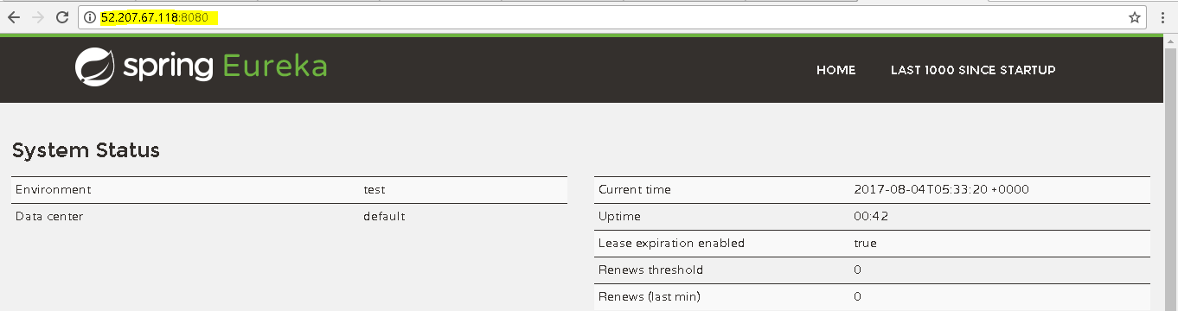
Start the Load Balancer and Access the application in a common IP
Use docker image for haproxy .
Configure the haproxy to use our configuration file.
Start the haproxy server.
haproxy will run in port 8080, we can access the application using this port.

Slide 10
Summary
Initialised Docker swarm with one master and two nodes.
Launched an application as a service with 5 replicas in master.
The services get deployed in all the nodes.
Used an external Load Balancer(haproxy) to connect to application running in various Ips.

