Slide 1
Hazelcast 3.6

Slide 2
Agenda
Overview
Member Installation
Mancenter Deployment
Client Implementation
Features
Use-cases
Data Storage
Architecture
In-Memory Data Grid
Web Session Clustering
Hazelcast Jcache

Slide 3
Overview
Hazelcast is an open source In-Memory Data Grid (IMDG).
It provides elastically scalable distributed In-Memory computing, widely recognized as the fastest and most scalable approach to application performance.
Hazelcast is designed to be lightweight and easy to use.
Hazelcast makes distributed computing simple by offering distributed implementations of many developer friendly interfaces from Java such as Map, Queue, Lock, and JCache.
Distributed applications can use Hazelcast for distributed caching, synchronization, clustering, processing, pub/sub messaging, etc.
Hazelcast is implemented in Java and has clients for Java, C/C++, .NET and REST.

Slide 4
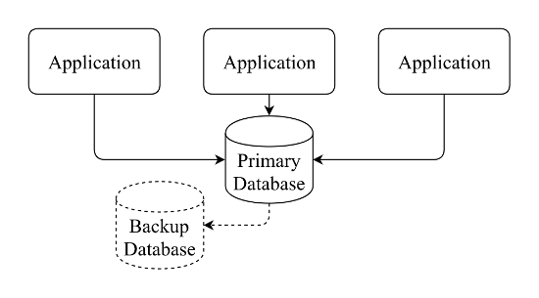
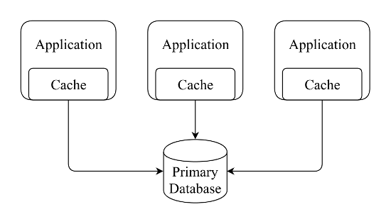
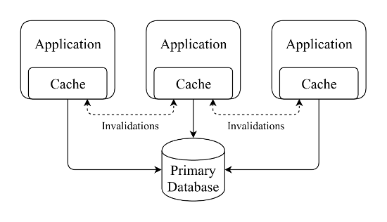
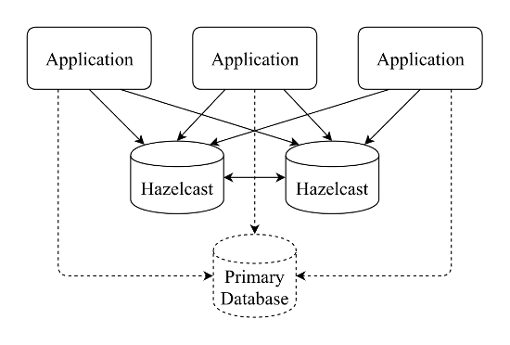
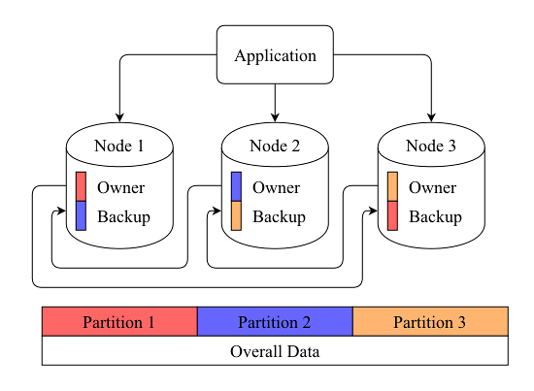
Approach to Handle Data

Slide 5
Member Installation Steps
Download Hazelcast 3.6 zip from http://download.hazelcast.com/download.jsp?version=hazelcast-3.6&p=171028013171028013
Extract the Hazelcast-3.6.zip file into working directory.
Following attributes value needs to be modified in Hazelcast.xml which is available under bin directory.
Group ➔ Cluster group name & password that would be used to enable multi node with same group name
management-center ➔ It should be enabled with mancenter web application link that provides consolidated statistic report includes all clustered members.
network – multicast ➔ It should be enabled to access all clustered members which are available in same network.
Run the start.bat to up the Hazelcast server
Do the same step to enable the more Hazelcast members/servers within same group

Slide 6
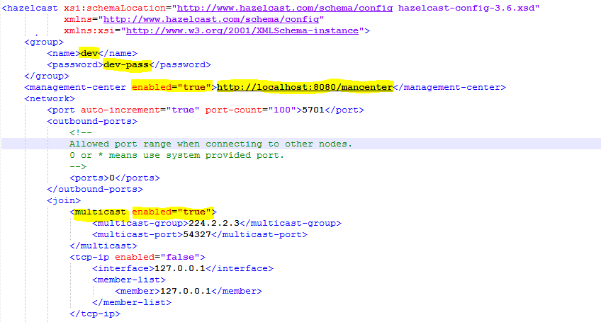
Sample Hazelcast.xml

Slide 7
Mancenter
Mancenter provides dashboard that includes clustered members, caching, maps, queues, topics, partition distribution details and performance statistic report
Deploy Mancenter
Hazelcast provides mancenter.war file which is available under mancenter directory
Deploy war file in any one application/web server
Login to mancenter Link : http://<<domain name >>/mancenter
Default user name & password to login: admin / admin
Mancenter displays all members which are clustered under same group name within same network
Provides different statistic views to analyse the data & performance

Slide 8
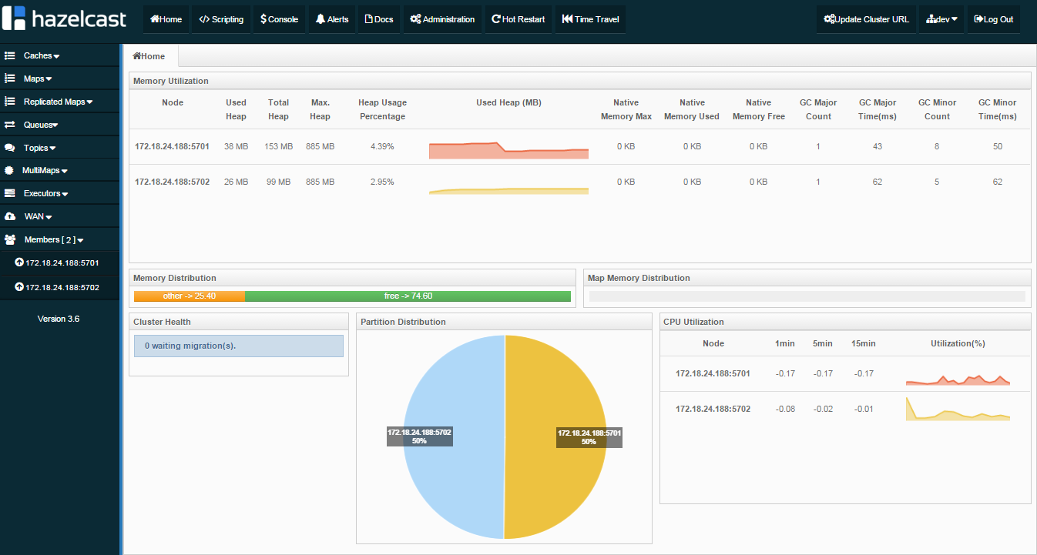
Mancenter – Home Screen Sample

Slide 9
Hazelcast Java Client
There are currently three ways to connect to a running Hazelcast cluster:
Native Clients (Java, C++, .NET)
Native Clients enables to perform almost all Hazelcast operations without being a member of the cluster.
It connects to one of the cluster members and delegates all cluster wide operations to it (dummy client), or it connects to all of them and delegates operations smartly (smart client).
Memcache Client
REST Client

Slide 10

Java Client Implementation
Have to include two dependencies in classpath to start using the Hazelcast client: hazelcast-<version>.jar and hazelcast-client-<version>.jar.
The first step is configuration. Java client can be configured through declaratively or programmatically. Below here mentioned programmatic approach sample for reference.
Have to set the clustered group name and password in GroupConfig Object
Have to set the member IP address in NetworkConfig Object to access the Hazelcast server.
Client always stick into single member when only one member is configured in NetworkConfig object. If more than one clustered members were configured, Hazelcast client dynamically connect to any one member based on laodbalance.

Slide 11
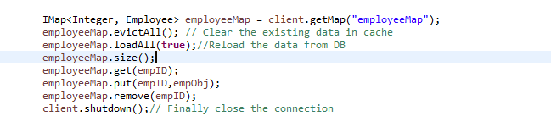
Java Client Implementation
After registered the group name and member ID address, have to initialize the client.
Sample client code for list, get, put
Data can be stored with Map, List, Set format in cache
To handle the DB data, have to implement the MapStore interface and overwrite the predefined methods in implementation class that should be configured in XML

Slide 12
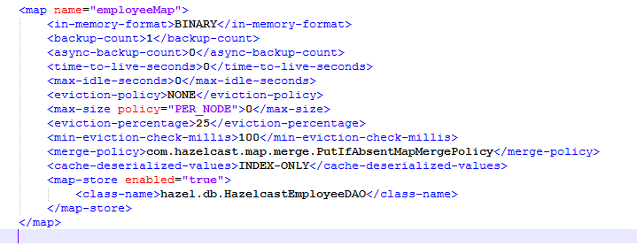
Sample XML for Map-Store Configuration

Slide 13
Features
Hazelcast is not having a master node. Each node in the cluster is configured to be the same in terms of functionality.
High Availability. Data being held entirely in-memory. Data backups are distributed across the cluster. In the case of a failure, such as a node crash, no data will be lost since Hazelcast distributes copies of data across all the nodes of cluster.
When the size of your memory and compute requirement increases, new nodes can be dynamically joined to the cluster to scale elastically.
Auto discovery of nodes on a network.
The ability to persist data asynchronously or synchronously.
Apart from caching, Hazelcast involves Job Processing, Clustered Scheduling, Data Aggregation and Cluster management

Slide 14
Data Storage
Hazelcast’s data storage containers except one are extensions of the java.util.Collections interfaces. Here is a list of the different data storage types:
IList – This keeps a number of objects in the order they were put in
IQueue – This follows BlockingQueue and can be used as alternative to a Message Queue in JMS. This can be persisted via a QueueStore
IMap – This extends ConcurrentMap. It can also be persisted by a MapStore. It also has a number of other features that I will talk about in another post.
ISet – The keeps a set of unique elements where order is not guaranteed.
MultiMap – This does not follow a typical map as there can be multiple values per key.

Slide 15
Use-cases
Distributed cache, often in front of a database
Storage for temporal data, like web sessions
In-memory data processing and analytics
Memcached alternative with a protocol compatible interface
Cross-JVM communication and shared storage
Second level caching in Hibernate

Slide 16
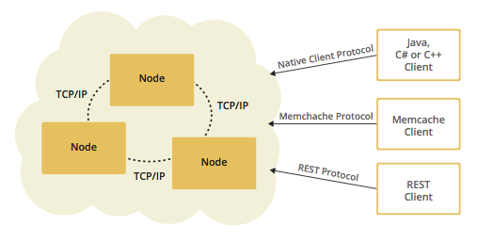
In-Memory Data Grid Architecture
Hazelcast data and services are centralized in one or more server members and they are accessed by the application through clients.
Cluster of server members that can be independently created and scaled.
Clients can communicate with these members to reach to Hazelcast data and services.
Hazelcast provides native clients (Java, .NET and C++), Memcache clients and REST clients.

Slide 17
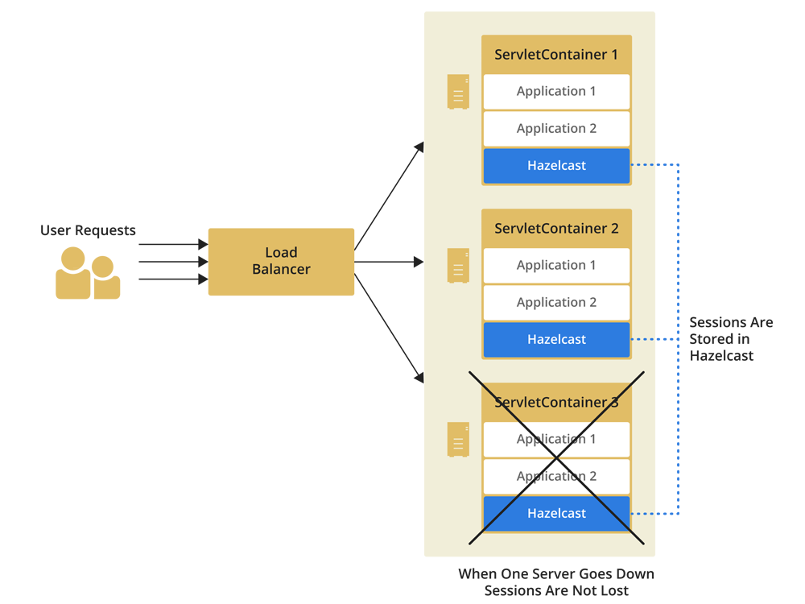
Web Session Clustering Architecture
Web Session Replication is replicating web session to other members of the cluster each time there is a change in the session data.

Slide 18
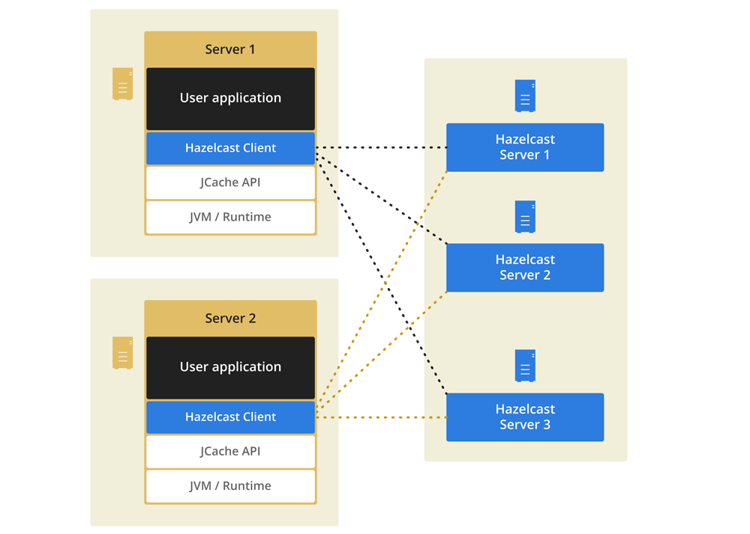
Hazelcast Jcache Architecture
JCache standardizes caching for the Java platform: it is a common mechanism to create, access, update, and remove information from caches.
Hazelcast, the leading open source in-memory data grid, enables organizations to seamlessly integrate with JCache.

Slide 19
Thank you
Visit us at www.techmahindra.com

