Slide 1
KUBERNETES

Slide 2
What Kubernetes is…
Kubernetes – CAAS, It helps in automating deployment , scaling and operations of application containers across clusters of hosts
Architecture
The Kubernetes Master is a collection of three processes that run on a single node in your cluster kube-apiserver, kube-controller-managerand kube-scheduler.
Each individual non-master node in your cluster runs two processes:kubelet, which communicates with the Kubernetes Master.kube-proxy, a network proxy which reflects Kubernetes networking services on each node
The “master” refers to a collection of processes managing the cluster state
The “nodes “in a cluster are the machines (VMs, physical servers, etc) that run your applications and cloud workflows

Slide 3
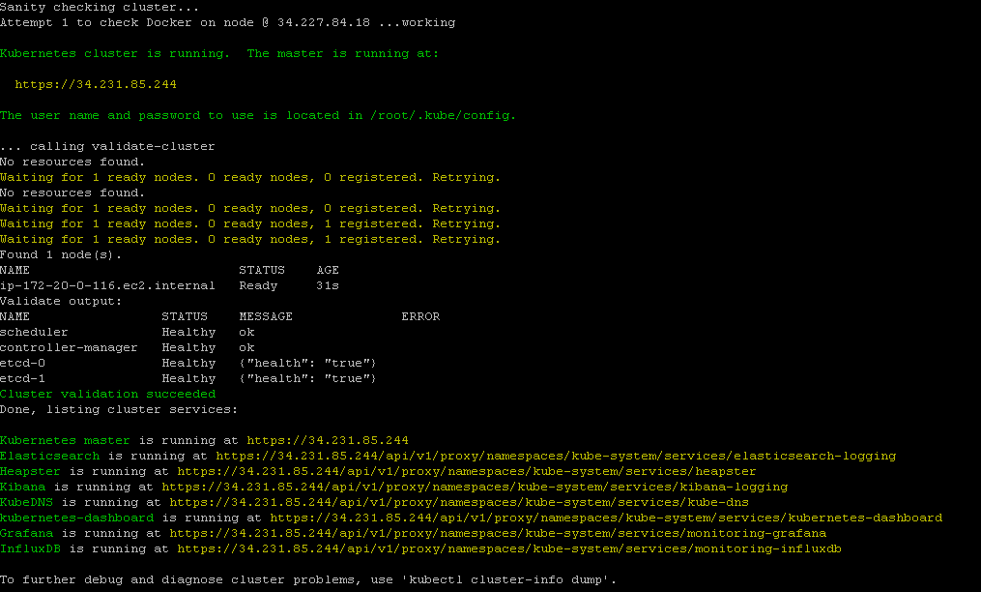
Installation
Setup Kubernetes Cluster on AWS EC2
Launch Amazon AMI linux
Install Kubernetes,Kube-up will work upto kubernetes version 1.5.x
Edit config-default.sh file ,vi config-default.sh
Start the cluster by kube-up.sh,bash cluster/kube-up.sh

Slide 4
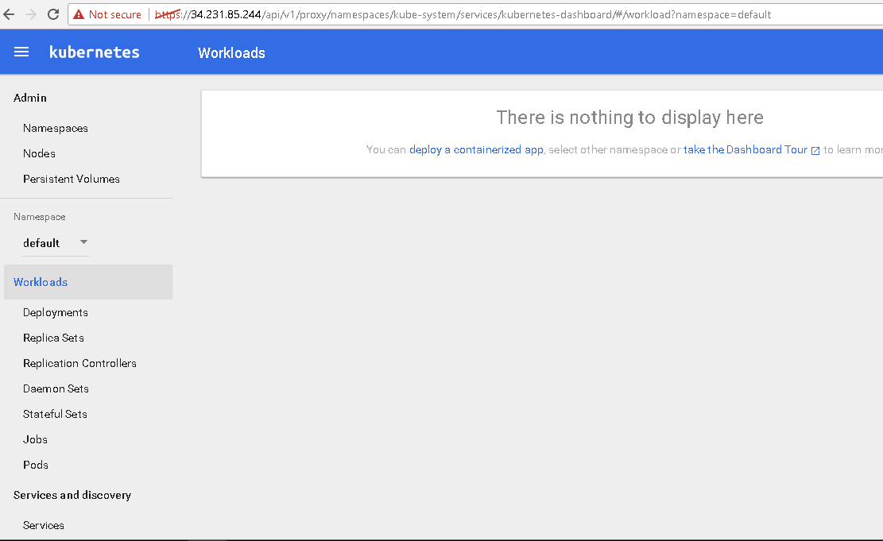
Dashboard
we can access Kubernetes web UI using ,https://master-public-ip/ui. It will ask for username and password which can be found in /root/.kube/config and /srv/kubernetes/basic_auth.csv files.
Finally we will get kubernetes dashboard

Slide 5

Deploying And Exposing services
Run a Hello World application in your cluster:
kubectl run hello-world --replicas=5 --labels="run=load-balancer-example" --image=gcr.io/google-samples/node-hello:1.0 --port=8080
Create a Service object that exposes the deployment:
kubectl expose deployment hello-world --type=LoadBalancer --name=my-service
Display information about the Service:
kubectl get services my-service
Output:

Slide 6
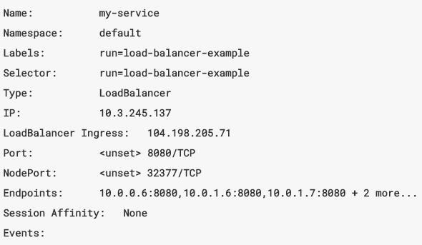
Display detailed information about the Service
kubectl describe services my-service
The external IP address to access the Hello World application
curl http://<external-ip>:<port>

Slide 7
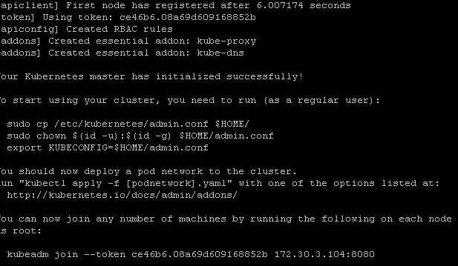
Installation _Kubernetes On BareMetal
Red Hat Enterprise Linux (version 7.0 or above) machine
Docker Installed
Install Latest Kubernetes version 1.6.0
yum install -y kubelet-1.6.1-0 kubeadm-1.6.1-0 kubectl-1.6.1-0 kubernetes-cni
Now initiate master
kubeadm init --apiserver-advertise-address=<your MasterIp > --apiserver-bind-port=8080

Slide 8
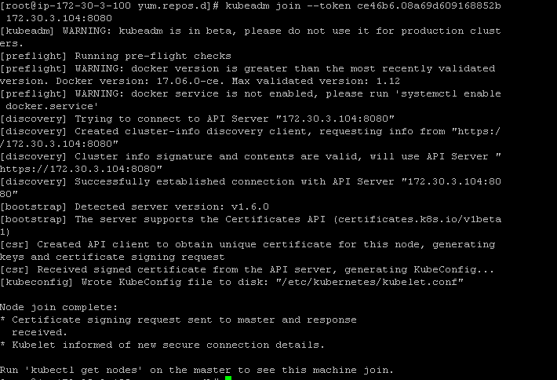
Node-Launch RHEL 7.0 above and follow Installation Process
Join minion with master using token provided while creating master
kubeadm join --token 1b9d68.1bb44aba3de83330 135.167.156.51:8080

Slide 9


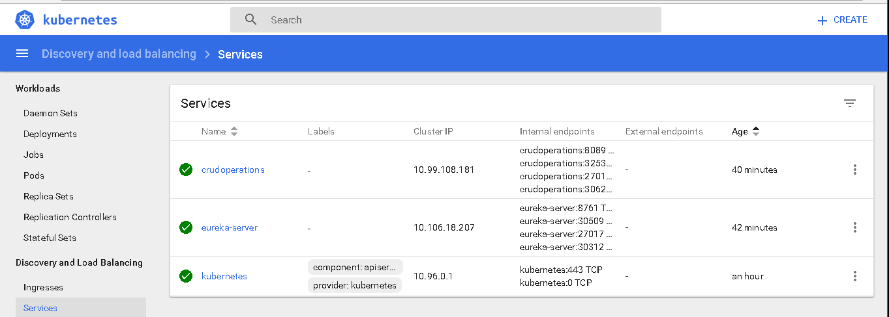
Give Permission to the node from the master
Now can able to get see the nodes
create dashboard components

