Slide 1
SE Research Seminar: Knowledge Graphs
Final Presentation
By Penz Manuel, Rasmusen Sven

Slide 2
Agenda
Domain Selection
Metrics & Dimensions definition
Intermediate External Source Conclusion
Web Scraper
Mapping
Assessment
Data source comparison & final data source conclusion
Duplicate detection
Error detection
Innsbruck I Penz Manuel, Rasmusen Sven I 29.06.2022

Slide 3
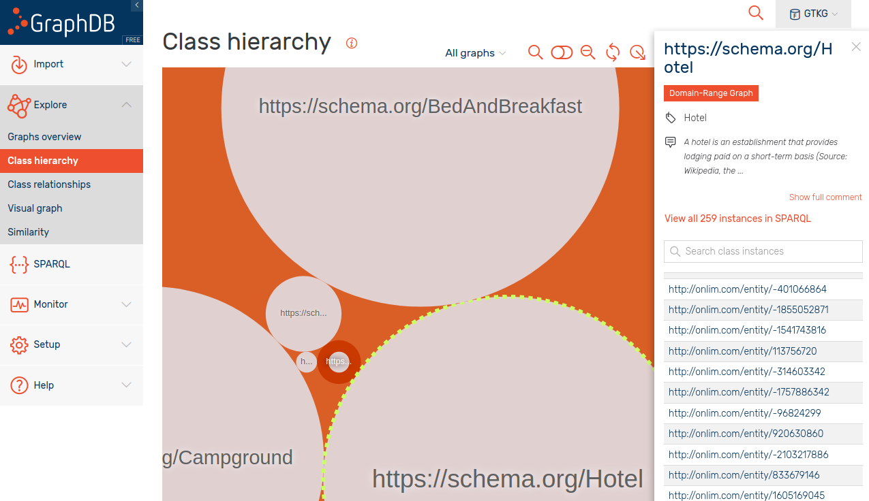
Domain Selection
259 hotel instances
Figure 1: The class hierarchy visualisation of GTKG displaying the existing hotel instances.
Innsbruck I Penz Manuel, Rasmusen Sven I 29.06.2022

Slide 4
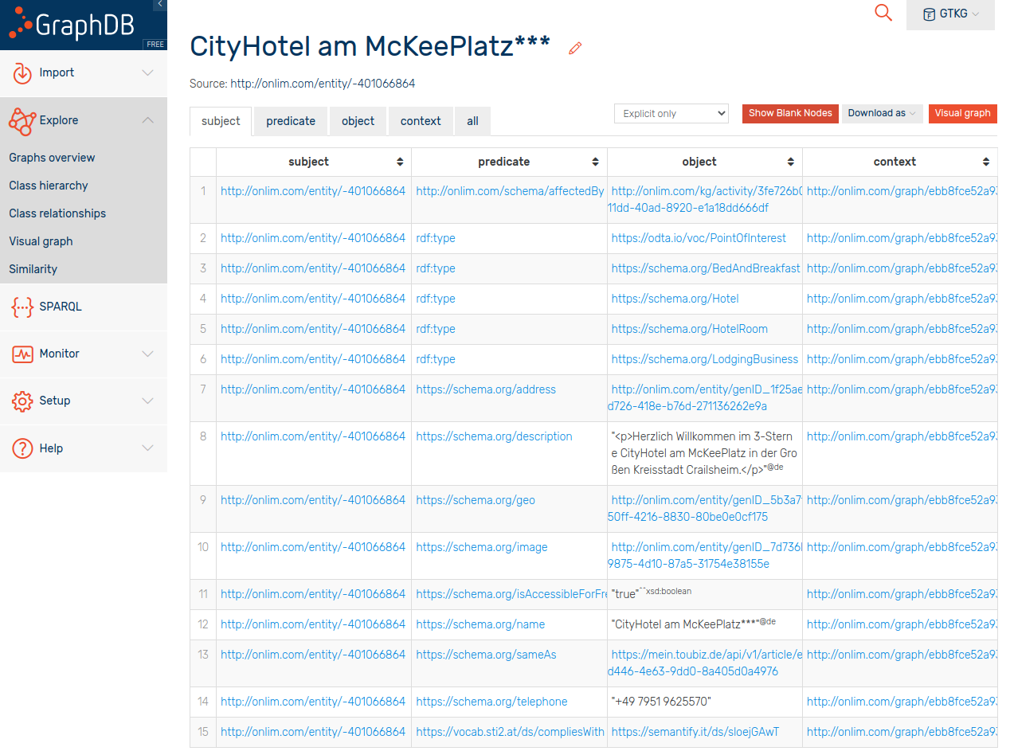
Domain Selection
Properties:
address
description
geo
image
isAccessibleForFree
name
sameAs
telephone
compliesWith
Missing Properties:
review
rating
owner
Figure 2: A detailed view of a specific hotel instance within the GTKG.
Innsbruck I Penz Manuel, Rasmusen Sven I 29.06.2022

Slide 5
Dimensions & Metrics
Accessibility
Provisioning of public endpoint
Weight = 0.45
1 If SPARQL and REST API
0.75 either SPARQL or REST API
0.5 any form of offline data (e.g. csv)
0 Otherwise
Retrievable format
Weight = 0.45
1 If RDF export available
0.75 If JSON export available
0.5 If semi-structured data available
0 Otherwise
Content negotiation
Weight = 0.1
1 If content negotiation is supported
0 Otherwise
Innsbruck I Penz Manuel, Rasmusen Sven I 29.06.2022

Slide 6
Dimensions & Metrics
Completeness
Instance completeness
Weight = 0.5
Population completeness
Weight = 0.5
Innsbruck I Penz Manuel, Rasmusen Sven I 29.06.2022

Slide 7

Dimensions & Metrics
Accuracy
Formal Syntactic Validity
Weight = 0.5
m
synValid() rule examples:
Postal Code:
length of 5
starting from 01 to 99
Phone number:
start with +49 or 0049 followed by a valid area code
starting from 02 to 09
total length between 3 and 5
Innsbruck I Penz Manuel, Rasmusen Sven I 29.06.2022

Slide 8

Dimensions & Metrics
Accuracy
Formal Semantic Validity
Weight = 0.5
semValid() rule examples:
website:
reachable or not?
phone:
does the number belong to the correct hotel?
Innsbruck I Penz Manuel, Rasmusen Sven I 29.06.2022

Slide 9
Conclusion to External Sources
www.wikidata.org:
SPARQL endpoint available!
www.firmenregister.de
No endpoint available!
Solution:
Scrape website
Innsbruck I Penz Manuel, Rasmusen Sven I 29.06.2022
Notes:
sven bis hier

Slide 10
Data source: www.firmenregister.de
Building a web scraper, schema alignment, mapping, and assessment.
Innsbruck I Penz Manuel, Rasmusen Sven I 29.06.2022

Slide 11
Scraper
Python
BeautifulSoup
Proxy Server
Scraper procedure
Grab the URL of every page listing lodging businesses
Grab the URL of every lodging business on each page
Grab data from a table inside each lodging business’ page
Innsbruck I Penz Manuel, Rasmusen Sven I 29.06.2022

Slide 12
Scraper
Exports data of almost 9k german lodging businesses into JSON file
….
},
{
"Firmenname": "Hotel Find GmbH",
"Adresse": "Hauptstätter Str. 53B",
"PLZ": "70178",
"Ort": "Stuttgart",
"Bundesland": "Baden-Württemberg",
"Telefon": "+49 711 6404076",
"Fax": "+49 711 6409417",
"E-Mail": "info@hotel-find.de",
"Homepage": "http://www.hotel-find.de",
"Kontakt": "Herr Culum"
},
{
….
Figure 3: firmenregister.json generated from scraper
Innsbruck I Penz Manuel, Rasmusen Sven I 29.06.2022

Slide 13
Mapping - firmenregister.de
Properties:
name - “Firmenname”
telephone - “Telefon”
faxNumber - “Fax”
email - “E-Mail”
url - “Homepage”
description - “Produkte/Infos”
#AddressMapping_JSON -> PostalAddress
streetAddress - “Adresse”
addressLocality - “Ort”
postalCode - “PLZ”
addressRegion - “Bundesland”
#ContactMapping_JSON -> ContactPoint
name - “Kontakt”
…..
<#LOGICALSOURCE>
rml:source "firmenregister.json";
rml:referenceFormulation ql:JSONPath;
rml:iterator "$.[*]".
<#LodgingBusinessMapping>
rml:logicalSource <#LOGICALSOURCE>;
rr:subjectMap [
rr:template "https://lodgingbusiness.example.com/{Firmenname}";
rr:class schema:Hotel;
];
rr:predicateObjectMap [
rr:predicate schema:name;
rr:objectMap [
rml:reference "Firmenname"
];
];
…..
Figure 4: Mapping file for firmenregister.de
Innsbruck I Penz Manuel, Rasmusen Sven I 29.06.2022

Slide 14
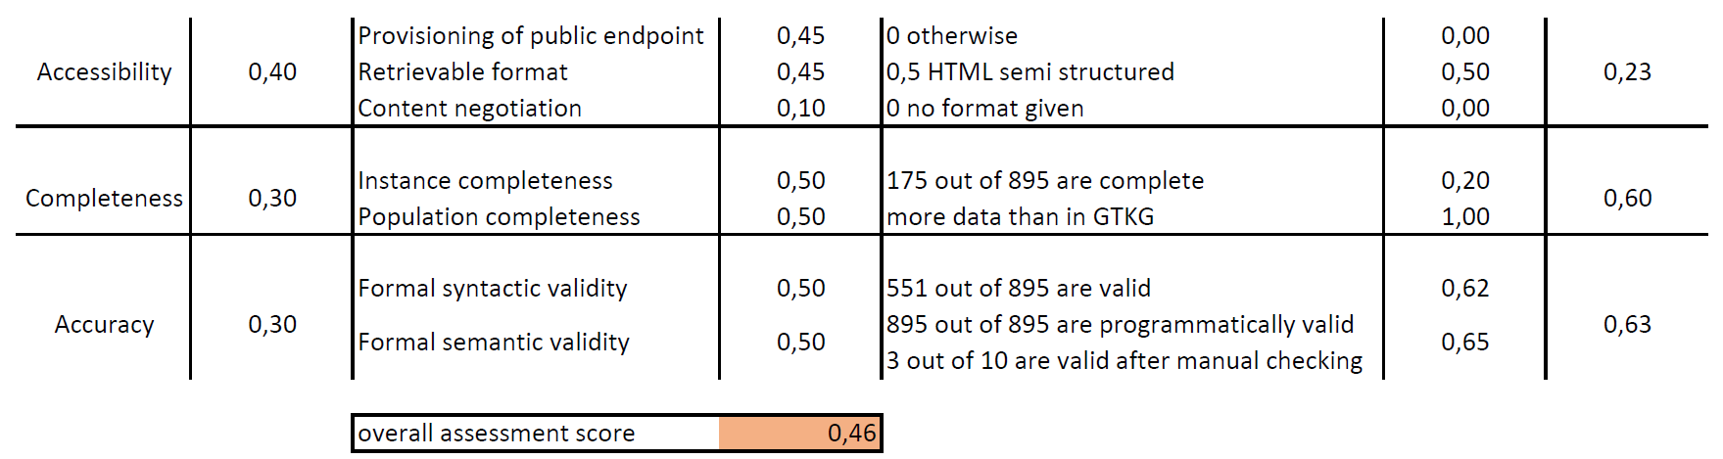
Assessment - firmenregister.de
Figure 5: The assessment results for www.firmenregister.de after programmatic and manual assessment
Innsbruck I Penz Manuel, Rasmusen Sven I 29.06.2022

Slide 15
Data source: www.wikidata.org
SPARQL query, schema alignment, mapping, and assessment.
Innsbruck I Penz Manuel, Rasmusen Sven I 29.06.2022

Slide 16
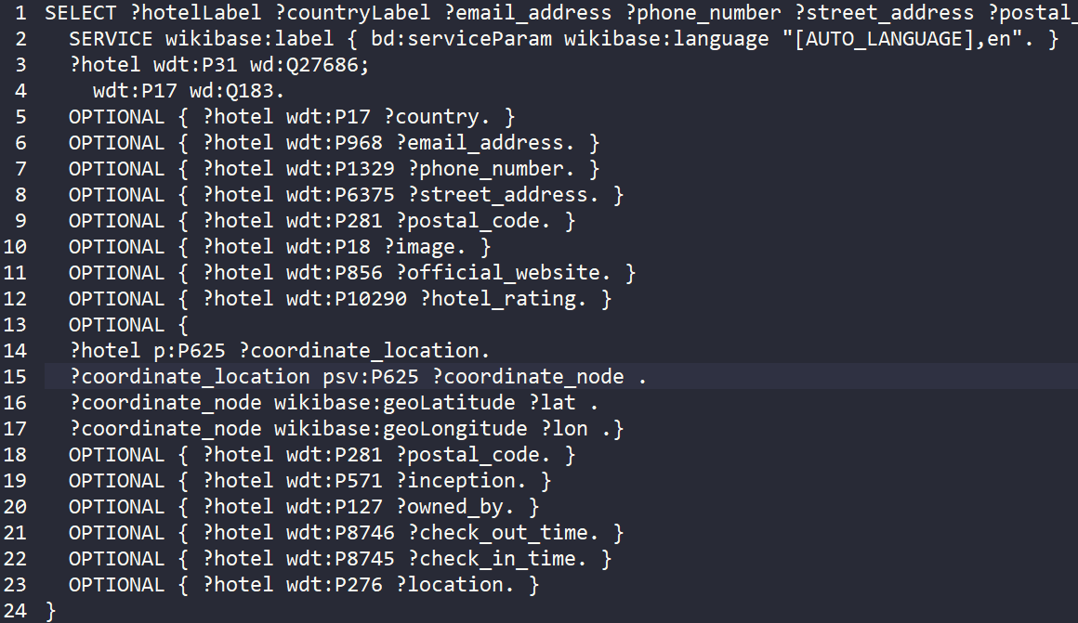
SPARQL - Query
Focus on mandatory data first
Figure 6: The SPARQL query used on www.wikidata.org .
Innsbruck I Penz Manuel, Rasmusen Sven I 29.06.2022

Slide 17
SPARQL - Query Result
Focus on mandatory data first
3273 instances from wikidata
….
},
{
"hotelLabel": "Hilton Munich Park",
"countryLabel": "Germany",
"email_address": "mailto:info.munich@hilton.com",
"phone_number": "+49-89-38450",
"street_address": "Am Tucherpark 7",
"postal_code": "80538",
"official_website": "https://www.hilton.com/en/hotels/muchitw-hilton-munich-park/",
"lat": "48.152449",
"lon": "11.598353",
"inception": "1972-07-01T00:00:00Z",
"owned_byLabel": "Hilton Worldwide"
},
{
….
Figure 7: The JSON data received after using the SPARQL query on www.wikidata.org .
Innsbruck I Penz Manuel, Rasmusen Sven I 29.06.2022
Notes:
write same as manuel

Slide 18
Mapping - wikidata.org
Properties:
name - “hotelLabel”
telephone - “phone_number”
faxNumber - “fax_number”
email - “email_address”
url - “official_website”
foundingDate- “inception”
checkinTime- “check_in_timeLabel”
checkoutTime- “check_out_timeLabel”
#Address -> PostalAddress
#GeoCoords -> GeoCoordinates
#Image -> ImageObject
#Owner -> Person
…..
<#Mapping>
rml:logicalSource <#LOGICALSOURCE>;
rr:subjectMap [
rr:template "https://schema.org/Hotel/{hotelLabel}";
rr:class schema:Hotel;
];
rr:predicateObjectMap [
rr:predicate schema:name;
rr:objectMap [ rml:reference "hotelLabel" ];
];
rr:predicateObjectMap [
rr:predicate schema:email;
rr:objectMap [ rml:reference "email_address" ];
];
rr:predicateObjectMap [
rr:predicate schema:telephone;
rr:objectMap [ rml:reference "phone_number" ];
];
…..
Figure 8: A code snippet used for mapping a hotel.
Innsbruck I Penz Manuel, Rasmusen Sven I 29.06.2022
Notes:
replace with figures with code snippet text

Slide 19
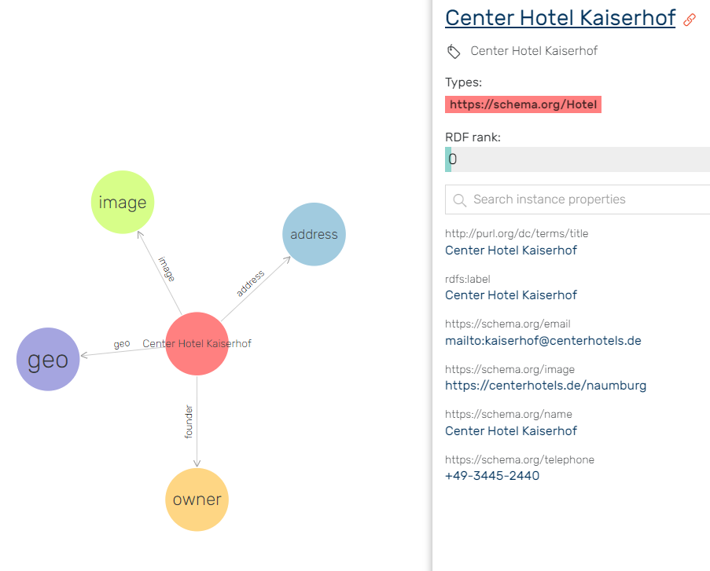
Importing contd. - wikidata.org
Figure 9: A detailed view of a newly inserted hotel instance.
Innsbruck I Penz Manuel, Rasmusen Sven I 29.06.2022

Slide 20
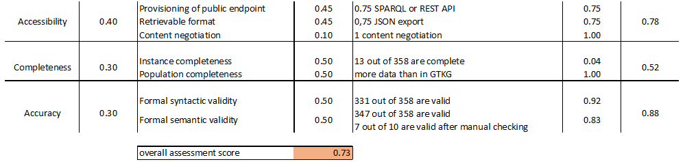
Assessment - wikidata.org
Figure 10: The assessment results for www.wikidata.org .
Innsbruck I Penz Manuel, Rasmusen Sven I 29.06.2022

Slide 21
Assessment - Comparison
Data source: www.firmenregister.de
Data source: www.wikidata.org
Figure 11: The assessment results for both data sources (www.firmenregister.de and www.wikidata.org) .
Innsbruck I Penz Manuel, Rasmusen Sven I 29.06.2022

Slide 22
Duplicate Detection
What tool? Why?
Innsbruck I Penz Manuel, Rasmusen Sven I 29.06.2022

Slide 23
Duplicate Detection - Duke
Duke¹ tool for detection
Pros:
Interactive mode
Easy to start
Cons:
Difficult Tuning
Time intensive
¹ https://github.com/largsa/Duke
Innsbruck I Penz Manuel, Rasmusen Sven I 29.06.2022

Slide 24
Duplicate Detection - Properties
Compared properties:
Name
Email
Postalcode
Phone
Locality
Url
Fax
Ignored properties:
country
checkinTime
checkoutTime
image
foundingDate
latitude
longitude
address
founder
Innsbruck I Penz Manuel, Rasmusen Sven I 29.06.2022

Slide 25
Duplicate Detection - Configuration Values
Configuration values:
Name - LOW = 0.1 HIGH = 0.6
Email - LOW = 0.45 HIGH = 0.85
Postalcode - LOW = 0.1 HIGH = 0.6
Phone - LOW = 0.2 HIGH = 0.85
Locality - LOW = 0.1 HIGH = 0.6
Url - LOW = 0.1 HIGH = 0.85
Fax - LOW = 0.1 HIGH = 0.85
Innsbruck I Penz Manuel, Rasmusen Sven I 29.06.2022

Slide 26
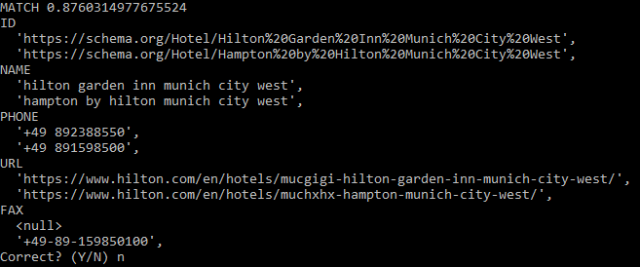
Duplicate Detection
Issues during third detection
124 detections
94 duplicates (~76%)
Many correct duplicates
Figure 12: This detection was considered the toughest one, as it was unclear if it was a duplicate or not.
Innsbruck I Penz Manuel, Rasmusen Sven I 29.06.2022

Slide 27
Error Detection
Procedure, Tool and Outcome
Innsbruck I Penz Manuel, Rasmusen Sven I 29.06.2022

Slide 28
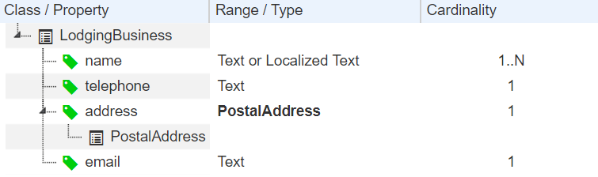
Error Detection - Procedure & Tool
Use the domain specification as an initial guideline
Mandatory properties first
Optional properties second
Check expected formats and assign sh:patterns
Use already existing instances as a guideline
example: Onlim’s inserted instances may have language tags
Adjust to accept language tags or strings using sh:or
Tool used: shacl.org/playground/
Figure 13: The given domain specification for LodgingBusiness. We used the Range / Type and Cardinality columns as a guideline.
Innsbruck I Penz Manuel, Rasmusen Sven I 29.06.2022

Slide 29
Error Detection - Outcome
Total Validation Reports: 20’516
12,799 are sh:MinCountConstraintComponent
Assessment of a subset: 13 out of 358 for instance completeness
6480 are owner violations
sh:MinCountConstraintComponent
sh:NodeConstraintComponent
…
schema:AddressShape
a sh:NodeShape ;
sh:closed false ;
sh:targetClass schema:PostalAddress ;
sh:property [
sh:path schema:addressCountry ;
sh:datatype xsd:string ;
sh:minCount 0 ;
sh:hasValue "Germany" ;
sh:name "is in Germany" ;
] ;
…
Figure 14: A code snippet of an AddressShape in SHACL. Here it is checked if the entered country is “Germany”.
Innsbruck I Penz Manuel, Rasmusen Sven I 29.06.2022

Slide 30
Statistics
What has changed?
Innsbruck I Penz Manuel, Rasmusen Sven I 29.06.2022

Slide 31
Statistics
Before:
10`874`984 triples
259 hotel instances
Changes:
110`050 more triples overall (~1%)
3`273 more hotels
Our GitHub:
https://github.com/csar8594/GTKG
After:
10`985`034 triples
3`532 hotel instances
Innsbruck I Penz Manuel, Rasmusen Sven I 29.06.2022

Slide 32
Issues
Obstacles and Lessons Learned
Innsbruck I Penz Manuel, Rasmusen Sven I 29.06.2022

Slide 33
Importing - firmenregister.de
Problems:
data inside the .n3 is not sorted using pyRML -> should look like below
after successful import, the data is still not present inside graphDB due to this sorting problem
rocketRML does export the data sorted but only if the number of properties is low and no rr:parentTriplesMap are used -> heap error
Solution: using joinCondition
and rocketRML
<https://address.example.com/%C3%84u%C3%9Fere%20Ansbacher%20Str.%203> <http://www.w3.org/1999/02/22-rdf-syntax-ns#type> <https://schema.org/PostalAddress> .
<https://address.example.com/%C3%84u%C3%9Fere%20Ansbacher%20Str.%203> <https://schema.org/addressLocality> "Weihenzell" .
<https://address.example.com/%C3%84u%C3%9Fere%20Ansbacher%20Str.%203> <https://schema.org/addressRegion> "Bayern"
rr:predicateObjectMap [
rr:predicate schema:PostalAddress;
rr:objectMap [
rr:parentTriplesMap <#AddressMapping_JSON>;
rr:joinCondition [
rr:child "Firmenname";
rr:parent "Firmenname";
]
];
];
Figure A1: The joinCondition used to fix the heap error.
Innsbruck I Penz Manuel, Rasmusen Sven I 29.06.2022

Slide 34
Issues & Lessons Learned
Overall:
Stick to vocabulary -> mapping used example.com initially
Check prefixes (http://schema.org ≠ https://schema.org)
Assessment:
Assign less weight to accessibility
Use a hotel oriented data source
Error Detection:
Start earlier (Possibly parallel to mapping)
May help mapping process
We have many empty Person instances from wrong mapping
Syntactic validity vs. Semantic validity
Innsbruck I Penz Manuel, Rasmusen Sven I 29.06.2022

Slide 35
Thank You!
We are open to questions and feedback!
Innsbruck I Penz Manuel, Rasmusen Sven I 29.06.2022

