Slide 1
SE Research Seminar: Knowledge Graphs Knowledge Assessment
Midterm Presentation
By Penz Manuel, Rasmusen Sven

Slide 2
Agenda
Recap
Hosting
Finding external sources
Metrics & Dimensions definition
External Source Conclusion
Web Scraper
Mapping
Assessment
Loading into GTKG
Data source comparison
Innsbruck I Penz Manuel, Rasmusen Sven I 18.05.2022

Slide 3
Recap
What have we done so far?
Innsbruck I Penz Manuel, Rasmusen Sven I 18.05.2022

Slide 4
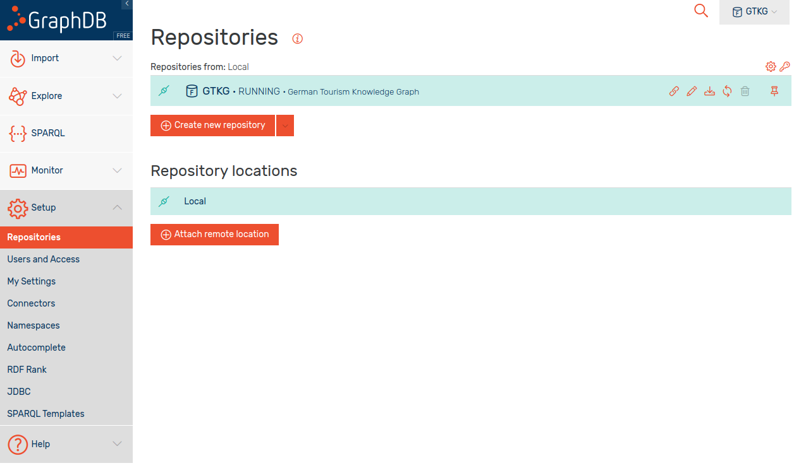
Hosting
Add new repository
Figure 1: The GraphDB view of the GTKG repository.
Innsbruck I Penz Manuel, Rasmusen Sven I 18.05.2022

Slide 5
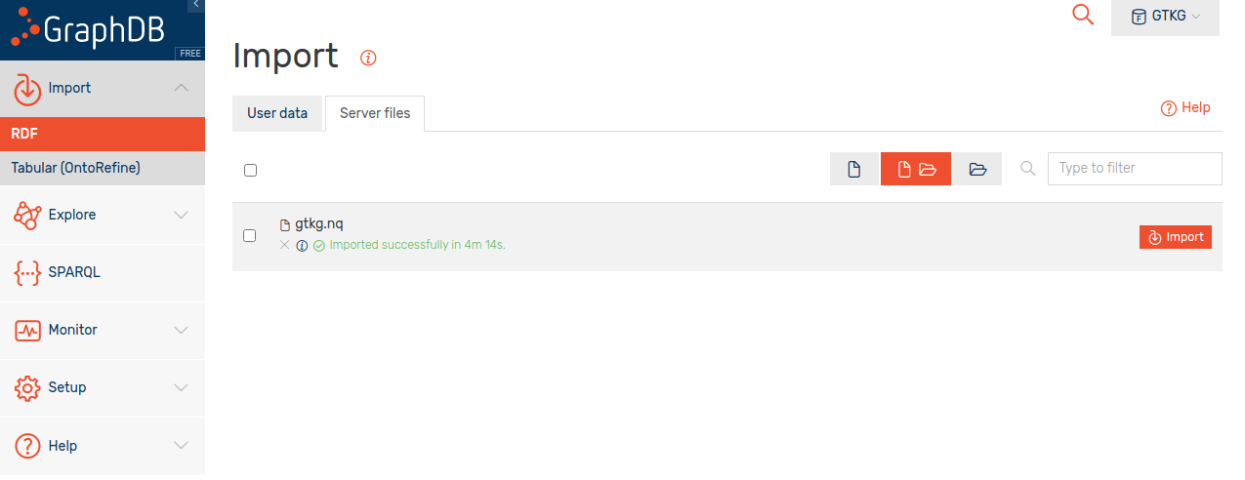
Hosting
Import RDF as „Server files“
User data limited to 200MB
Figure 2: Importing the GTKG data into GraphDB.
Innsbruck I Penz Manuel, Rasmusen Sven I 18.05.2022

Slide 6
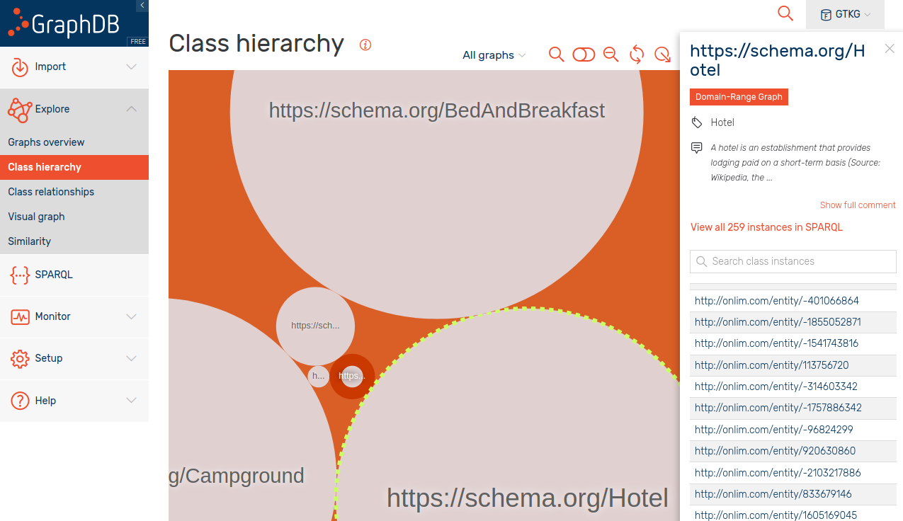
Hosting
Figure 3: The class hierarchy visualisation of GTKG displaying the existing hotel instances.
Innsbruck I Penz Manuel, Rasmusen Sven I 18.05.2022

Slide 7
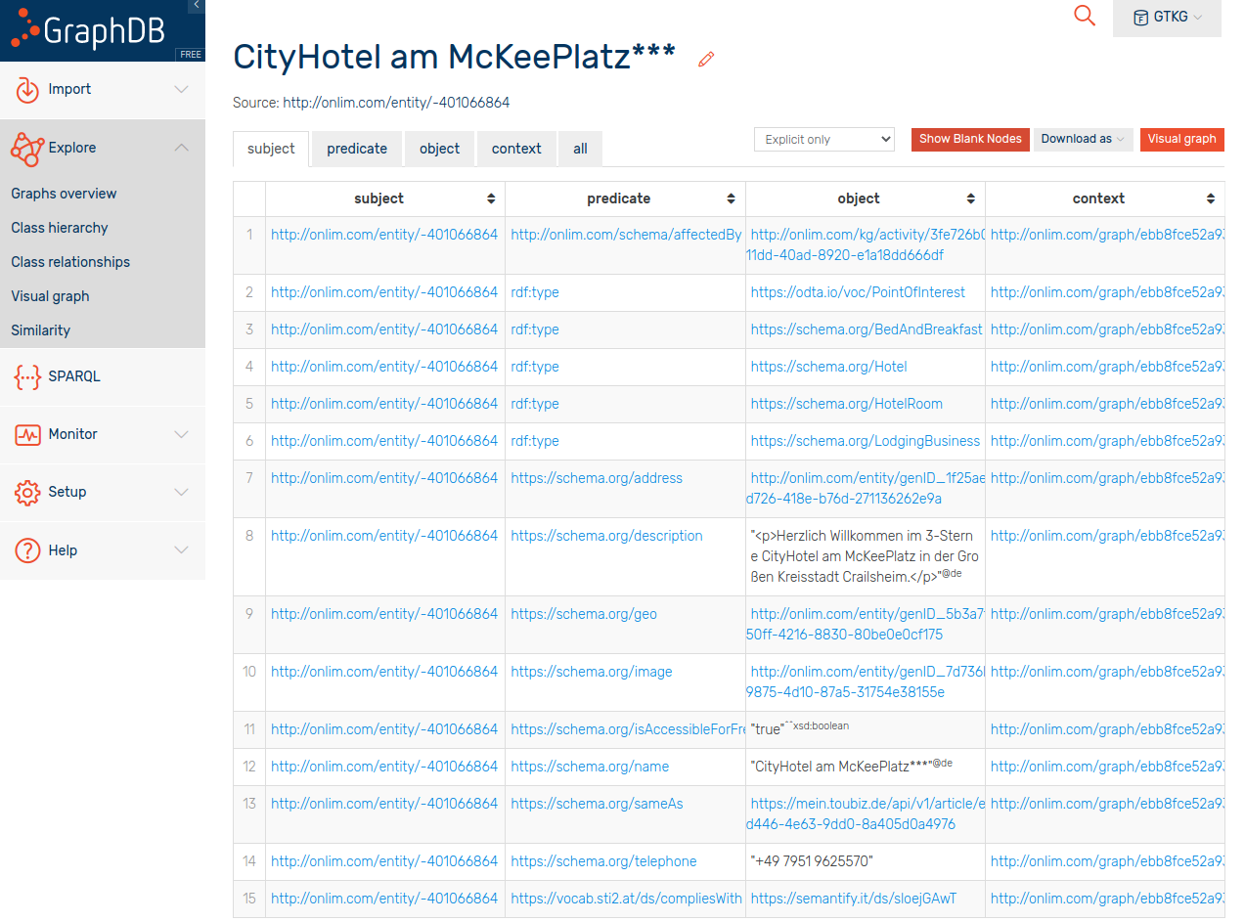
Hosting
Properties:
address
description
geo
image
isAccessibleForFree
name
sameAs
telephone
compliesWith
Missing Properties:
rating
reviews
Figure 4: A detailed view of a specific hotel instance within the GTKG.
Innsbruck I Penz Manuel, Rasmusen Sven I 18.05.2022

Slide 8
External Sources
www.booking.com:
API:
Guest Review API - https://connect.booking.com/user_guide/site/en-US/review-api/
Offers:
Guest Reviews
www.tripadvisor.com
API:
Content API - https://developer-tripadvisor.com/content-api/
Offers:
Location ID, name, address, latitude & longitude
Read reviews link, write-a-review link
Overall rating, ranking, subratings, awards, the number of reviews the rating is based on, rating bubbles image
Price level symbol, accommodation category/subcategory, attraction type, restaurant cuisine(s)
Innsbruck I Penz Manuel, Rasmusen Sven I 18.05.2022

Slide 9
External Sources
www.govdata.de:
SPARQL endpoint available!
Offers:
Various statistical data collections regarding hotels / tourism
www.google.at/maps:
API:
Maps API - https://developers.google.com/maps
Offers:
Places API (Nearby businesses, customer reviews, etc.)
Geocoding API (longitude, latitude)
JSON data
Innsbruck I Penz Manuel, Rasmusen Sven I 18.05.2022

Slide 10
External Sources
www.wikidata.org:
SPARQL endpoint available!
Offers:
JSON, CSV and TSV data
www.dbpedia.org:
SPARQL endpoint available!
Offers:
JSON, RDF, CSV and many more
Innsbruck I Penz Manuel, Rasmusen Sven I 18.05.2022

Slide 11
Dimensions & Metrics
Accessibility
Provisioning of public endpoint
Weight = 0.45
1 If SPARQL and REST API
0.75 If SPARQL or REST API endpoint is publicly available
0.5 any form of offline data
0 Otherwise
Retrievable format
Weight = 0.45
1 If RDF export available
0.75 If JSON export available
0.5 If semi-structured data available
0 Otherwise
Content negotiation
Weight = 0.1
1 If content negotiation is supported
0 Otherwise
Innsbruck I Penz Manuel, Rasmusen Sven I 18.05.2022
Notes:
sven

Slide 12
Dimensions & Metrics
Completeness
Instance completeness
Weight = 0.5
Population completeness
Weight = 0.5
Innsbruck I Penz Manuel, Rasmusen Sven I 18.05.2022

Slide 13

Dimensions & Metrics
Accuracy
Formal Semantic validity
Weight = 0.5
m
semValid() rule examples:
Postal Code:
length of 5
starting from 01 to 99
Phone number:
start with +49 or 0049 followed by a valid area code
starting from 02 to 09
total length between 3 and 5
Innsbruck I Penz Manuel, Rasmusen Sven I 18.05.2022

Slide 14

Dimensions & Metrics
Accuracy
Formal Syntactic validity
Weight = 0.5
synValid() rule examples:
Postal Code:
given: https://schema.org/Text
needed: https://schema.org/Integer
Address:
If a lodging business is present in the GTKG and in the data source then we use the Levenshtein distance to calculate the difference between two strings/numbers in order to detect syntactic errors.
Innsbruck I Penz Manuel, Rasmusen Sven I 18.05.2022

Slide 15
Conclusion to External Sources
www.wikidata.org:
SPARQL endpoint available!
www.dbpedia.org:
SPARQL endpoint available!
www.firmenregister.de
No endpoint available!
Solution:
Scrape website
Innsbruck I Penz Manuel, Rasmusen Sven I 18.05.2022
Notes:
sven bis hier

Slide 16
Data source: www.firmenregister.de
Building a web scraper, schema alignment, mapping, and assessment.
Innsbruck I Penz Manuel, Rasmusen Sven I 18.05.2022

Slide 17
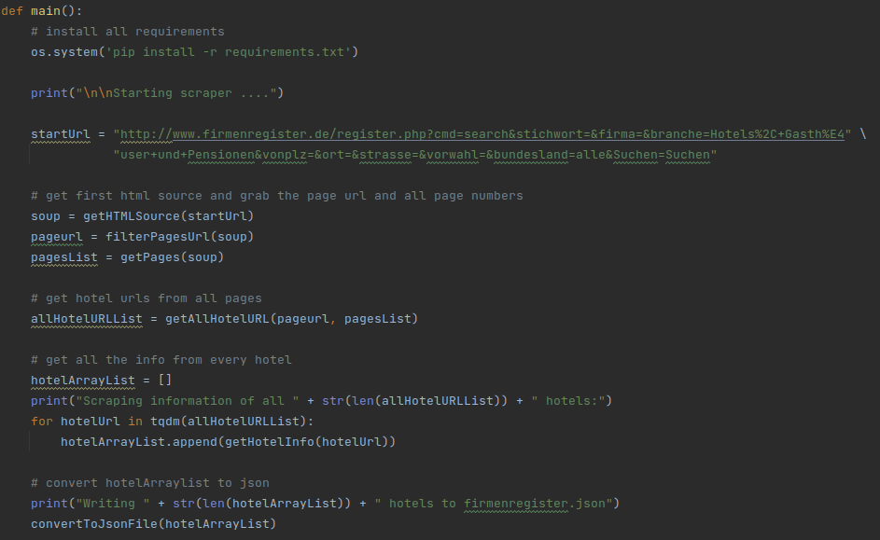
Scraper
Python
BeautifulSoup
Proxy Server
Figure 5: A python code snippet of the web scraper to gather information from www.firmenregister.de .
Innsbruck I Penz Manuel, Rasmusen Sven I 18.05.2022

Slide 18
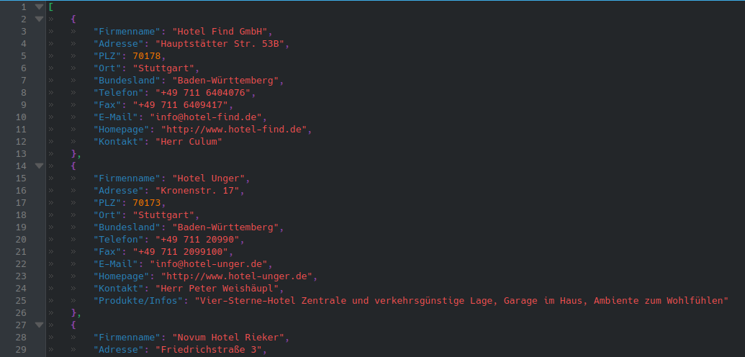
Scraper
Exports data of almost 9k german lodging businesses into JSON file
Advantage:
pyRML can handle .json file mapping into .n3 file
Figure 6: The JSON data received after scraping www.firmenregister.de .
Innsbruck I Penz Manuel, Rasmusen Sven I 18.05.2022

Slide 19
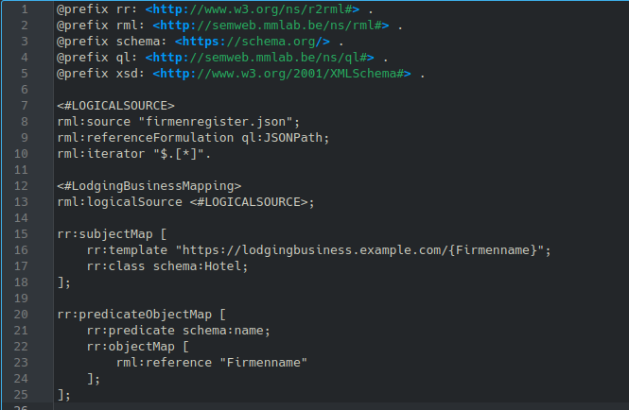
Mapping - firmenregister.de
Properties:
name - “Firmenname”
telephone - “Telefon”
faxNumber - “Fax”
email - “E-Mail”
url - “Homepage”
description - “Produkte/Infos”
#AddressMapping_JSON -> PostalAddress
streetAddress - “Adresse”
addressLocality - “Ort”
postalCode - “PLZ”
addressRegion - “Bundesland”
#ContactMapping_JSON -> ContactPoint
name - “Kontakt”
Figure 7: A code snippet used to map the www.firmenregister.de data.
Innsbruck I Penz Manuel, Rasmusen Sven I 18.05.2022

Slide 20
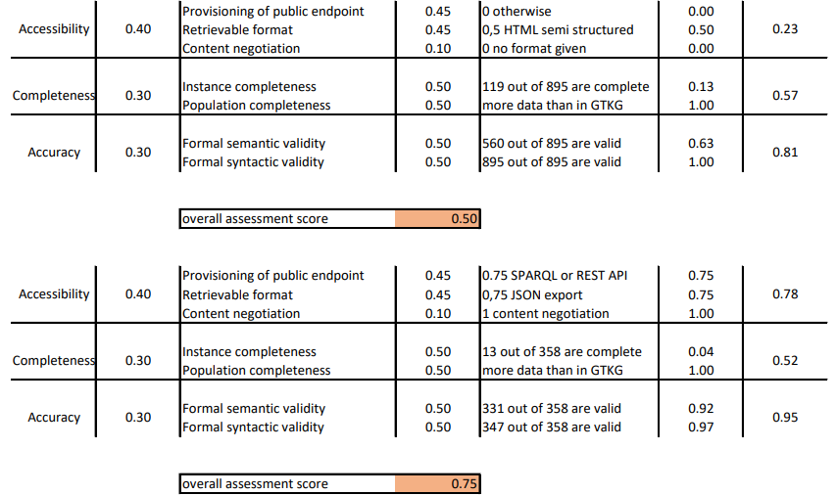
Assessment - firmenregister.de
Figure 8: The assessment results for www.firmenregister.de .
Innsbruck I Penz Manuel, Rasmusen Sven I 18.05.2022

Slide 21
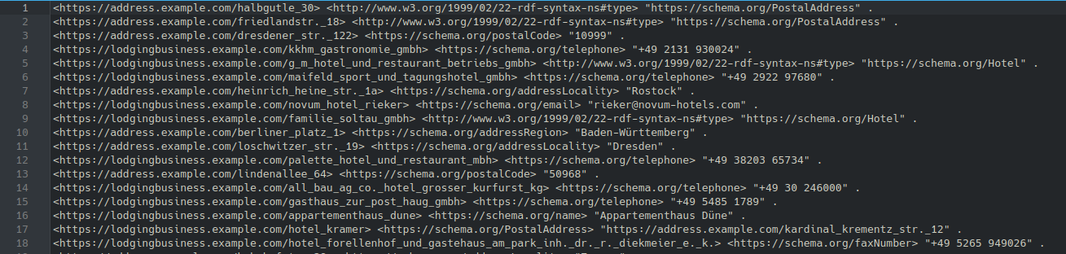
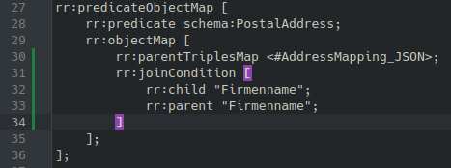
Importing - firmenregister.de
Problems:
data inside the .n3 is not sorted using pyRML
after successful import the data is still not present inside graphDB due to this sorting problem
rocketRML does export the data sorted but only if the number of properties is low and no rr:parentTriplesMap are used -> heap error
Solution: using joinCondition
and rocketRML
Figure 9: A sample result of the created N3 data.
Figure 10: The joinCondition used to fix the heap error.
Innsbruck I Penz Manuel, Rasmusen Sven I 18.05.2022

Slide 22
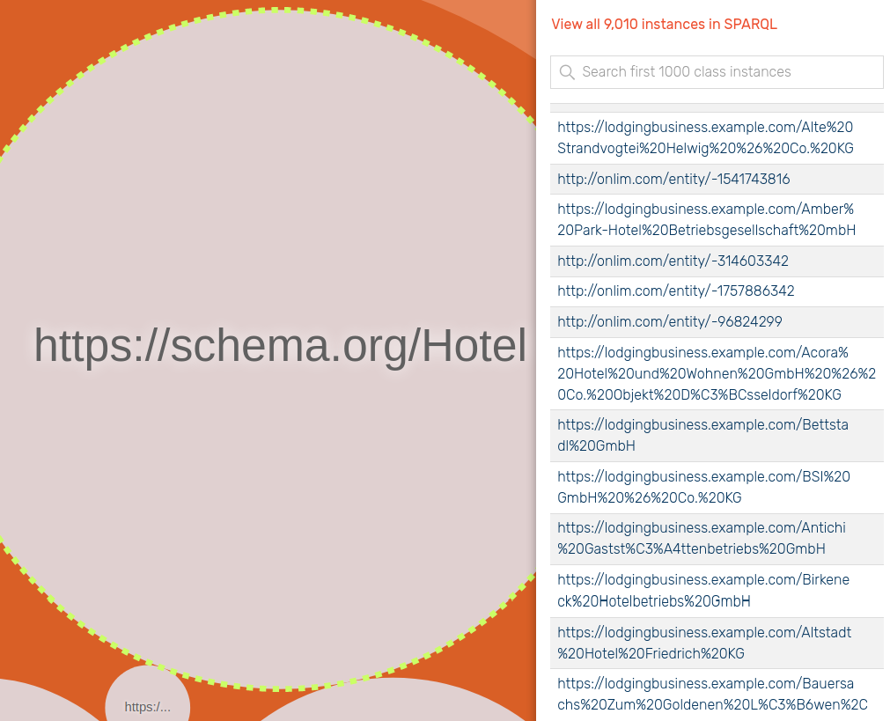
Importing contd. - firmenregister.de
Figure 11: A view of the newly created data inserted into the GTKG.
Innsbruck I Penz Manuel, Rasmusen Sven I 18.05.2022

Slide 23
Data source: www.wikidata.org
SPARQL query, schema alignment, mapping, and assessment.
Innsbruck I Penz Manuel, Rasmusen Sven I 18.05.2022

Slide 24
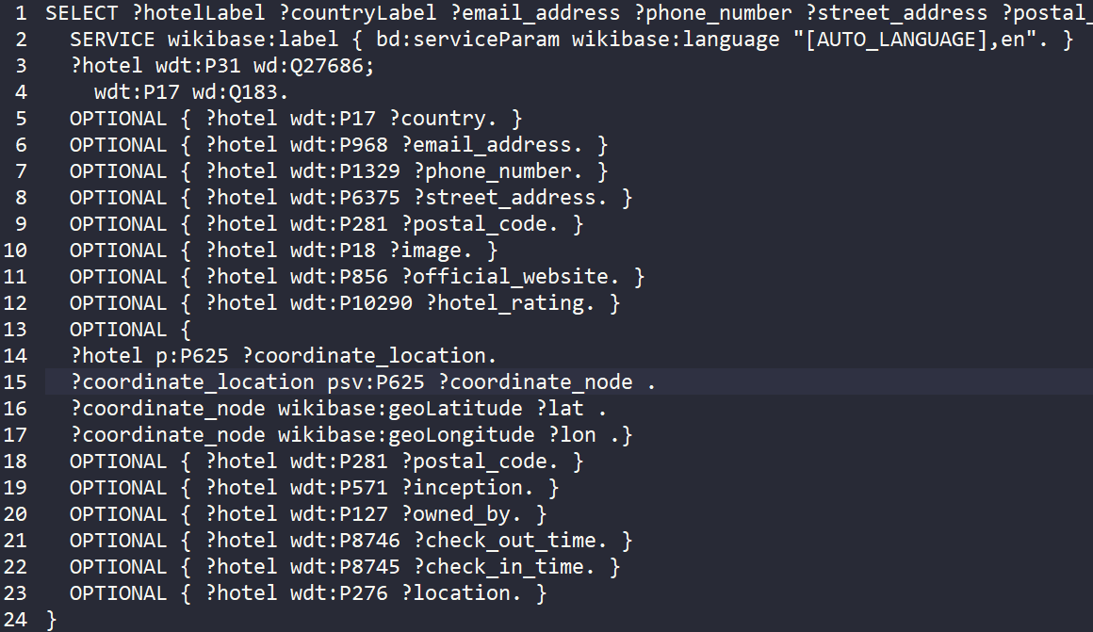
SPARQL - Query
Focus on mandatory data first
Figure 12: The SPARQL query used on www.wikidata.org .
Innsbruck I Penz Manuel, Rasmusen Sven I 18.05.2022

Slide 25
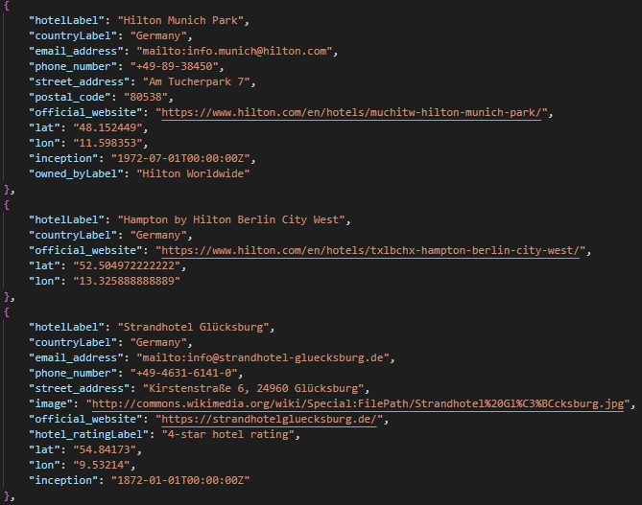
SPARQL - Query Result
Focus on mandatory data first
Figure 13: The JSON data received after using the SPARQL query on www.wikidata.org .
Innsbruck I Penz Manuel, Rasmusen Sven I 18.05.2022

Slide 26
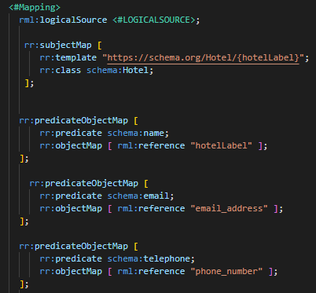
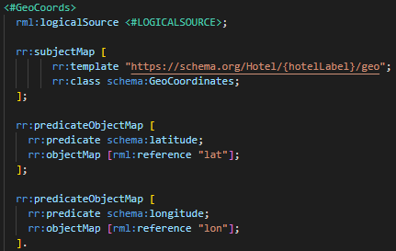
Mapping - wikidata.org
Properties:
name - “hotelLabel”
telephone - “phone_number”
faxNumber - “fax_number”
email - “email_address”
url - “official_website”
foundingDate- “inception”
checkinTime- “check_in_timeLabel”
checkoutTime- “check_out_timeLabel”
#Address -> PostalAddress
#GeoCoords -> GeoCoordinates
#Image -> ImageObject
#Owner -> Person
Figure 14: A code snippet used for mapping a hotel.
Figure 15: A code snippet used for mapping GeoCoordinates.
Innsbruck I Penz Manuel, Rasmusen Sven I 18.05.2022

Slide 27
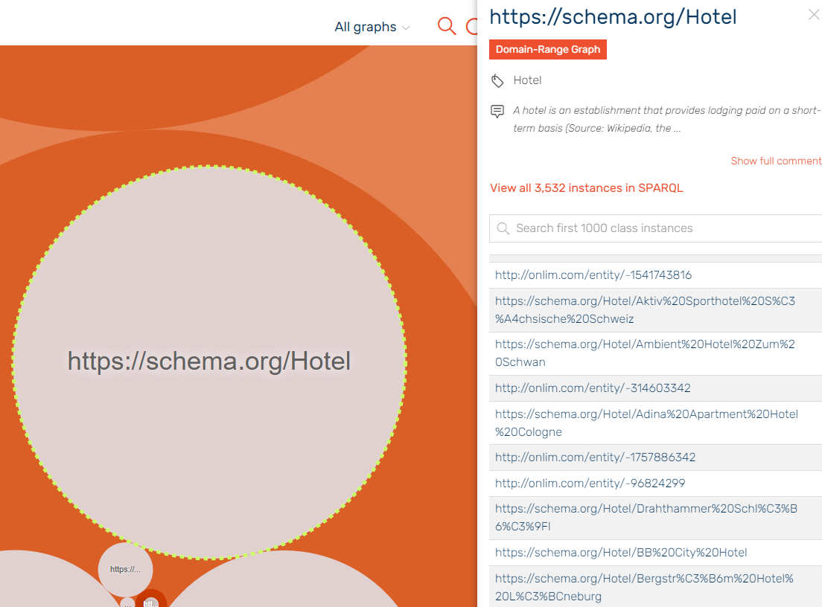
Importing contd. - wikidata.org
Figure 16: A view of the newly created data inserted into the GTKG.
Innsbruck I Penz Manuel, Rasmusen Sven I 18.05.2022

Slide 28
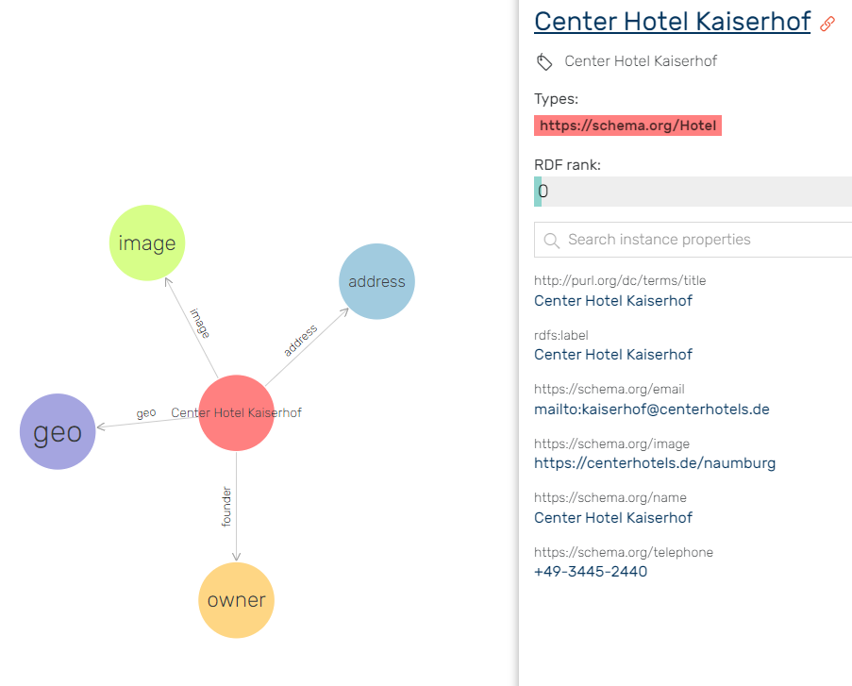
Importing contd. - wikidata.org
Figure 17: A detailed view of a newly inserted hotel instance.
Innsbruck I Penz Manuel, Rasmusen Sven I 18.05.2022

Slide 29
Assessment - wikidata.org
Figure 18: The assessment results for www.wikidata.org .
Innsbruck I Penz Manuel, Rasmusen Sven I 18.05.2022

Slide 30
Assessment - Comparison
Data source: www.firmenregister.de
Data source: www.wikidata.org
Figure 19: The assessment results for both data sources (www.firmenregister.de and www.wikidata.org) .
Innsbruck I Penz Manuel, Rasmusen Sven I 18.05.2022

Slide 31
Thank You!
We are open for feedback and questions.
Innsbruck I Penz Manuel, Rasmusen Sven I 18.05.2022

