Slide 1

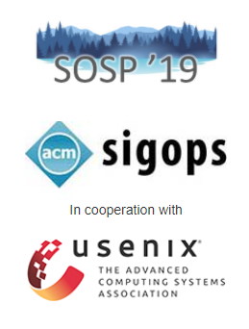
A Generic Communication Scheduler for Distributed DNN Training Acceleration
Authors:
Yanghua Peng
Yibo Zhu
Yangrui Chen
Yixin Bao
Bairen Yi
Chang Lan
Chuan Wu
Chuanxiong Guo
Venue:
The 27th ACM Symposium on Operating Systems Principles, 2019
1

Slide 2
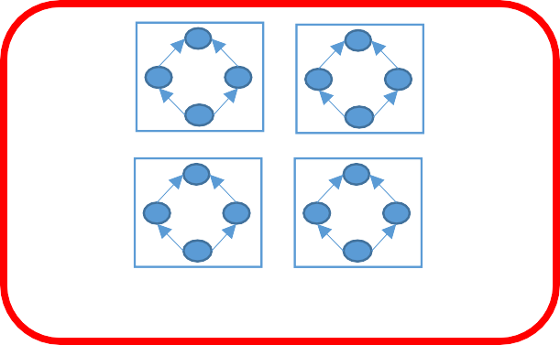
DNN Training
Training of DNNs is both compute-hungry and takes longer training time
ResNet50 | Training Time
1 TPUv3 | 10 hours
1024 TPUv3 | 1.28 minutes
BERT | Training Time
16 TPUv3 | 81 hours
1024 TPUv3 | 76.19 minutes
https://mlperf.org/training-results-0-6 https://arxiv.org/pdf/1904.00962.pdf
Scaling approaches to training of DNNs: data parallelism and model parallelism
Worker 4
Worker 1
Worker 2
Worker 2
Worker 3
Worker 3
Worker 4
Worker 1
data parallelism
model parallelism
2
Notes:
The larger goal motivating this research is to harness data-level parallelism to reduce the DNN training time.

Slide 3
Data Parallel DNN Training
^{Epoch 0 Epoch 1 Epoch 2} Epoch 3
Epoch E
Training
Minibatch 0 | Minibatch 1 |  | Minibatch 2 |  | Minibatch M
 | Forward | Backward
Iteration
Computation
f₀ | f₁ | … | f_{n-1} | b_{n-1} | b_{n-2} | … | b₀
push_{n-1}
pull_{n-1}
push_{n-2}
pull_{n-2}
Communication
…
push₀
pull₀
‹#›

Slide 4








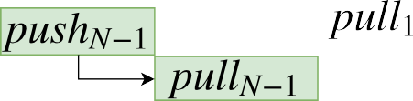
Dependency Graphs (Parameter-Server)
BP Iteration
FP Iteration +1
GPU
Computation
...
...
Communication
...
‹#›

Slide 5










Communication Scheduling
GPU
Push
2
1
0
Pull
2
1
-0
FIFO
GPU
Push
2 2 1 1 0 0 0 1 1 1 1 2
Pull
2 2 1 1 0 0 0 1 1 1 1 2
Authors have independently found 40% speedup just by leveraging priority scheduling & tensor partitioning.
‹#›

Slide 6





Limitations of Existing Work
Limited to specific framework implementations, e.g., P3 for MXNet PS and TicTac for TensorFlow PS.
Heuristic scheduling with empirical results
Out-of-sync with the demands of the real-world settings:
PS
TCP RDMA
Allreduce
ML frameworks
Communication architectures
Network protocols
‹#›

Slide 7
Key questions motivating this research include:
Proposed solution should work in all setups.
Necessitates minimal modifications.
Achieves elegant scheduling optimality.
‹#›

Slide 8
Single Unified Scheduling
Key Finding:
Inherent relationship between the underlying dependency graph for DNN training.
Solution:
ByteScheduler: A generic tensor scheduling framework
One unified scheduler framework that abstracts tensor scheduling from various frameworks, communication architectures and network protocols
One principled practical scheduling algorithm.
Supports Tensorflow, Keras, Pytorch, and MXNet, and compatible with both TCP and RDMA networks.
‹#›
Notes:
The dependency graph structure is intrinsic for DNN training, regardless of training frameworks, communication architectures, or network protocols

Slide 9
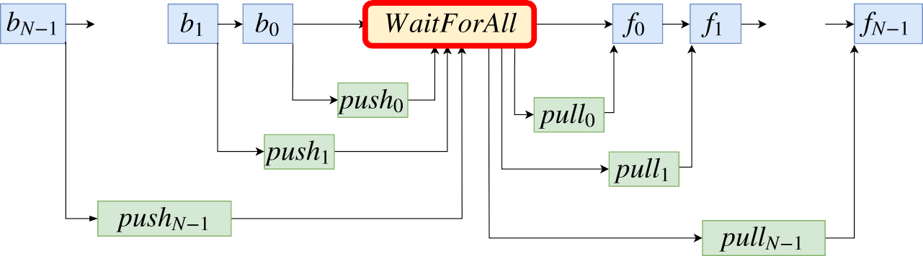
Problem 1: Choice of Framework?
Imperative framework (e.g., PyTorch) and declarative framework (e.g., TensorFlow)
Global barrier between iterations (e.g., TensorFlow, PyTorch), causing any scheduling of push/all-reduce ineffective
BP Iteration FP Iteration +1
GPU
Computation
...
...
Communication
...
...
Notes:
Different ML Frameworks

Slide 10
Problem 2: Choice of Runtime Environments
The overhead of scheduling & tensor partitioning is different for different system setups and network conditions
How to balance the performance gain with scheduling overhead? The system parameters (e.g., partition size) are likely to be affected by different runtime configurations, e.g., bandwidths, DNNs
_{2.5} 1e3
0.90 ^{1e3}
2.0
1.5
1.0
0.5
0.75
0.60
0.45
0.30
1 GbSs
10 GbSs
6SeeG (iPages/sec)
6SeeG (images/sec)
1 GbSs
10 GbSs
200 400
600
200
400
CreGit 6ize (.B)
600
3artition 6ize (.B)

Slide 11
Design of ByteScheduler

Slide 12
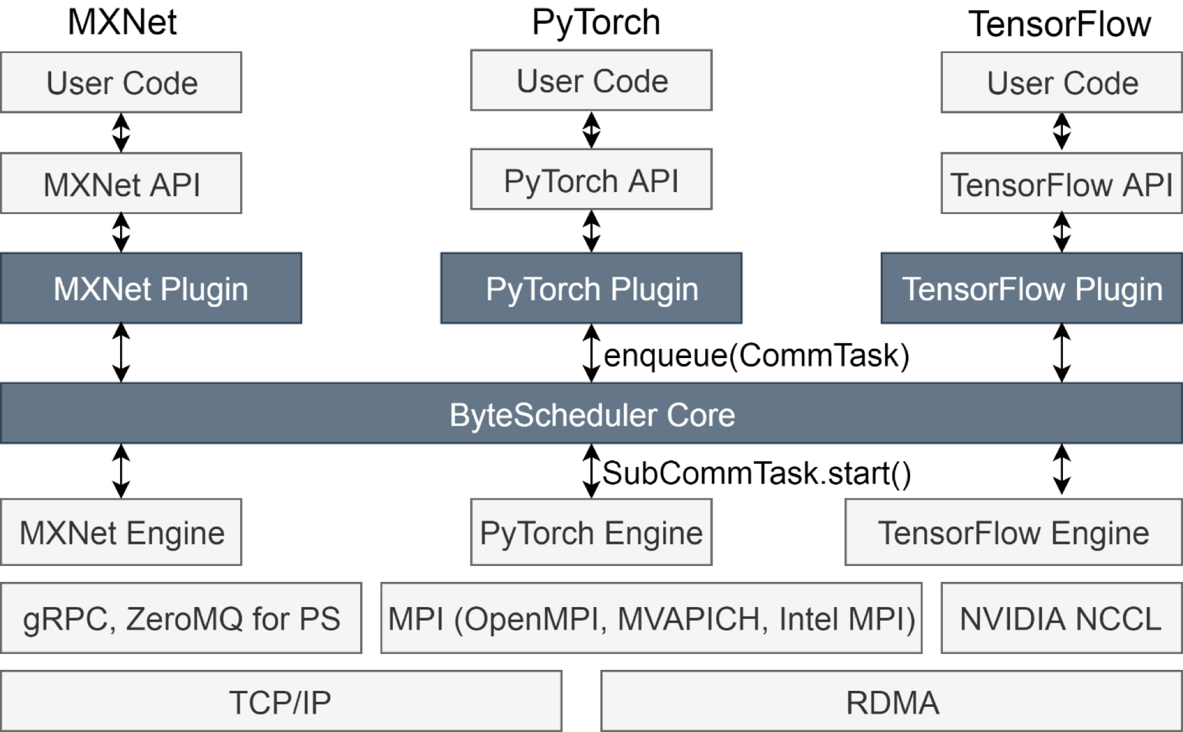
Frameworks-Agnostic Unified Scheduler
DNN definition
ByteScheduler
Graph execution Communication
Notes:
The authors had to make the decision around the positioning of the ByteScheduler in the Communication stack.

Slide 13
Frameworks-Agnostic Unified Scheduler
DNN definition
ByteScheduler
Graph execution Communication

Slide 14
CommTask: A Unified Abstraction
CommTask: A wrapped communication operation, e.g., push one tensor, all- reduce one tensor
CommTask APIs implemented in framework plugins:
partition(size): partition a CommTask into SubCommTasks with tensors no larger than a threshold size
notify_ready(): notify Core about the readiness of a CommTask
start(): start a CommTask by calling the underlying push/pull/all-reduce
notify_finish(): notify Core about the completion of a CommTask
Notes:
Threshold is one of the important system parameters & heuristic variable around the design of the communication tasks,

Slide 15


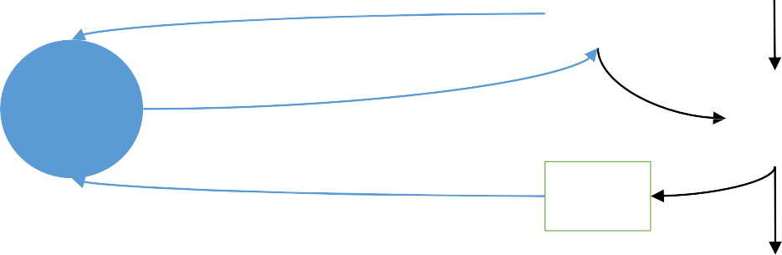


Dependency Proxy: Administers Scheduling Control
A Dependency Proxy is an operator to get the scheduling control from the frameworks to the Core
Different implementation for imperative, declarative engines
Dependency Proxy:
Trigger CommTask.notify_ready() via a callback
Wait to finish until Core calls CommTask.start()
Generate completion signal using CommTask.notify_finish()
Engine
BP
CommTask.notify_ready()
Proxy
Core
Comm.
Op
CommTask.start()
Proxy
CommTask.notify_finish()
FP in the next iteration

Slide 16


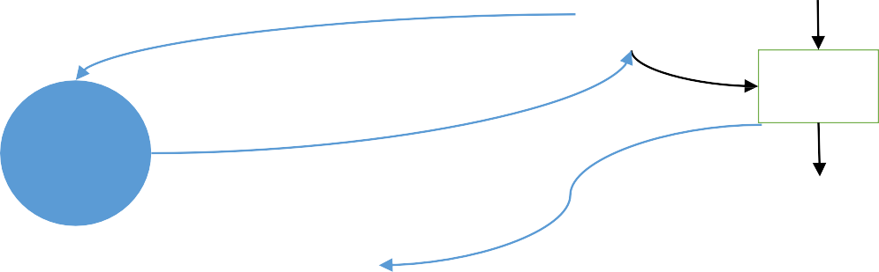




Dependency Proxy: Crossing the Global Barrier
Out-of-engine communication: Start the actual communication outside engine
Layer-wise out-of-engine dependencies: Build correct dependency for each layer by adding a Proxy to block forward computation.
Engine
BP
CommTask.notify_ready()
Proxy
Async
Comm .
Op.
Core
CommTask.start()
Barrier
Comm.
Op
CommTask.notify_finish()
FP in the next iteration

Slide 17

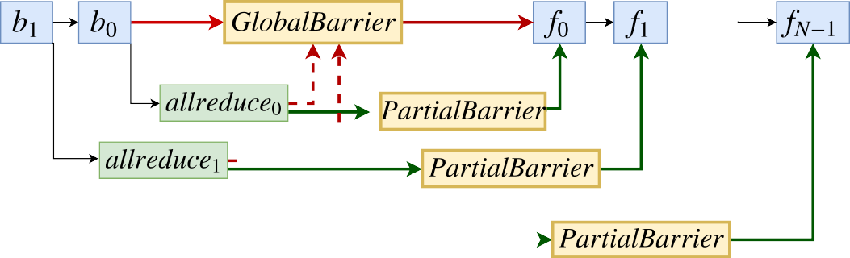
Dependency Proxy: Crossing the Global Barrier
Out-of-engine communication: Start the actual communication outside engine
Layer-wise out-of-engine dependencies: Build correct dependency for each layer by adding a Proxy to block forward computation
BP Iteration
FP Iteration +
GPU
Computation
...
...
Communication
...

Slide 18
Optimal Scheduling Theorem
Optimal scheduling for minimizing the time for each iteration:
For PS, prioritize push_{i} over push_{j}, and pull_{i} over pull , ∀ i < j
For all-reduce, prioritize allreduce_{i} over allreduce_{j}, ∀ i < j
Assuming infinitely small partition size and immediate preemption without overhead
In practice, both partitioning and preemption may have overheads.

Slide 19
Credit-based Preemption
Stop-and-wait approach in previous work can not fully utilize network bandwidth
Send a single tensor and wait for its ACK
Credit-based Preemption
Work like a sliding window and the credit is the window size
Allow multiple tensors in a sliding window to be sent concurrently
Credit size is an important system parameter
Pro: higher bandwidth utilization
Con: less timely preemption due to FIFO communication stack

Slide 20
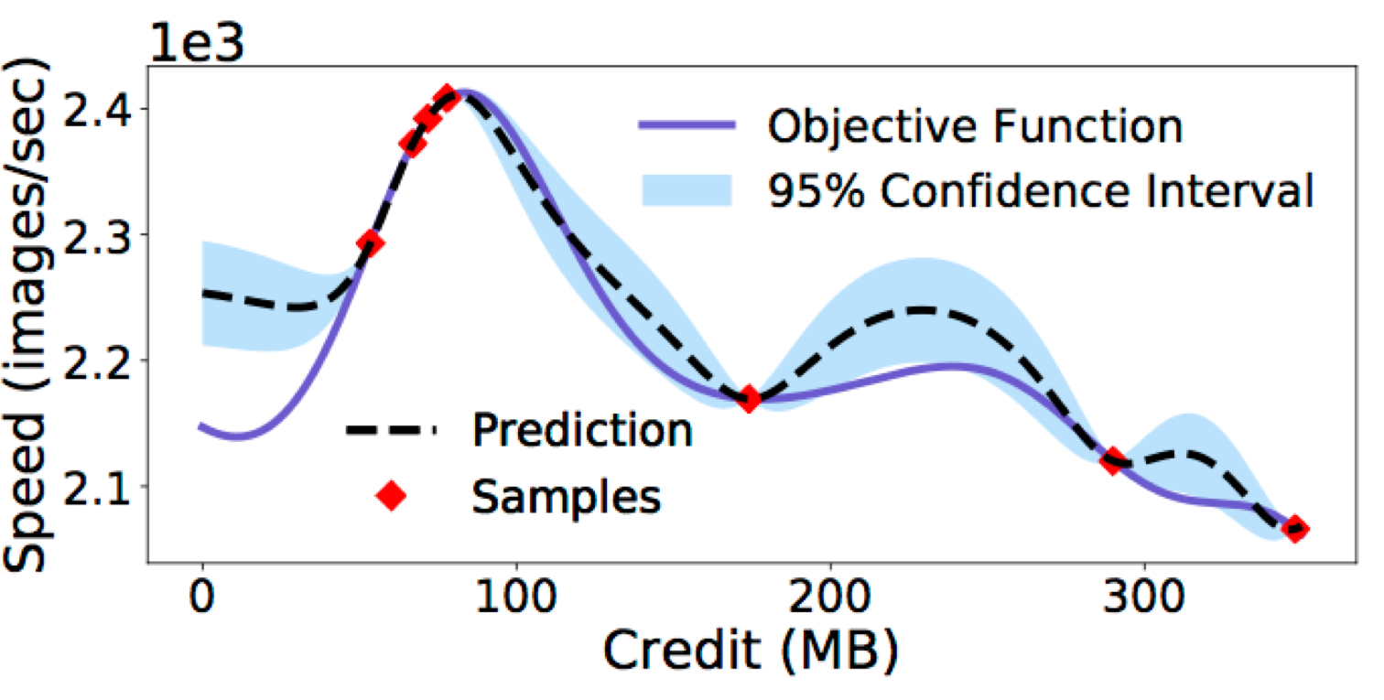
Auto-tuning Partition Size and Credit Size
Optimal partition size and credit size are affected by many factors, e.g., network bandwidths, number of workers, DNN models, CPU and GPU types
We use Bayesian Optimization for auto-tuning
Work with general objective function
Minimize the overhead, i.e., the number of sampled points

Slide 21
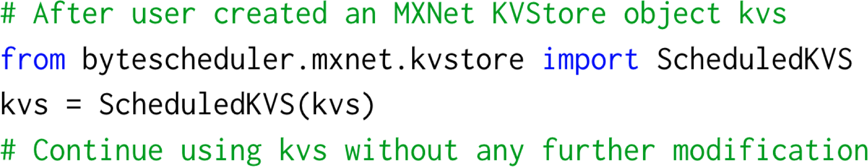
Evaluation
Implementation: MXNet PS and all-reduce (based on Horovod), PyTorch (based on Horovod), TensorFlow PS
Testbed: 16 machines, each with 8 Tesla V100 GPUs and 100 Gbps bandwidth
Comparison:
Baseline: vanilla ML frameworks
Linear scaling: vanilla training speed on 1 machine multiplied by the number of machines

Slide 22
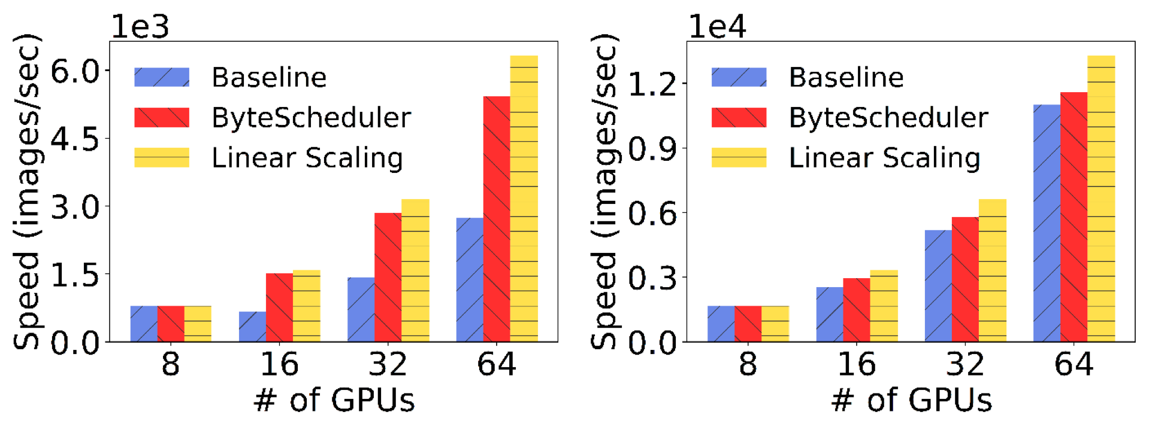
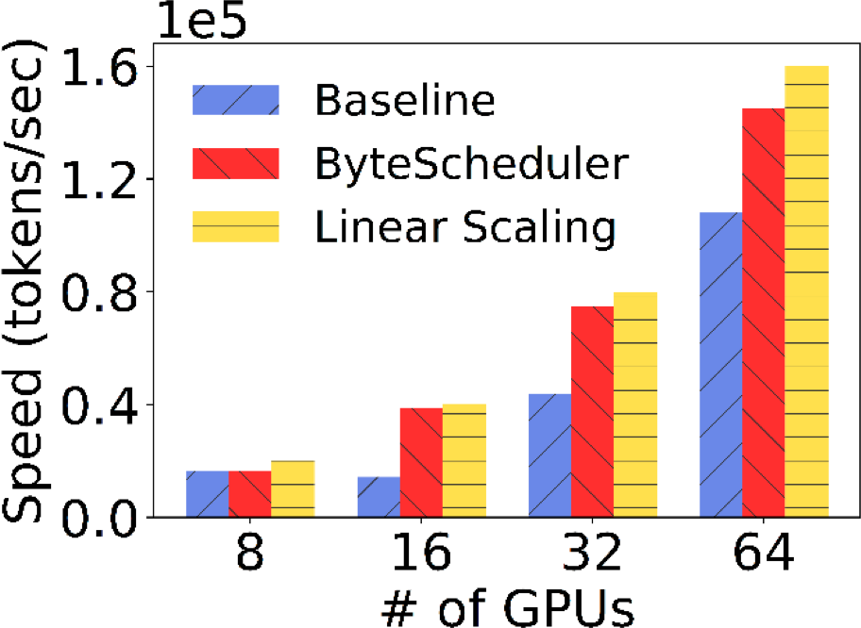
ByteScheduler Scalability
VGG16 (97%-125%) ResNet50 (9%-15%)
MXNet PS RDMA
Up to 2x improvement and approximates linear scaling
Transformer (70%-171%)

Slide 23
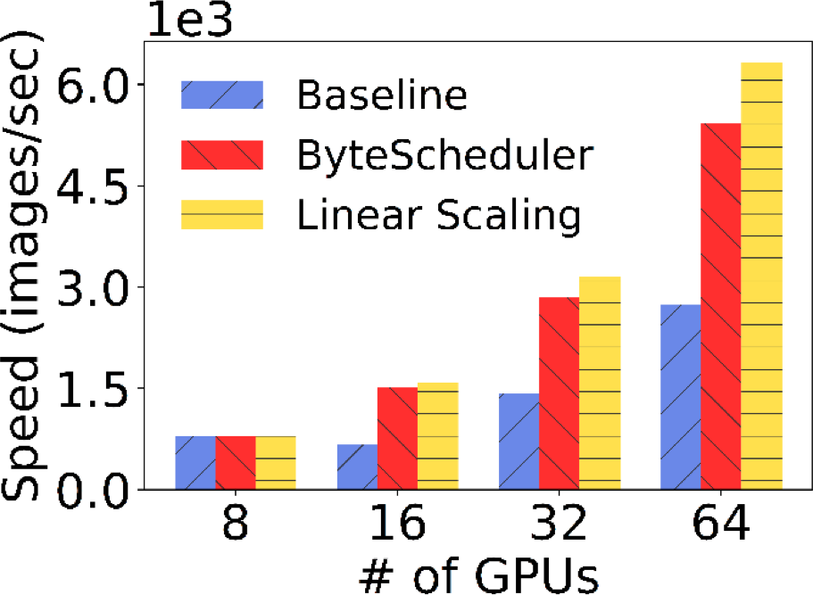
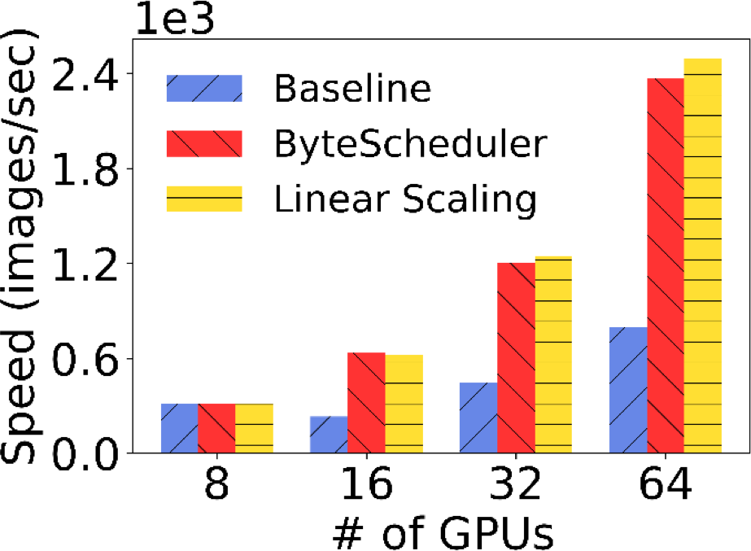
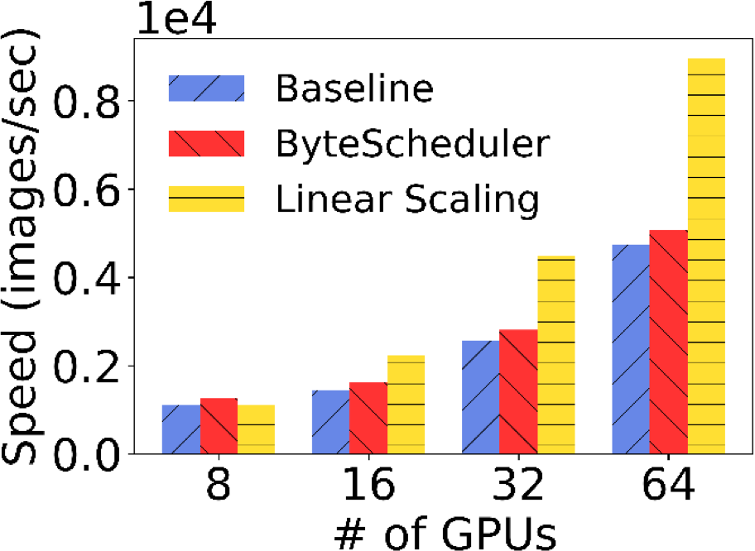
ByteScheduler for Multiple Frameworks
MXNet PS RDMA (97%-125%)
TensorFlow PS RDMA (170%-196%)
PyTorch NCCL TCP (7%-13%)
VGG16
Up to 2x improvement compared to the baseline
‹#›

Slide 24
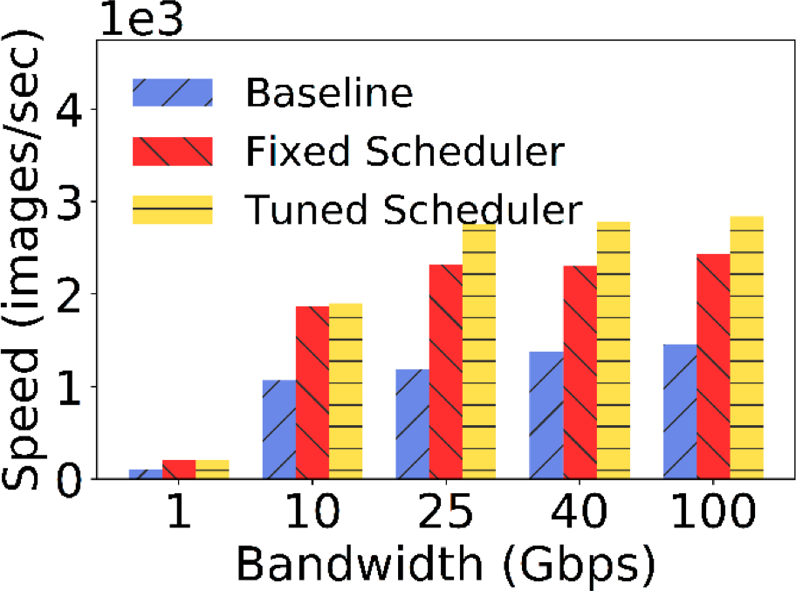
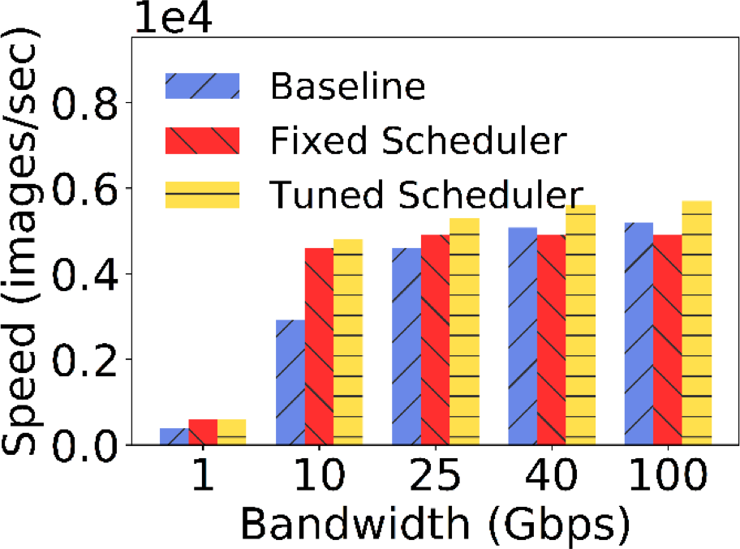
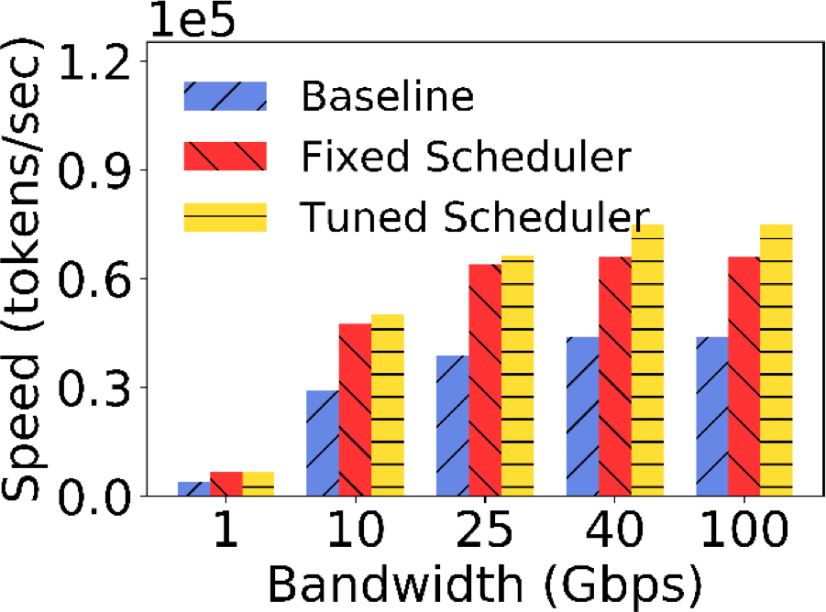
ByteScheduler Adapts to Different Bandwidths
VGG16 (79%-132%) ResNet50 (10%-64%)
MXNet PS RDMA
Consistent speedup in all bandwidth settings
Without auto-tuning, the training speed is lower
Transformer (67%-70%)
‹#›

Slide 25
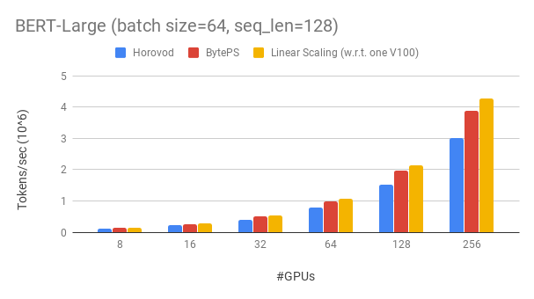
ByteScheduler Performance
Achieves ~90% scaling efficiency for BERT-large with 256 GPUs.
Scaling efficiency with Horovod+NCCL with optimal parameter tuning is ~70%.
Over slower network, ByteScheduler over 2x speedup compared to Horovod+NCCL.
‹#›

Slide 26
Conclusion
ByteScheduler: A generic communication scheduler for distributed DNN training acceleration.
Unified abstraction for tensor scheduling
Principled tensor scheduling design with parameter autotuning
Generalizable across training frameworks
Superior cloud, shared clusters speedups over traditional MPI paradigm.
Incorporates several accelerations including hierarchical strategy, pipelining, tensor-partitioning, NUMA-aware local communications, priority-based scheduling, etc.
‹#›

Slide 27
Limitations
Missing support for pure CPU training.
Lack of support for following features in ByteScheduler Architecture:
Sparse model training
Fault Tolerance
Straggler-mitigation
Missing support for aggressive compressions including gradient compression.
‹#›
Notes:
One reason is that the cheap PS assumption of ByteScheduler do not hold for CPU training. Consequently, you need CUDA and NCCL to build and run BytePS.

