Slide 1
GRNN: Low-Latency and Scalable RNN Inference on GPUs
Connor Holmes, Daniel Mawhirter, Yuxiong He, Feng Yan, Bo Wu
Presentation by: Sohaib Ahmad

Slide 2
Motivation
No efficient inference library for RNN inference on GPUs
Microsoft and Facebook run their RNN inference on CPUs
Resource wastage, as many data centers already equipped with GPUs
Basic operators in RNNs are matrix multiplications, amenable to GPUs
29% of Google’s workload on TPUs are RNNs

Slide 3
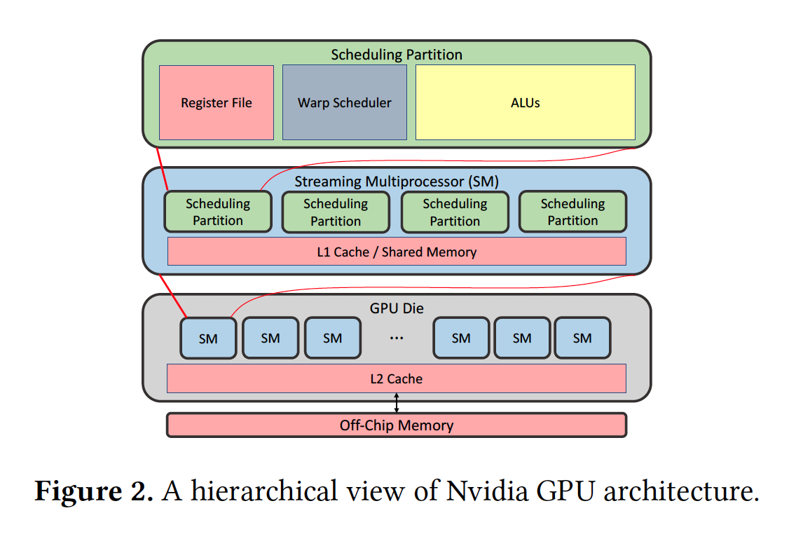
Background: GPU Architecture
To better utilize GPUs, first need to understand how they work
Each GPU -> multiple SMs
Thread block assigned to an SM by GPU hardware
Each SM -> multiple scheduling partitions (with L1 cache)
Thread block is divided into multiple warps (each of 32 threads)
Warp schedulers schedule the warps
Registers < L1 cache < L2 cache

Slide 4
Background: RNNs
Recurrent neural networks
Useful for modeling sequential data
Examples: Speech recognition, machine translation, question answering
Two popular versions:
LSTM (long short-term memory)
GRU (gated recurrent unit)

Slide 5
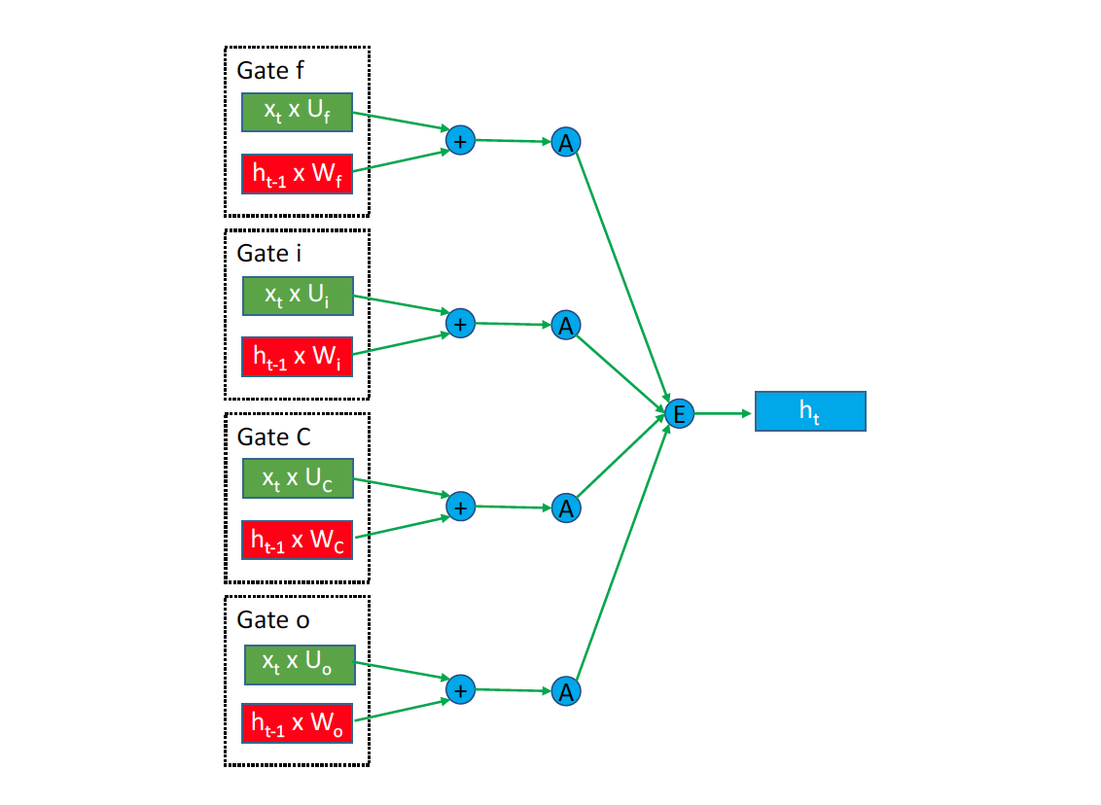
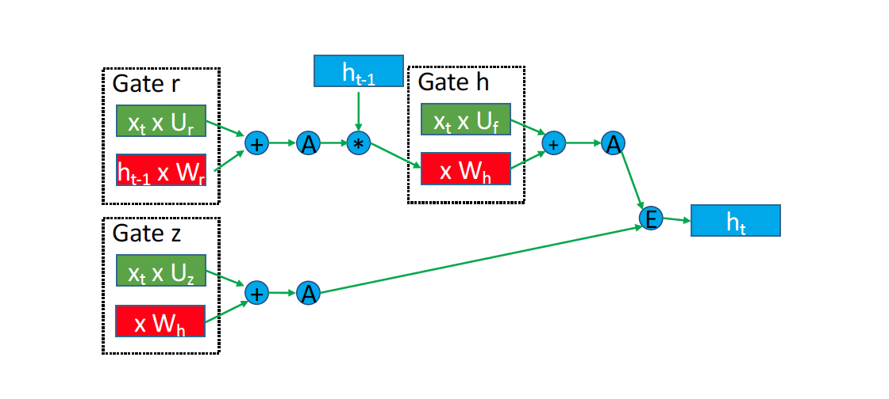
Background: RNN Architecture
LSTM
GRU
In each iteration, input matrix (x) and previous hidden state (h_{t-1}) used to update new hidden state (h_{t}) and output

Slide 6
Limitations of existing approaches
L1. Repeated data loading
On each iteration, entire weight matrix is loaded from memory or L2 cache
L2. Large kernel launch overhead
One or more kernels (functions) launched per iteration. The overhead for such kernel launches is non-trivial
L3. Poor scalability in either model or batch size
DeepCPU has poor scalability due to limited theoretical throughput of CPU
GPU libraries have poor scalability due to inefficient implementation despite high throughput of GPUs

Slide 7
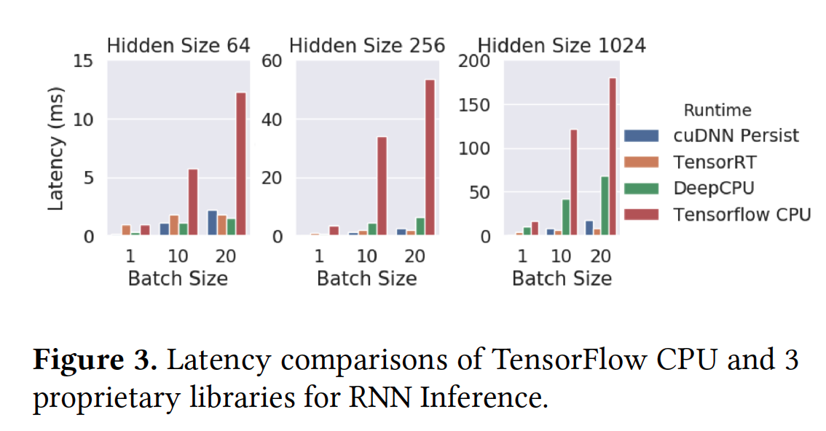
Scalability in model and batch size
Tensorflow CPU the worst in all cases
cuDNN < TensorRT for 5/9 configurations, but not scalable in terms of batch size
For small models, DeepCPU < cuDNN
For larger models, cuDNN < DeepCPU
cuDNN’s better scalability comes from the use of GPU rather than efficient implementation
DeepCPU: Microsoft’s RNN inference library (CPU)
cuDNN: Nvidia’s optimization library for RNN training (GPU)
TensorRT: Nvidia’s optimized library for RNN inference (GPU)

Slide 8
Opportunities
For an LSTM model with hidden dimensions of 1024, we need 16MB space for weights
Nvidia Volta GPU has 20MB total register file space, 10MB shared memory (we can fit the whole model)
Weights cannot stay in memory if we keep relaunching the kernel
Solution: Use persistent threads and keep the weights loaded (addressing L1)
Due to usage of persistent threads, we just launch one kernel (addressing L2)
Due to weight data reuse, scalability also improves (addressing L3)

Slide 9
Challenges
Global synchronization of persistent threads is non-trivial
How to map threads to operators?
Due to many possible configurations, exhaustive search over configuration space is very time consuming

Slide 10
GRNN: Overview
GPU based library for RNN inference on GPUs with:
Low latency
High throughput
Efficient resource utilization
Implemented in CUDA, can be easily integrated to Tensorflow, PyTorch, Caffe
Supports both LSTM and GRU

Slide 11
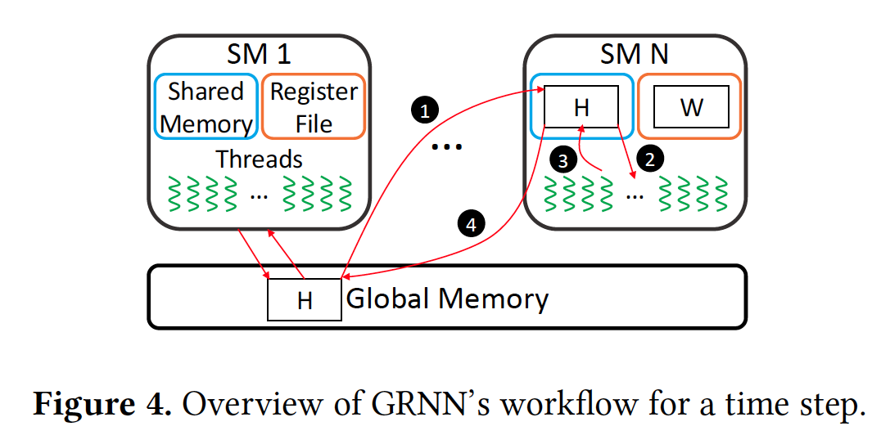
GRNN: Workflow
Replicate global hidden state in shared memory of each SM
Map threads to weight matrix and state
Execute operators to produce local copy of H
Synchronize all SMs and update global copy of H

Slide 12
Partitioning computation across SMs
Basic approach: assign entire operators to different SMs
Problem: weight matrix of matrix multiplication cannot fit into single register file
Solution: partition multiplications across SMs
How?

Slide 13
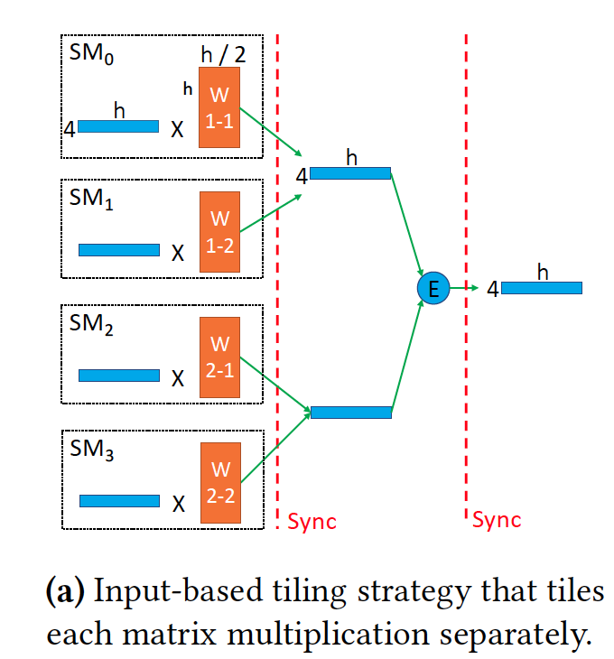
Input-based tiling
Given: 2 multiplications, 4 SMs
Divide weight matrices across SMs
Perform parallel multiplications, then synchronize
Another synchronization needed after element-wise operations to produce final vector

Slide 14
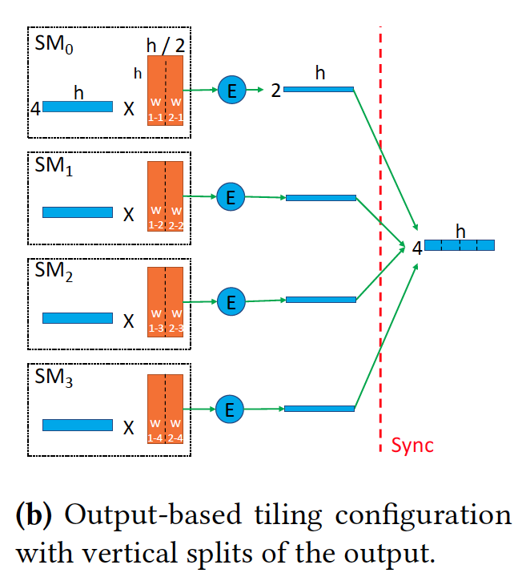
Output-based tiling
Given: 2 multiplications, 4 SMs
Instead of going bottom-up, we work top-down
Place corresponding weight matrix partitions for vertical split of output on different SMs
Only one synchronization needed at the end

Slide 15
Special case: GRU
Recall: dependency structure of GRU

Slide 16
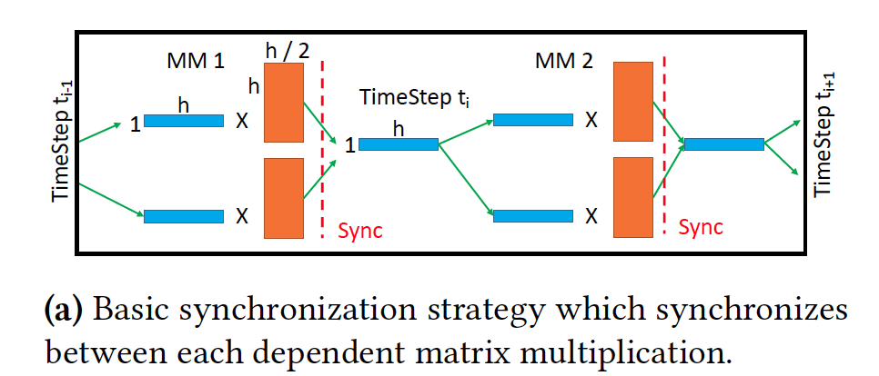
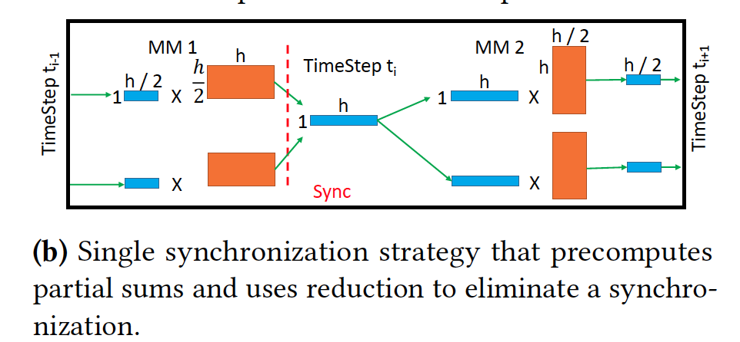
Special case: GRU
Basic strategy: vertical partitioning
Need 2 synchronizations
Better approach: horizontal partitioning
Need 1 synchronization + compute overhead

Slide 17
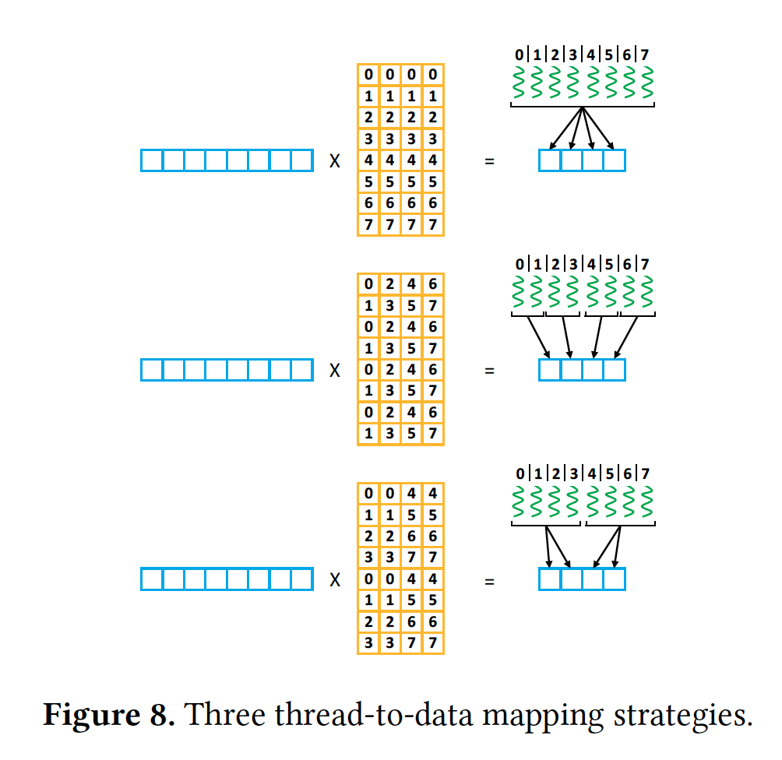
Mapping Threads to Computation
1st approach: minimizes memory accesses
1 load, 8 partial sums
2nd approach: minimizes reduction overhead
4 loads, 2 partial sums
3rd approach: middle ground
2 loads, 4 partial sums

Slide 18
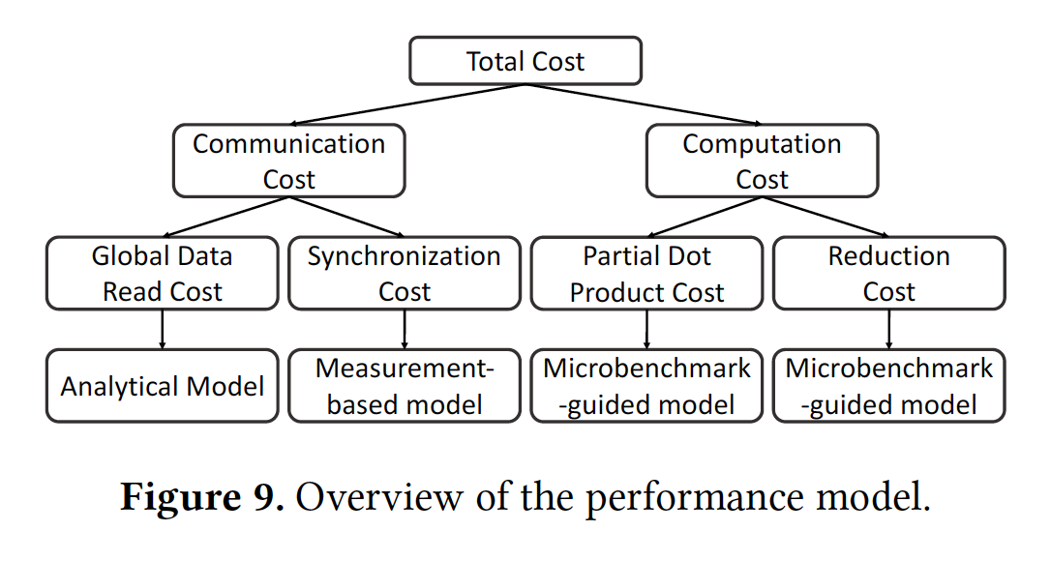
Configuration Selection
Number of possible configurations can be over 100,000
First eliminate all that use more registers than SMs can provide
Then based on this cost model, top K configurations selected (K is tunable)
For top-5, 98% of optimal throughput achieved

Slide 19
Experimental Setup
Nvidia Titan V system, with Xeon E3-1286 v3 host with 32GB RAM
80 SMs, 12GB HBM2 memory
Theoretical peak throughput: 13.67 TFLOPS
For DeepCPU: Dual socket E5-2650 v4 system
Each socket: 12 cores @ 2.2 GHz

Slide 20
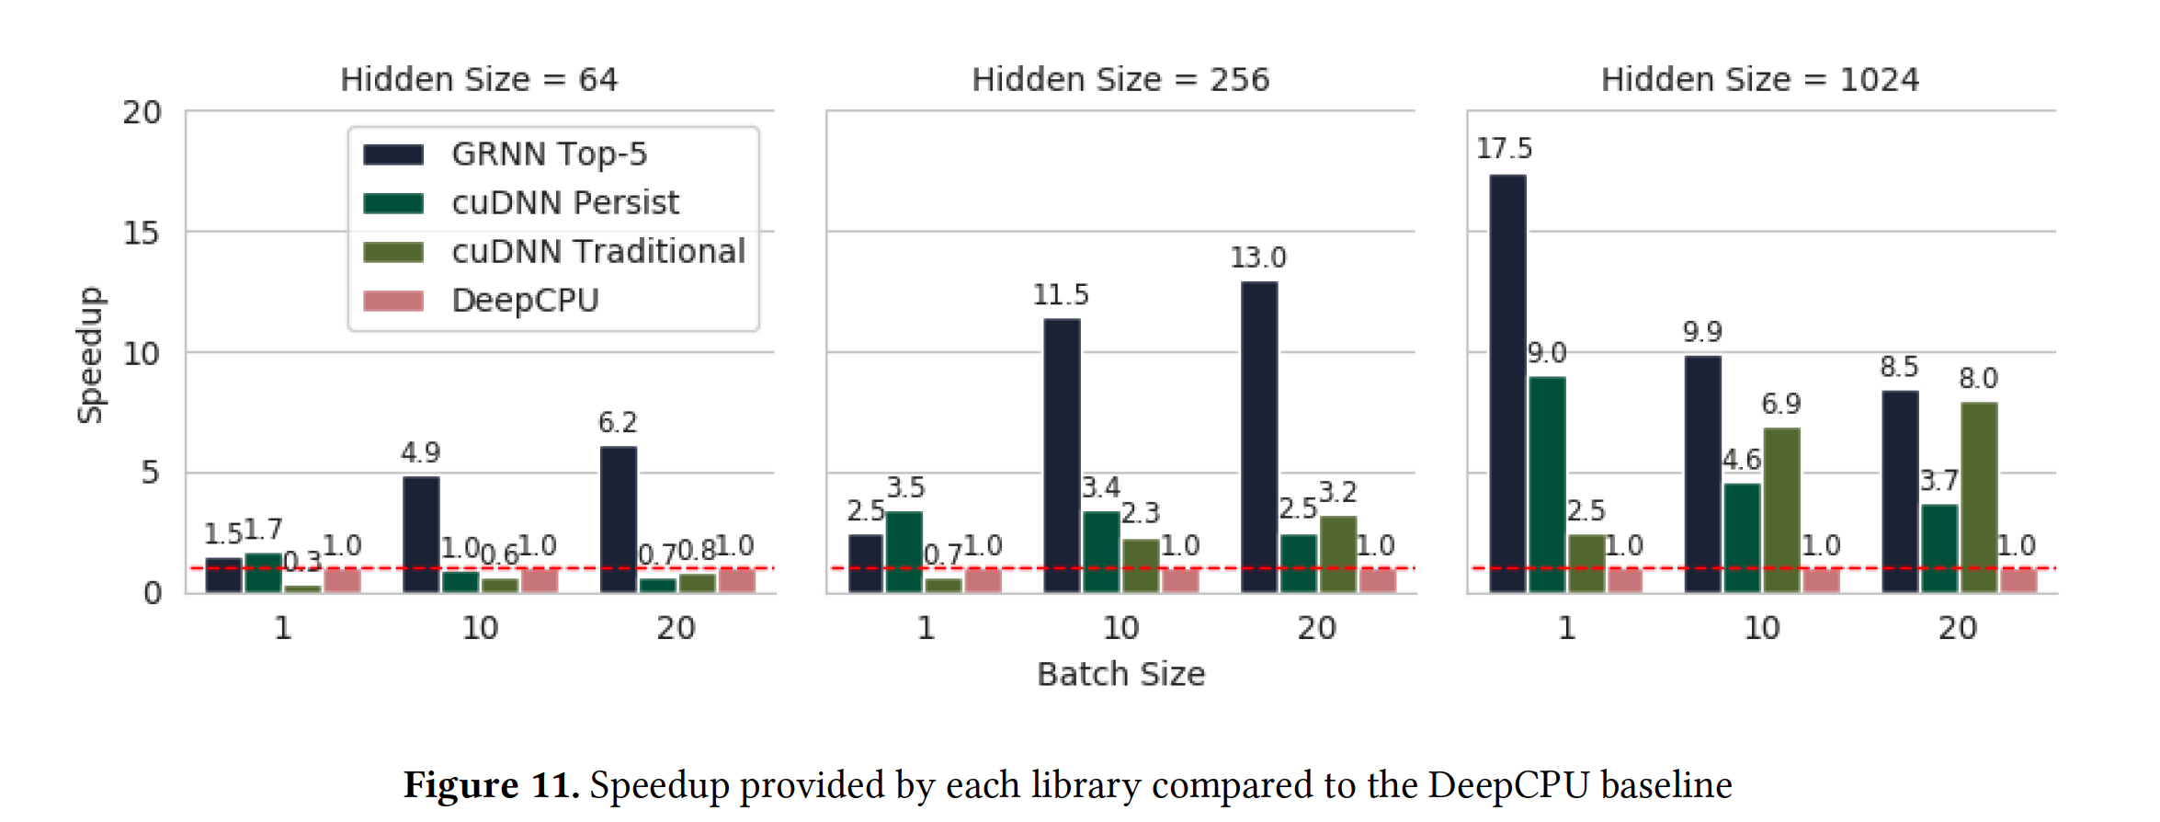
Results – Speedup

Slide 21
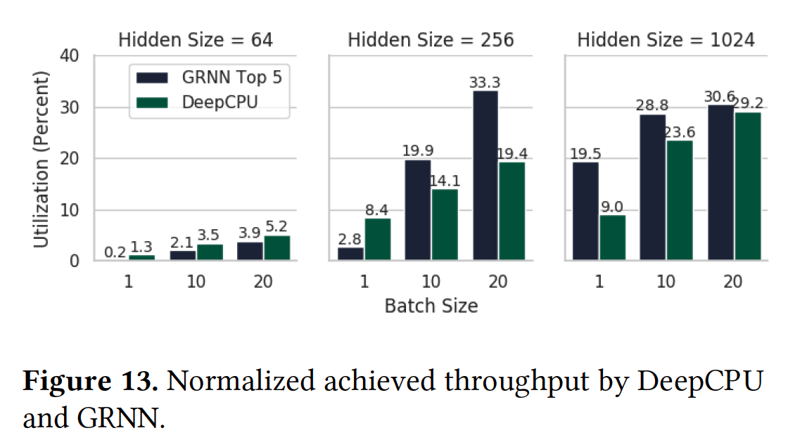
Results – Resource Utilization

Slide 22
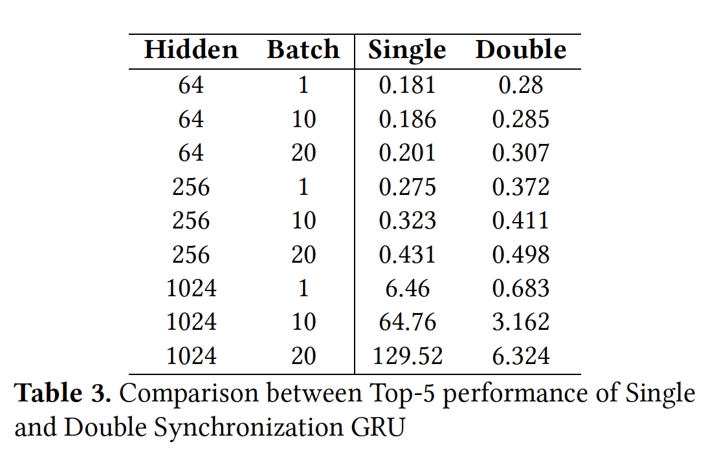
Results – Single vs Double Sync in GRU
As model size grows, overhead of reduction in single synchronization increases
Can select best one depending on model and batch size

Slide 23
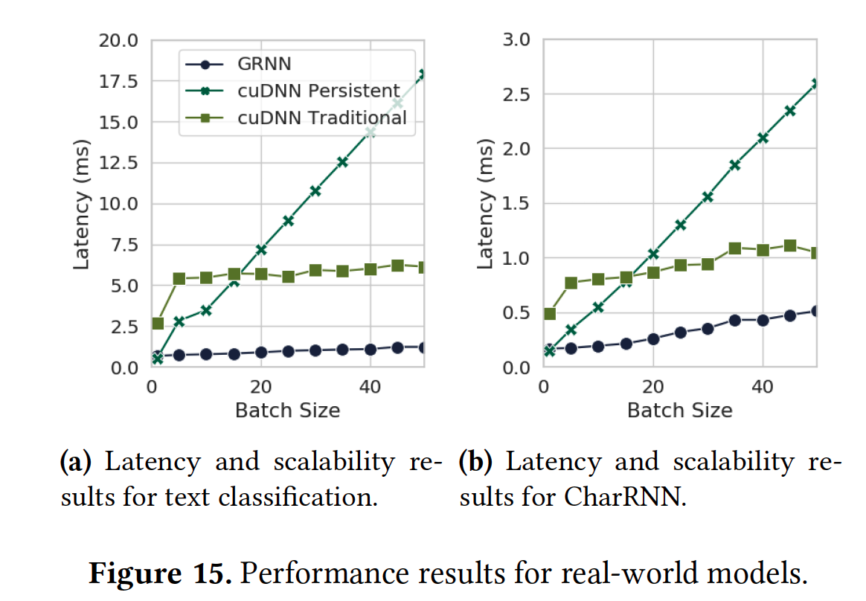
Results – Text Classification and CharRNN

Slide 24
Limitations
Works well for a single RNN model, takes up the entire GPU using persistent threads
Evaluating the cost of all possible configurations can be time consuming, overhead not considered
TensorRT not included in final evaluation even though it performs better than cuDNN and DeepCPU for RNN inference

Slide 25
Conclusion
GRNN is a CUDA-based library to improve RNN inference using GPUs
Outperforms both CPU-based (DeepCPU) and GPU-based (cuDNN) libraries in terms of latency and resource utilization
Provides a configurable space to select the best approach given model size, input size, and hardware specifications

