Slide 1
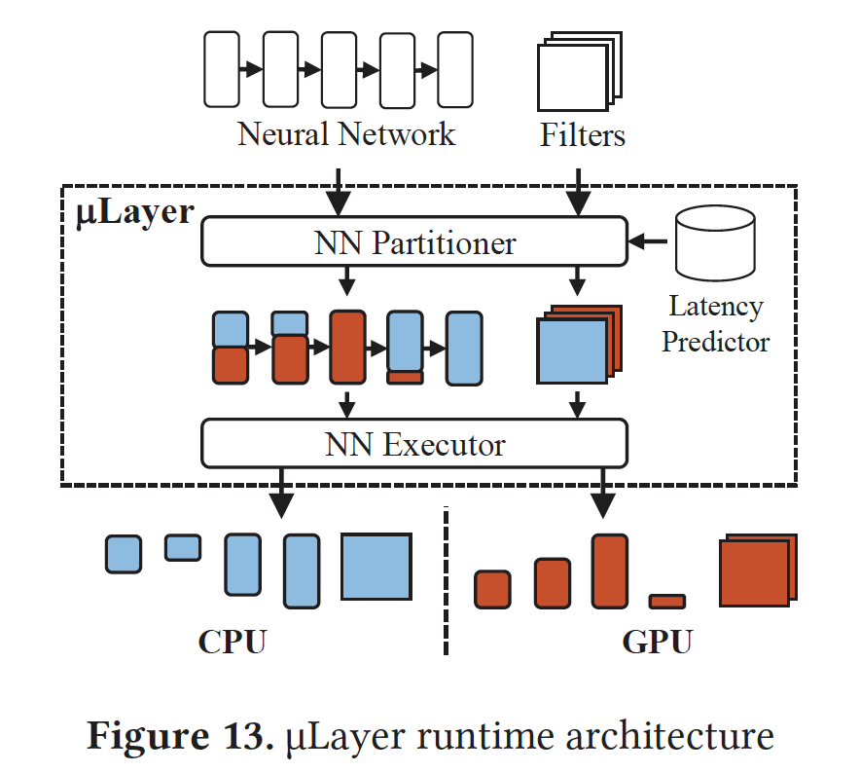
Implementation
uLayer consists of three parts:
NN Partitioner
For each layer, decides split ratio (0 <= p <= 1) for channel-wise workload distribution
Latency Predictor
Given parameters of an NN layer and p, estimates execution latency of the layer (extending Neurosurgeon’s model^{[1]})
NN Executor
Uploads filter values of NN to CPU and GPU memory, converts QUInt8 to F16 for GPU, executes
[1] Yiping Kang, Johann Hauswald, Cao Gao, Austin Rovinski, Trevor Mudge, Jason Mars, and Linjia Tang. 2017. Neurosurgeon: Collaborative Intelligence Between the Cloud and Mobile Edge. In Proc. 22nd ACM International Conference on Architectural Support for Operating Systems and Programming Languages (ASPLOS).

Slide 2
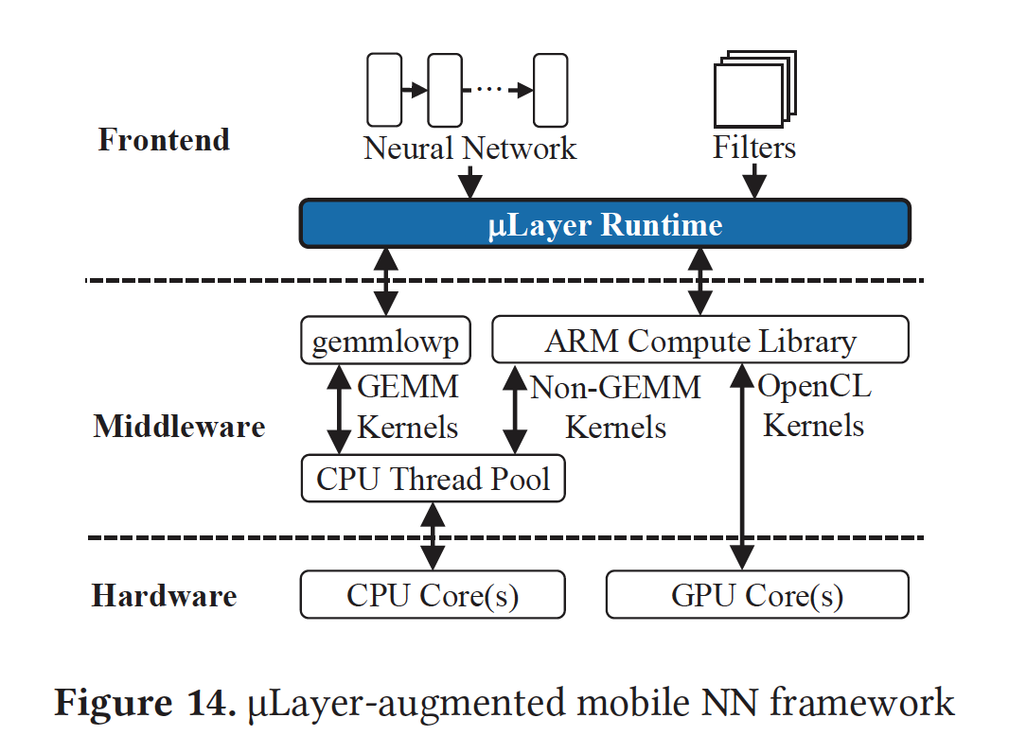
uLayer Framework
Two middlewares used:
ARM Compute Library (mostly)
gemmlowp for CPU (for GEMM or GEneralized Matrix Multiplications in convolutional and FC layers)
Operates on QUInt8 values by default, improving performance
Asynchronous GPU commands to hide invocation latency

Slide 3
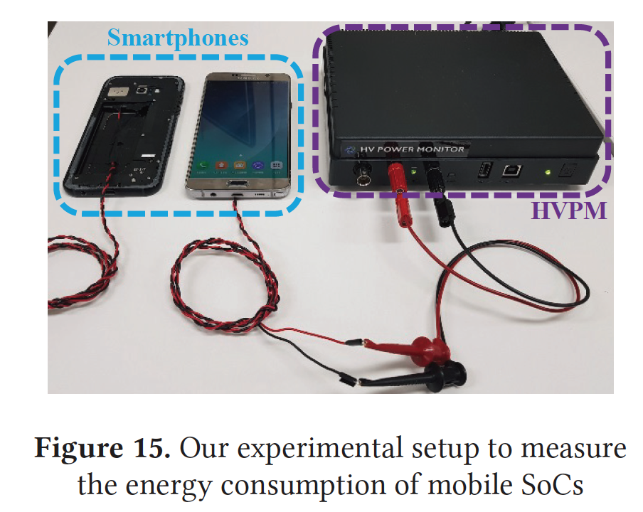
Experimental Setup
Two mobile SoCs:
Samsung Exynos 7420 (high-end mobile)
Four high-performance 2.1GHz CPU cores
Four energy-efficient 1.5GHz CPU cores
Octa-core 700MHz GPU
Samsung Exynos 7880 (mid-range mobile)
Eight 1.9GHz CPU cores
Triple-core 962MHz GPU
HV Power Monitor to measure energy consumption

Slide 4
Models and Dataset
Five representative NNs:
GoogLeNet
SqueezeNet v1.1
VGG-16
AlexNet
MobileNet v1
They all use the ImageNet dataset
NNs having divergent branches
Early NNs with large filter sizes
Small-scale NN

Slide 5
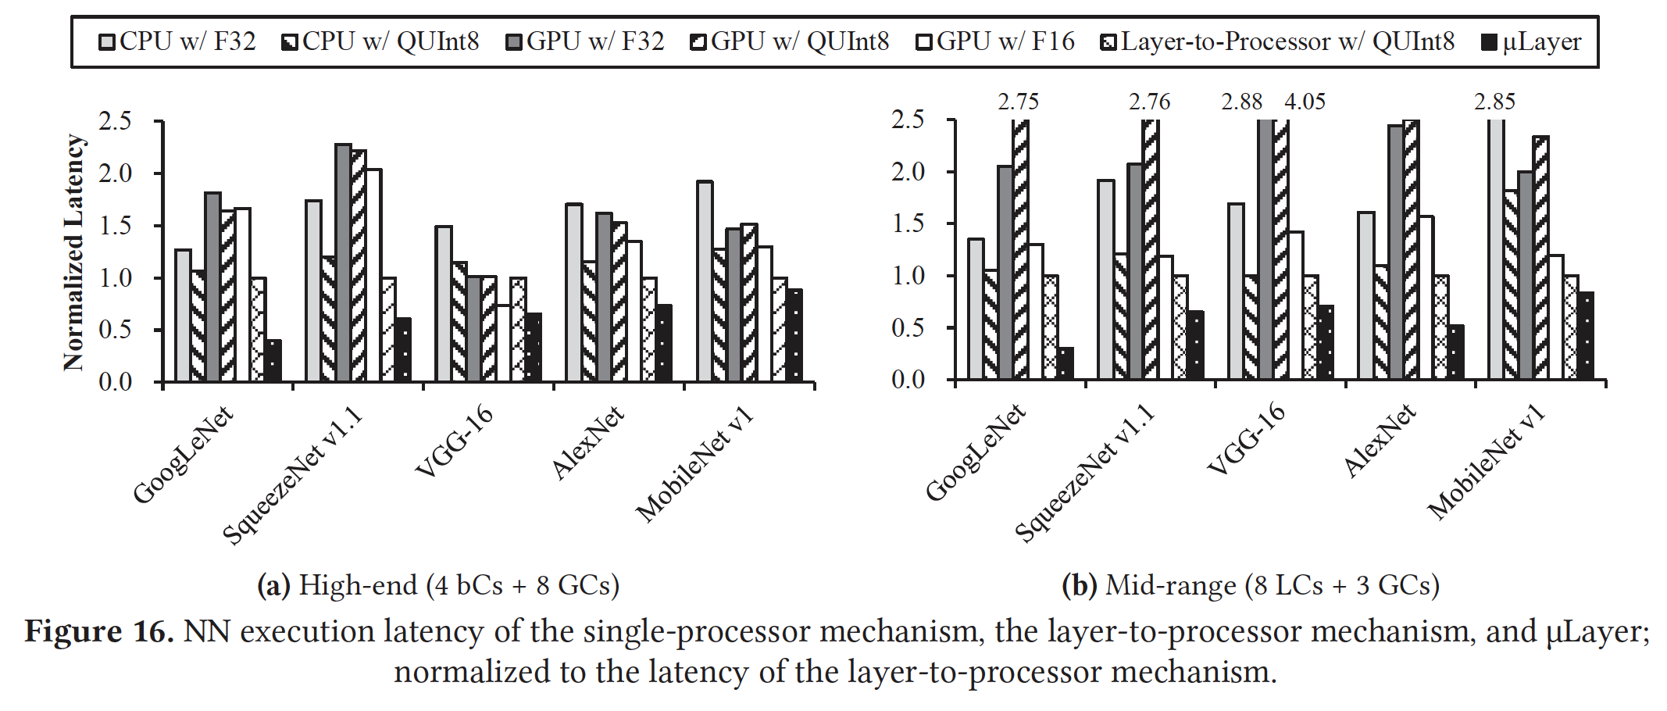
Results – Latency
uLayer beats layer-to-processor mechanism by 59.9% (high-end) and 69.6% (mid-range)

Slide 6
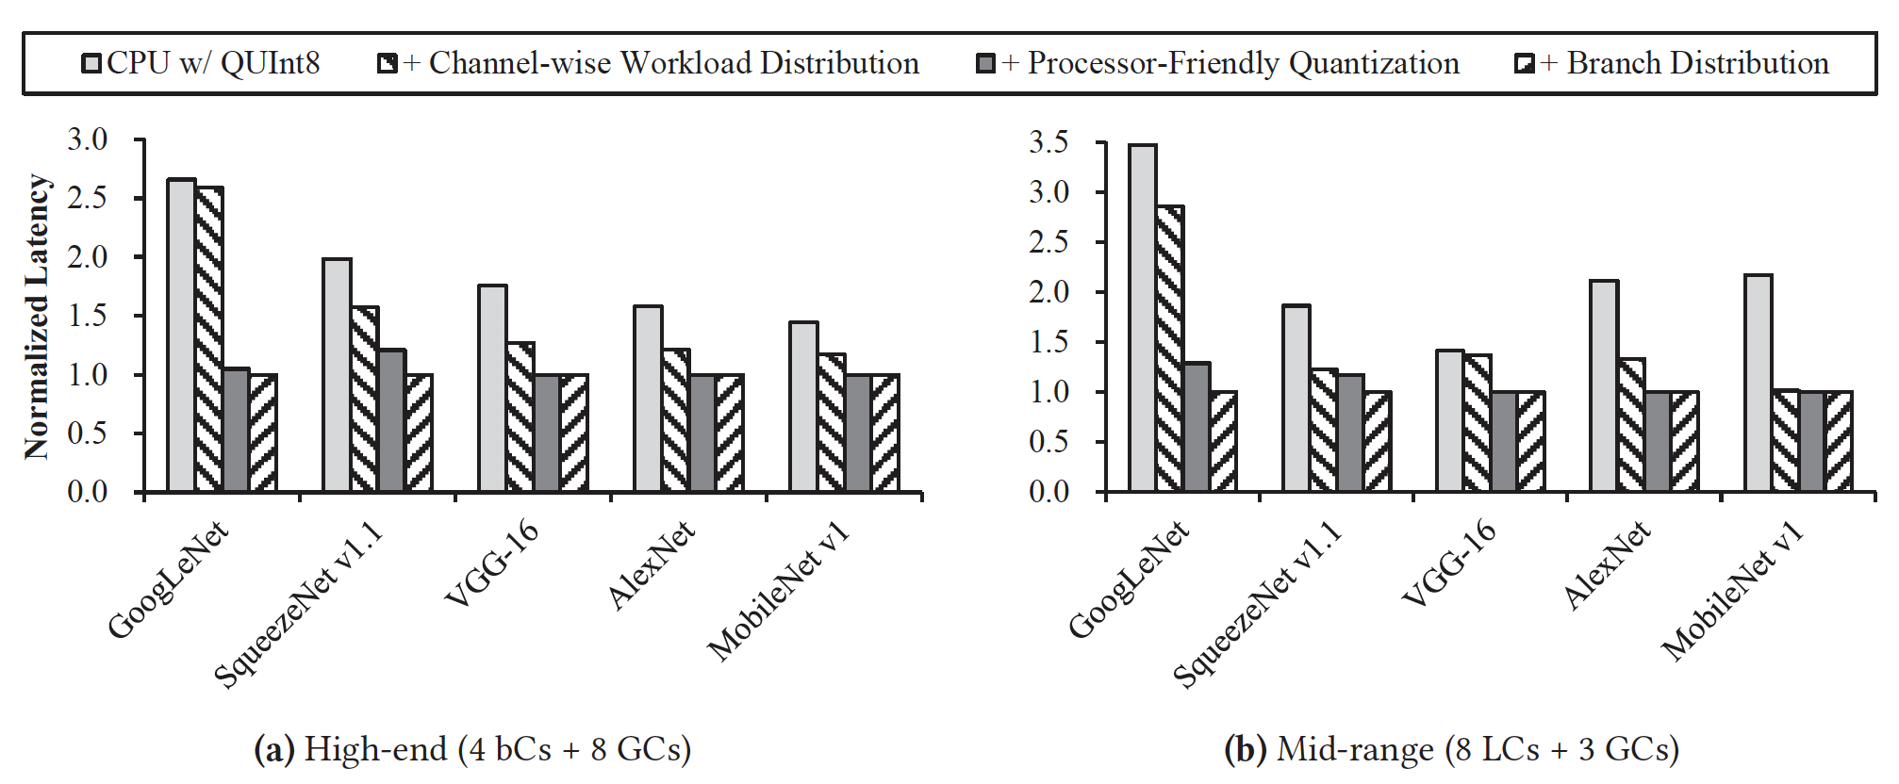
Contribution of each optimization
Channel-wise distribution contributes most to AlexNet having few, large convolutional layers
Processor-friendly quantization helps GoogLeNet due to many conv layers with small filters
Branch distribution helps GoogLeNet and SqueezeNet by exploiting divergent branches

Slide 7
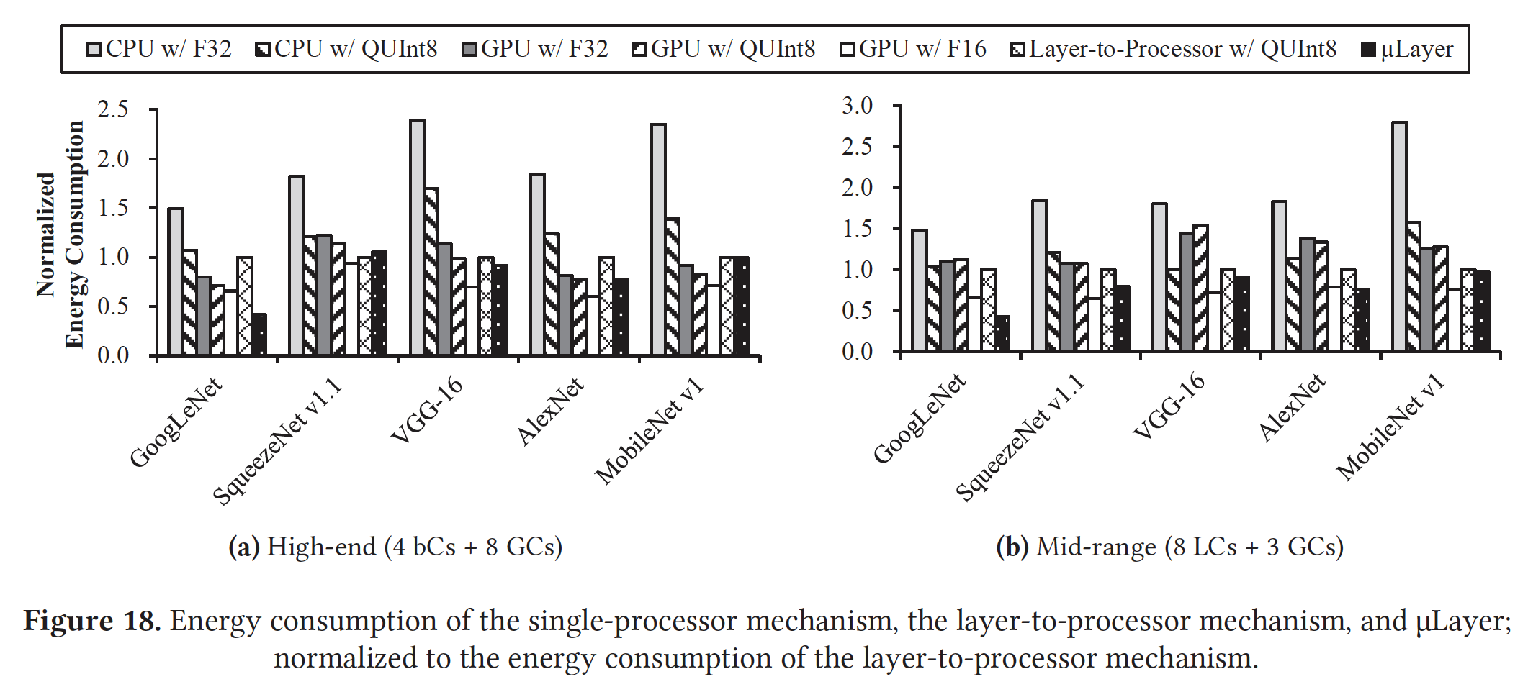
Results – Energy consumption
Energy efficiency is due to:
Lower execution latency compared to other approaches
Reduction in memory bandwidth access when using 8-bit QUInt8 instead of 32-bit F32

Slide 8
Conclusion
Existing mobile NN frameworks optimize performance by distributing layers to different hardware resources, bound by performance of a single processor
uLayer uses both CPU and GPU to accelerate each NN layer
uLayer reduces latency by up to 69.6% and improves energy efficiency by up to 58.1%

