Slide 1
MobiRNN: Efficient Recurrent Neural Network Execution On Mobile GPU
Qingqing Cao, Niranjan Balasubramanian, Aruna Balasubramanian
Stony Brook University
June 23, 2017
1st International Workshop on Embedded and Mobile Deep Learning (EMDL ‘17)
Notes:
I’m going to give an introduction to MobiRNN, a deep inference framework for recurrent neural networks on mobile GPU.

Slide 2

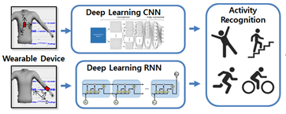

Success Of Deep Learning
Intelligent Personal Assistant
Machine Translation
Credit: Tetherfi
Credit: CISS
Credit: Webcertain
Notes:
As you all know, today many mobile applications become more successful from deep learning techniques.
For example you can use Siri, Google Assistant etc. to easily make phone calls, set reminders, play music and so on.
Deep learning models also greatly improve the performance of human activity recognition on wearables and make fine grained health monitoring, smart care possible.
Recently Google deploy neural machine translation system that reduces translation errors by more than 50%.

Slide 3


Why We Need Deep Learning On Mobile
Availability
Privacy
Credit: HealthCare
Notes:
For the people in this room, I’ll just quickly go through that since our topic is mobile deep learning, the motivation behind this is obvious, i.e., availability and privacy.
One solution is to run deep learning models locally on the mobile devices. However, due to computation power and limited memory limitation, running these model directly can cause big performance issues and may be even not possible.

Slide 4
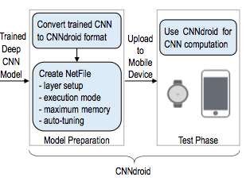
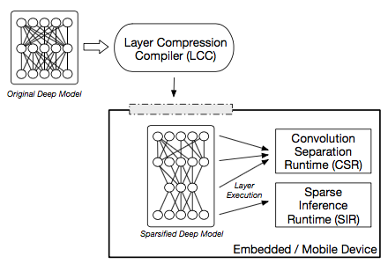
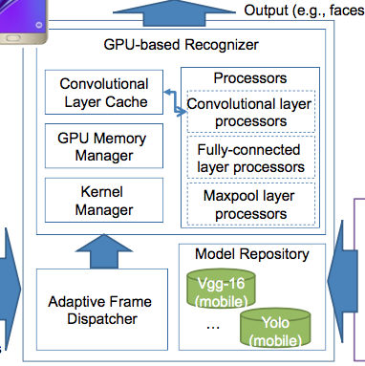
Existing Solutions Focus On Vision/CNN
CNNDroid [MM ‘16]
SparseSep [SenSys ‘16]
DeepMon [MobiSys ‘17]
Credit: Tian
Many others,Deep Compression[ICLR ‘16], Quantized CNN[CVPR '16]...
Notes:
As you can see here, these issues has been mostly investigated in the vision community. Most of them use convolutional neural networks. Existing well-known optimizations were originally designed mainly for CNNs.
CNNdroid uses RenderScript to speedup convolution and fully connected layers computation on the mobile.
SparseSep leverages optimizations like convolution separation runtime.
This year mobisys paper DeepMon also uses convolutional layer decomposition and caching on the mobile GPU to help speed up vision model execution

Slide 5
Not All Tasks Use CNN Models
Can we use CNN-style Parallelization optimizations for RNNs?
State-of-the-art solutions for question answering, human activity recognition, neural machine translation etc. often use RNN models.
Notes:
However, recall that for the applications we mentioned just now, state of the art solutions often use recurrent neural networks
, which are a form of deep learning models that have very different architecture and performance considerations from CNN

Slide 6




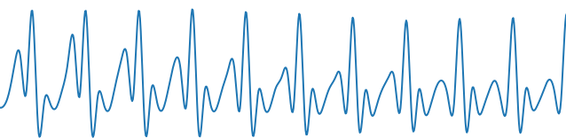
RNN Models Work On Sequential Data
The cells inside RNN models have inseparable computational dependencies
Streaming sequential data have temporal dependencies in nature
CNN models do not have such dependencies
cell state
input state
Notes:
Generally RNN models work well on sequential data. Let me first introduce a typical use case of Recurrent neural networks, the figure in bottom shows a real world example of the sensor data collected from the smartphone. In activity recognition task, we read this data and make some inference about the user activity, say every few seconds. Maybe we want to know if they are moving or walking etc.
Now let me show how the RNN model can do this job. Basically, RNN models use cells structure to maintain history information of input data and to control how input data flow through the cells.
First input unit
So for example when processing this second unit x2, it uses some computation from the previous inputs it has seen (as you can see from this cell/block) and combines it with some computation over the current input unit and then makes some output. And it keeps doing this for continuous activity monitoring
As we can see from the calculation process, Dependencies. This is because the recurrent neural network tries to model the sequential data that have temporal dependencies by nature
However, CNN models do not have such dependencies
For example, convolution computation can happen in parallel on all the pixels of an image
Here we cannot do that level of parallelization because of the dependencies
So how to parallelize RNN models if we can’t do it in CNN-style?

Slide 7
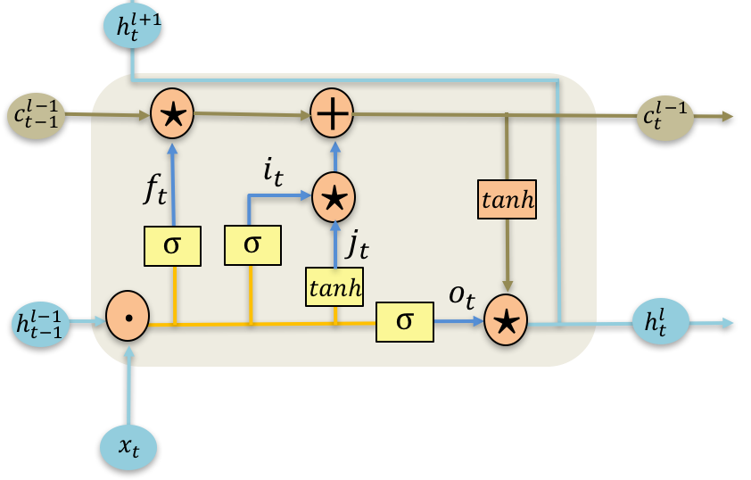
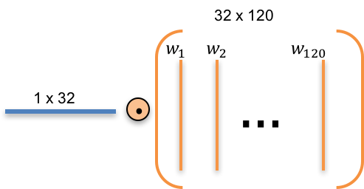
MobiRNN: Parallelization Within Cell
matrix multiplication
Notes:
In ths work, we propose MobiRNN. The key idea is that instead of parallelizing the computation across cells, we parallize the computation inside each cell on the GPU
So first what is going on within each cell that I showed to you in the last slide?
Let’s look at one such cell. What I am showing here is a specific type of recurrent neural network cell, called as the Long-short term memory or LSTM for short.
In this type of LSTM cell there is a bunch of computations – usually matrix multiplications, additions and activations.
Let’s take matrix multiplication as a computation example. We have a 1 by 32 vector and 32 by 120 matrix

Slide 8
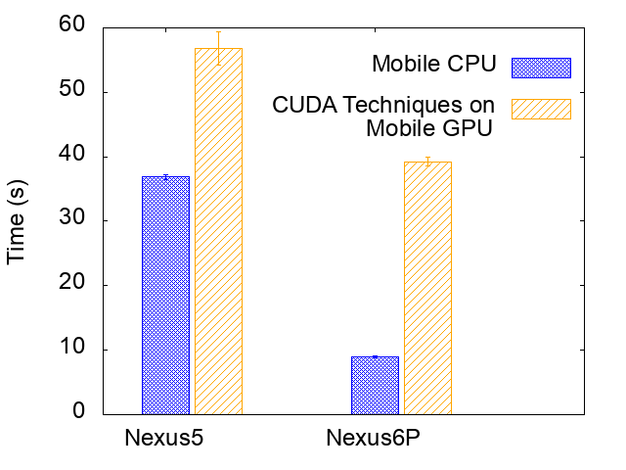
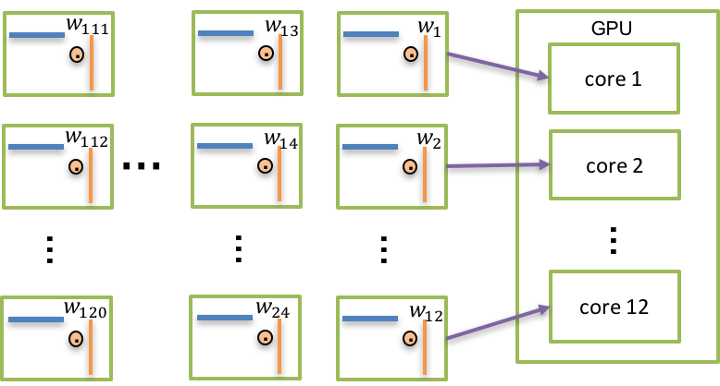
CUDA-style Parallelization Does Not Work
Notes:
We find that traditional CUDA-style parallelization of this matrix multiplication does not work. Before I give the experimental results of this failure. Let me first explain how CUDA-style parallelization works.
The basic idea here is to break down the matrix into a set of small vectors that can be sent to different cores within the GPU and do the multiplication inside each core.
This seems like a good idea but it turns out that using this kind of parallelization actually hurts performance rather than improving it. As you can see from the figure, y axis is the time of running a LSTM model, offloading to the GPU made the model run up to 4 times slower compared to running the model on the CPU.
So why is this happening ?

Slide 9
Why Desktop-style Parallelization Does not Work
Mobile GPUs have fewer cores and shared memory
Non-negligible overhead of workload scheduling among cores
Notes:
CUDA works on desktop GPUs because they usually have many cores. The default factorization of the matrix computations can fit within the available cores and everything works out fine to give good parallelization benefits.
On mobile phones however, we have fewer cores and the memory is shared. So the default factorization doesn’t fit very well anymore. Besides, if we have too many small work units, they can add scheduling costs because of non-negligible overheads.

Slide 10
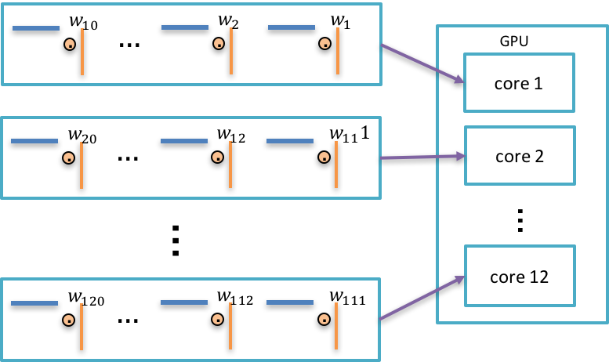
MobiRNN Coarse-grain Parallelization
Notes:
Given the scheduling overhead it makes sense to have fewer units to schedule for the mobile GPUs.
Instead of having the developer worry about the right factorization, we leverage renderscript, a parallelization framework that has been used successfully in recent systems.
At its core, RenderScript offers a way to define computation in terms of some custom data structures designed for data parallel operations, which are then automatically broken down into work units that get executed in the GPU. In the matrix multiplication example, a batch of small work units are pushed to the mobile GPU instead of one by one.

Slide 11
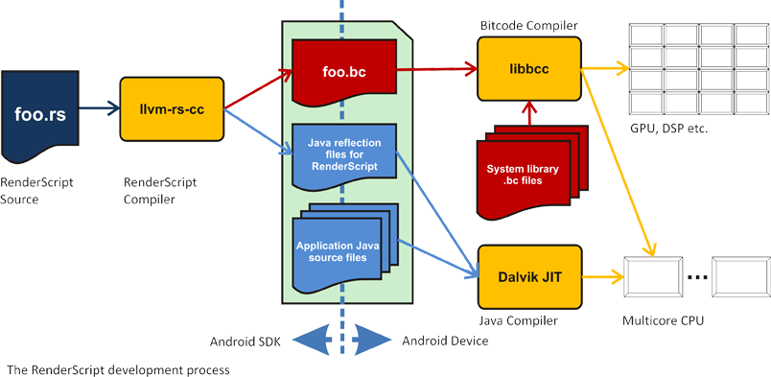
Implementations
RenderScript Framework
Memory Reuse Optimization:
Pre-allocate memory for cell state(c) and hidden state(h)
Notes:
The idea behind renderscript is as follows. If you want some computation to be parallelized effectively, you write your computation using some primitives/kernels given in the renderscript language. Then they are compiled by the renderscript compiler into some intermediate repersentation which is essentially some binary code that renerscript runtime knows how to efficiently schedule for different types of architectures.
Further, we also optimize memory allocations for variables using RenderScript primitives that allow for reuse of previously allocated memory, thereby reducing unnecessary and frequent on-demand memory allocation.

Slide 12
Experiment Setup
Goal
Study the effectiveness of parallelizing RNN models on the mobile devices
Dataset
The smartphone sensor dataset (7352 training and 2947 test sets)
Models
- By default use 2 layer stacked LSTM model for human activity recognition
- Various model complexity (layer size [2 , 3] and hidden units [32, ~, 256])
Devices
Nexus 5 running Android 6.0.1, Nexus 6P running Android 7.1

Slide 13
Experimental Results
MobiRNN improves RNN performance by more than 3X on phone GPUs
But improvement depends on GPU load, model complexity, and device type
Benefit comes from parallelization, not necessarily GPU execution

Slide 14
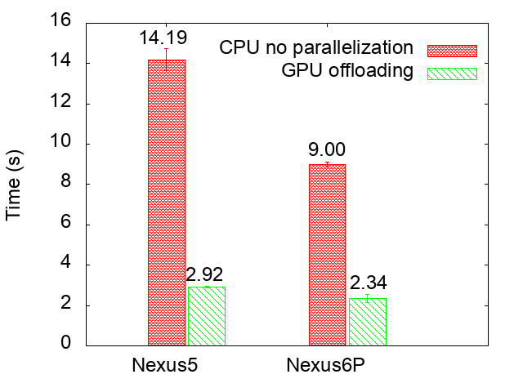
Speed-ups On Diverse Devices
✔ 3.93 times faster on the GPU compared to the CPU
✔ Less powerful devices benefits more from GPU offloading
Time of running the LSTM model on the GPU versus the CPU, the results show the aggregate time for running 100 test cases.
Notes:
Y axis Time mentions

Slide 15
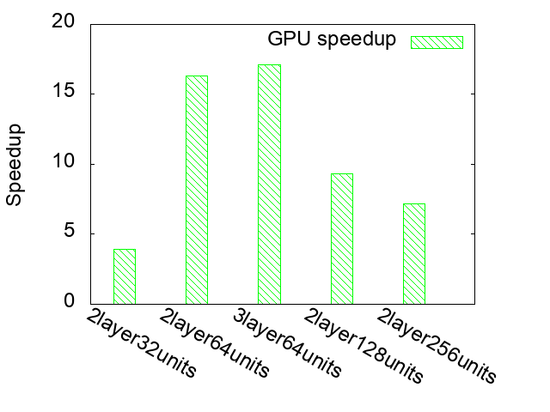
GPU Benefits Depends On Model Complexity
✔ For more complex models, parallelization helps even more
✔ GPU speed up saturates due to number of hidden units
Speedup of running the LSTM model on the GPU
versus the CPU as the model complexity varies
Notes:
Y axis speedup higher is better
As the model complexity increases, the speed up using the GPU increases initially. This is to be expected, since for more complex models, parallelization helps even more.
However, when the model complexity increases due to number of hidden units rather than the number of layers, the GPU speed up saturates due to the large number of parameters which exhaust the memory bandwidth.
Hidden units adds more computations inside cell while more layers add computation but the dependencies still prevent further parallelization
For example, the LSTM model with 2 layer and 128 hidden units has 263000 parameters, which is four times that of the LSTM model with 2 layer and 64 hidden units

Slide 16
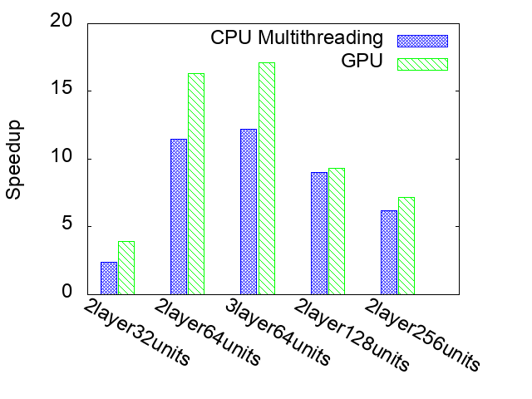
Most of the Benefits Come from Parallelization
✔ CPU Multithreading does speed up performance considerably compared to GPU
✔ GPU offloading still gives slightly better speed ups over multithreaded version
✔ GPU offloading under high load performs worse than CPU
Speedup of running the LSTM model
on the GPU versus the multithreaded CPU
Notes:
We find most of the benefits come from parallelization, what do I mean by this?
If we look at the result of parallelization on CPU using multithreading, we also see good speedups.
The GPU still performs better.
This result is useful especially in the mobile environments, the GPU can be under high load for rendering UI on the phone. In fact, we have some results for speedup under different GPU load. And we find that under high GPU load, GPU offloading performs worse than CPU
These results were obtained on the Nexus 5 phone. Multithreading does speed up performance considerably even when the model is run on the CPU. However, the GPU gives an average of 32% speed up over the multithreaded version across the models.
We have done preliminary experiments showing that multithreading on the CPU will provide even more benefits on the newer Nexus 6P phone, since the CPU on this newer phone is more powerful. Results are similar, This result shows that the offloading to GPU may not always be the best solution for improving the performance of deep learning models, and other design points need to be explored

Slide 17
Takeaways
Parallelization techniques for RNNs need to be different from CNN's due to data differences and model dependencies
MobiRNN: Parallelization technique for RNNs that use RenderScript implementation
Parallelizing RNN model on GPU for activity recognition provides 3X benefits
While GPU offloading offers good speedups, most of the benefits can be obtained using multithreaded CPU

Slide 18
Thank you
Latest MobiRNN is available at:
https://github.com/csarron/MobiRnn
I maintain a list of mobile deep learning research resources at: https://github.com/csarron/emdl
qicao@cs.stonybrook.edu

Slide 19
Deep Learning Optimizations On Mobile
1. Model side optimizations:
pruning, weights sharing, quantization, decomposition etc.
[Deep Compression, ICLR ‘16], [ Quantized CNN, CVPR '16]
2. System level parallelization:
CPU: TensorFlow, Caffe2, MXNet, BLAS libs for ARM(Eigen, OpenBLAS etc.)
GPU: Core ML, DeepMon, CNNDroid (Metal, OpenCL, RenderScript, Vulkan etc.)
DSP, FPGA ...

Slide 20
Deep Learning Optimizations On Mobile
3. CNN specific optimizations:
low rank approximation [CVPR’15]
convolution kernel separation [SparseSep, SenSys ‘16],
convolution layer caching [DeepMon, MobiSys ‘17],
depthwise separable convolutions [MobileNets, Google ‘17]
...

Slide 21
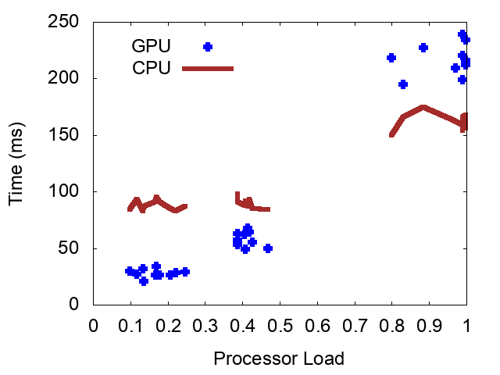
GPU Offloading Is Not Always Better
✔ Time to run the model increases as CPU/GPU load increases
✔ GPU offloading is better during for low and medium load. But under high load, it’s better to run on the CPU
Time of running the LSTM model
on the GPU and CPU under different load
Notes:
for example, the GPU on Android is designed to perform rendering UI.
Figure shows that the latency of the LSTM model correlates with the load on the GPU; as the GPU is more loaded, it takes longer for the LSTM model to run on the CPU. GPU load is correlated with the time it takes to run the LSTM model. As the load on the GPU increases, the time it takes to run the model also increases.
We find that under low and medium loads, running the LSTM model on the GPU reduces latencies; however, under both high GPU and high CPU load it is better to run the RNN on the CPU rather than the GPU.

Slide 22
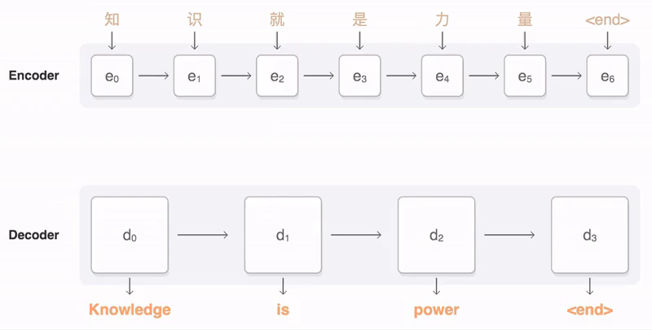
RNNs Are Well Suited For Sequential Data
Credit: Google Seq2Seq
Notes:
These applications all use sequential data, state of art solutions for these tasks mainly adopt recurrent neural networks like long short term memory, gate recurrent unit networks.
But our work focuses on recurrent neural networks. Network architectures are different
Optimizations cannot directly applied for RNNs
Limited resources are constraints for mobile systems

