Slide 1





Towards Accurate and Reliable Energy Measurement of NLP Models
Qingqing
Cao
Aruna
Balasubramanian
Niranjan
Balasubramanian
Notes:
Hello everyone! I’m Qingqing Cao, from Stony Brook University. In this talk, I’ll introduce why it’s important to study the energy of NLP models and how we can accurately measure the energy, this is a collaboration work with my advisors Aruna, and Niranjan.

Slide 2




Studying Energy of NLP Models Is Critical
Pre-training
Fine-tuning
Language modeling
Task Classifier
Big model
Pre-trained model
Email
Label
Large-scale unlabeled dataset
Task-specific labeled dataset
Send 1k$ to claim your best paper | Spam
Dear Mr. xx, I’m writing to let you... | Not Spam
>800 GB
>12 GB
Notes:
Currently, people use large scale NLP models through a two-step training process. First, a large neural network model is designed and pre-trained on large amounts of unlabeled data using self-supervision techniques. The model will learn good language representations. Then this pre-trained model is fine-tuned on the target task such as spam email classification.

Slide 3
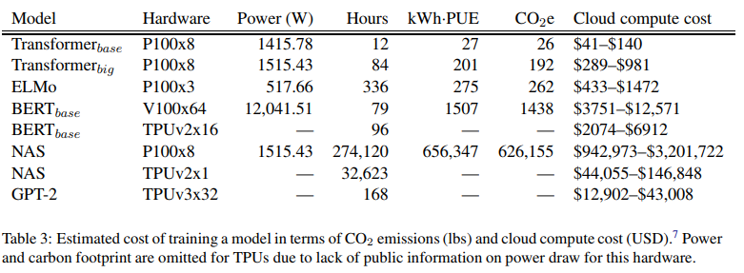
Studying Energy of NLP Models Is Critical
Pre-training
Costs of training once
(Strubell et al. ACL’19)
Language modeling
Big model
Large-scale unlabeled dataset
Accurate energy estimation is critical for choosing and training large scale NLP models
>800 GB
>12 GB
Notes:
Now, the problem is that pre-training a model is very expensive.
This table shows the both the financial and carbon costs of training different transformer models once. For example, the CO2 emission for training BERT on GPU is roughly equivalent to a trans-American flight.
Training a BERT model or doing a neural architecture search of transformer models can cost thousands to millions of dollars. Moreover, research and developing new models cost even more.
It is critical to study the energy consumption of NLP models, because accurate energy estimation is important when choosing and training large scale NLP models.

Slide 4



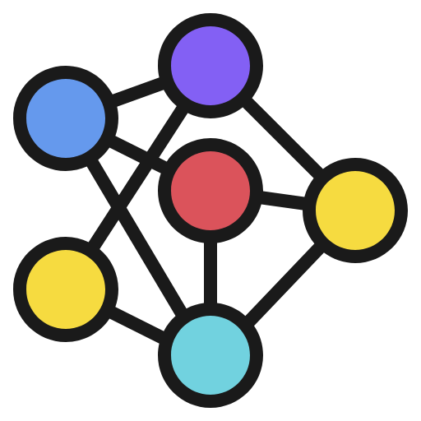



Energy Use Cases of NLP Models
🆚
Estimating energy consumption of NLP models to prioritize training and deployment
(icon credit: Becris and Freepik)
Analyze energy bottlenecks to design more energy-efficient models
Notes:
For example, if we know the amount of energy different models consume, we can prioritize which models to train first and which models are better to deploy on the battery-powered mobile devices.
Another key use case is that by analyzing the energy bottlenecks, we can design more energy-efficient model architectures.

Slide 5
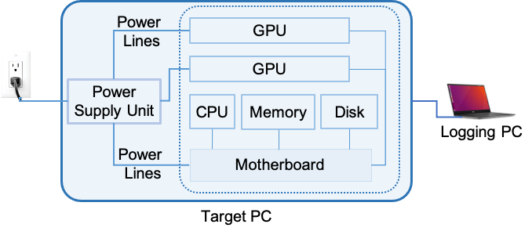
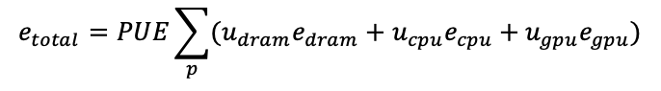
How Is Energy Measured Currently?
power counter values
hardware resource utilization
(Strubell et al., 2019; Henderson et al., 2020)
simple to use, only require software setup
Notes:
So how is energy measured currently? A PC often has many hardware components like CPU, Memory and GPU, it’s reasonable to get the total amount of energy by considering the energy consumed by each of these hardware components. CPU or GPU component often has built-in power counters that record the power values. So one way to measure the energy consumption on the PC is to first collect the energy values from the power counters in hardware components, then measure how much of the hardware resource is used (i.e. utilization), and combine the energy consumption of each component with its resource utilization. As given by the formula below:
In this formula: P_dram, P_cpu, P_gpu are the resources utilization and e_dram, e_cpu and e_gpu are the energy usage of each hardware resource. PUE means power usage effectiveness and is a constant which compensates the cooling factor.
This approach is easy to use, only require software setup with no additional effort.

Slide 6
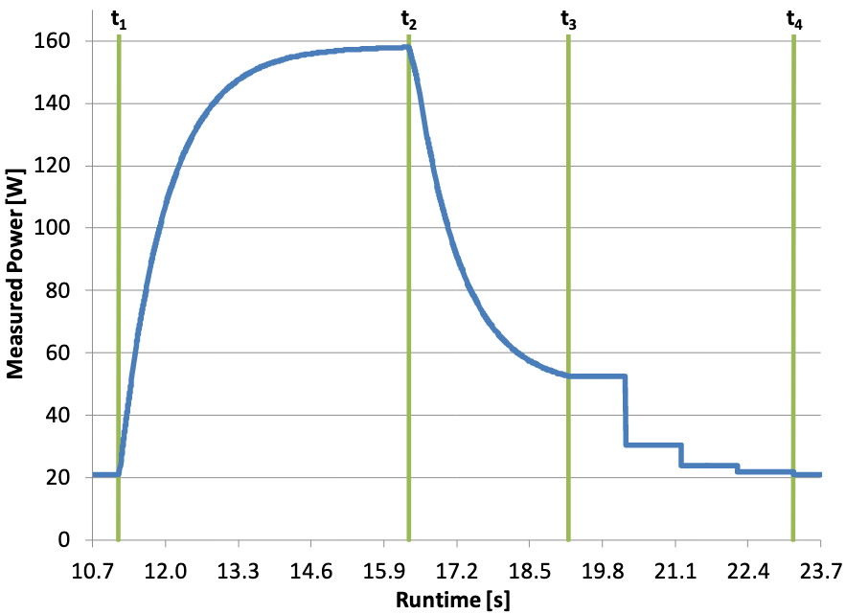
Power Counter Values w/o Calibration Are Inaccurate
power lag
tail energy
standby
standby
GPU power profile when running a compute program
(Pathaket al., 2011, Burtscher et al., 2014)
Notes:
However, previous research has shown that reading values from power counters of each component without calibration is inaccurate.
This figure shows an example of the GPU power timeline when running a compute-intensive program.
As you can see, the power lags behind the program activity, especially during the ramping up and ramping down phases.
Another known case is tail energy phenomenon where the power draw continues even after the computation has stopped. [Software clean up, capacitor discharge etc. Mobile device is more prominent.]

Slide 7
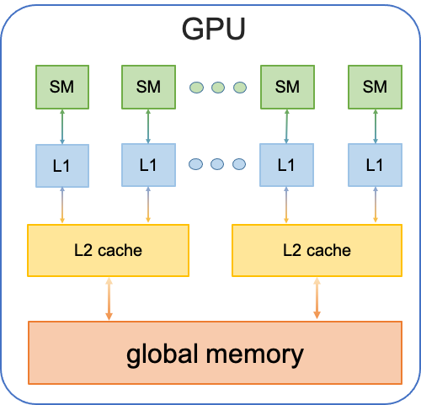
Non-Utilization Behaviors Also Cause Energy
compute energy correlate to utilization
but data movement is the major energy bottleneck (>50%)
(Eyeriss, ISSCC 2016; A Boroumand et al. ASPLOS 2018)
Notes:
Another problem is that energy is not always linearly related to the hardware utilization to the energy consumption.
Because no-utilization hardware behaviors also cause energy.
For example, the figure shows the high-level GPU architecture. SM stand for Streaming Multiprocessor that perform the computation. L1, L2 cache and global memory are different levels of GPU memory to load and store data.
The energy consumed by the Streaming Multiprocessors to perform computation does correlate to utilization.
But the computer architecture community found the energy bottleneck for deep learning hardware like GPUs is the data movement in the GPU memories instead of compute processors. GPU utilization alone cannot reflect such kind of consumed energy.

Slide 8
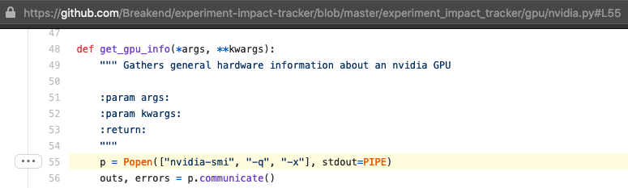
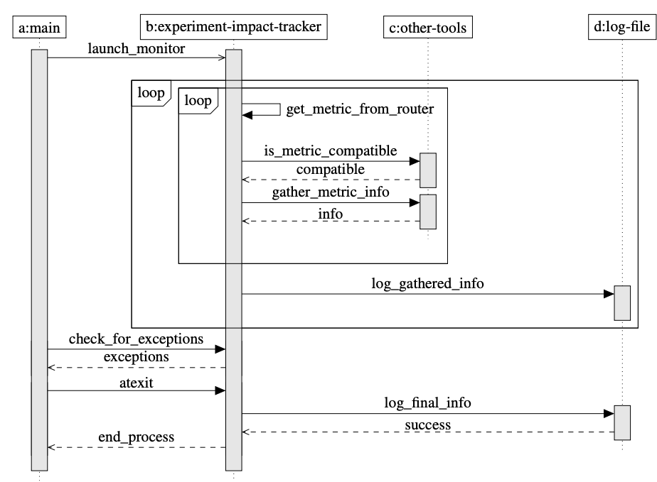

Profiling Problems in Existing Software Methods
spawn a new process to monitor resources
high profiling overhead
(Henderson et al., 2020)
coarse-grained and high variances
Notes:
Moreover, existing software profiler spawns a new process to monitor the resources usage.
Spawning new processes frequently will cause high profiling overhead when sampling the utilization and energy data.
Therefore, to avoid such overhead, the profiler has to run less frequently (often multi-seconds per sample) and the collected data are coarse-grained and have high variances, which will make energy measurements less accurate.

Slide 9

Our Goal
Study inaccuracies in current software-based estimations by comparing with a hardware-based measurement method
Notes:
To approach these energy estimation problems, our goal in this work is to study inaccuracies in current software-based estimations by comparing with a hardware-based measurement method.

Slide 10
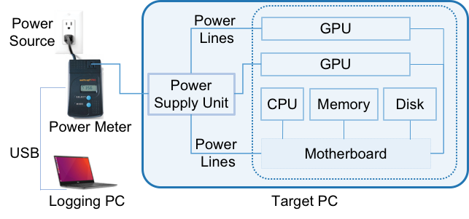
Measuring Energy Using External Power Meters
built-in power sensors
The external power meter collects the ground-truth of consumed energy
Notes:
We know that the problems for existing software measurement methods come from using the internal power sensor values.
In this work, we use an external power meter to get accurate energy measurements as the ground truths, and study how far existing software measurements are from the ground truths.

Slide 11


Evaluation Setup
Models:
Dataset: SQuAD QA, fine-tuned on the train split, report numbers on dev split
Device: 2 PCs, each with 2 desktop GPUs (see details in the paper)
Measurement tools:
the experiment-impact-tracker library (Henderson et al., 2020) for software measurements;
a WattsUp power meter for hardware measurements
Notes:
In our experiments, we use four models: BERT-base, RoBERTa-base, MobileBERT, and DistilBERT all fine-tuned over the SQuAD question answering dataset. And benchmark their latency and energy consumption on 2 desktop machines. you can see the machine details in the paper.
We use the experiment-impact-tracker library for software measurements and a WattsUp power meter for hardware measurements.

Slide 12
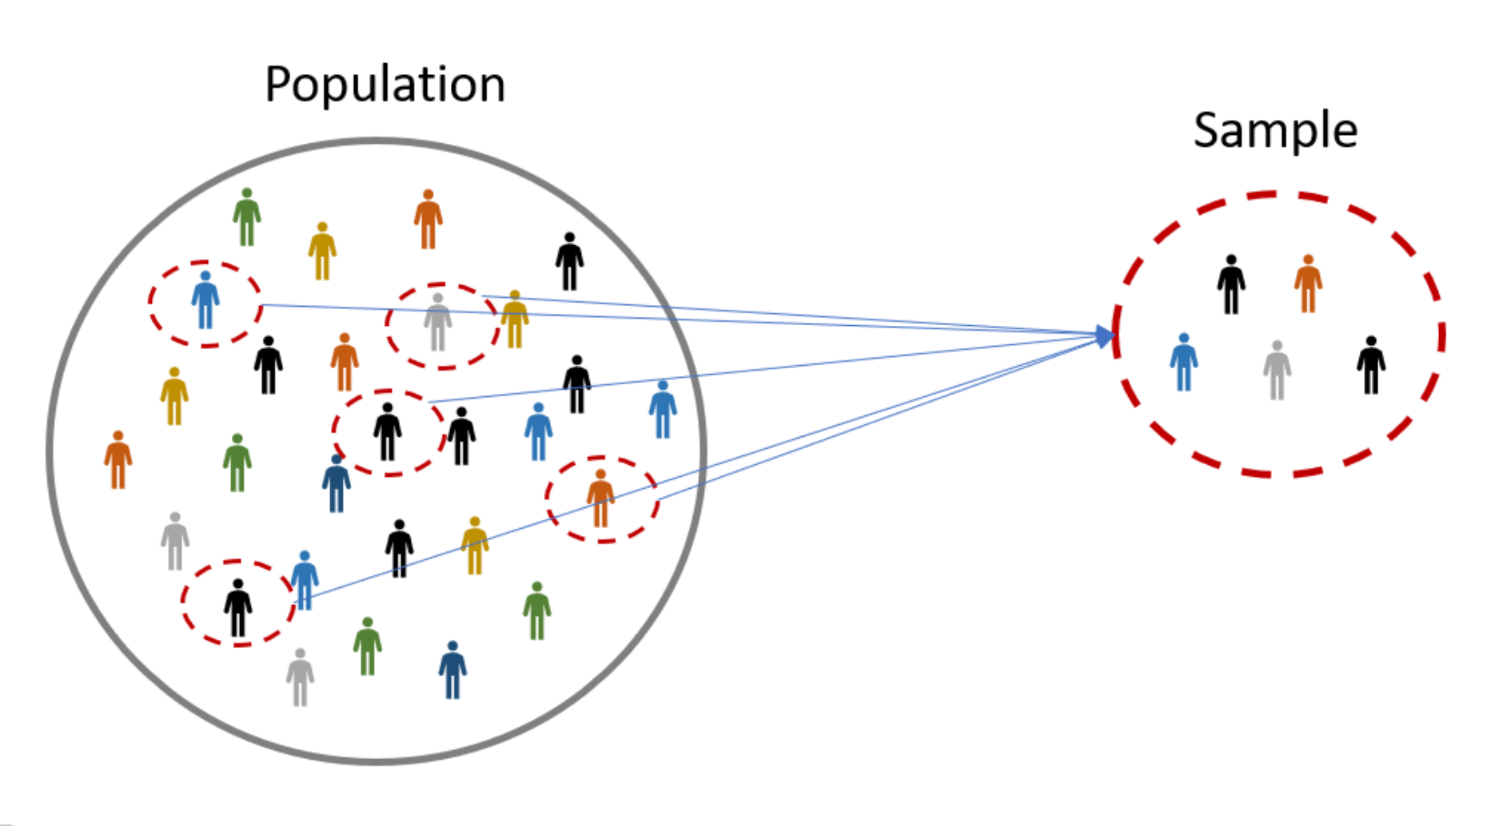

Evaluation Methodology
randomly sample 1k questions, run 10 times
To guarantee only the tested program consumes the energy:
for all experiments, no other application is running
before the experiments, ensure the PCs only draw standby power
after each experiment finishes, cool down the PCs
Notes:
We randomly sample 1k questions in the dev split, and run each experiment 10 times.
To make sure the energy measurements are consistent and faithful, we need to guarantee that only the tested program consumes the energy.
To do this, for all experiments, no other application is running.
To avoid potential overheating issue that can affect energy measurements,
we measure the standby power consumption (when the CPU load is 1%) and ensure before running the experiments that the PC does not draw more than the standby power.
We also cool down the PCs after each experiment finishes to avoid residual energy issues.

Slide 13
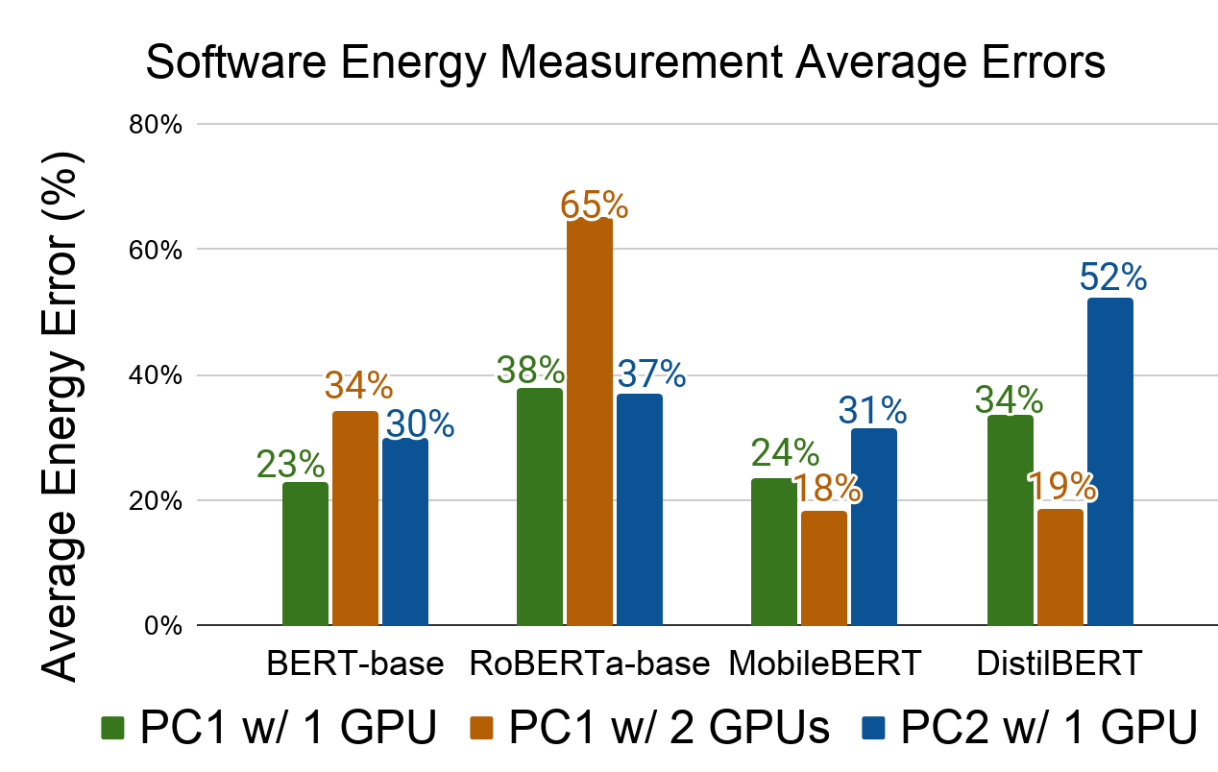
How Accurate Are Existing Software Measurements?
> 20% error on average
Notes:
Now, let’s see how accurate are existing software energy measurements.
This figure shows the average energy error of the software measurement method for four Transformer models under 3 different device settings.
We use the power meter energy values as ground-truths. As you can see, software measurements cause over 20% errors on average and the error can be as high as 65%.
You may wonder even these absolute energy values are inaccurate, we could still compare the relative energy values for different models.

Slide 14
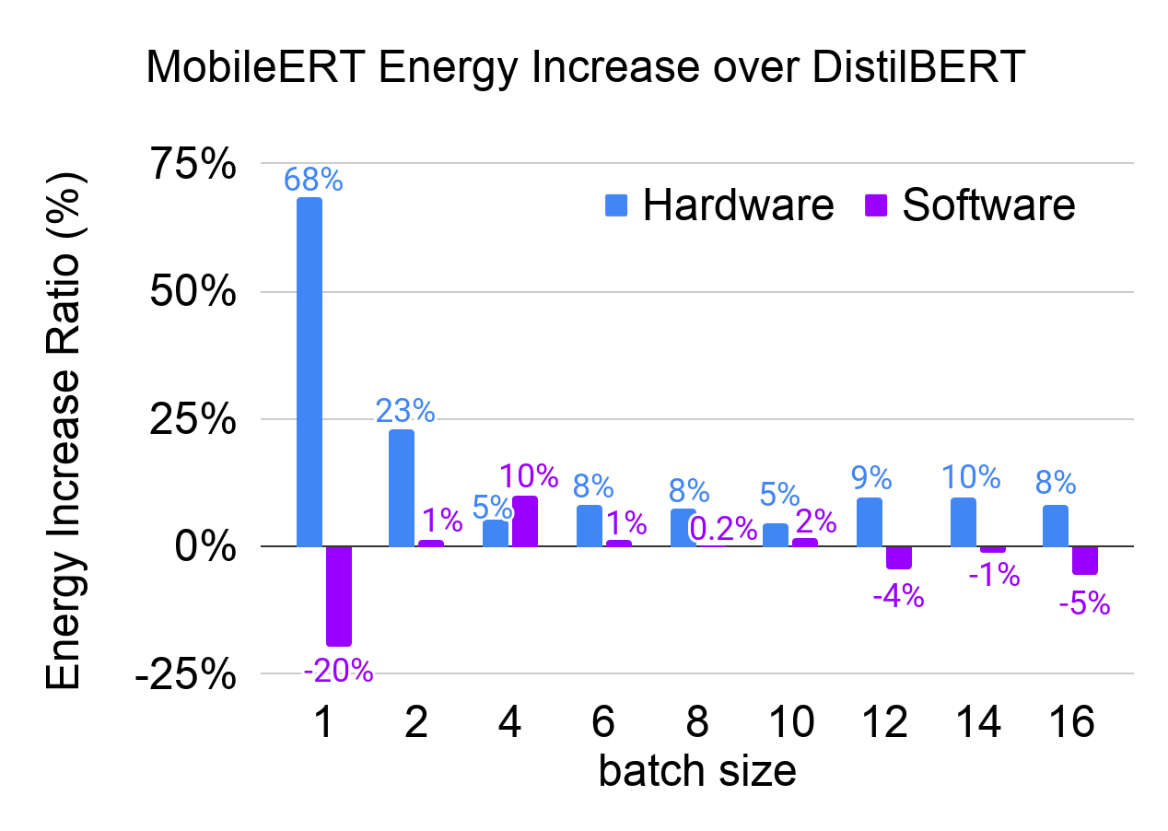
Relative Measurements Are Error-Prone
MobileBERT consumes more energy than DistilBERT, but software measurements give the opposite wrong conclusion!
Notes:
We want to point out that even relative energy measurements are error-prone.
For example, we want to choose between two mobile transformer models: MobileBERT vs DistilBERT based on energy consumption.
The figure shows the relative energy increase ratios from MobileBERT to DistilBERT for both hardware and software measurements.
Hardware measurements tell us MobileBERT consumes more energy than DistilBERT in general as you can see from the blue bars.
But, software measurements can give misleading choice, like for batch size 1, software measurement says distilBERT consumes 20% energy, which is not true.
We have more results for comparing the accuracy and energy trade-offs among these models. You can read our paper for the details.

Slide 15
Towards Accurate Energy Estimation of NLP Models
We aim to build accurate energy estimation models to predict the energy consumption
🧗 challenges
😊 future work
😟 existing software methods suffer from power lag and tail energy
😃 use external power meters to calibrate the software energy measurements
😔 utilization-only based linear energy estimation is insufficient
😄 use NLP model specs, device configs, and resources usage statistics to estimate
😧 existing profiling incurs high overhead causing unstable measurements
🤓 use in-process sampling buffers to support lightweight resources profiling
Notes:
Obviously one cannot scale energy measurements using the hardware.
To make energy measurements more accurate while also easy to use, we aim to build accurate energy estimation models to predict the energy consumption without additional hardware efforts. As I mentioned earlier, there are several challenges, we will address them in the near future. Specifically,
existing software methods suffer from power lag and tail energy issues, we’ve already shown external power meters can provide more accurate measurements, we also plan to use the hardware measurements to calibrate the software estimations.
We know that utilization based linear energy estimation is insufficient. We plan to incorporate more factors that affect the energy consumption, such as the NLP model definitions, hardware devices configurations, and more fine-grained resources usage statistics.
We also know that fine-grained resources profiling can cause high overhead and lead to unstable measurements, so we plan to use in-progress sampling buffers to support lightweight resources profiling.
Thank you.

