Slide 1





BTR: Binary Token Representations for Efficient Retrieval Augmented Language Models
Qingqing
Cao
Sewon
Min
Yizhong
Wang
Hanna
Hajishirzi
2024 (spotlight)
Notes:
Hello everyone, I’m Qingqing Cao, I’m currently a research scientist at Apple AIML, this work was done at University of Washington. I’m happy to talk about BTR, xxx

Slide 2

Retrieval LMs address issues like hallucination
Notes:
As you know, large language models like ChatGPT still has issues like hallucination, retrieval-augmented LMs can help address the issue by relying on external evidence document data.

Slide 3

Retrieval-augmented language models are slow
Many input passages lead to long sequences, making reader encoding slow
Reader
Passage1
Query
Encoder
Query
Retriever
Answers
Passage2
Query
Encoder
Decoder
Passage3
Query
Encoder
Corpus Index
Previous solutions precompute passage representations, but require huge storage costs
Notes:
The problem is that running retrieval language models is slow and not practical
This is how retrieval augmented language model works, given a query, it uses a retriever to find relevant evidence passages from external corpus like Wikipedia, a reader model, for example a large language model, processes the retrieved passages together with query to produce answers. Using retrieved passages help reduce hallucinated information.
This figure shows a state-of-the-art reader architecture called fusion in decoder (or FiD), which encodes query passages in parallel and fuse their encoded representations in the decoder
No w the problem is that there are many input passages, they lead to long sequences and makes the reader encoding slow,
Existing solutions precompute passage representations to reduce encoding computation, but they require huge costs to store the precomputed representations

Slide 4
BTR Overview
Reader
Runtime compression
Passage1
Query
Encoder
Passage2
Query
Encoder
Decoder
Answers
Passage3
Query
Encoder
Decomposition and
Calibrated Binarization
Cacheable Binary Token Representations
Offline compression
Notes:
We develop a system called BTR, which means binary token representations for the passages, to improve the storage as well as inference speed.
Here, let me describe how BTR works, the key idea is that we create cacheable binary token representations for the passages via decomposition and calibrated binarization
Decomposition breaks down the passage and query encoding the reader encoder layers, allowing us to precompute passages and cache them for runtime use
calibrated binarization builds effective and compact binary representations that incur small storage footprint
Then, we design offline token compression algorithm to remove redundant information in those binary representations and further reduce storage costs.
Additionally, we develop runtime compression techniques to further speedup reader inference.
Now, let’s look up each of these techniques

Slide 5

Cacheable binary passage token representations
Encoder
Layer n
Transformer block
Layer k+1
Transformer block
Runtime look-up
010
101
110
100
001
Binarizatin
Decomposing query and passage encoding in the lower layers
Layer k
Key-value store of binary vectors and variance
Precomputed
offline
DeFormer
(ACL 2020, Q. Cao et, al)
Layer 1
Offline compression
Query
Passages
Notes:
First, how do we build cacheable passage representations
Give query and passages, inside the encoder, we decompose the query and passage encoding in the lower layers up to layer k, now since there is no dependency between passage and query, we can precompute passages offline,
for passage part, we apply the binarization to create 1-bit vectors for the passage tokens, i.e., binary token representations, we save the representations to key value store and look them during runtime, then join their representations with query representations from upper layer k+1
The decomposition technique comes from my earlier work DeFormer, but the key difference is that we apply binarization over passage representations, which is non-trivia

Slide 6

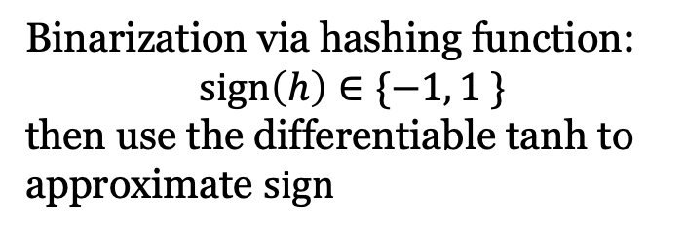

Calibrated binarization
fail because large-scale values collapse tanh into -1 and +1 quickly
Direct Binarization
Encoder
$$h_{k+1}$$
Layer n
Transformer block
Transformer encoder block
Add
Binarization via hashing function:
$sign\left(h\right)∈\{−1, 1 \}$
then use the differentiable tanh to approximate $sign$
Layer k+1
Transformer block
FFN
LayerNorm
010
101
110
100
001
Add
Binarization
Layer k
Attention
Calibrated Binarization
1. Apply binarization after layernorm
Layer 1
LayerNorm
2. save representation variance to recover the representation scales
$$h_{k}$$
Query
Passages
Notes:
The binarization is done via the sign hashing function, which maps float values to -1 and 1, we use the differentiable tanh to approx. sign
The key question here is how should we apply the binarization
One naïve solution is to directly binarize the passage representations (or hiddens states) after the transformer layer, but this does not work, because we observe the hidden states often have large-scale values such as over 500 or < -500, which collapse tanh into -1 and +1 quickly during training, resulting in low quality representations
So, we address this challenge by introducing calibrated binarization, it has two steps, first we apply binarization after the layernorm, which provides normalized values and avoid the scale issue, then we save the variance of representation, which is important to recover the representations to correct scal(by dividing the product of layernorm weights and the variance)

Slide 7
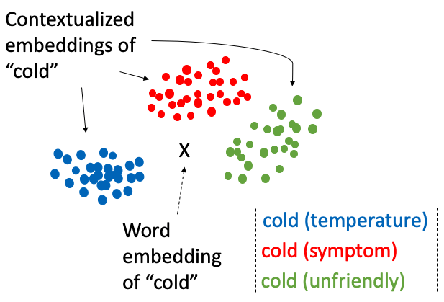
Offline compression to further save storage
binary passage token representations have context redundancy:
each token can occur millions of times in different contexts (passages) but many have similar semantic information
Compression algorithm: merge r% of the binary token representations based on their semantic similarity measured by Hamming distance
Source: Enhancing Clinical Concept Extraction with Contextual Embedding
Notes:
After calibrated binarization, the passage representations still have context redundancy, this provide us opportunity to further compress them and improve storage efficiency
context redundancy basically means, each token can occur millions or billions of times in different contexts (passages) but many have similar semantic information
For example, the word or token cold, have different meanings (temperature, symptom or unfriendly) in different contexts, but their contextualized representations won’t vary too much for each meaning,
Based on this fact, we design a compression algorithm, the idea is to merge some percentage of the binary token representations according to their semantic similarity measured by Hamming distance

Slide 8
BTR training improves accuracy
1. train a reader model without any decomposition or binarization
Encoder
Layer n
Transformer block
use continuous passage vectors to supervise the linearly projected binary vectors
Layer k+1
Transformer block
2. train a decomposed model (no binarization) with the step1 model as teacher, using query-aware passage token distillation
010
101
110
100
001
Binarizatin
Layer k
distill top-k passage tokens that are most relevant to the query
3. train the decomposed reader with binarization, and add a passage representation recovery loss to maintain semantic information
Layer 1
Query
Passages
Notes:
in fact , introducing cacheable binary token representations does cause accuracy loss for downstream tasks because we do lose information in the passages
Now let’s look at how we train BTR to reduce such accuracy loss, the training has three steps
First, we train a reader model without any decomposition or binarization, then train a decomposed model (without binarization) with the step1 model as teacher,
and we develop a new distillation technique called query-aware passage token distillation to transfer the passage information without relying on query (because remember in the lower encoder layers, we no longer have access to query representations), the idea is simple, we distill top-k passage tokens that are most relevant to the query
In the third step, train the decomposed reader with binarization, and add a passage representation recovery loss to maintain semantic information, we use continuous passage vectors (before binarization) to supervise the linearly projected binary vectors, such that the binary vectors are linearly related to the original continuous passage vectors and retain much information as possible

Slide 9
Runtime compression for faster BTR inference
Output
Encoder
Decoder
Layer n
Transformer block
Transformer block
Intra-passage token compression reduces redundant information in each passage in the encoder
Runtime compression
Runtime compression
Transformer block
Transformer block
Runtime compression
Layer k+1
Transformer block
Transformer block
Cross-passage token compression reduces similar semantic information across different query-relevant passages
Runtime compression
Binarization
Transformer block
Layer k
Precomputed
offline
Transformer block
Layer 1
Query
Passages
Notes:
Regarding to BTR inference, we additionally design runtime token compression
to speed up the reader model.
The runtime compression happens in both the upper layers of the encoder and the entire decoder.
In the encoder, we make it intra-passage token compression, because it reduces redundant information in each passage in the encoder.
And in the decoder, we apply cross-passage compression, which reduces similar information across different query-passage pairs

Slide 10
Evaluation setup
Tasks: 3 open-domain QA datasets, fact-checking, and MMLU
Metrics: measure task accuracy, report inference throughput (QPS), storage (GB)
Baselines: Atlas, Atlas-Q, DensePhrase, DeFormer, LLaMA2-7b
Notes:
We evaluate BTR and baseline models on 5 knowledge intensive NLP tasks, measure their task accuracy and inference throughput and disk storage
We compare with 5 different baselines, we implement BTR over Atlas model, which is a state-of-the-art FiD style retrieval-augmented language model.
All the models use the same retrieval since our focus is on the reader model. For Atlas, the reader model is T5,
Atlas-Q is a quantized version of Atlas, DensePhrase creates dense phrase representations of passages. It retrieves answers from the phrase index without using the retrieve-and-read pipeline.
DeFormer is a simplified version of BTR without binarization , offline and runtime token compression
LLaMA2-7b is a recent large generative language model, we finetune using LoRA adapter

Slide 11
BTR is more efficient and accurate
NaturalQuestions Results
100x reduction
BTR achieves over 3x speedup compared to baselines (Atlas) and provides >100x reduction in storage (compared to DeFormer)
3x speedup
BTR for larger models can achieve >4x speedup, see more results in the paper
Notes:
For time limit, I’ll show the key results on the Natural Questions open QA dataset.
in the figure,Y axis is accuracy, x axis is throughput, we use circle area to show storage size (log scale), so the top right smaller circle is better. As you can see, BTR BTR achieves over 3x speedup compared to baselines (Atlas) and provides >100x reduction in storage (compared to DeFormer)
LLaMa and DensePhrase are much lower in accuracy thought their storage or speed is more better
I also want to mention that BTR for larger model, can achieve 4x speedup
Feel free to checkout our paper for more results

Slide 12
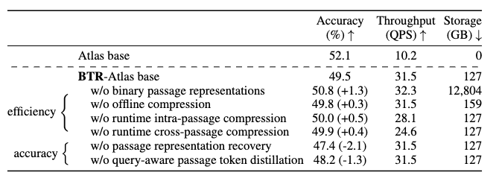
Each component in BTR is effective
BTR efficiency gains (improved throughput and reduced storage) mainly come from cacheable binary token representations
BTR training reduces the accuracy loss caused by efficiency techniques
Notes:
So what are the effects of each technique in BTR?
This table presents the accuracy versus throughput and storage tradeoffs
We ablate efficiency and accuracy components in BTR,
BTR efficiency gains (improved throughput and reduced storage) mainly come from cacheable binary representations.
All the efficiency techniques cause some accuracy drops, but BTR training techniques are able to recover most of the accuracy loss

Slide 13
BTR takeaways and impact
We design BTR, cacheable and calibrated binary token representations to improve the inference efficiency of retrieval LMs
BTR achieves over 3-4x inference speedup, reduces storage by over 100x while maintaining task performance
Binary representations could potentially supercharge on-device LMs, especially for personalized tasks that require storing local knowledge
Notes:
In summary, We design BTR, cacheable and calibrated binary token representations to improve the inference efficiency of retrieval LMs,
BTR achieves over 3-4x inference speedup, reduces storage by over 100x while maintaining task performance
Lastly, I want to highlight that Binary representations could potentially supercharge on-device LMs, especially for personalized tasks that require storing local knowledge

