Slide 1
Measurements in AWS VM2VM (#4a)
Ahmet Aspir
Mark Nardi
Martin Pfeifhofer

Slide 2
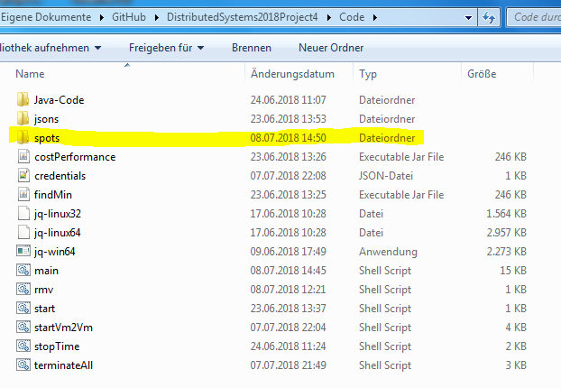
main.sh
1. Generate folders for every instance-type and its regions

Slide 3
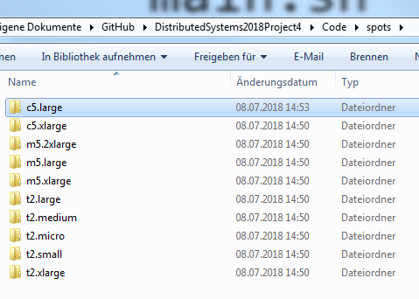
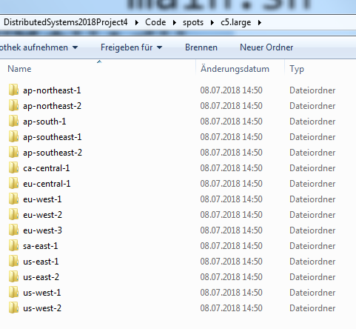
main.sh

Slide 4
main.sh
2. Gather prices for all instance-types in each region and store them in every region folder of each instance-type

Slide 5
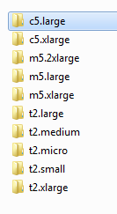
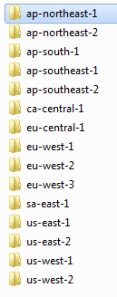

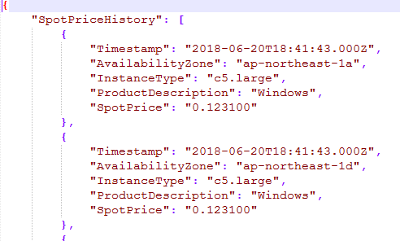
main.sh

Slide 6
3. findMin.jar
3.1 Find the best price for all regions of each instance-type
3.2 Extract the 2 cheapest spot-instance entries from above and save it in the instance-type folder

Slide 7
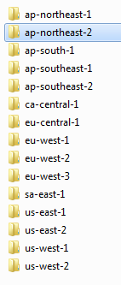

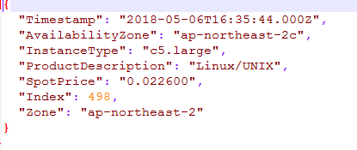
findMin.jar

Slide 8
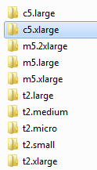
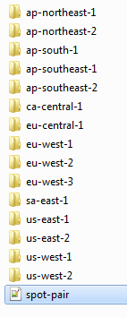
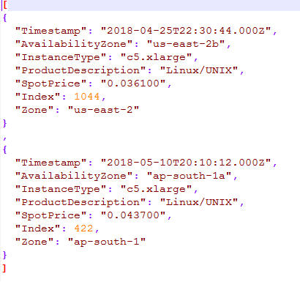
findMin.jar

Slide 9
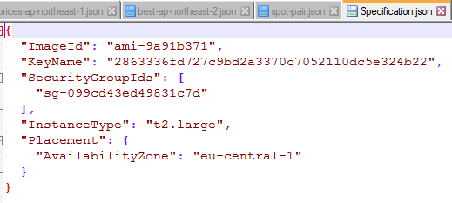
main.sh
4. Prepare Specification file for spot-request (Sec-group, Key, Image-Id, ect...)

Slide 10
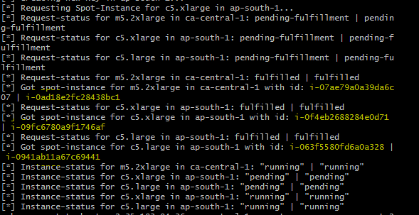
main.sh
5. Send a request for 2 instances in same region and try to acquire them (get running instance ids)

Slide 11
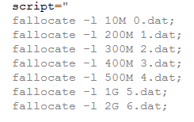
6. startVm2Vm.sh
6.1 Setup aws config
6.2 Connect to one instance and transfer key and the measurement script
6.3 Once connected generate files and start measurement script

Slide 12
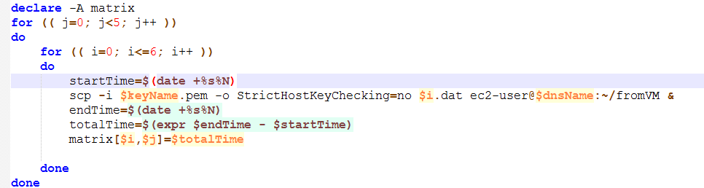

6.4 stopTime.sh
6.4.1 Transfer 7 files 5 times and take average time for each transmission of a file
6.4.2 Save the result as a file

Slide 13
startVm2Vm.sh
6.5 download the result file and fill it with necessary information

Slide 14

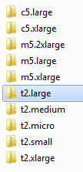
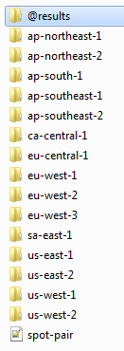
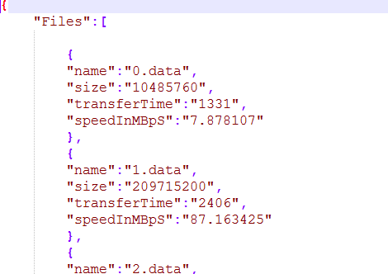
7. cost-peformance.jar
7.1 crawl through every instance-type folder and check the results

Slide 15
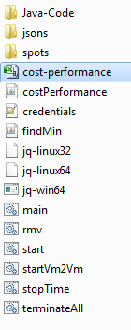
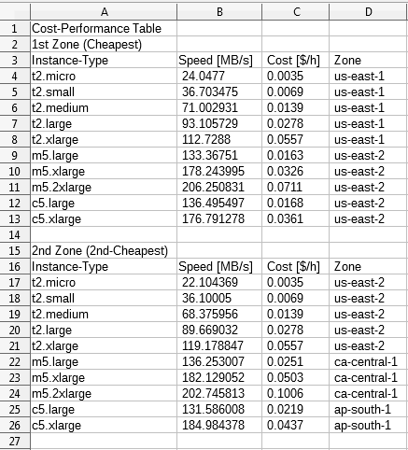
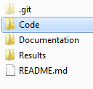
cost-peformance.jar
7.2 create one single CSV-File for all results with the 2 zones of each instance-type

