Slide 1
Semantic Web – Food The Application
Aspir Ahmet
Dick Tobias
Egger Daniel
Kaufmann Stefan

Slide 2
Overview
Introduction
Use Case
Data Sources
Ontology
Enrichment
LOD Linking
Information Extraction (NLP)
Application
General Description
Validation with SHACL
Demo

Slide 3
Overview
Introduction
Use Case
Data Sources
Ontology
Enrichment
LOD Linking
Information Extraction (NLP)
Application
General Description
Validation with SHACL
Demo

Slide 4
Usecase
knowledge-graph recipe application
recipe search on a website:
ingredients
health labels
diet labels
multifunctional search with respect to different user-intentions

Slide 5

Data Sources
Edamam
organizes the world's food knowledge in one database
1,7+ million recipes
very rich in terms of information
Small Online Dataset
518 recipes
insufficient recipe information

Slide 6
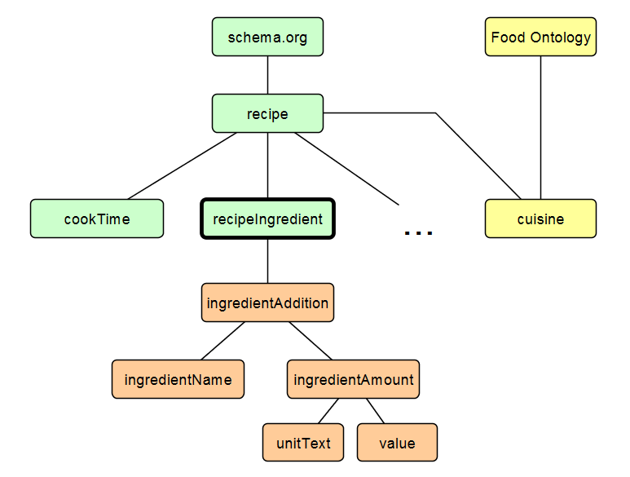
Ontology
schema.org
base vocabulary
Food Ontology
cuisine
extension of schema:recipeIngredient
allows extensive description for ingredients

Slide 7
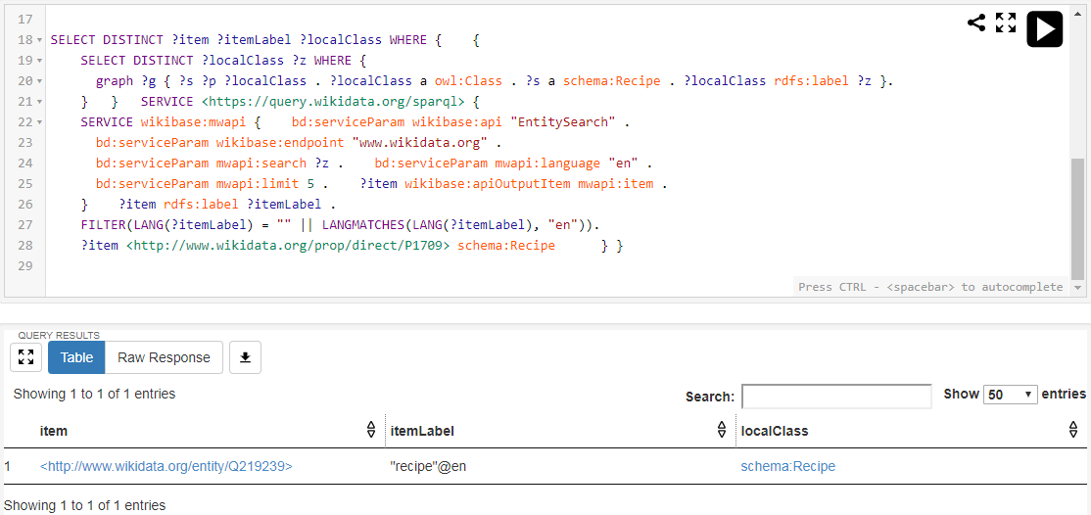
Federated Query

Slide 8
Overview
Introduction
Use Case
Data Sources
Ontology
Enrichment
LOD Linking
Information Extraction (NLP)
Application
General Description
Validation with SHACL
Demo

Slide 9
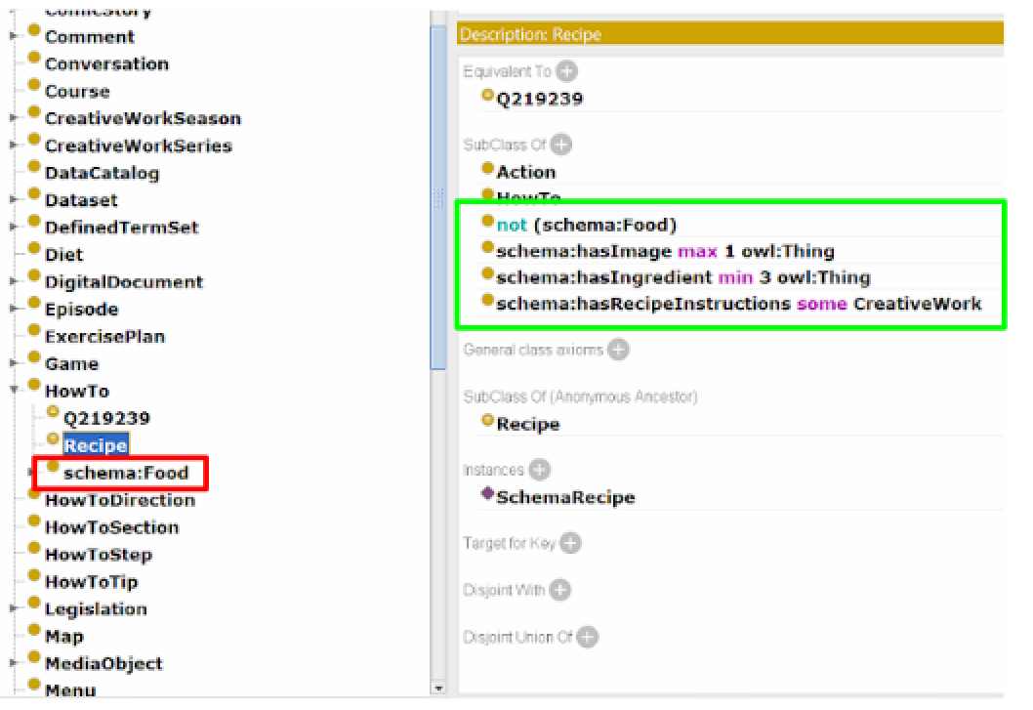
LOD Linking
extented schema-vocabulary with schema:Food
stated OWL axioms for the recipe class

Slide 10
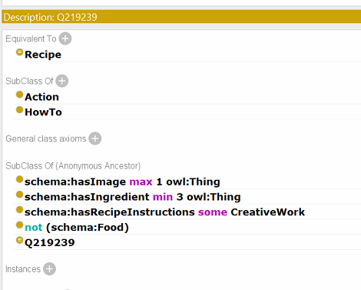
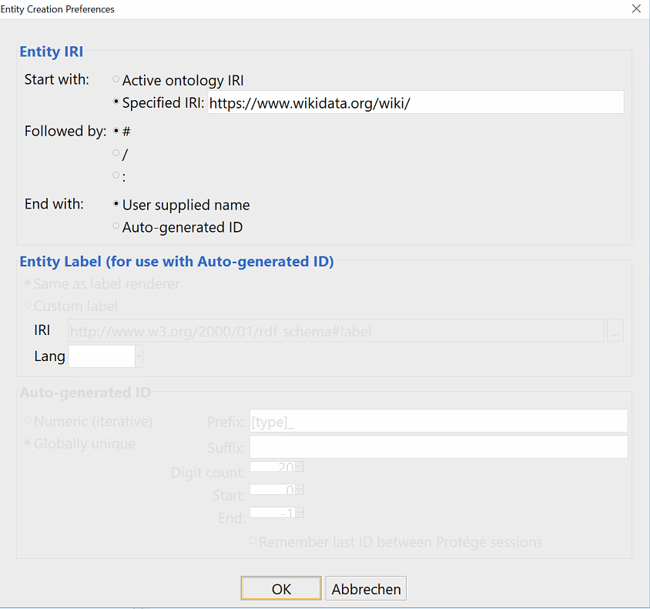
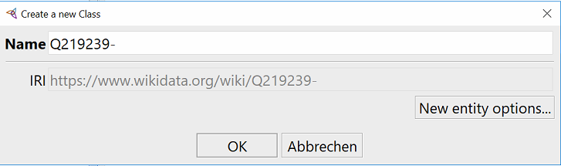
LOD Linking
linked schema:Recipe with wikidata (Recipe = Q219239)
subclasses are automatically inferred by the equivalence to schema:Recipe

Slide 11
Information Extraction (NLP)
used ML (NER)
1 QUANTITY
glass UNIT
red NAME
wine NAME
1 QUANTITY
yellow NAME
pepper NAME
, O
deseeded O
and O
thinly O
sliced O
...
Token Classifier Model
Training

Slide 12
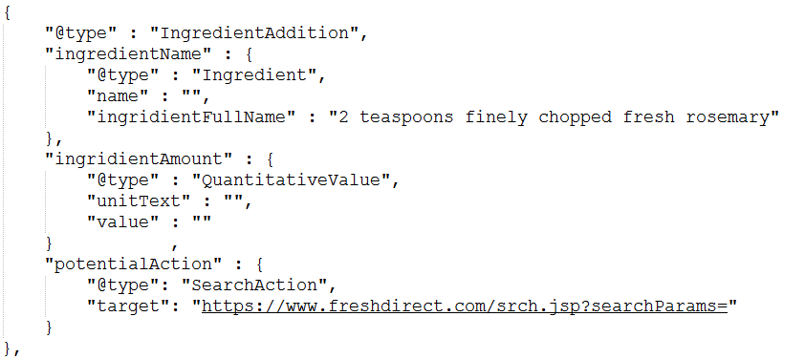
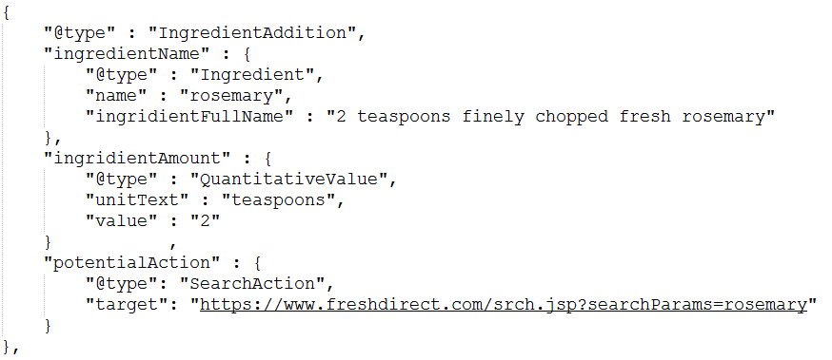
Information Extraction (NLP)
applying NLP

Slide 13
Overview
Introduction
Use Case
Data Sources
Ontology
Enrichment
LOD Linking
Information Extraction (NLP)
Application
General Description
Validation with SHACL
Demo

Slide 14
Application
allows recipe search based on
multiple ingredients
health labels
diet labels
currently contains ~4500 different recipes

Slide 15
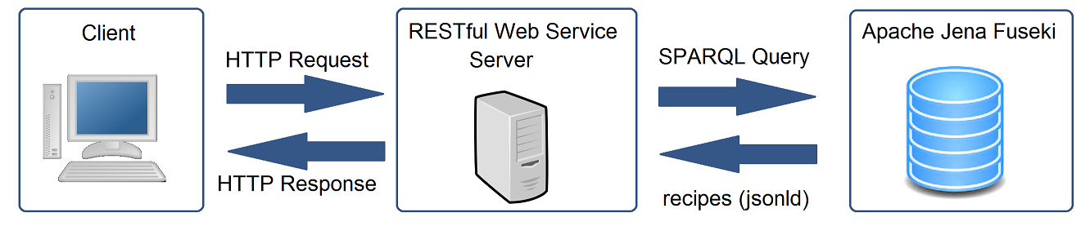
Application - Architecture

Slide 16
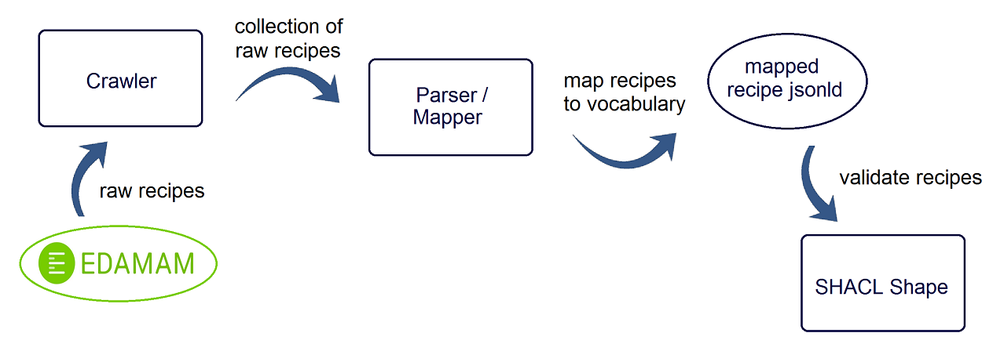
Obtaining Recipes

Slide 17
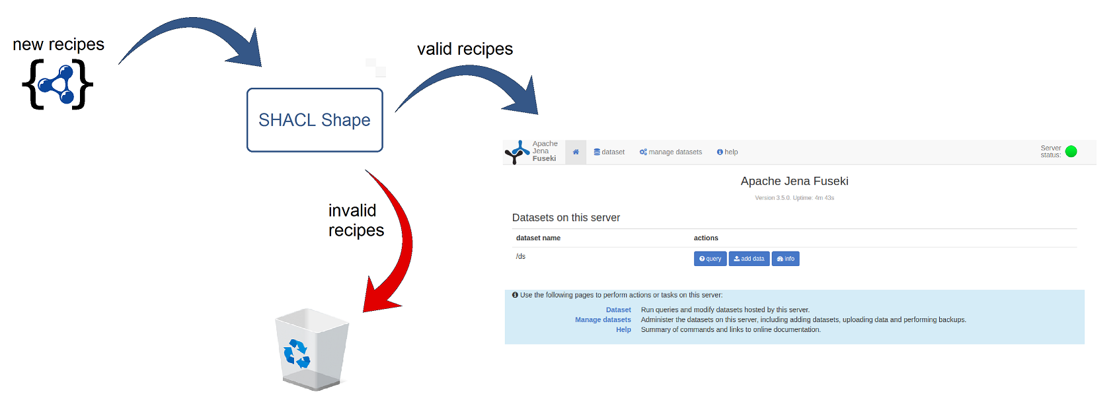
Validation with SHACL Shapes
validate new recipes before uploading them to Fuseki

Slide 18
Demo

Slide 19
Screenshots

