Slide 1
Axis Bank Statement Analysis
A Data Science Approach
Name: Sathish C
2026

Slide 2
Problem Statement
Analyze bank transactions to evaluate
Financial health
Risk analysis

Slide 3
Objectives
• Income vs Expense
• Spending patterns
• Risk analysis

Slide 4
Dataset
Bank statements (CSV/PDF)
Fields: Date, Description, Credit, Debit, Balance

Slide 5
System Architecture
User uploads statement
Stored in AWS S3
Processed via AWS Lambda
Stored in PostgreSQL (RDS)
Visualized in Dashboard

Slide 6
ETL Pipeline
Extract: Upload & read data
Transform: Clean & feature engineering
Load: Store in database

Slide 7
Feature Engineering
• Monthly income
• Monthly expenses
• Credit/Debit ratio
• Average balance

Slide 8
Key Metric
Credit/Debit Ratio = Credits / Debits
Indicates financial stability

Slide 9
Technologies Used
Python
Pandas
Matplotlib
Seaborn
Plotly
PostgreSQL
AWS (S3, Lambda, RDS)
Streamlit Dashboard

Slide 10
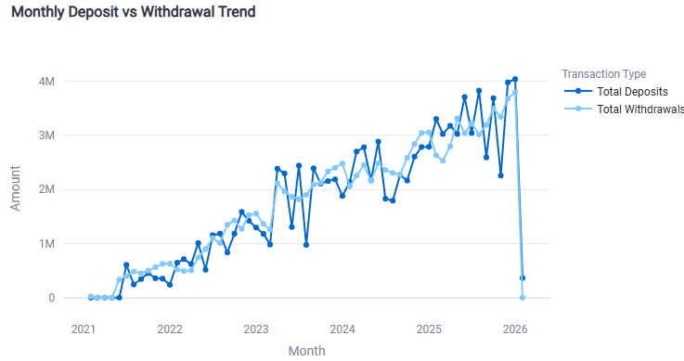
Monthly Deposit vs Withdrawal Trend

Slide 11
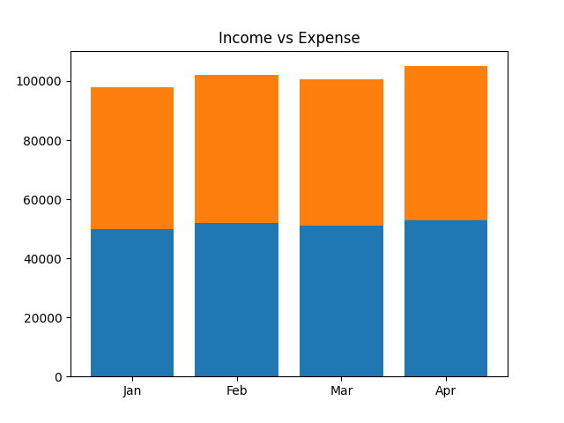
Income vs Expense Chart

Slide 12
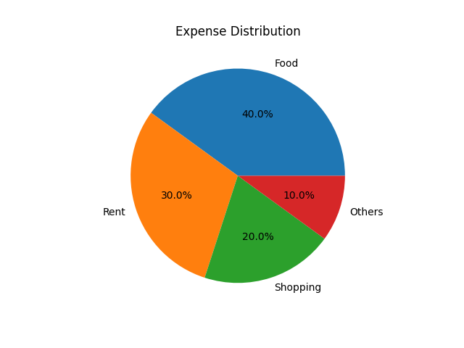
Expense Distribution

Slide 13
Insights
• High spending months
• Low savings
• Risk indicators
• Increasing transaction trend over time
• Deposits & withdrawals closely aligned
• Sudden drop may indicate anomaly or missing data

Slide 14
Use Cases
Loan approval
Credit scoring
Personal finance monitoring for Income & Expense

Slide 15
Conclusion
Data helps in better financial decisions
Improved decision making
Scalable cloud-based solution

