Slide 1
Abstraction
Less is More, also More is More
WeCode 2018
Carolyn Saund
(Inspired by Cheng Lou’s Presentation)
Notes:
Reason about software in general, not just writing a specific library or framework, but writing all libraries.
Also helps with all aspects of life, debate, software, technology, philosophy
This is a talk about being a software engineer, not a scientific thinker of computational analyst
This talk is about software engineering in a practical sense.
Particularly salient for contributing to open source communities
Draw from react/nodeJS
Quotes on slides are the **takeaways**
Quick note about using your community for things like this.

Slide 2
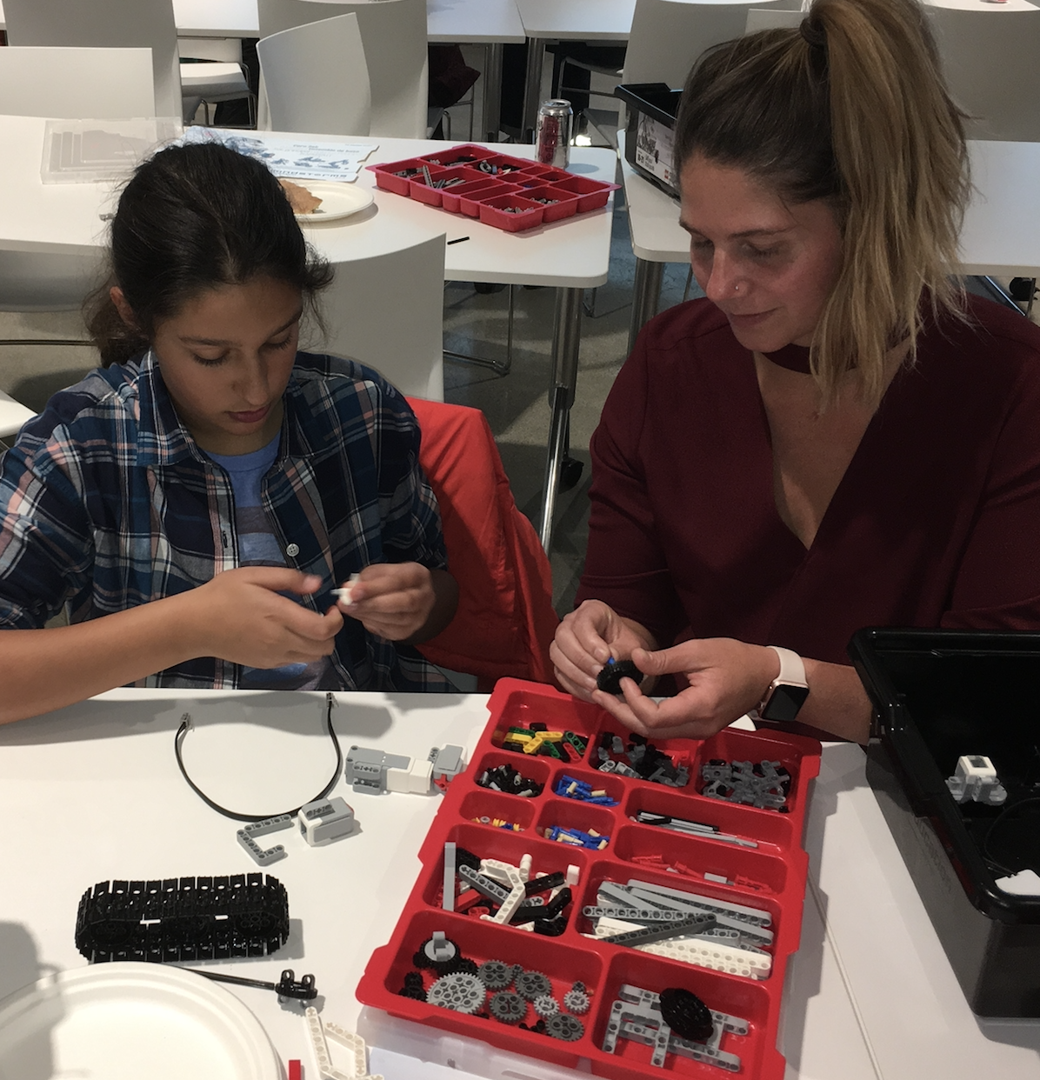
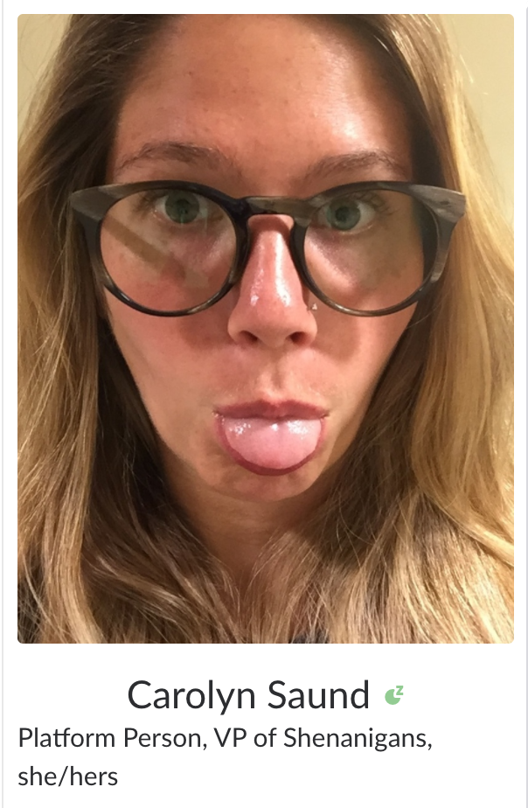
Hi, I’m Carolyn
Software Engineer, Jibo (2015-2017)
“Senior” Software Engineer, Cogito (2017-2018)
Technical Lead
Manager
PhD Student (2018-???)

Slide 3
How do we design good APIs?
Notes:
As true engineers, we would like reliable ways to make good decisions, consistently
Hopefully this talk is that
Why do we call a subclass (B) that extends a class (A) a subclass? It almost definitionally has more properties, why is it not a superclass?
Number of methods?
**NUMBER OF INSTANCES**
In the pool of instances, there are necessarily more instances of A, so A occurs more often (includes all instances of B)
In the realm of software engineering, it often seems like we’re speaking in the same terms, making same baseline assumptions, when in reality we’re often talking past each other

Slide 4
Spectrum of Abstraction
Examples
Concrete Experiences

Slide 5
The Spectrum of Abstraction

Slide 6
Abstract (Power)
2
3
Cost
1
2
1
Concrete (Utility)
Notes:
Top level, something that is abstract
Allows us to descend each level and get to these concrete use cases (actual products) (products can be libraries! -- advance)
As software engineers, our goal is not to create abstractions. We want to build stuff. Means to an end
For computer scientists this may not be the case, an abstraction is the end
Middle layer may be a framework of sorts!
Define our terms:
Power: The ability to drill down the levels of abstraction and get to use cases
Utility: Concreteness -- attached to usefulness
Ex. Concrete products should be devoid of all abstraction, “it just works”
Ex. React is not very useful! You use it to build useful stuff
Ex. ability to search for flights is powerful, but having and booking the right flight is useful. I don’t actually want to search for flights, I want the flight that I want immediately.
Drilling down is costly! Our goal is to cover all the green leaves with fewest circles, with fewest cost

Slide 7
Principle of Least Power
Notes:
If you want to cover all these concrete use-cases, want to use least powerful tool possible to achieve them, for less mental overhead.
Of all leaf nodes, we only care about four
Little bit of cost in the last one, but otherwise we’re not paying any cost
Another option is going a little higher

Slide 8
Library Framework
Notes:
Library vs. Framework often debated
Only a specialization of this paradigm
Library is choosing nodes lower in the tree
Framework is choosing higher
Covers use-cases you absolutely don’t need, but someone will need this, and we can all refer to this framework as a common tool within our community. This is the purpose of this framework.
Half social, half engineering
In library case, don’t need to take right-most node, we can use our knowledge to choose from the set of boilerplate material that is just there already and “just works”
Right now in JS there is a complaint about “micromodules” -- what would that look like?
Circles surrounding all the green leaf nodes. All the use-cases covered, but you need a different module for each tiny use-case.
Npm install any concrete thing without learning how it works
Too many! Without saying it’s bad, just noticing how it’s represented

Slide 9
Lots of problems arise from a misunderstanding of where we should be in the layers of abstraction.
Notes:
Writing code is easy, deciding architecture is hard.

Slide 10
Consequences
Every edge has a cost:
Lost adopters
Every circle has a cost:
Specificity
2
1
2
1
Notes:
Doesn’t matter if it’s a library or a product, if it’s too abstract, it’ll be too difficult to learn how to use.
Way too much mental overhead
Lose interest
If you’re way too concrete, you end up not covering all the use-cases
As you get more concrete, lose more situational-specific properties
“Properties”: Things we want to maximize as engineers, unique features you can have when product is not overly general
How do you circle the perfect amount? IDK probably NP-complete. Rely on intuition as engineers
Ex. If javascript only had strings. No other variables, just strings.
Cool, one unifying concept
Sucks: Linting sucks, won’t even catch most basic errors
Undistringrishable
Pick a level of uniformity

Slide 11
We’re often not seeking more power, but more principled ways to use our existing power.
Notes:
As software engineers, we seek power because that’s where elegance comes from
Practically, this isn’t true.
If we were seeking more power, we would stop at gotos! We can do everything with 1s and 0s, it’s all turing complete anyway, let’s just quit here.
The point is to reduce our expressivity in a principled way
Instead of gotos we now have for loops!
AND NOW we even have map, filters, reduce
Extrapolate -- can we constrain expressivity even more? Would it still be powerful enough to use daily?
Interesting opportunities for parallelising, optimization (unordered optimization)
Just get creative -- constraints give us good properties!
It’s about having power right here, right now, without any cost.

Slide 12
Examples

Slide 13
Example:
Mutability vs. Immutability
Notes:
Coming from mutable languages (like C for example), hard to get why immutability is important
Strictly less power, why would I choose something I can only do less with?
IT’S NOT about the potential power of doing more,
It’s about exploiting the properties you gain by being able to do less (advance)

Slide 14
It’s not about the power you gain from doing more. It’s about exploiting the properties you gain by doing less.
Notes:
Because you’re doing less, you gain some nifty stuff
LIKE TIME TRAVEL
Redux “componentShouldUpdate” has become a critical hook in react component lifecycle

Slide 15
Example:
JS (inline) CSS vs.
Traditional CSS
Notes:
JS seems like it can do less
One good argument against inline CSS is
Giving a layout algorithm the power of a full language is WAYYYY too much, we lose way too many nice properties we liked.
THIS IS JUST TRUE.
CSS is obviously less powerful and expressive, so if we could do everything with CSS we’d theoretically prefer to use it!
Haha implementation would be a slight detail here.
Much easier to reason about, cause there isn’t much. No abstraction to go up and down
Theoretically easier to analyze CSS
Much easier to write a static analyzer, for example, for traditional CSS than for when you have to account for the power of a full turing complete language
BUT obviously we ARE using functions, we’re not using traditional CSS, we are demonstrably at the wrong level of abstraction

Slide 16
Concrete Experiences
(me IRL)

Slide 17
Don’t cover every use case.
Notes:
Easiest way to gain performance is do less work.
Products are impossible to use when they do everything -- specialize.
Shave off as many green nodes as you can!
Attractive part of thinking in terms of levels of abstraction: clear justification to not cover every use case (Cost! Lose opportunities to optimize)
Speed
Composition
Mental overhead
Nicer user experiences
And you don’t even know these would exist in the first place!
Ex. Supporting nice API abstractions that can still be fast, you can get stuck if you go too specific too early
Also want to support the smallest API surface area as possible to gain wiggle room for performance optimization
Techs that take off tend to be “averagely” powerful! Not all powerful, not all constraining

Slide 18
Repeating Code is… fine.
Notes:
Copy-pasting is alright… We like abstractions, but sometimes the cost is just too high.
Cost < benefit of having a single node.
Personal preference!
If you want to circle the top node, fine, you can do it, but every time I read your function I need to do the work of drilling down, which can have exponential effects when we’re talking about working across libraries
JUDGEMENT
Same phenomenon of micro-modules of npm -- everything is a module, but now we’re paying more cost to abstract things than to actually use them.

Slide 19
Don’t be seduced by elegance.
Notes:
Elegance: choosing something way too powerful because it’s a single unifying principle
Monads are so pretty! With one thing we can tame so many concepts
BUT that’s too general to be popular, too general to be used in an immediate way
If you’re the only person who needs to master it, then it’s all up to you, do whatever
If you’re making something for other people (code, product) be aware of the imposition you’re leaving to the user.

Slide 20
When in doubt, use examples.
Notes:
Examples are the lowest levels of abstraction (utility, concrete use-cases)
When writing a library, write documentation first
Write a readme
Figure out how you’d like it to be used, and the levels of abstraction become clearer

Slide 21
Conclusion
Notes:
This talk is high level of abstraction, I didn’t teach anything about how to choose the level of abstraction.
This talk is actually pretty useless,
By definition at beginning, also pretty powerful:
If you can master the levels of abstraction, and drill down well, you can potentially apply this paradigm to use cases throughout software and in life, but only if you apply these principles
Theory isn’t good enough, urge you to think about these when you start new code
Decide where you want to be before starting the project before you execute.

Slide 22
Thank You!
carolynsaund@gmail.com
@CarolynBot
Cogito!!!

