Slide 1
Distributed System for Person
Identification Using IoT, Edge, and Cloud Layers
Marcel Auer, Roman Jarz, Gabriel Kofler
und Andreas Voppichler

Slide 2
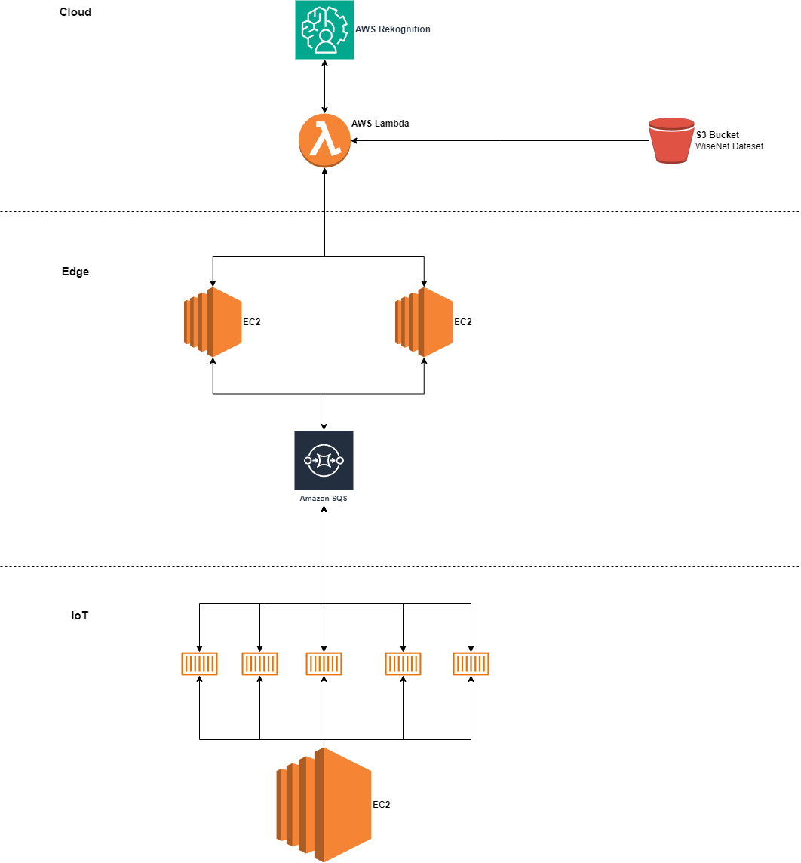

Slide 3

IOT layer
first compressed the videos with ffmpeg from wisenet dataset
every device has a unique ID
2 threads: one for sending images, one for receiving
3 sqs queues: receiving and listing alarms, sending images
automated setup with docker and terraform
OpenCV
Web Interface: http based, alarms seeable

Slide 4
Edge Layer
simulating Edge Layer on EC2
uploading weights and .cfg file for YOLO
Producer-Consumer threading (for real application multiprocessing + async communication)
YOLO: cropping frames if person detected (confidence 60%)
Lambda: sending cropped frame to Cloud
sqs queue: receiving response message from Cloud (IOT-ID and status)
sqs queue: Edge detects alarms and propagates it to correct IOT device
terraform and docker for automatization

Slide 5



Cloud layer - lambda function
not a direct connection with aws rekognition => Lambda in between
boto3.client.recognition: “search_faces_by_image” function
s3 bucket
aws-collection
autoscaling

Slide 6
Live-Demo

Slide 7
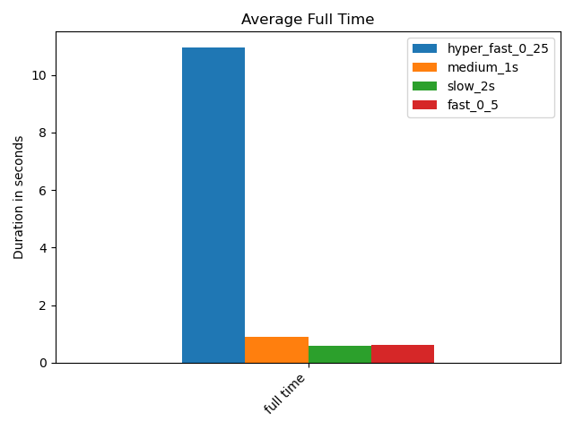
Benchmarking

Slide 8
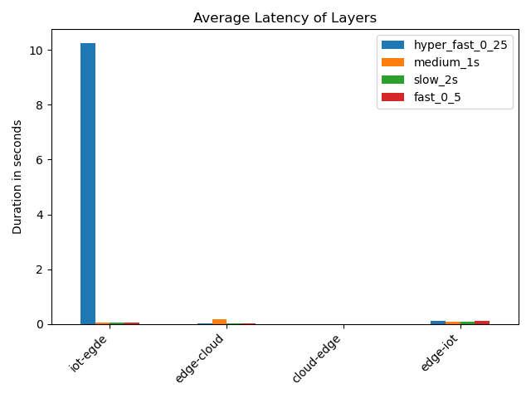

Slide 9
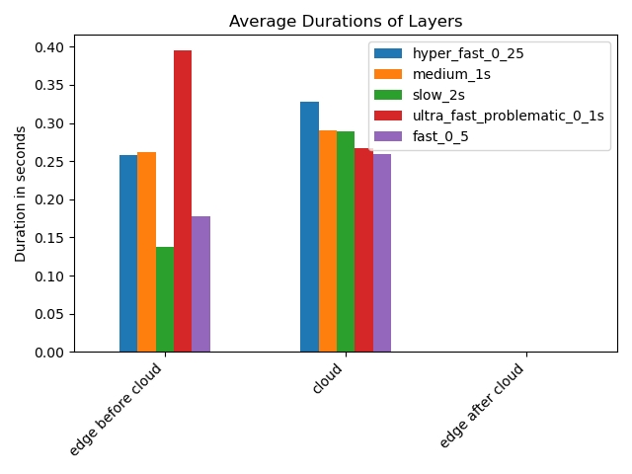

Slide 10
Future Improvements
add async communication between cloud and edge
edge: replace multithreading by multi processing
edge: move yolo-processing to thread/processing
add autoscaling to edge

