Slide 1

Task 3 – Prompt Engineering
Saqib Razzaq, Joey Hieronimy

Slide 2
Outline
Task description
Our approach
Current progress
Next steps

Slide 3
Task description
Prompt Engineering
Prompt a LLM to get desired output
Refine prompt
Correct false outputs
Improve output format
Different techniques
Zero-Shot
One-Shot
Few-Shot
Chain-Of-Thought
Self-Consistency
General-Knowledge

Slide 4
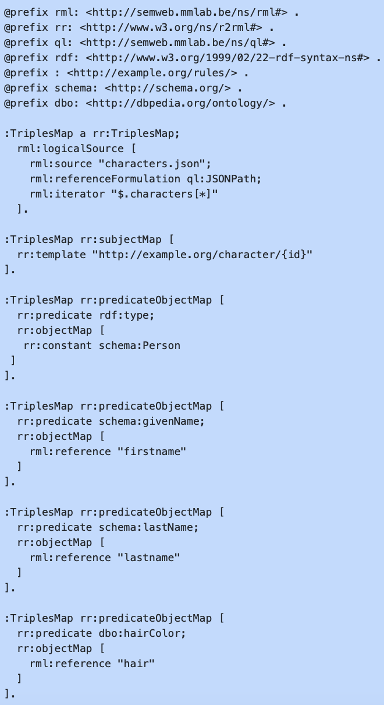
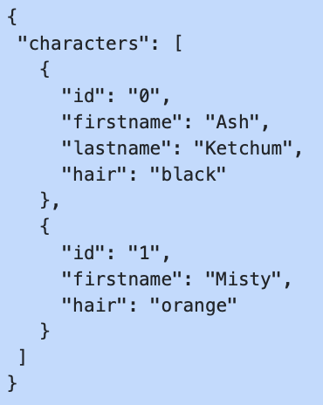
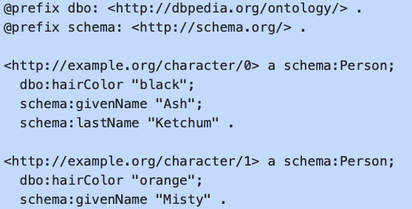
Task description
Generating RML Mappings

Slide 5
Task description
Generating RML Mappings

Slide 6
Task description
Prompt Engineering
Prompt a LLM to get desired output
Refine prompt
Correct false outputs
Improve output format
Different techniques
Zero-Shot
One-Shot
Few-Shot
Chain-Of-Thought
Self-Consistency
General-Knowledge

Slide 7
Our approach

Slide 8


