Slide 1

Task 3 – Prompt Engineering
Saqib Razzaq, Joey Hieronimy

Slide 2
Outline
Task description
Our approach
Current progress
Next steps

Slide 3
Task description
Prompt Engineering
Prompt a LLM to get desired output
Refine prompt
Correct false outputs
Improve output format
Different techniques
Zero-Shot
One-Shot
Few-Shot
Chain-Of-Thought
Self-Consistency
General-Knowledge

Slide 4
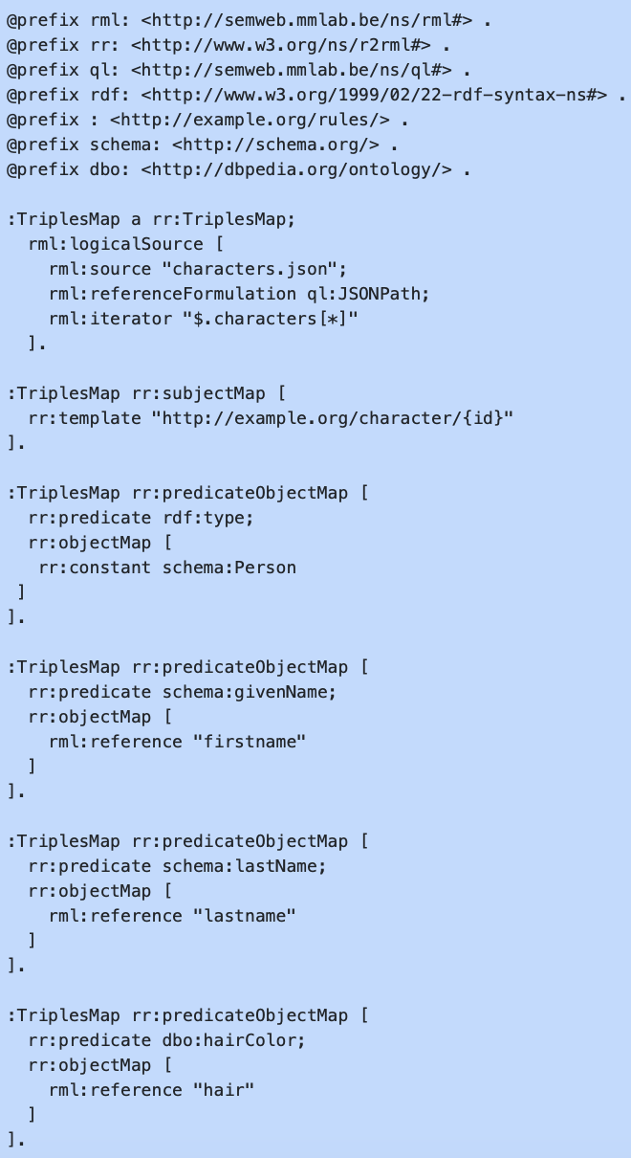
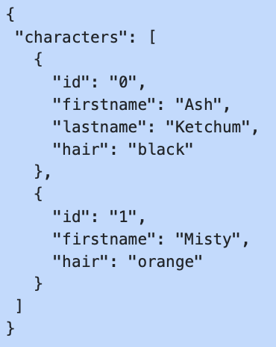
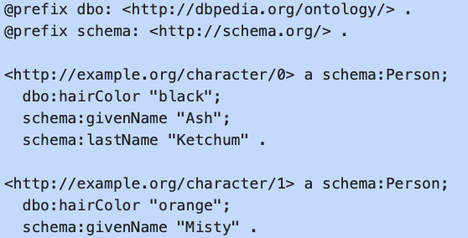
Task description
Generating RML Mappings

Slide 5
Task description
Generating RML Mappings

Slide 6
Task description
Prompt Engineering
Prompt a LLM to get desired output
Refine prompt
Correct false outputs
Improve output format
Different techniques
Zero-Shot
One-Shot
Few-Shot
Chain-Of-Thought
Self-Consistency
General-Knowledge

Slide 7
Our approach
Using Conventional ChatGPT 3.5
Find Dataset (CSV or JSON)
Starting off with simple prompts
More specificity
Refinement
Error identification and correction
Resulting RDF generation

Slide 8
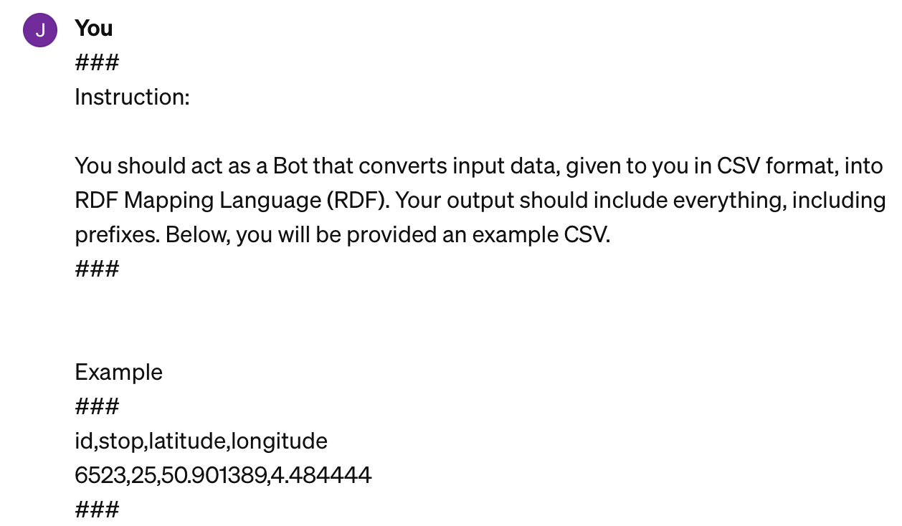
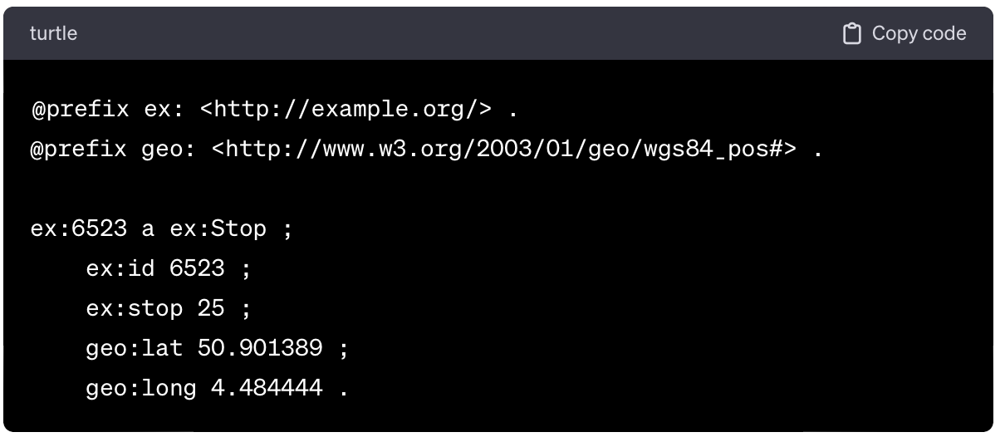
Current Progress
Reading through guides about prompt engineering
First some testing on sample Data
Goal was to get a feel for prompting
Zero-shot and One-shot

Slide 9
Current Progress
Dataset: IMDB Top 1000 Films Dataset
16 rows, 1000 columns
Poster_Link, Series_Title, Released_Year, Certificate, Runtime, Genre, IMDB_Rating, Overview, Meta_score, Director, Star1, Star2, Star3, Star4, No_of_Votes, Gross
Poster_Link ,Series_Title ,Released_Year ,Certificate ,Runtime ,Genre ,IMDB_Rating ,Overview ,Meta_score ,Director ,Star1 ,Star2 ,Star3 ,Star4 ,No_of_Votes ,Gross
"https://m.media-amazon.com/images/M/MV5BMDFkYTc0MGEtZmNhMC00ZDIzLWFmNTEtODM1ZmRlYWMwMWFmXkEyXkFqcGdeQXVyMTMxODk2OTU@._V1_UX67_CR0,0,67,98_AL_.jpg" ,The Shawshank Redemption ,1994 ,A ,142 min ,Drama , 9.3 ,"Two imprisoned men bond over a number of years, finding solace and eventual redemption through acts of common decency." , 80 ,Frank Darabont ,Tim Robbins ,Morgan Freeman ,Bob Gunton ,William Sadler , 2343110 ,"28,341,469"

Slide 10
Current Progress
Tested out zero-shot and few-shot prompting
Assignment Falsely understood
Tried generating output RDF instead of RML
Still great results

Slide 11
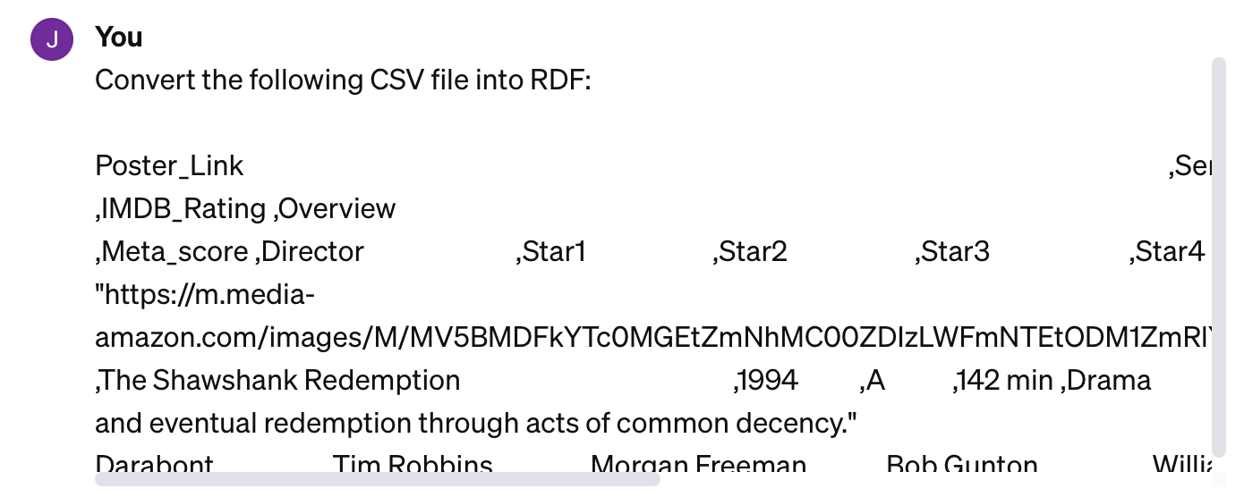
Current Progress

Slide 12
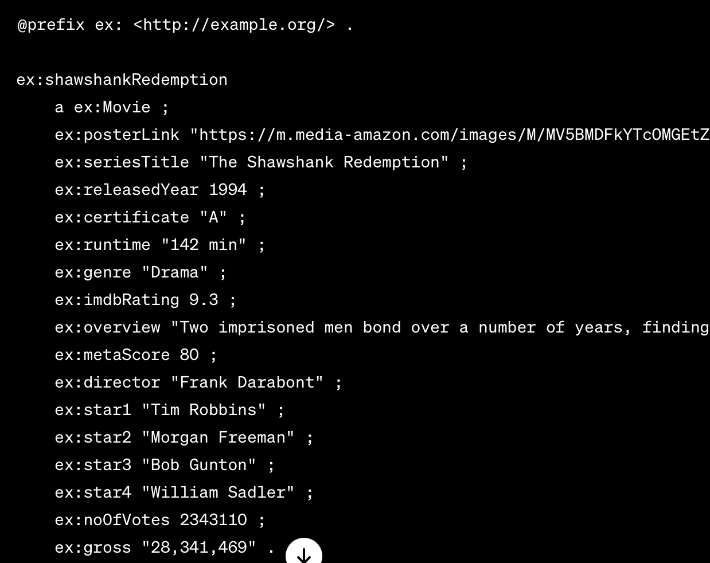
Current Progress

Slide 13
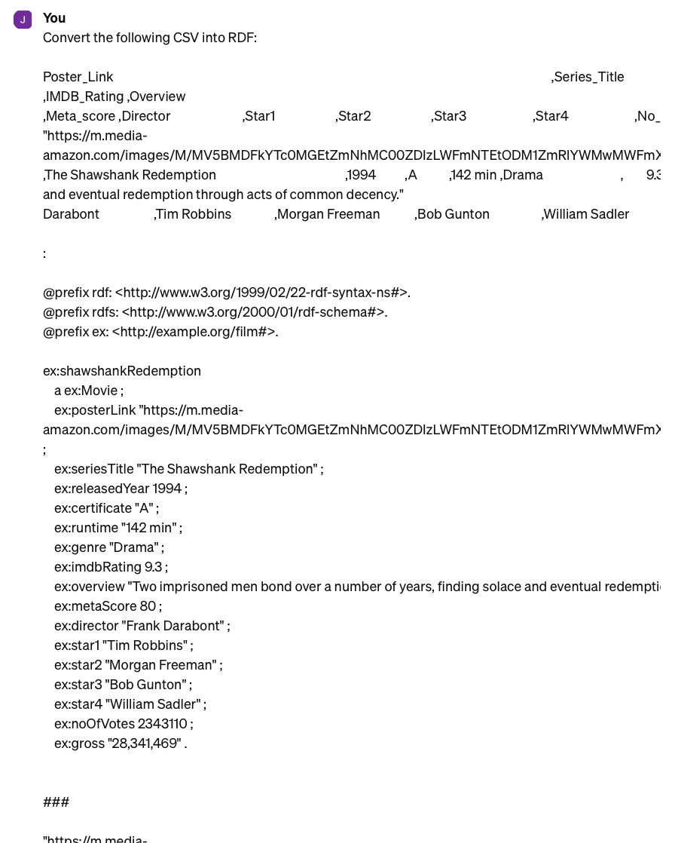
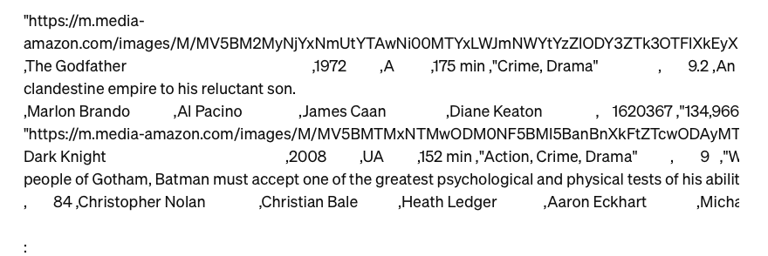
Current Progress

Slide 14
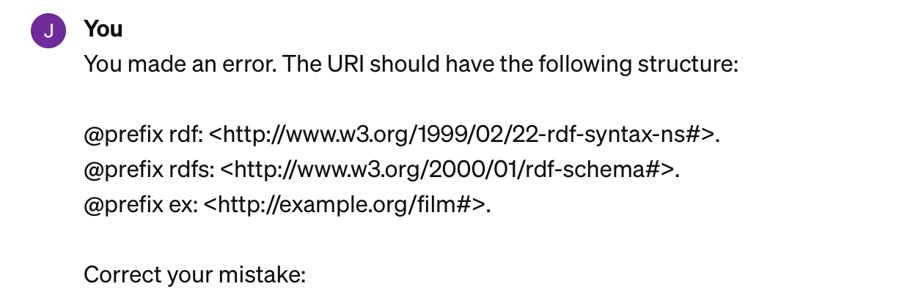
Current Progress
Generated wrong header!
Tried correcting mistake:

Slide 15
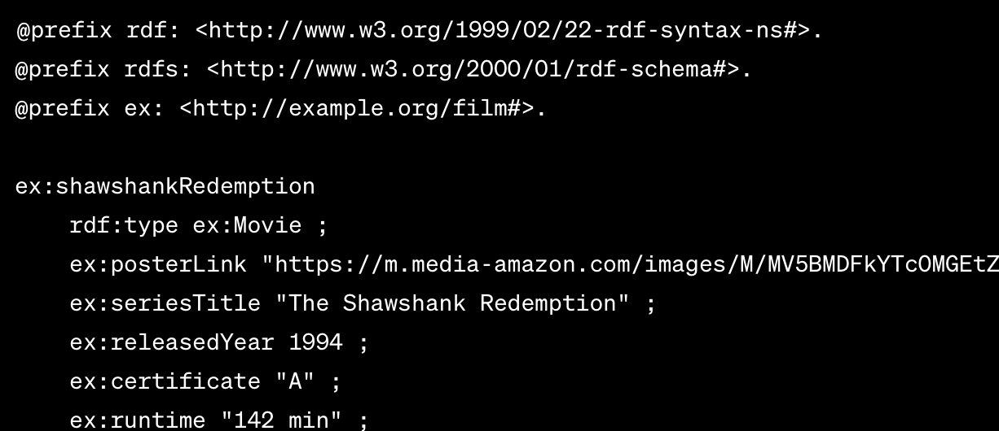
Current Progress
Now correct output:

Slide 16
Next Steps
Do the same with RML instead of RDF
Refine results even further

Slide 17


