Slide 1

Prompt Engineering – Final Presentation
Saqib Razzaq, Joey Hieronimy

Slide 2
Outline
Task description
Dataset
Prompting
Comparisons
Conclusion

Slide 3
Task description
Prompt Engineering
Prompt a LLM to get desired output
Refine prompt
Correct false outputs
Improve output format
Different techniques
Zero-Shot
One-Shot
Few-Shot
Chain-Of-Thought
Self-Consistency
General-Knowledge

Slide 4
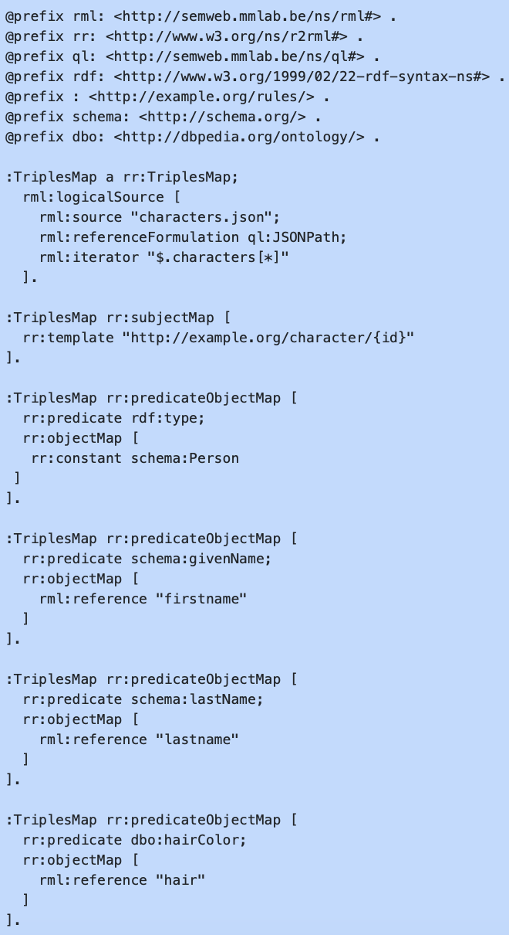
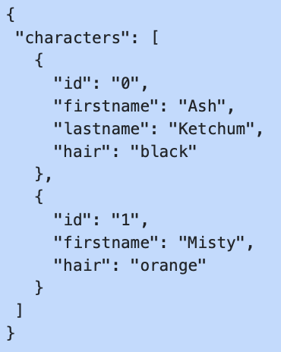
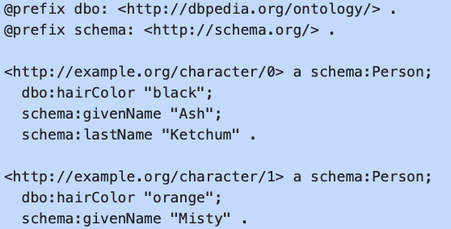
Task description
Generating RML Mappings

Slide 5
Task description
Generating RML Mappings

Slide 6
Task description
Prompt Engineering
Prompt a LLM to get desired output
Refine prompt
Correct false outputs
Improve output format
Different techniques
Zero-Shot
One-Shot
Few-Shot
Chain-Of-Thought
Self-Consistency
General-Knowledge

Slide 7

Dataset
IMDb Top 1000 dataset
Internet Movie Database
Provide open dataset of Top 1000 rated films
16 data columns, 1000 instances
Poster_Link ,Series_Title ,Released_Year ,Certificate ,Runtime ,Genre ,IMDB_Rating ,Overview ,Meta_score ,Director ,Star1 ,Star2 ,Star3 ,Star4 ,No_of_Votes ,Gross

Slide 8
Dataset
Poster_Link ,Series_Title ,Released_Year ,Certificate ,Runtime ,Genre ,IMDB_Rating ,Overview ,Meta_score ,Director ,Star1 ,Star2 ,Star3 ,Star4 ,No_of_Votes ,Gross
"https://m.media-amazon.com/images/M/MV5BMDFkYTc0MGEtZmNhMC00ZDIzLWFmNTEtODM1ZmRlYWMwMWFmXkEyXkFqcGdeQXVyMTMxODk2OTU@._V1_UX67_CR0,0,67,98_AL_.jpg" ,The Shawshank Redemption ,1994 ,A ,142 min ,Drama , 9.3 ,"Two imprisoned men bond over a number of years, finding solace and eventual redemption through acts of common decency." , 80 ,Frank Darabont ,Tim Robbins ,Morgan Freeman ,Bob Gunton ,William Sadler , 2343110 ,"28,341,469"

Slide 9
Prompting
ChatGPT 3.5
Chat Generative Pre-trained Transformer based on a LLM
Developed by OpenAI
Free and widely available to everyone
Prompting techniques from the Prompt Engineering Guide¹
RDF Generation
Zero-Shot
One-Shot
RML Generation
Zero-Shot
One-Shot
Few-Shot
¹ https://www.promptingguide.ai

Slide 10
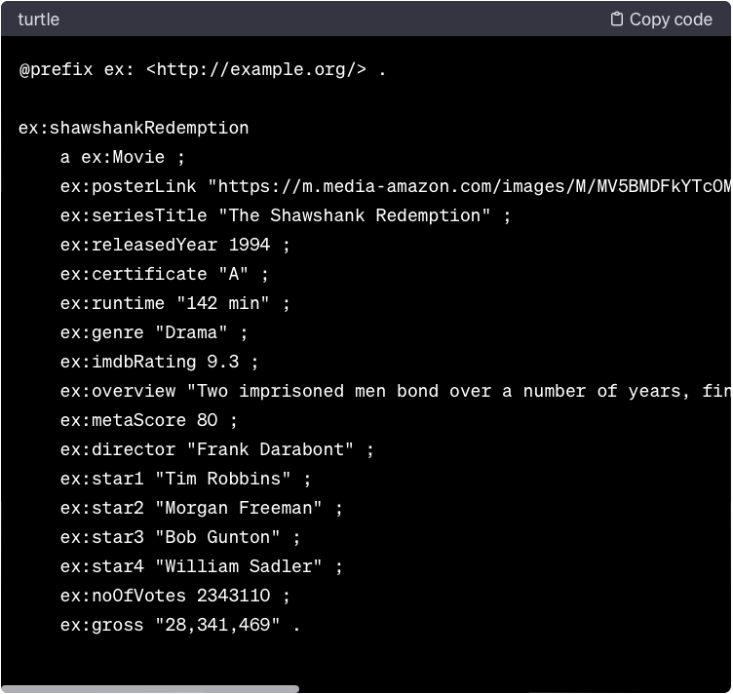
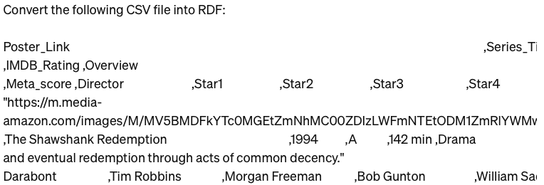
RDF Generation – Zero-Shot
Assignment misundersttod at first
RDF generation directly
Still good result

Slide 11
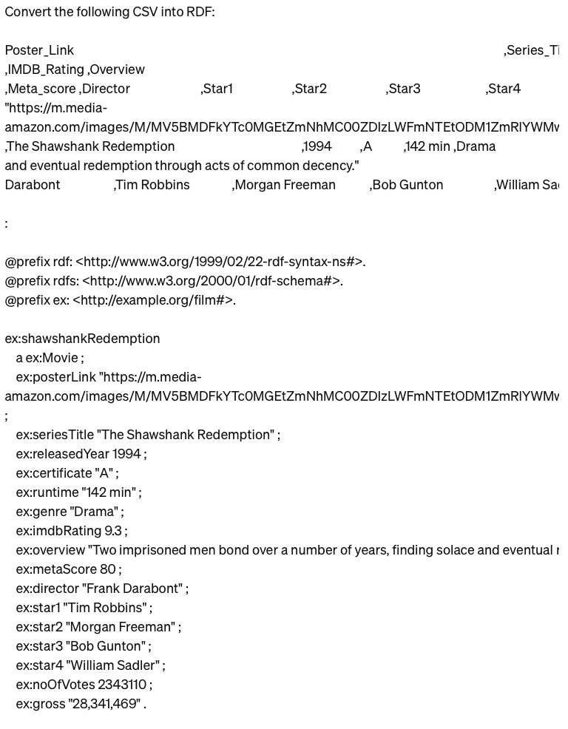
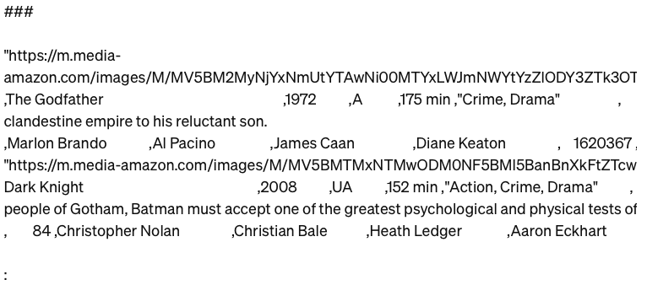
RDF Generation – One-Shot
Provided an example output additionally to instruction
Clearly separated instruction from Task

Slide 12
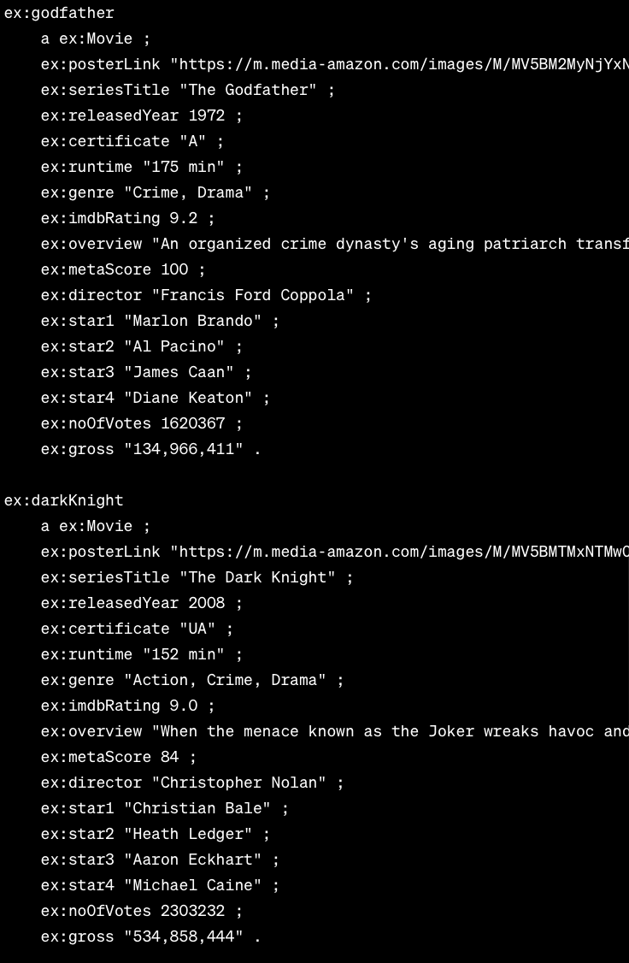
RDF Generation – One-Shot

Slide 13
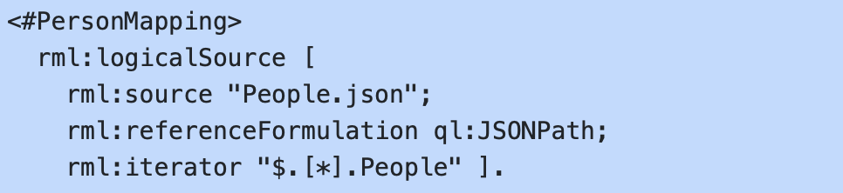
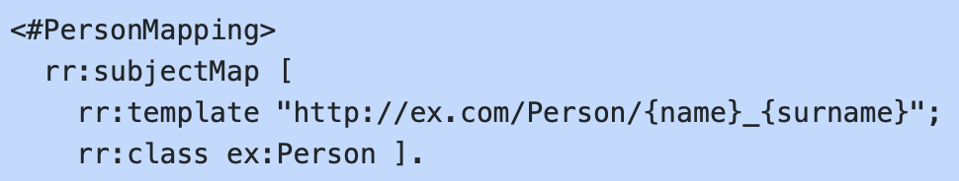
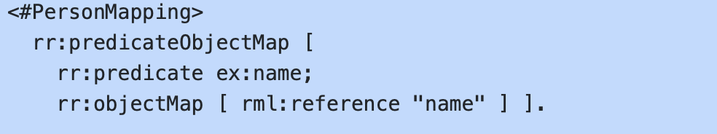
RML Generation
Now generating RML
RDF Mapping Language
Used to generate RDF out of structured data (JSON, CSV, XML,…)
Portability - one RML file can be used on a lot of data
Define set of mapping rules
Consists of Logical Source, Subject Map and zero or more Predicate-Object Maps

Slide 14
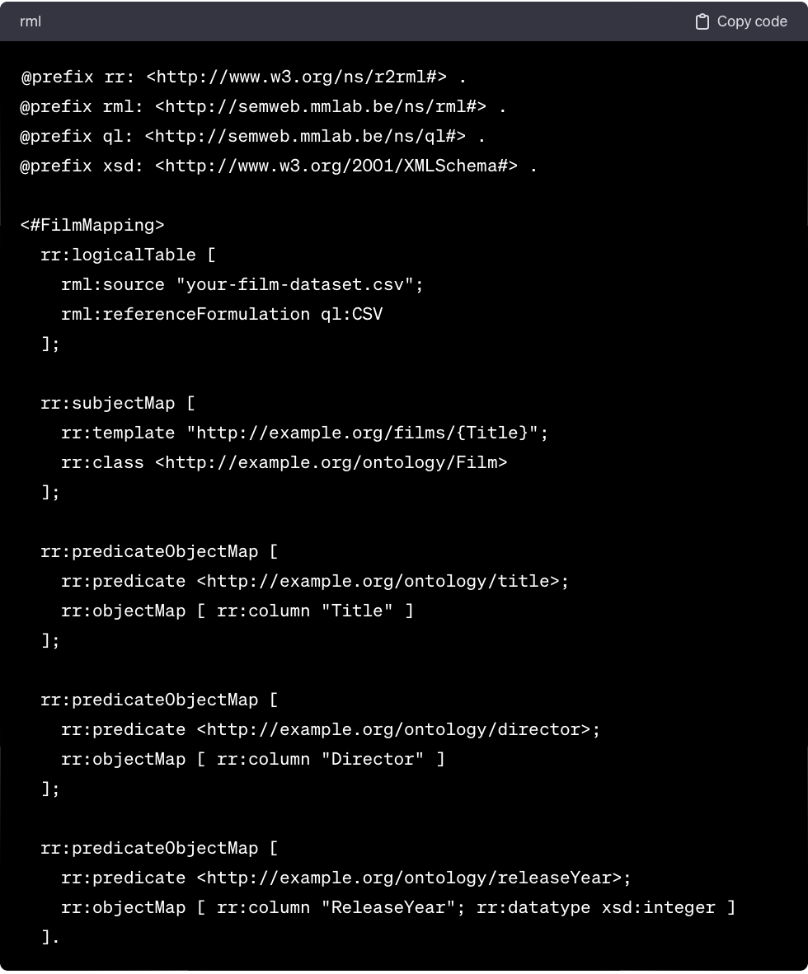
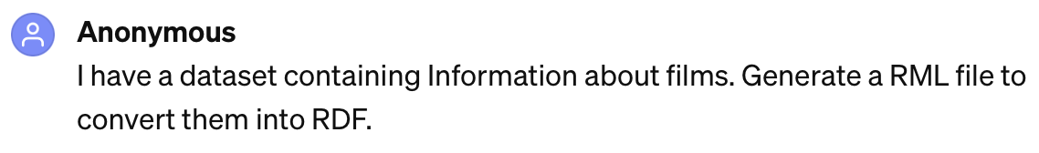
RML – Zero-Shot
First attempt: generate RML with no info

Slide 15
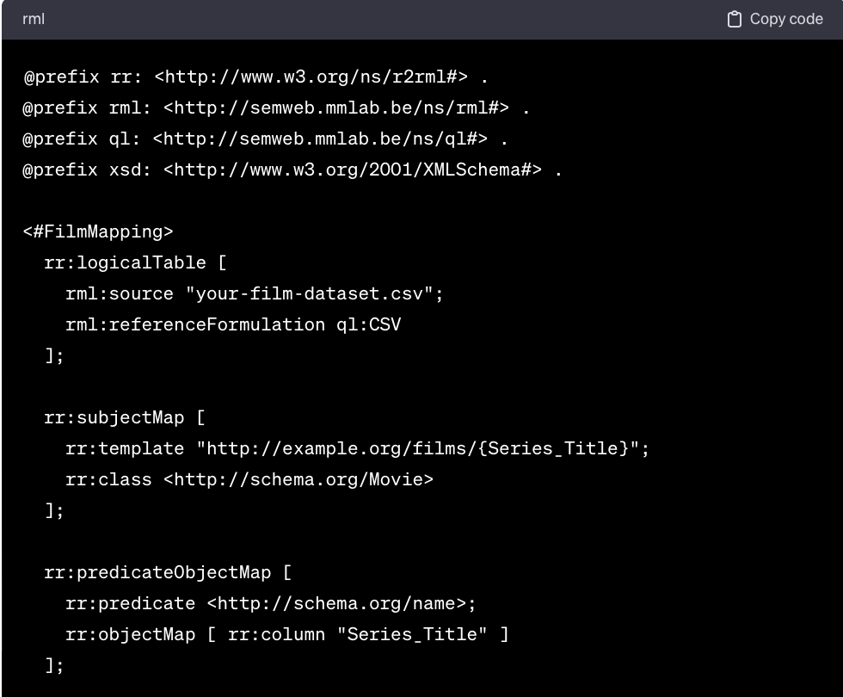
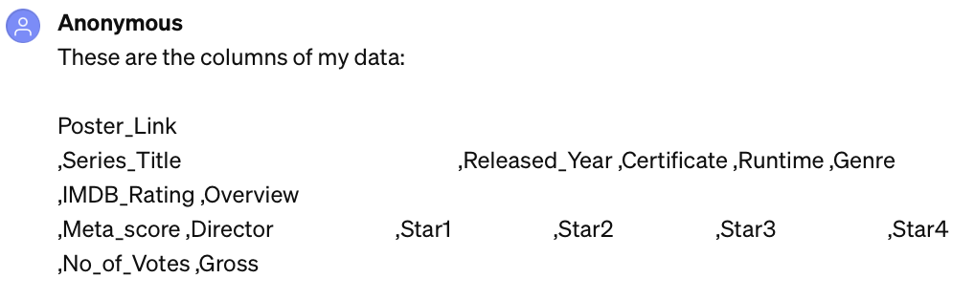
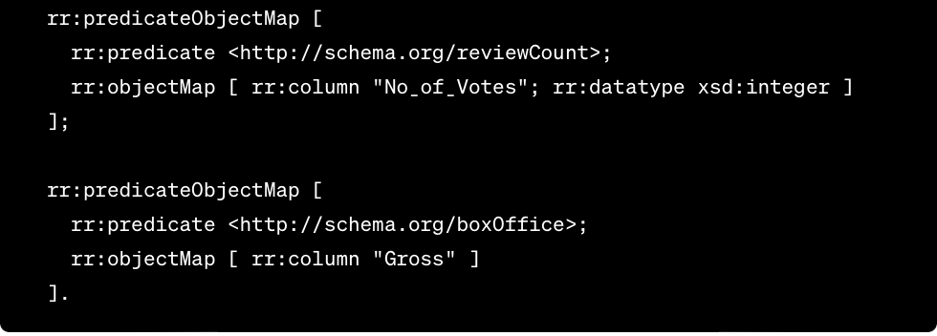
RML – Zero-Shot
Result improved after providing more details
No schema prefix!

Slide 16
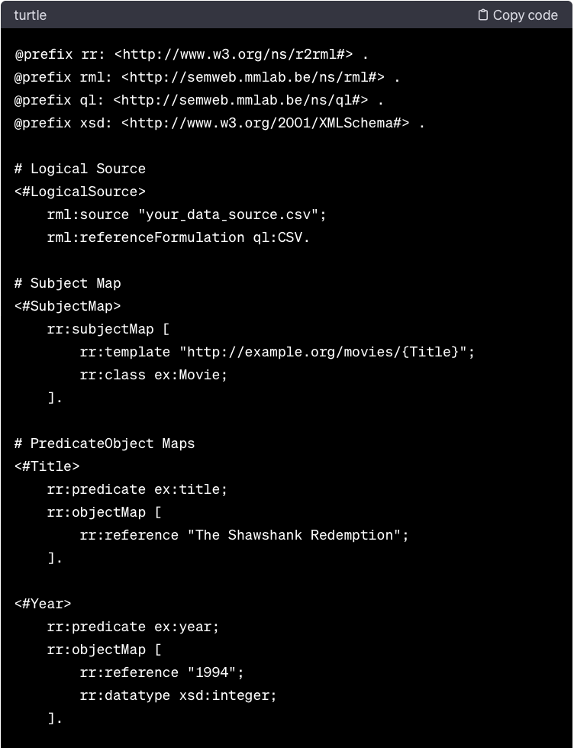
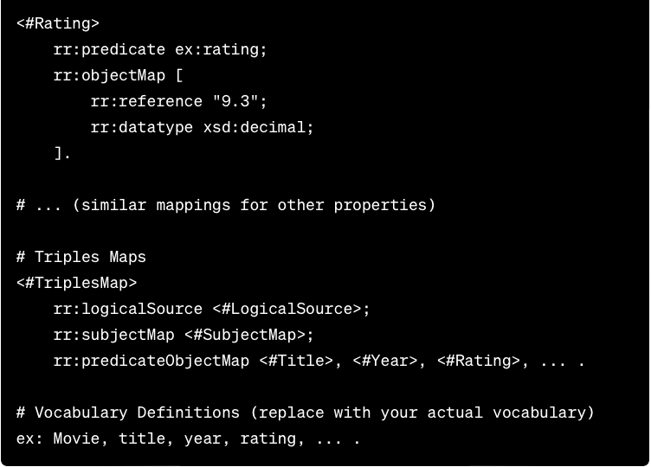
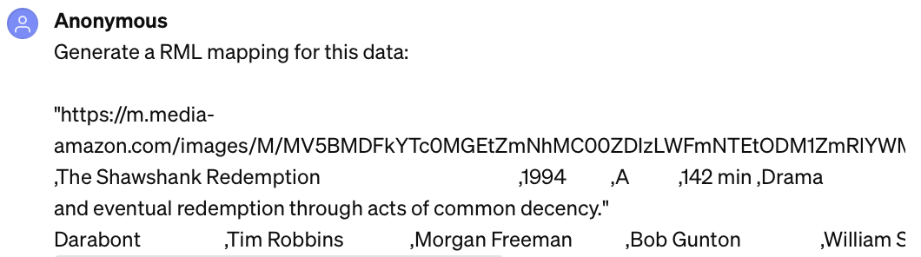
RML – Zero-Shot
Next only example data given
Didn’t generate the entire file
No schema

Slide 17
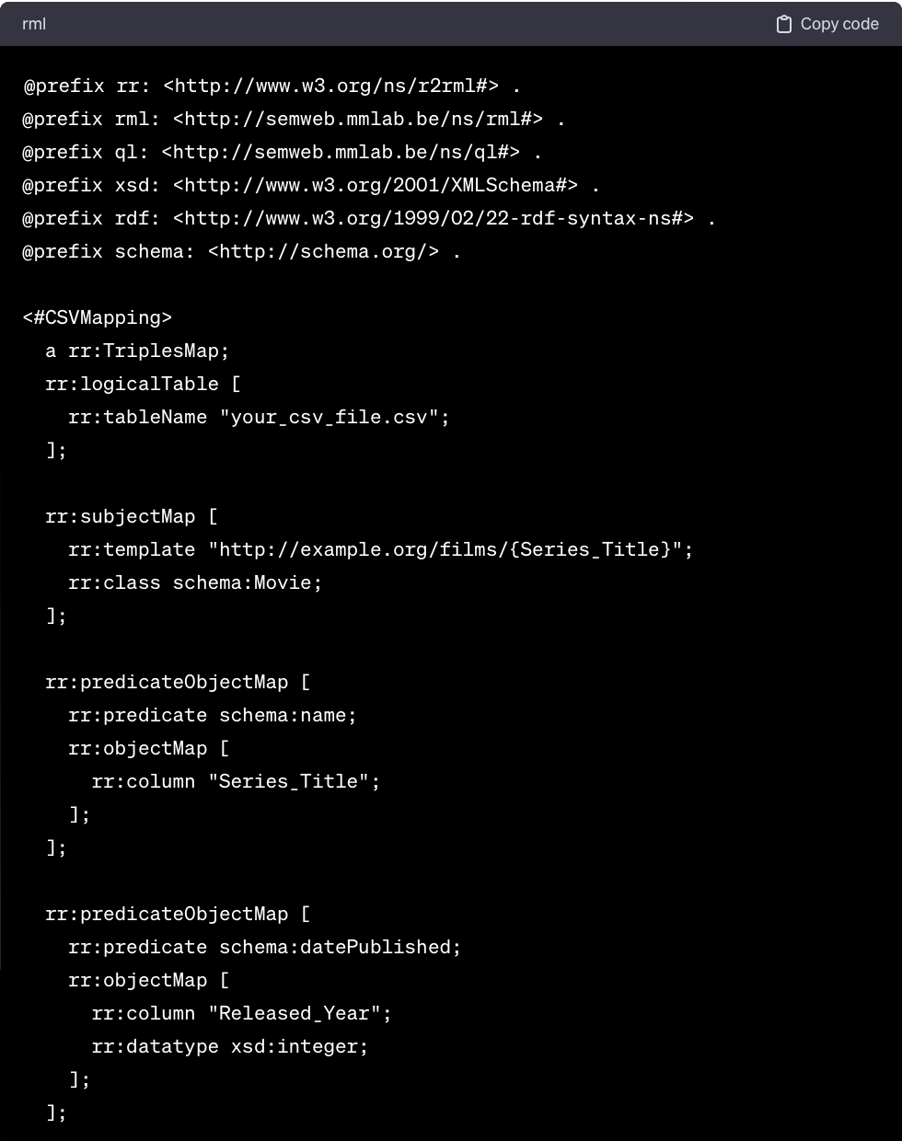
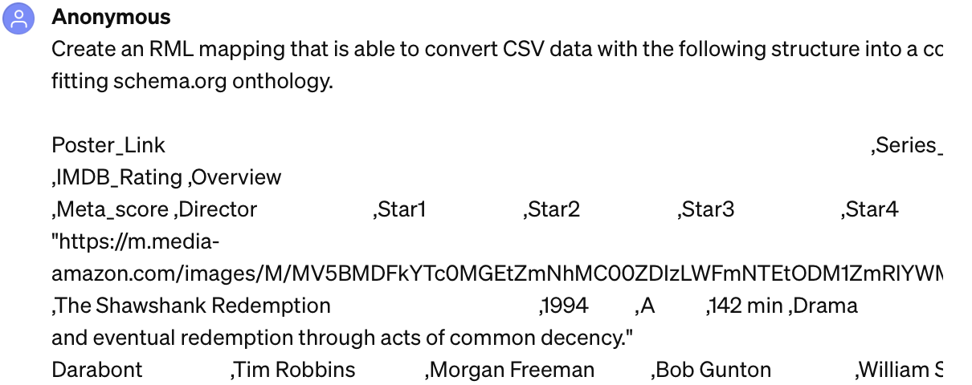
RML – Zero-Shot
Finally, all information provided:

Slide 18
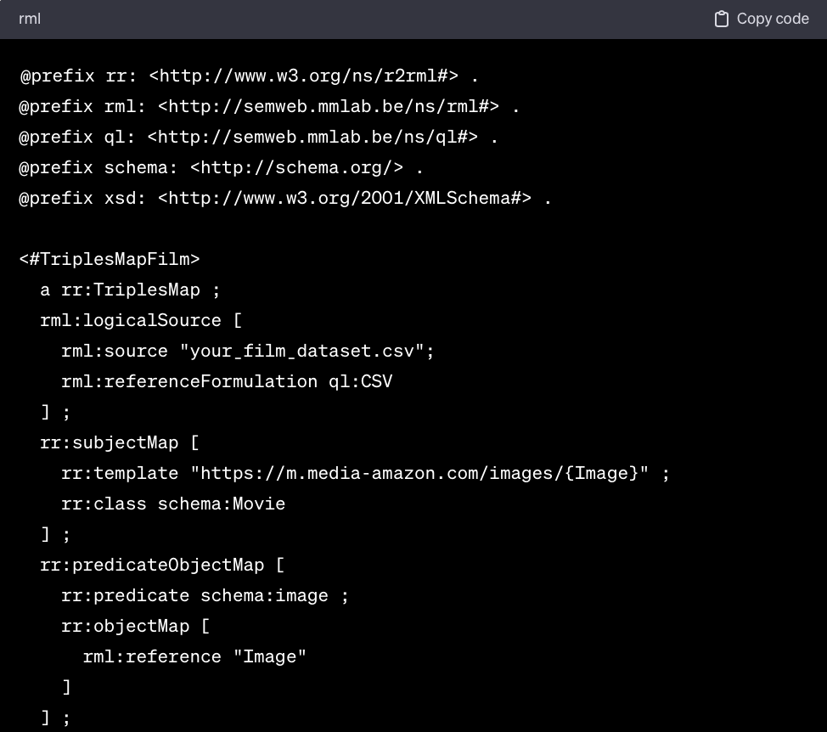
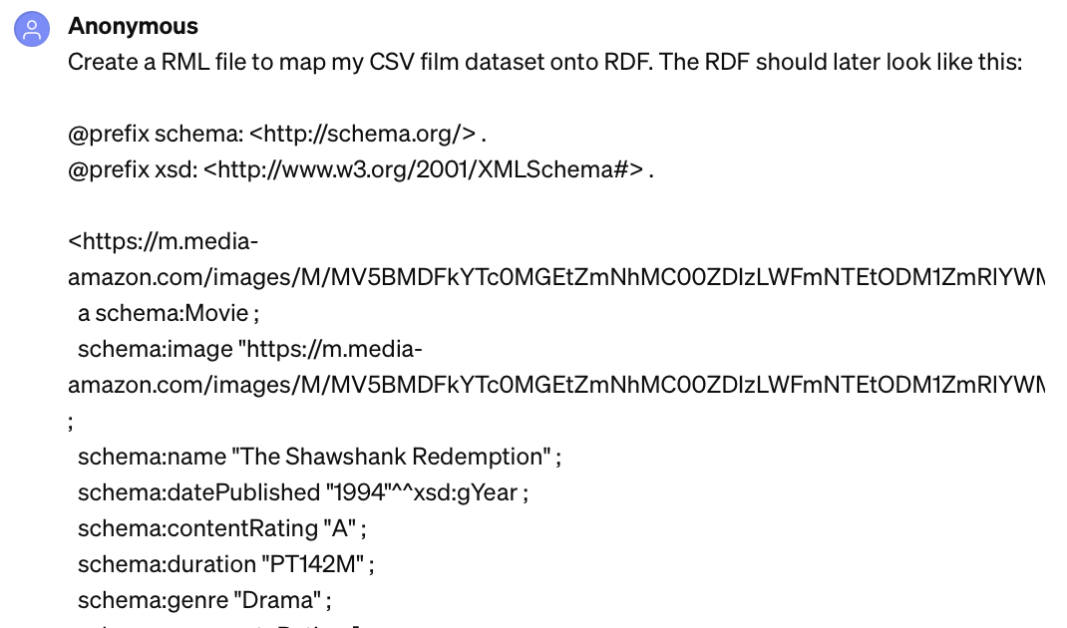
RML – One-Shot
Provide an example desired output RDF
Generate RML based on that

Slide 19
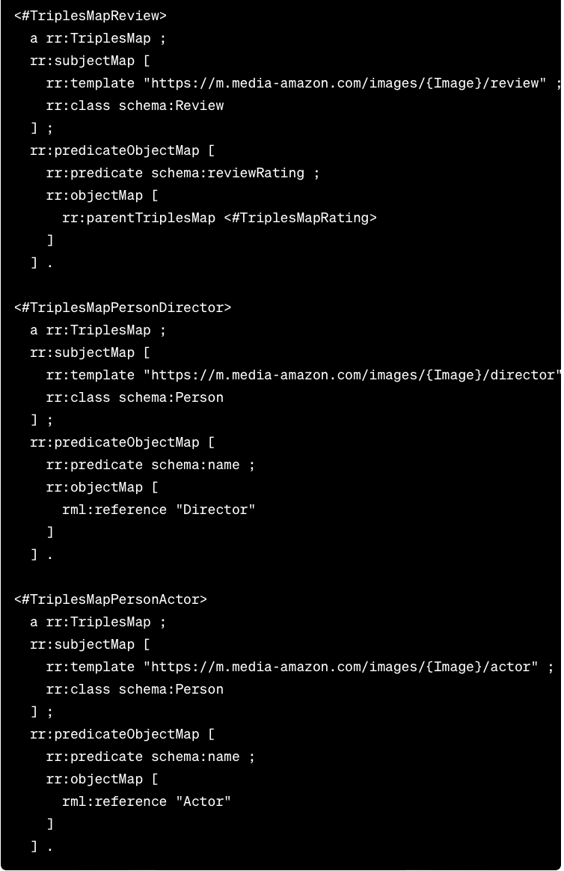
RML – One-Shot

Slide 20
RML – Few-Shot

Slide 21


